Slide 1
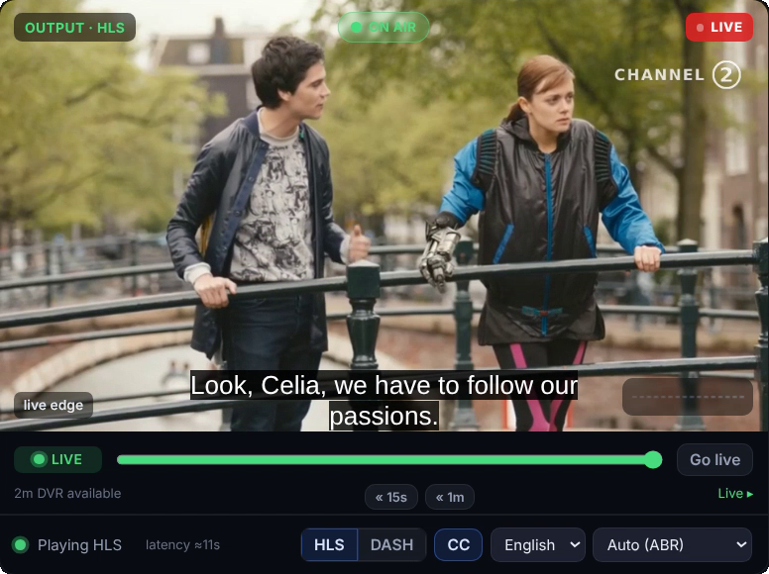
Every live hour becomes a library.
LIVE → VOD
Record every channel as it airs and publish clips while the match is still on.
Presenter name · Role · 19 October 2026
Notes:
Title slide. Layout: Volt title. Replace the screen card with the product screen that tells your story.

Slide 2
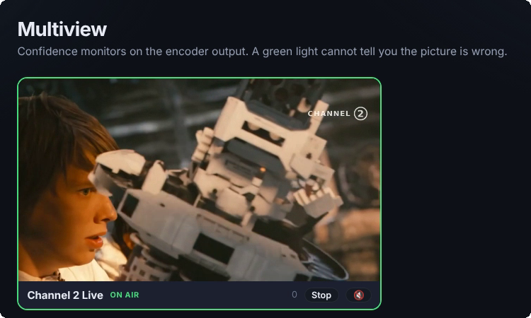





What we will cover
AGENDA
01
Go live, stay live
Channels, events, radio and FAST on one platform
02
Live → VOD
Record as it airs, clip and publish while still live
03
VOD → Live
Turn a media library into a scheduled channel
04
Monitoring and failover
Five gates, backup inputs and the slate
05
Integrate
Player SDK, embeds and an API with keys per app

Slide 3
Live → VOD
SECTION 02
Recording starts when the channel goes on air. Clip and publish while it is still live.

Slide 4





Built for the operator's night
PLATFORM
Primary and backup inputs
Live subtitles
Five-gate monitoring
Automatic switch to the backup, slate on total loss.
Captions and translation on the live stream.
Server → Input → Encoder → Output → On air.
Record as it airs
EPG and scheduling
Analytics
Every channel recorded, ready to clip while live.
XMLTV import and scheduled playout for FAST.
Audience and QoS for every channel and event.

Slide 5
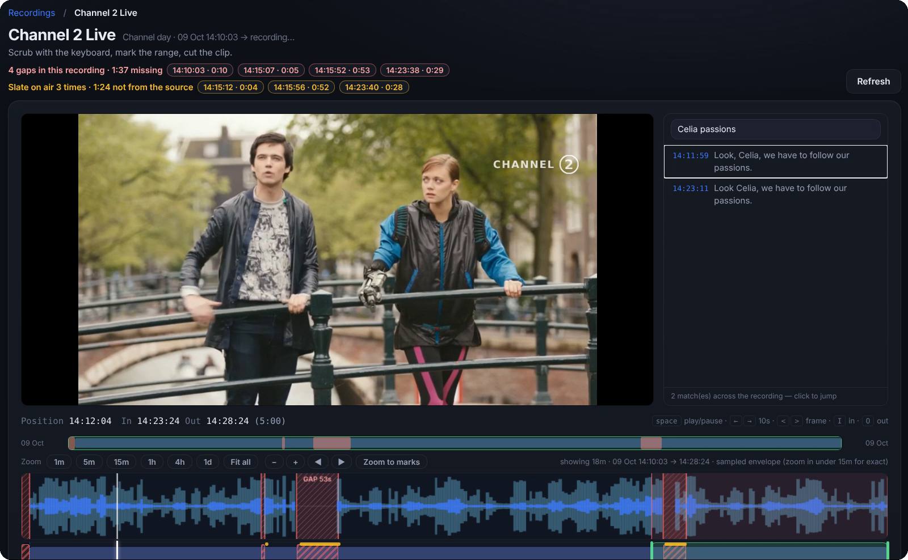
Clip while the channel is still live
RECORDING WORKBENCH
1
Gap and slate report
1
Every gap and every slate on air, with time and length.
2
2
Player
3
Scrub with the keyboard, frame by frame.
3
Transcript search
Find a line in the captions and jump to it.
4
In and out
Mark the range in timecode, then cut the clip.
4
5
Timeline
5
Waveform with outages marked, zoom 1m to 1d.

Slide 6










Live → VOD
SIGNAL FLOW
VOLT PLATFORM
TV
SRT
HLS · DASH
Camera
Ingest
Encoder
Packager
Origin
CDN
Mobile
SRT · primary
primary · backup
ABR renditions
HLS · DASH
live + DVR
edge
Web
Backup
SRT · backup
Recording
Media Library
every channel
Live → VOD
Live signal
Backup path
Secondary / control

Slide 7




VOD → Live
SIGNAL FLOW
VOLT PLATFORM
TV
files
HLS · DASH
Watchfolder
Media Library
Schedule
Playout
Packager
CDN
Mobile
file ingest
publishing rules
EPG · XMLTV
FAST channel
HLS · DASH
edge
Web
Upload
Loops & fillers
browser
slate · filler
Live signal
Secondary / control

Slide 8
Calm about the bad night
INPUTS AND FAILOVER
Every channel takes a primary and a backup input. When the primary drops, Volt switches to the backup and says so.
If every source is lost, the slate goes on air until the signal returns.
No signal on the primary input. Volt switched to the backup at 14:02:11.
SPECIFICATION | BEHAVIOUR
Ingest protocols | SRT, RTMP
Inputs | Primary and backup per channel
Failover | Automatic switch to backup
Total loss | Slate on air
Outputs | HLS and DASH
Captions | Live subtitles and translation
Health | Server → Input → Encoder → Output → On air

Slide 9
The checks an operator makes, built in
AT A GLANCE
5
2
2
gates on every stream
inputs per channel
output formats
Server → Input → Encoder → Output → On air
Primary and backup, over SRT or RTMP
HLS and DASH from the same channel
HOW VOLT REPORTS A FAILOVER
“No signal on the primary input. Volt switched to the backup at 14:02:11.”
BACKUP ON AIR

Slide 10
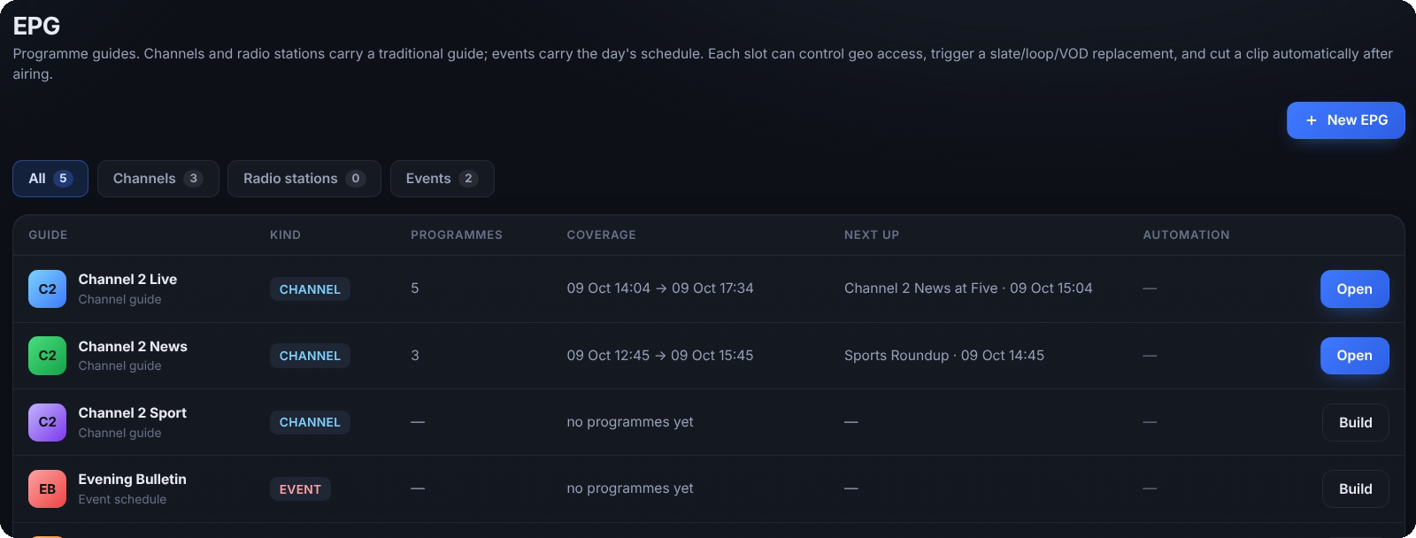
Turn your archive into a channel
VOD → LIVE
Add media to the library by upload or watchfolder. Publishing rules decide where each item can go.
Build the schedule in the EPG, or import it as XMLTV.
Go on air as a FAST channel, with loops and fillers covering the gaps.
Paper is for documents, appendices and print. Product screens stay in Control room.

Slide 11
See it live.
Watch a channel go from the camera to every screen, then clip it while it is still on air.
Book a demo
Your name · your.name@example.com · +00 000 000 000

