Slide 1

School Safety and Housing Prices
Data Bootcamp Final Project
Emily Bai and Christian Claus

Slide 2
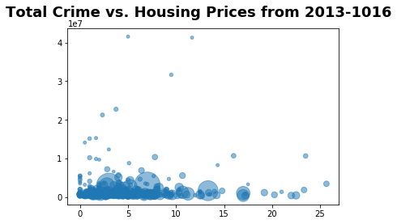
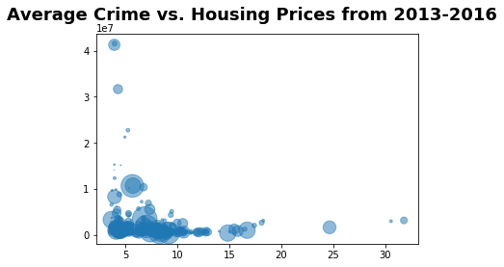
Average Crime vs. Housing Prices 2013-2016
This scatter plot shows the average of average crimes for any given year for each zip code for all five boroughs over 3 years. The results support the previous plot, where the data with high housing prices are on the left side of the graph, where school crime is low.
Total Crime vs. Housing Prices 2013-2016
This scatter plot shows the average total crimes for each zip code for all five boroughs over 3 years. The only data points where average housing prices are over 300,000 are in areas where average crime is below ~12/13 (where upper limit is 26) per year.

Slide 3
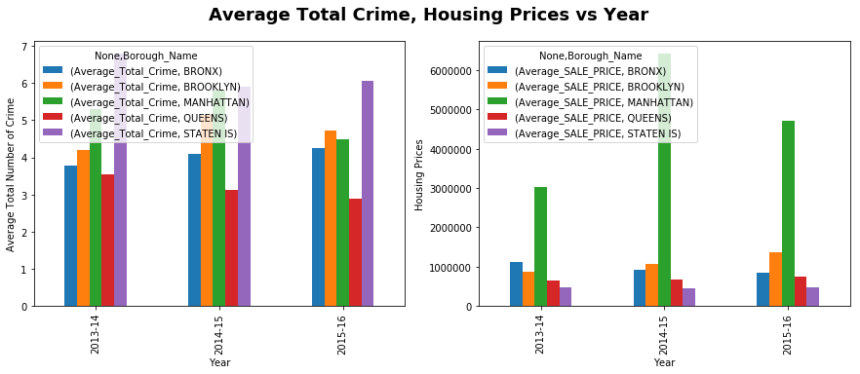
Average Total Crime, Housing Prices vs. Year
The 2nd part of our graphs included visualizing both our variables across the three years. Total crime data did not change significantly across the three years, though we see a decrease in crime in Queens, Manhattan and Staten Island. As for housing prices, Manhattan’s prices spiked in 2014 but remained consistently significantly higher than the other four boroughs.

Slide 4
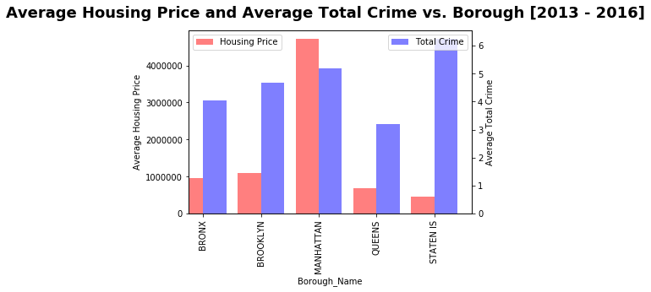
Average House Price and Average Total Crime vs. Borough (across 3 years)
The 3rd part of our graphs display the average of housing prices and total crime for each borough across all three years. The results were plotted on this bar graph and we can see there is not a very noticeable correlation between the two variables. However, generally, areas with higher crime had lower housing prices.

Slide 5
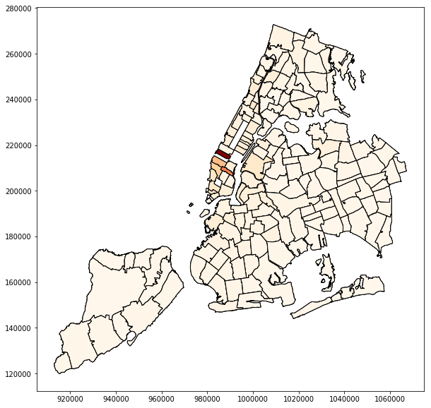
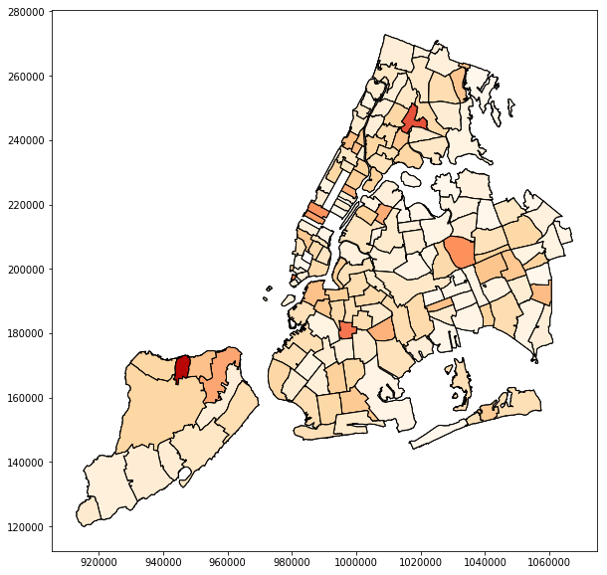
Map of NYC Average Housing Prices
This map of NYC shows a visualization of the house pricing in the city based on zip code. The darker areas are where Manhattan is which correlates with the data suggesting Manhattan’s significantly higher sale prices.
Map of NYC Average Total Crime
This map shows a visualization of the school crime statistics in NYC based on zip code. The darker areas represent areas with more average total crime in the area from 2013-2016.

