Slide 1

Stateful Bolts for Storm
Abhishek Bhattacharjee
Aniket Alhat
Mohit Bhakkad
Onkar Bhandwalkar
Pune Institute of Computer Technology, Pune

Slide 2
?
Distributed and fault-tolerant real time computation system

Slide 3
Outline
Background
Why Storm
Components
Fault-tolerance in Storm
Proposed Idea
Implementation Design
Companies using STORM
References

Slide 4
Introduction
Notes:
4

Slide 5
Created by Nathan Marz @ BackType/Twitter
Analyze twits, links, users on Twitter
Open sourced at Sep 2011
Eclipse Public License 1.0
Storm 0.5.2
16k java and 7k Clojure Loc
Incubated with Apache as Apache Storm
Current stable release 0.9.0.1
0.9.0 major core improvement
Notes:
50 billion twits, 10 billion links, 0.2 users
July 2011
Only two ppl
100M /day
300 reqs / sec
100-200 machines
3 full time employee 2 interns
5

Slide 6
Why Storm ?
Notes:
6

Slide 7
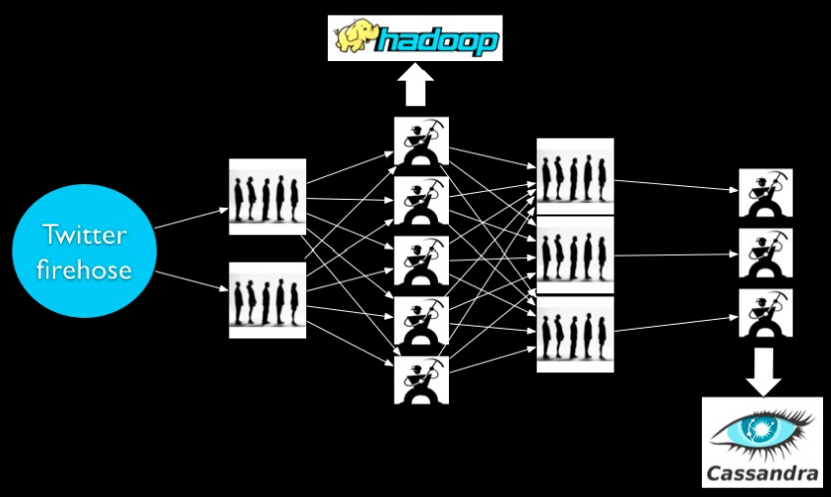
Before Storm

Slide 8
Problems
Scale is painful
Poor fault-tolerance
Coding is tedious
Batch processing
Long latency
no realtime
Notes:
Hashing/mod cause deley while add machine
8

Slide 9
Storm
Scalable and robust
Guarantees no data loss
Fault-tolerant
Guarantees Message Processing
Programming language agnostic
Use case
Stream processing
Distributed RPC
Continues computation

Slide 10
Components

Slide 11
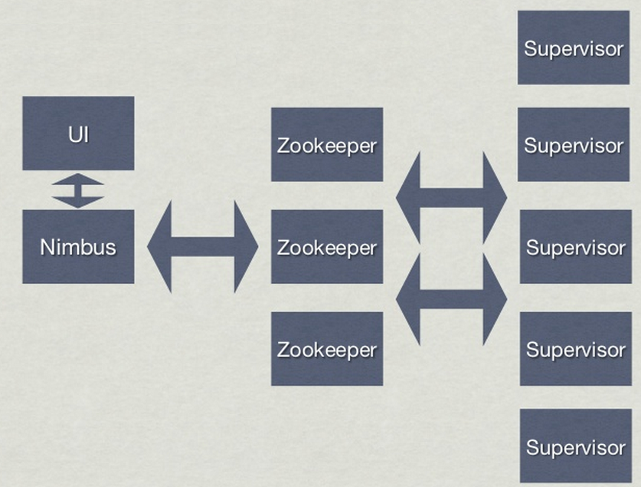
Storm Framework

Slide 12
Storm Framework
Nimbus
Like JobTacker in Hadoop
Nimbus is responsible for distributing code around the cluster, assigning tasks to machines, and monitoring for failures.
Supervisor
Manage workers
The supervisor listens for work assigned to its machine and starts and stops worker processes as necessary based on what Nimbus has assigned to it. Each worker process executes a subset of a topology; a running topology consists of many worker processes spread across many machines

Slide 13
Storm Framework
Zookeeper
All coordination between Nimbus and the Supervisors is done through a Zookeeper cluster. Additionally, the Nimbus daemon and Supervisor daemons are fail-fast and stateless; all state is kept in Zookeeper or on local disk.
This design leads to Storm clusters being incredibly stable.
UI
Web-UI

Slide 14
Physical View
Supervisor ^{Worker} Worker node
ZooKeeper:
Storing cluster operational state
Worker:
ZooKeeper Supervisor Worker ^{Java process}
of topology
Nimbus ZooKeeper Supervisor Worker Worker process
Nimbus:
Master daemon process
• distributing code ZooKeeper Supervisor * N * N
• monitoring failures
Executor: Task:
_{Supervisor:} Java thread spawned Component (spout/
work assigned its node ^{the same component} data processing
* N
executes a subset
assigning tasks
Executor
Task
responsible for
•
Worker daemon process listening for Supervisor
by worker runs on bolt) instance
one or more tasks of
performs the actual

Slide 15
Conceptual View
Bolt:
Source of streams
Bolt
Stream:
Tuple
Bolt
Tuple
Spout Bolt
Tuple
Bolt
List of name-value pair
Topology: Graph of computation composed of spout/bolt as the node and stream as the edge
Spout:
Consumer of streams does some processing possibly emits new tuples
Spout
Unbound sequence of tuples
Bolt
Tuple:

Slide 16


Tuples
Tuples
ordered list of elements
(“user”, “link”, “event”, “10/3/12 17:50“)
Streams
unbounded sequence of tuples
Notes:
16

Slide 17
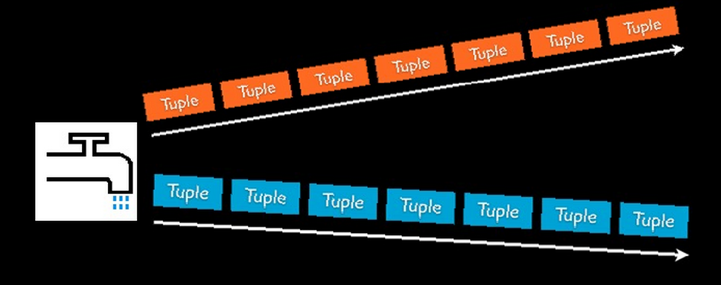
Spouts
Source of streams
Example
Read from logs, API calls, event data, queues, …

Slide 18
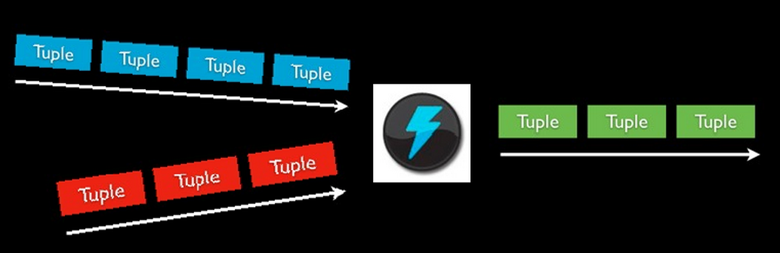
Bolts
Processes input streams and produces new streams
Example
Stream Joins, DBs, APIs, Filters, Aggregation, …

Slide 19
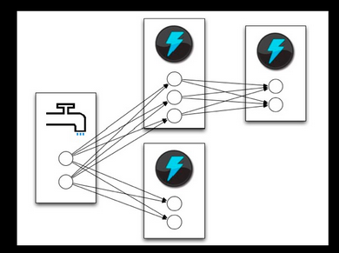
Tasks
Instances of Spouts and Bolts
Managed by Supervisor

Slide 20
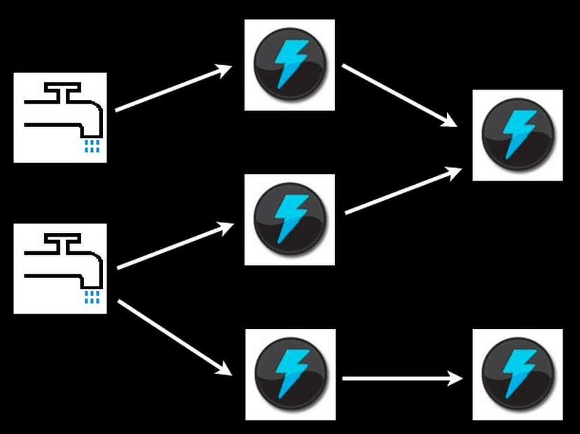
Topology
Topology
A directed graph of Spouts and Bolts

Slide 21
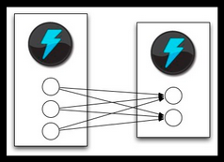
Stream Grouping
All grouping
Send to all tasks
Global grouping
Pick task with lowest id
Shuffle grouping
Pick a random task
Fields grouping
Consistent hashing on a subset of tuple fields

Slide 22
Fault-tolerance

Slide 23
Fault-tolerance
Cluster works normally
Sending executor heartbeat
Nimbus ZooKeeper Supervisor Worker
Monitoring Synchronizing Reading worker cluster state assignment heartbeat from Sending heartbeat ^{local file system}

Slide 24
Fault-tolerance
Nimbus goes down
Processing will still continue. But topology lifecycle operations and reassignment facility are lost
Sending executor heartbeat
Nimbus ZooKeeper Supervisor Worker
Monitoring Synchronizing Reading worker cluster state assignment heartbeat from Sending heartbeat ^{local file system}

Slide 25
Fault-tolerance
Worker node goes down
Nimbus will reassign the tasks to other machines and the processing will continue
Sending executor heartbeat
Nimbus ZooKeeper Supervisor Worker
Monitoring Synchronizing Reading worker cluster state assignment heartbeat from Sending heartbeat ^{local file system}
Supervisor Worker

Slide 26
Fault-tolerance
Supervisor goes down
Processing will still continue. But assignment is never synchronized
Sending executor heartbeat
Nimbus ZooKeeper Supervisor Worker
Monitoring Synchronizing Reading worker cluster state assignment heartbeat from Sending heartbeat ^{local file system}

Slide 27
Fault-tolerance
Worker process goes down
Supervisor will restart the worker process and the processing will continue
Sending executor heartbeat
Nimbus ZooKeeper Supervisor Worker
Monitoring Synchronizing Reading worker cluster state assignment heartbeat from Sending heartbeat ^{local file system}

Slide 28
The tuple trees that are made incomplete due to the bolt task failure will time-out and the spout will be able to replay the source tuple for that tree. Tuples that have already successfully completed will not be replayed. So generally you keep any persistent state in a database, oftentimes doing something like waiting to ACK tuples until you've done a batch update to the database. Stateful bolts will just be a much more efficient way of keeping a large amount of state at hand in a bolt.
Proposed Idea

Slide 29
Supporting technologies used
Apache Maven
Apache Maven is a software project management and comprehension tool. Based on the concept of a project object model (POM), Maven can manage a project's build, reporting and documentation from a central piece of information.
Apache Kafka
Kafka is a distributed, partitioned, replicated commit log service. It provides the functionality of a messaging system, but with a unique design.
Redis
Redis is an in-memory database that persists on disk. The data model is key-value, but many different kind of values are supported: Strings, Lists, Sets, Sorted Sets, Hashes.

Slide 30
Why Kafka?

Slide 31
Why Redis?

Slide 32
Applications

Slide 33
Implementation Design

Slide 34
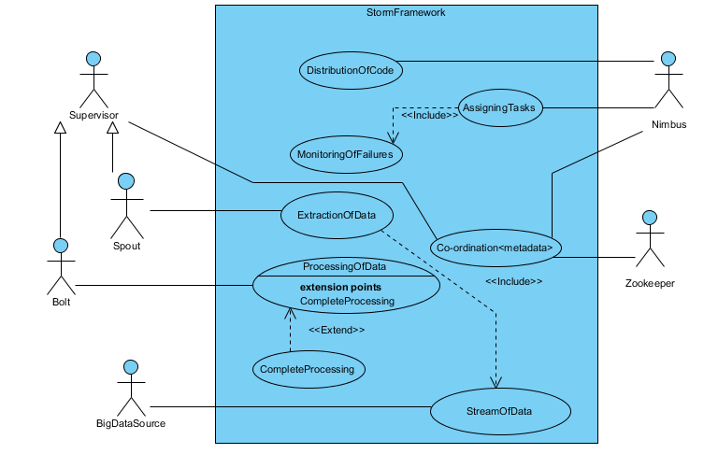
Use Case Diagram

Slide 35
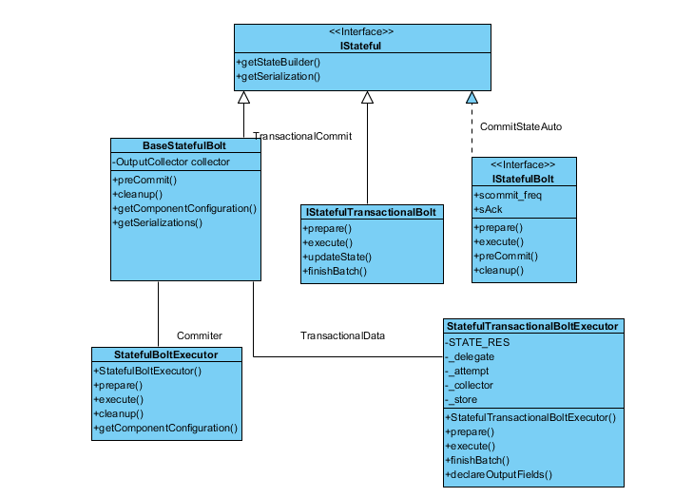
Class Diagram

Slide 36
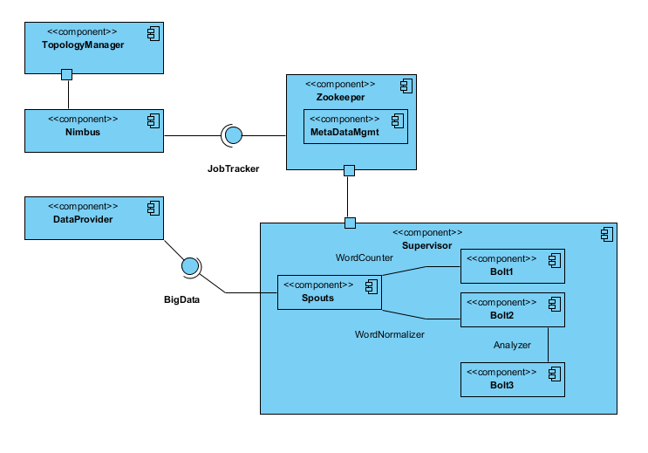
Component Diagram

Slide 37
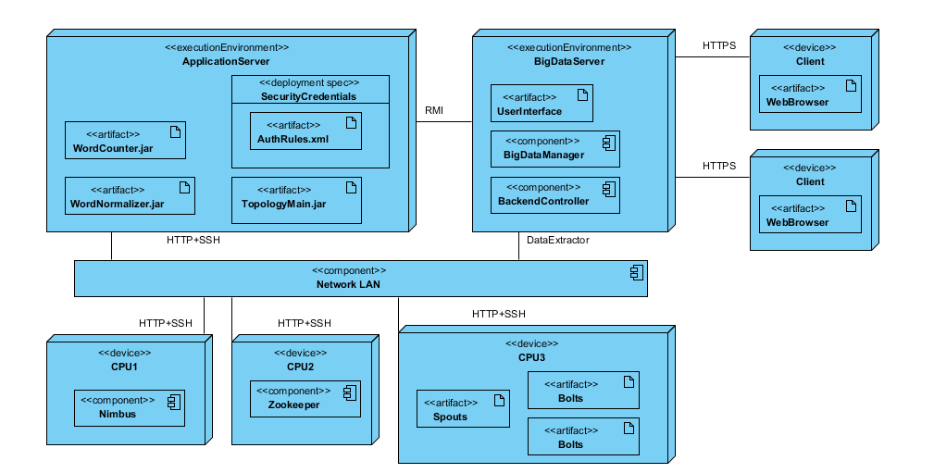
Deployment Diagram

Slide 38











Companies using STORM
and many more…

Slide 39
Reference
Notes:
39

Slide 40
Reference
“Getting started with Storm”, Jonathan Leibiusky, Gabriel Eisbruch,
and Dario Simonassi , O’REILLY
Twitter Storm
- Sergey Lukjanov@slideshare
- http://www.slideshare.net/lukjanovsv/twitter-storm
Storm Anatomy
- Eiichiro Uchiumi
- http://www.slideshare.net/eiichirouchiumi/storm-anatomy
Storm
- nathanmarz@slideshare
- http://www.slideshare.net/nathanmarz/storm-11164672
Realtime Analytics with Storm and Hadoop
- Hadoop_Summit@slideshare
- http://www.slideshare.net/Hadoop_Summit/realtime-analytics-with-storm
Website [www.storm-project.net]

Slide 41
Q/A
Notes:
41

Slide 42
Thanks
Notes:
42

