Slide 1
Array
Questions

Slide 2
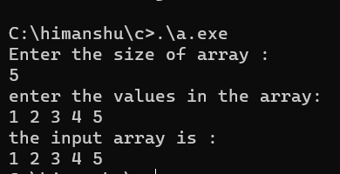
1.WAP to input the elements in 1-d Array from user then print it?
#include<stdio.h>
int main(){
int size;
printf("Enter the size of array : \n");
scanf("%d",&size);
//declaring array
int arr[size];
printf("enter the values in the array: \n");
//taking input in the array arr
for(int i=0;i<size;i++){
scanf("%d",&arr[i]);
}
//printing the array arr
printf("the input array is : \n");
for(int i=0;i<size;i++){
printf("%d ",arr[i]);
}
return 0;
}
Output

Slide 3
2.WAP to make a print function to print elements of 1d array?
#include<stdio.h>
void print(int* array);
int main(){
int size;
printf("Enter the size of array : \n");
scanf("%d",&size);
//declaring array
int arr[size];
printf("enter the values in the array: \n");
//taking input in the array arr
for(int i=0;i<size;i++){
scanf("%d",&arr[i]);
}
print(arr);
return 0;
}
void print(int* array){
//printing the array arr
int size=sizeof(array);
printf("the input array is : \n");
for(int i=0;i<=size;i++){
printf("%d ",array[i]);
}
}
Output

Slide 4
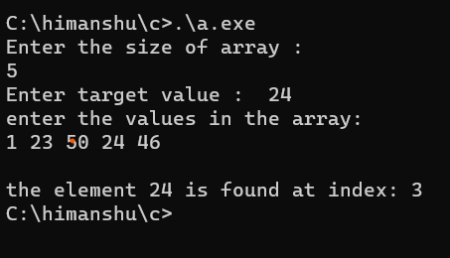
3. Wap to search the element in the array?
#include<stdio.h>
int main(){
int size;
printf("Enter the size of array : \n");
scanf("%d",&size);
int target;
printf("Enter target value : ");
scanf("%d",&target);
//declaring array
int arr[size];
printf("enter the values in the array: \n");
//taking input in the array arr
for(int i=0;i<size;i++){
scanf("%d",&arr[i]);
}
//searching in array
for(int i=0;i<size;i++){
if(arr[i]==target)
printf(“\nthe element %d is found at index: %d ",arr[i],i);
}
}
Output:

Slide 5
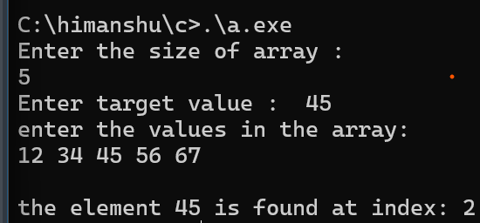
4. Wap to make a search function to search element in the array ?
#include<stdio.h>
void search(int ,int *array);
int main(){
int size;
printf("Enter the size of array : \n");
scanf("%d",&size);
int target;
printf("Enter target value : ");
scanf("%d",&target);
//declaring array
int arr[size];
printf("enter the values in the array: \n");
//taking input in the array arr
for(int i=0;i<size;i++){
scanf("%d",&arr[i]);
}
search(target,arr);
return 0;
}
void search(int target,int *array){
//searching in array
int size=sizeof(array);
for(int i=0;i<=size;i++){
if(array[i]==target)
printf("\nthe element %d is found at index: %d ",array[i],i);
}
}
Output:

Slide 6
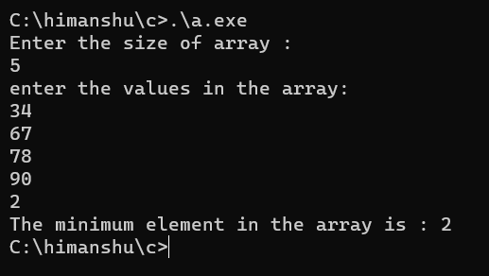
5. Wap to input elements in an array then find the minimum element present in the array?
#include<stdio.h>
int main(){
int size;
printf("Enter the size of array : \n");
scanf("%d",&size);
//declaring array
int arr[size];
printf("enter the values in the array: \n");
//taking input in the array arr
for(int i=0;i<size;i++){
scanf("%d",&arr[i]);
}
//searching minimum element in array
//let min =arr[0]
int min=arr[0];
for(int i=1;i<size;i++){
if(arr[i]<min){
min=arr[i];
}
}
//printing minimum no of the array
printf("The minimum element in the array is : %d",min);
return 0;
}
Output:

Slide 7
6. Wap to make a min function to find the minimum element present in the array?
#include<stdio.h>
int min(int *newarray);
int main(){
int size;
printf("Enter the size of array : \n");
scanf("%d",&size);
//declaring array
int arr[size];
printf("enter the values in the array: \n");
//taking input in the array arr
for(int i=0;i<size;i++){
scanf("%d",&arr[i]);
}
//printing minimum no of the array
printf("The minimum element is : %d",min(arr));
return 0;
}
//searching minimum element in array
int min(int *newarray){
int size=sizeof(newarray);
//let minimum=nwarray[0]
int minimum=newarray[0];
for(int i=1;i<=size;i++){
if(newarray[i]<minimum){
minimum=newarray[i];
}
}
return minimum;
}
Output:

Slide 8
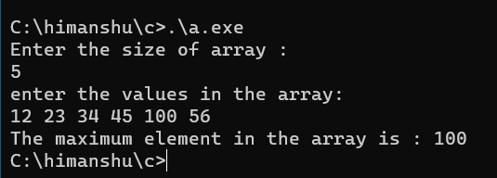
7. Wap to input elements in an array then find the maximum element present in the array?
#include<stdio.h>
int main(){
int size;
printf("Enter the size of array : \n");
scanf("%d",&size);
//declaring array
int arr[size];
printf("enter the values in the array: \n");
//taking input in the array arr
for(int i=0;i<size;i++){
scanf("%d",&arr[i]);
}
//searching maximum element in array
//let max =arr[0]
int max=arr[0];
for(int i=1;i<size;i++){
if(arr[i]>=max){
max=arr[i];
}
}
//printing maximum no of the array
printf("The maximum element in the array is : %d",max);
return 0;
}
Output:

Slide 9
8. Wap to make a max function to find the maximum element present in the array?
#include<stdio.h>
int max(int *newarray);
int main(){
int size;
printf("Enter the size of array : \n");
scanf("%d",&size);
//declaring array
int arr[size];
printf("enter the values in the array: \n");
//taking input in the array arr
for(int i=0;i<size;i++){
scanf("%d",&arr[i]);
}
//printing maximum no of the array
printf("The maximum element is : %d",max(arr));
return 0;
}
//searching maximum element in array
int max(int *newarray){
int size=sizeof(newarray);
//let maximum=nwarray[0]
int maximum=newarray[0];
for(int i=1;i<=size;i++){
if(newarray[i]>maximum){
maximum=newarray[i];
}
}
return maximum;
}
Output:

Slide 10
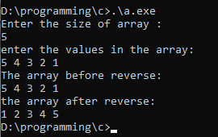
9. Wap to input elements in an array then find the reverse of the array?
#include<stdio.h>
int main(){
int size;
printf("Enter the size of array : \n");
scanf("%d",&size);
//declaring array
int arr[size];
int last=size-1;
printf("enter the values in the array: \n");
//taking input in the array arr
for(int i=0;i<size;i++){
scanf("%d",&arr[ i]);
}
//the input array is :
printf("The array before reverse:\n");
for(int i=0;i<size;i++){
printf("%d ",arr[i]);
}
//reversing the array
for(int i=0;i<size/2;i++){
int temp=arr[i];
arr[i]=arr[last];
arr[last]=temp;
last--;
}
//printing the reversed array
printf("\nthe array after reverse: \n");
for(int i=0;i<size;i++){
printf("%d ",arr[i]);
}
return 0;
}
Output:

Slide 11
10. Wap to make a reverse function to find the reverse of the array?
#include<stdio.h>
void reverse(int *array);
int main(){
int size;
printf("Enter the size of array : \n");
scanf("%d",&size);
//declaring array
int arr[size];
printf("enter the values in the array: \n");
//taking input in the array arr
for(int i=0;i<size;i++){
scanf("%d",&arr[ i]);
}
//the input array is :
printf("The array before reverse:\n");
for(int i=0;i<size;i++){
printf("%d ",arr[i]);
}
reverse(arr);
//printing the reversed array
printf("\nthe array after reverse: \n");
for(int i=0;i<size;i++){
printf("%d ",arr[i]);
}
return 0;
}
void reverse(int *array){
int size=sizeof(array);
int last=size;
//reversing the array
for(int i=0;i<size/2;i++){
int temp=array[i];
array[i]=array[last];
array[last]=temp;
last--;
}
}
Output:

Slide 12
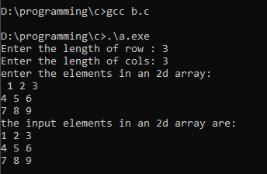
11. Wap to input elements in 2d array then print it?
#include<stdio.h>
int main(){
int rows,cols;
printf("Enter the length of row : ");
scanf("%d",&rows);
printf("Enter the length of cols: ");
scanf("%d",&cols);
int arr[rows][cols];
printf("enter the elements in an 2d array: \n ");
for(int i=0;i<rows;i++){
for(int j=0;j<cols;j++){
scanf("%d",&arr[i][j]);
}
}
//printing the array
printf("the input elements in an 2d array are: \n");
for(int i=0;i<rows;i++){
for(int j=0;j<cols;j++){
printf("%d ",arr[i][j]);
}printf("\n");
}
return 0;
}
Output:

Slide 13
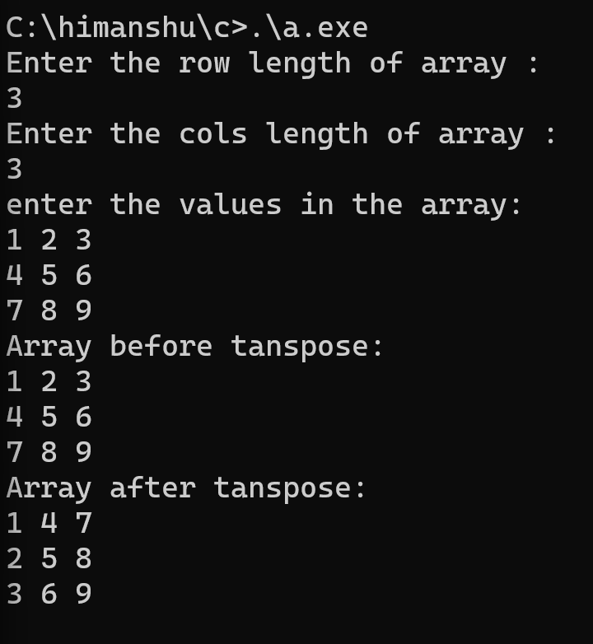
12. Wap to input elements in an 2d array then find its transpose?
Method 1
#include<stdio.h>
int main(){
int rows,cols;
printf("Enter the row length of array : \n");
scanf("%d",&rows);
printf("Enter the cols length of array : \n");
scanf("%d",&cols);
//declaring array
int arr[rows][cols];
printf("enter the values in the array: \n");
//taking input in the array arr
for(int i=0;i<rows;i++){
for(int j=0;j<cols;j++){
scanf("%d",&arr[i][j]);
}
}
printf("Array before tanspose: \n");
for(int i=0;i<rows;i++){
for(int j=0;j<cols;j++){
printf("%d ",arr[i][j]);
}printf("\n");
}
printf("Array after tanspose: \n");
for(int i=0;i<rows;i++){
for(int j=0;j<cols;j++){
printf("%d ",arr[j][i]);
}printf("\n");
}
return 0;
}
Output:

Slide 14
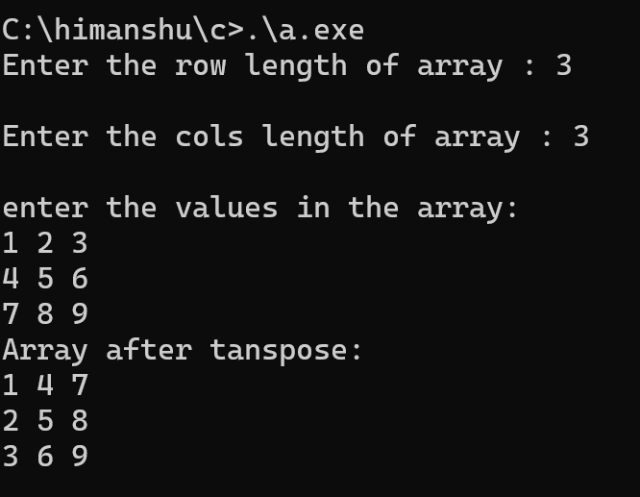
13. Wap to input elements in an 2d array then find its transpose?
Method 2
#include<stdio.h>
int main(){
int rows,cols;
printf("Enter the row length of array : ");
scanf("%d",&rows);
printf("\nEnter the cols length of array : ");
scanf("%d",&cols);
//declaring array
int arr[rows][cols],newarray[rows][cols];
printf("\nenter the values in the array: \n");
//taking input in the array arr
for(int i=0;i<rows;i++){
for(int j=0;j<cols;j++){
scanf("%d",&arr[i][j]);
}
}
//transposing an array
for(int i=0;i<rows;i++){
for(int j=0;j<cols;j++){
newarray[i][j]=arr[j][i];
}
}
printf("Array after tanspose: \n");
for(int i=0;i<rows;i++){
for(int j=0;j<cols;j++){
printf("%d ",newarray[i][j]);
}printf("\n");
}
return 0;
}
Output:

Slide 15
14. Wap to print multiplication of 2 matrix ?
#include<stdio.h>
int main(){
int m,n,z;
printf("Enter no of rows in array1 : ");
scanf("%d",&m);
printf("Enter no of cols in array1 : ");
scanf("%d",&n);
printf("No of rows in array2 : %d\n",n);
printf("Enter no of cols in array2 : ");
scanf("%d",&z);
int first[m][n];
int second[n][z];
int third[m][z];
//taking input to the first array
printf("Enter the elements in array1 : \n");
for(int i=0;i<m;i++){
for(int j=0;j<n;j++){
scanf("%d",&first[i][j]);
}
}
//taking input to the second array
printf("Enter the elements in array2 : \n");
for(int i=0;i<n;i++){
for(int j=0;j<z;j++){
scanf("%d",&second[i][j]);
}
}

Slide 16
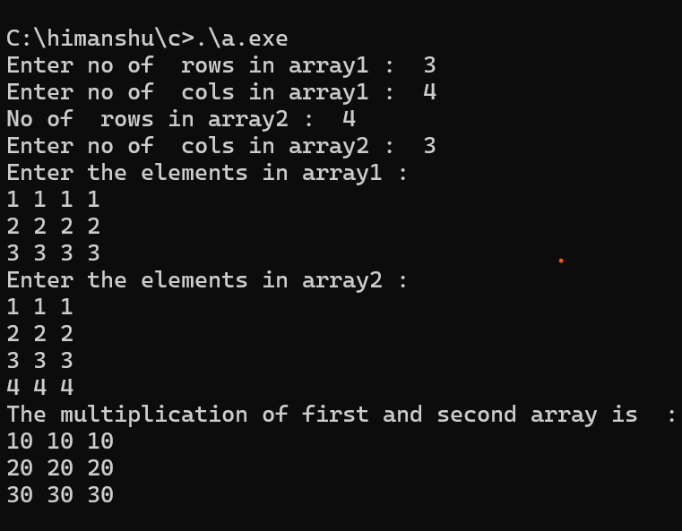
//storing values in third array
int sum=0;
for(int i=0;i<m;i++){
for(int j=0;j<z;j++){
for(int k=0;k<n;k++){
sum+=first[i][k]* second[k][j];
}
third[i][j]=sum;
sum=0;
}
}
printf("The multiplication of first and second array is : \n");
for(int i=0;i<m;i++){
for(int j=0;j<n;j++){
printf("%d ",third[i][j]);
}printf("\n");
}
return 0;
}
O
U
T
P
U
T

Slide 17
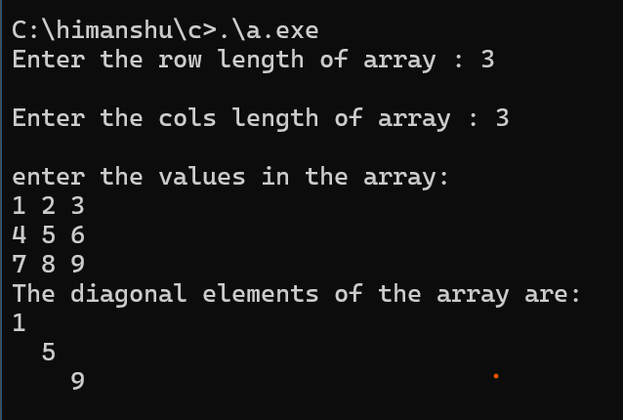
15. Wap to print diagonal of array?
#include<stdio.h>
int main(){
int rows,cols;
printf("Enter the row length of array : ");
scanf("%d",&rows);
printf("\nEnter the cols length of array : ");
scanf("%d",&cols);
//declaring array
int arr[rows][cols];
printf("\nenter the values in the array: \n");
//taking input in the array arr
for(int i=0;i<rows;i++){
for(int j=0;j<cols;j++){
scanf("%d",&arr[i][j]);
}
}
//printing daigonal elements
printf("The diagonal elements of the array are: \n");
for(int i=0;i<rows;i++){
for(int j=0;j<cols;j++){
if(i==j)
printf("%d ",arr[i][j]);
else
printf(" ");
}printf("\n");
}
return 0;
}
Output:

Slide 18
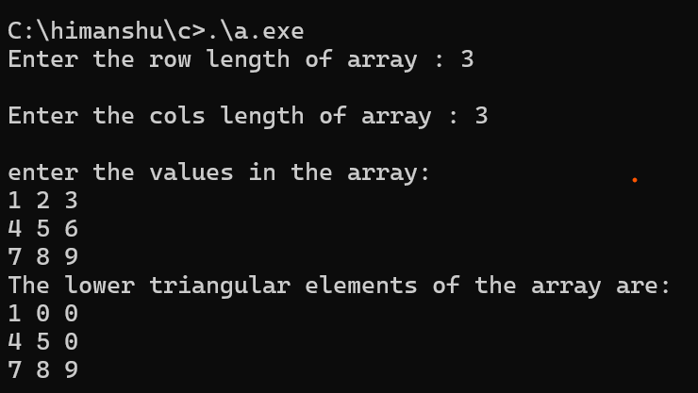
16 Wap to print lower triangular elements of array?
#include<stdio.h>
int main(){
int rows,cols;
printf("Enter the row length of array : ");
scanf("%d",&rows);
printf("\nEnter the cols length of array : ");
scanf("%d",&cols);
//declaring array
int arr[rows][cols];
printf("\nenter the values in the array: \n");
//taking input in the array arr
for(int i=0;i<rows;i++){
for(int j=0;j<cols;j++){
scanf("%d",&arr[i][j]);
}
}
//printing daigonal elements
printf("The lower triangular elements of the array are: \n");
for(int i=0;i<rows;i++){
for(int j=0;j<cols;j++){
if(i>=j)
printf("%d ",arr[i][j]);
else
printf("0 ");
}printf("\n");
}
return 0;
}
Output:

Slide 19
17 Wap to print lower triangular elements of array?
#include<stdio.h>
int main(){
int rows,cols;
printf("Enter the row length of array : ");
scanf("%d",&rows);
printf("\nEnter the cols length of array : ");
scanf("%d",&cols);
//declaring array
int arr[rows][cols];
printf("\nenter the values in the array: \n");
//taking input in the array arr
for(int i=0;i<rows;i++){
for(int j=0;j<cols;j++){
scanf("%d",&arr[i][j]);
}
}
//printing daigonal elements
printf("The lower triangular elements of the array are: \n");
for(int i=0;i<rows;i++){
for(int j=0;j<cols;j++){
if(i>=j)
printf("%d ",arr[i][j]);
else
printf("0 ");
}printf("\n");
}
return 0;
}
Output:

Slide 20
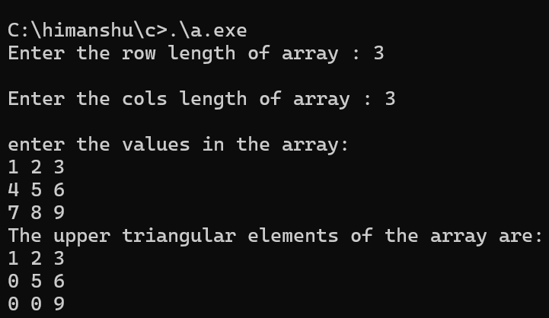
18 Wap to print upper triangular elements of array?
#include<stdio.h>
int main(){
int rows,cols;
printf("Enter the row length of array : ");
scanf("%d",&rows);
printf("\nEnter the cols length of array : ");
scanf("%d",&cols);
//declaring array
int arr[rows][cols];
printf("\nenter the values in the array: \n");
//taking input in the array arr
for(int i=0;i<rows;i++){
for(int j=0;j<cols;j++){
scanf("%d",&arr[i][j]);
}
}
//printing daigonal elements
printf("The upper triangular elements of the array are: \n");
for(int i=0;i<rows;i++){
for(int j=0;j<cols;j++){
if(i<=j)
printf("%d ",arr[i][j]);
else
printf("0 ");
}printf("\n");
}
return 0;
}
Output:

