Slide 1
Cameron Chin URA Project
Phase 1 – Data Collection | Phase 2 – Image Processing
Near Completion 4 Step process -Web scrapper downloads articles from nature.com based on a search term you give it -Image extractor locates any images inside of the downloaded pdfs -Binary sorter goes through all extracted images and decides which to keep -Regional CNN identifies where the useful parts of the images are and then crops them out of the kept images | Not Started Thinking of training a Mask RCNN on shaplet response vectors to allow for quick computation of pixel level defects. Would allow for a graphic output very quickly and give a visual representation of defects along with the shaplet quantitative information

Slide 2
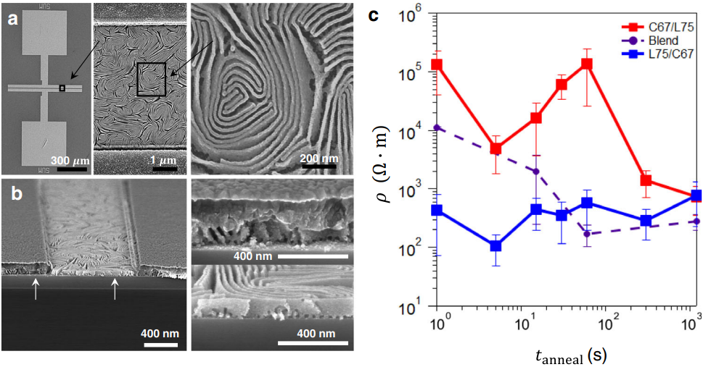
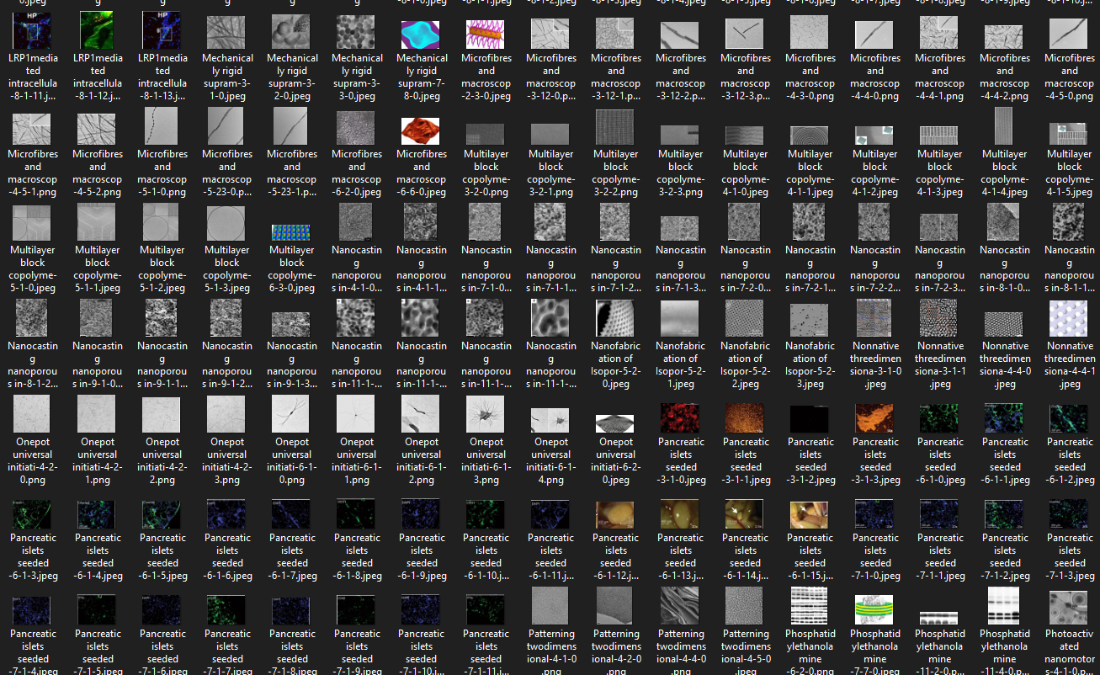
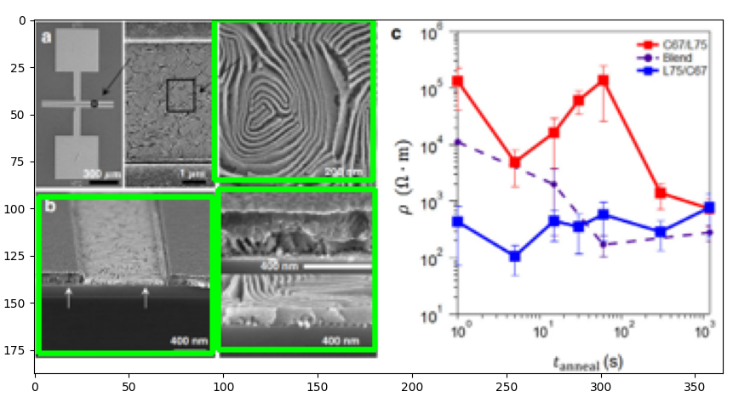
This image is one of hundreds that is extracted from the downloaded pdfs when the web scrapper runs a search
Phase 1 – Data Collection
Regional CNN
Each green box is predicted by the AI then crops each box and saves it. After running hundreds of images through, we end with hundreds of usable images

Slide 3
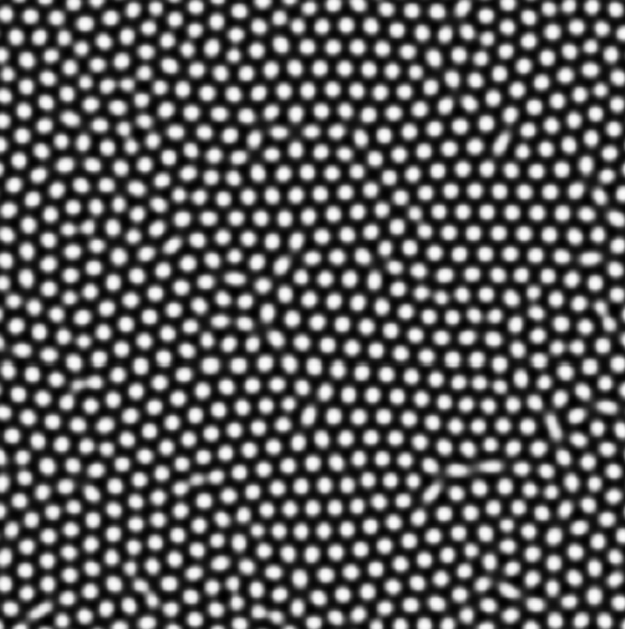
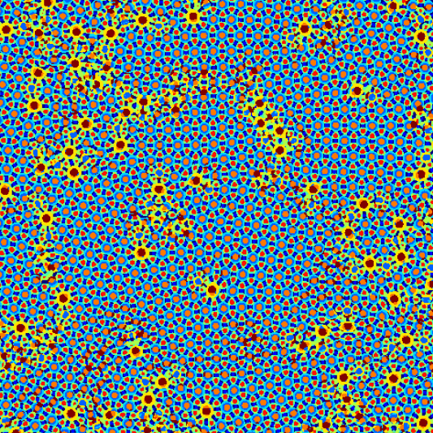
Phase 2 – Image Processing
Mask RCNN
Taking the best images from the data collection part of the project
Then training a Mask RCNN using the shaplet response vectors
Will hopefully be able to produce processed images that give visual representation of defects along with some quantitative data

