Slide 1
Using data to explore the evolution of data journalism
Chase Davis
Center for Investigative Reporting
@chasedavis

Slide 2
github.com/cirlabs/data-journalism-ignite

Slide 3
Precision journalism
Analytic journalism
Computational journalism
Database journalism
Computer-assisted reporting
Data-driven journalism
Data journalism

Slide 4
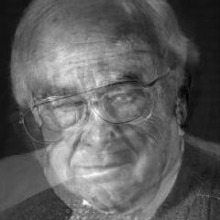

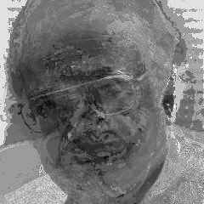

Slide 5
Data
Journalism
Story
Computer
Number
Census
Poll
Record
People
Information
Voter
Science
Mean
Variable

Slide 6
Borrowing
Qualifications
Borrowing
Qualifications
BANK
LOANS
GRANTED
BANK
LOANS
GRANTED

Slide 7
1985
1998
2012

Slide 8
DATABASES
25 classes
SPREADSHEETS
15 classes
WEB SEARCH
13 classes
GIS
4
STATISTICS
4
FoxPro Data cleaning Coldfusion ASP

Slide 9
DATABASES
7 classes
SPREADSHEETS
8 classes
WEB SEARCH
2
GIS
6 classes
NLTK Social network analysis Python Django Web scraping R MySQL Fusion Tables Regex Google Refine

Slide 10
DATABASES
R
GIS
JAVASCRIPT
SOCIAL NETWORK ANALYSIS
PYTHON
1994
2000
2006
2012
SAS
PERL
FOXPRO
ASP
SPREADSHEETS

Slide 11
Government (federal/state/local)
Justice (courts/crime/law)
First Amendment and FOIA
Business
Health
Mapping
Transportation
Education
Social issues
Politics

Slide 12
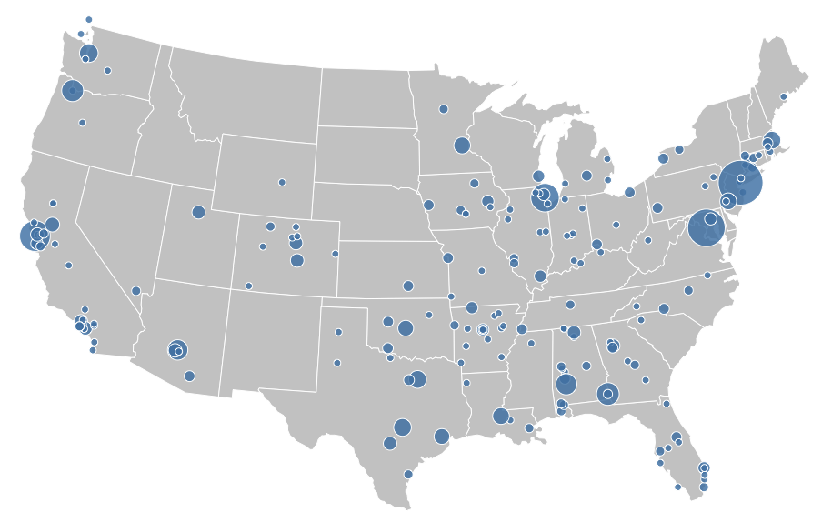

Slide 13
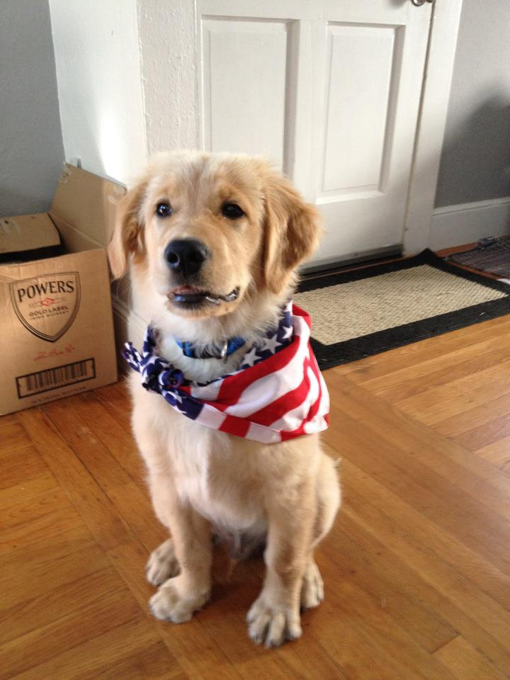

Slide 14
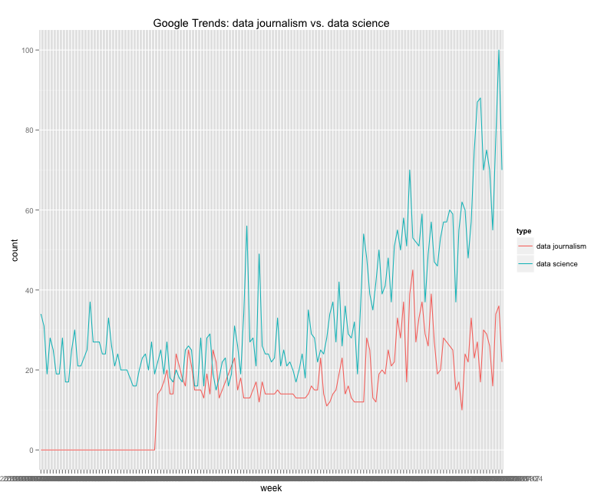

Slide 15
Nontraditional
Urgent
Focus on storytelling

Slide 16
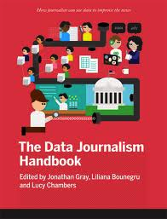

Investigative journalism
Info presentation + display
Public policy
Problem solving
Big Data techniques
Product development

Slide 17
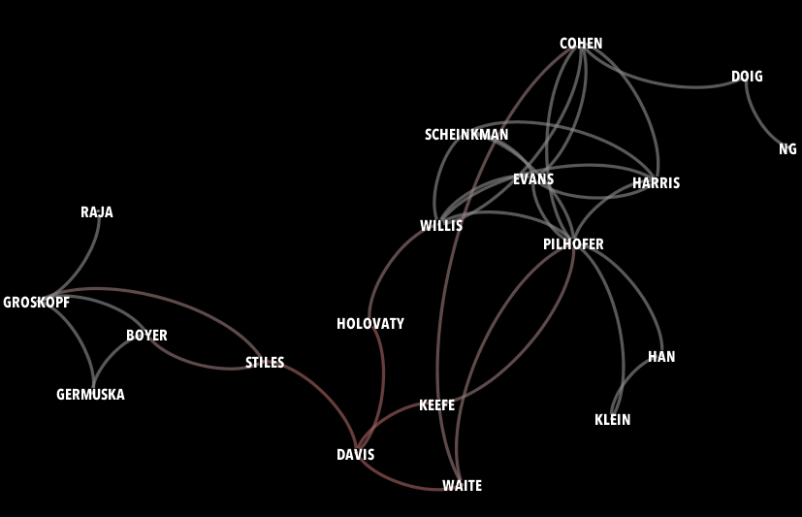

Slide 19
github.com/cirlabs/data-journalism-ignite
Thanks!
Chase Davis
Center for Investigative Reporting
@chasedavis

Slide 20
Sources
- Wikipedia
- UNC-Chapel Hill
- Investigative Reporting Workshop
- The New Precision Journalism (by Phil Meyer)
- The Atlanta Journal Constitution
- Pulitzer.org
- Investigative Reporters and Editors, Inc.
- Our awesome dog, Kirby
- Google Trends
- The Data Journalism Handbook
- What is Data Science? (by Roger Magoulas, O'Reilly Media)
- NewsFoo!

