Slide 1
The many faces
of
machine learning
(in the newsroom)
Data journalism
Chase Davis
@chasedavis
@chasedavis

Slide 2
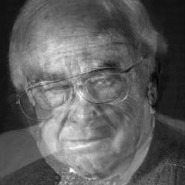
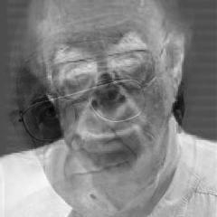
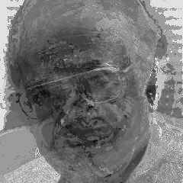

Slide 3
Classification
Clustering
Outlier detection
Similarity

Slide 4
First up:
Classification
(lots of problems are classification problems)

Slide 5
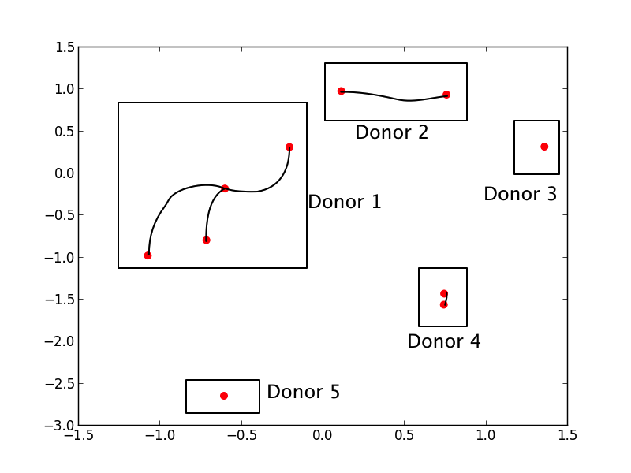
github.com/cjdd3b/fec-standardizer/

Slide 6
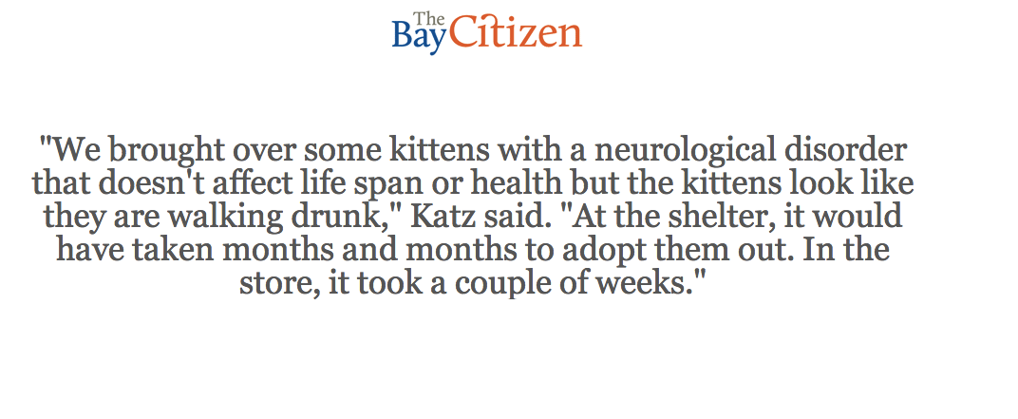
github.com/cjdd3b/citizen-quotes

Slide 7
Clustering
(clusters are more than just spatial)

Slide 8
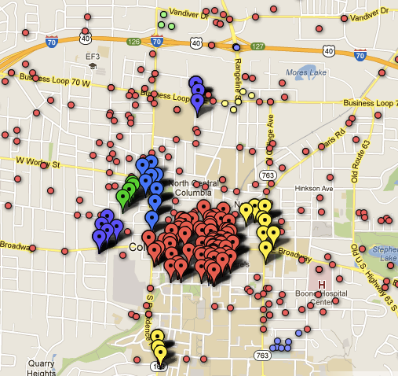

Slide 9
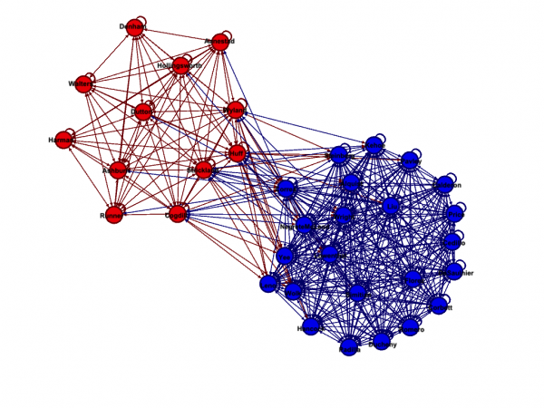

Slide 10
Outlier detection
(especially in high-dimensional data)

Slide 11
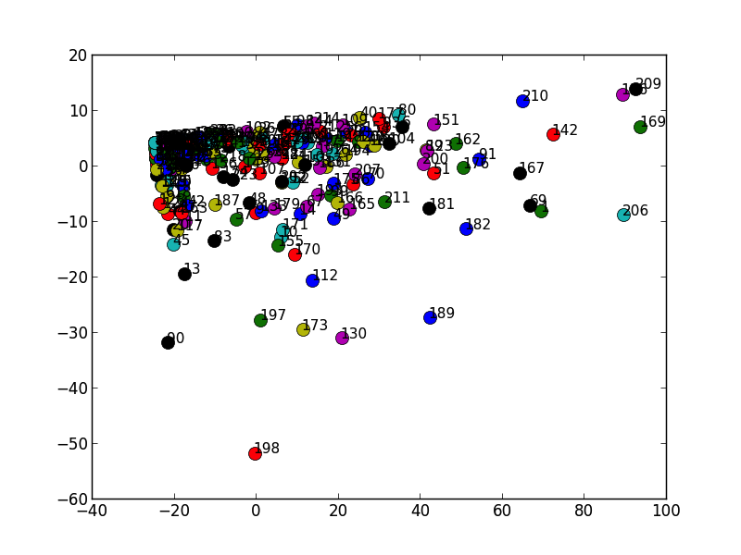

Slide 12
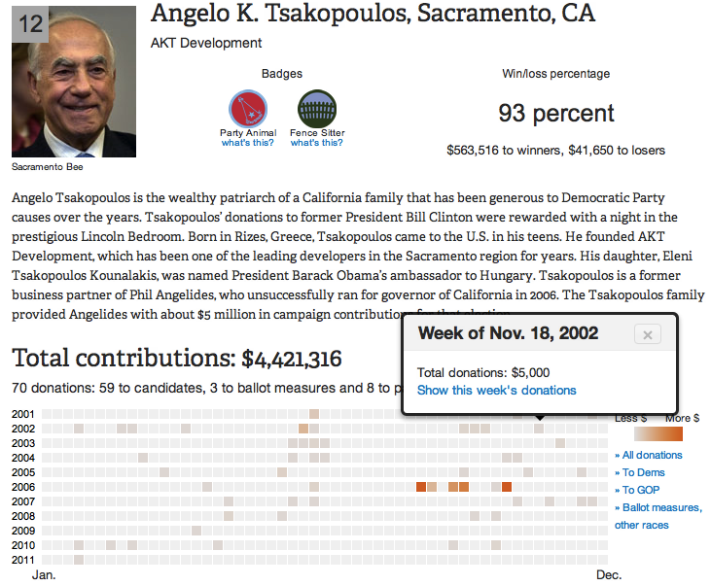
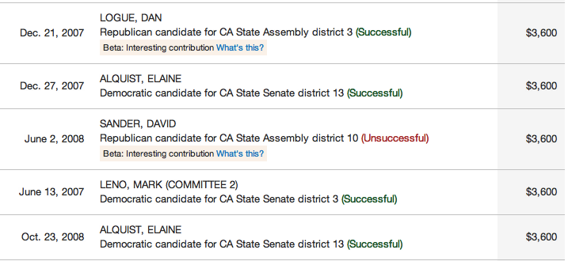

Slide 13
Similarity

Slide 14
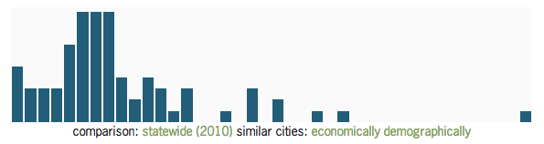

Slide 15
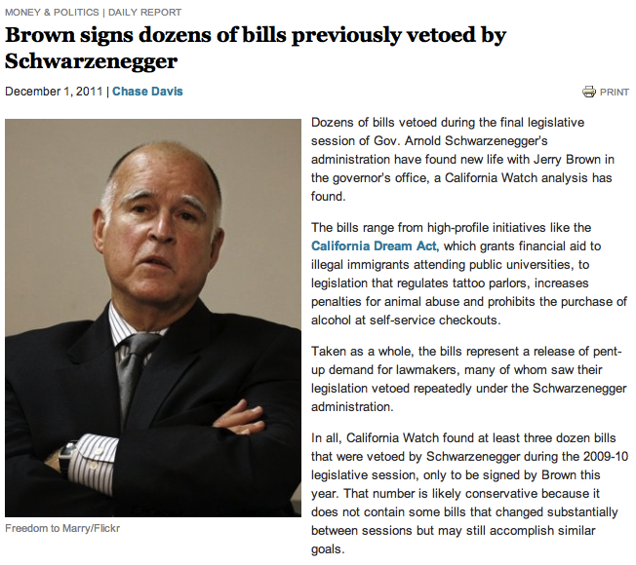

Slide 16
@chasedavis
(thanks!)

