Slide 1
5 algorithms
in
5 minutes
Data journalism
Chase Davis
@chasedavis
@chasedavis

Slide 2
github.com/cjdd3b/nicar2013

Slide 3
PCA
+
MDS

Slide 4
Good for ...
Finding outliers
(especially in high-dimensional data)

Slide 5
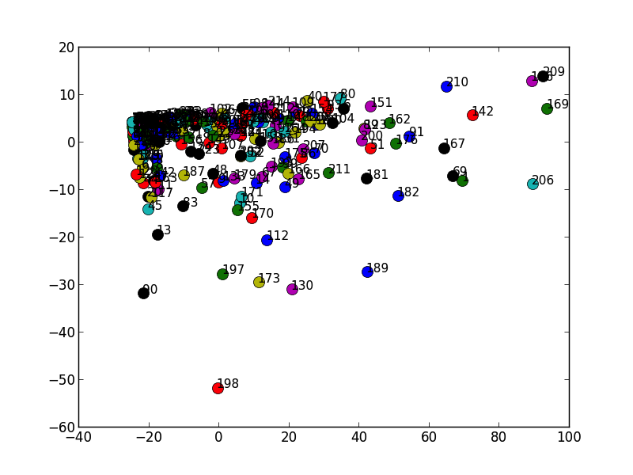

Slide 6
Nearest
Neighbors

Slide 7
Good for ...
Finding similar
items

Slide 8
1. Los Angeles
2. San Diego
3. Riverside
4. Sacramento
5. San Bernardino

Slide 9
Random forests

Slide 10
Good for ...
Classifying things
(a ton of problems are classification problems)

Slide 11
An act to add Section 236.3 to the
Penal Code, relating to human trafficking.
Crime
Education
Public postsecondary education:
executive officer compensation.A

Slide 12
DBSCAN

Slide 13
Good for ...
Finding clusters

Slide 14
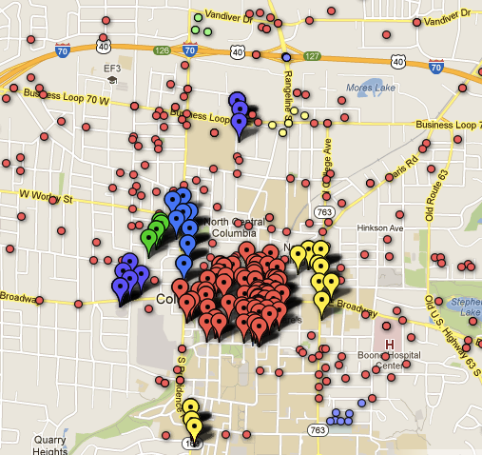

Slide 15
Locality
Sensitive
Hashing

Slide 16
Good for ...
Finding similar
documents

Slide 17
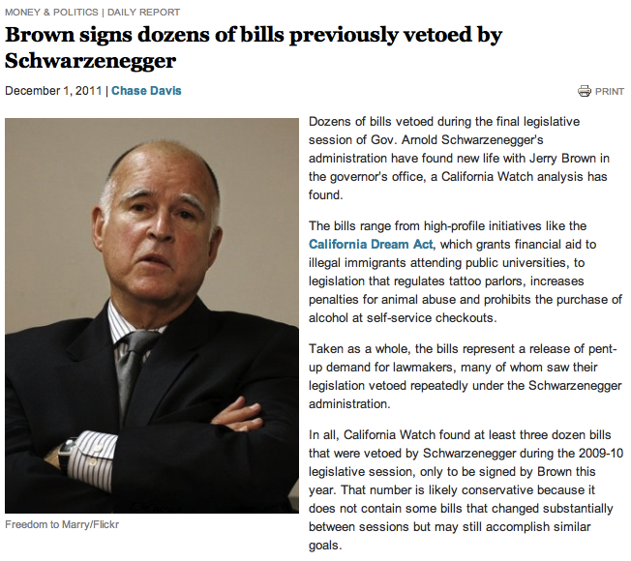

Slide 18
github.com/cjdd3b/nicar2013

Slide 19
@chasedavis
(thanks!)

Slide 20


