Slide 1
Campaign finance
(the data science
way)
Data journalism
Chase Davis
@chasedavis

Slide 2
CIR
+
IRE
+
Kaggle
Data journalism
Chase Davis
@chasedavis

Slide 3
14 entries total
Some highlights...
Data journalism
Chase Davis
@chasedavis

Slide 4
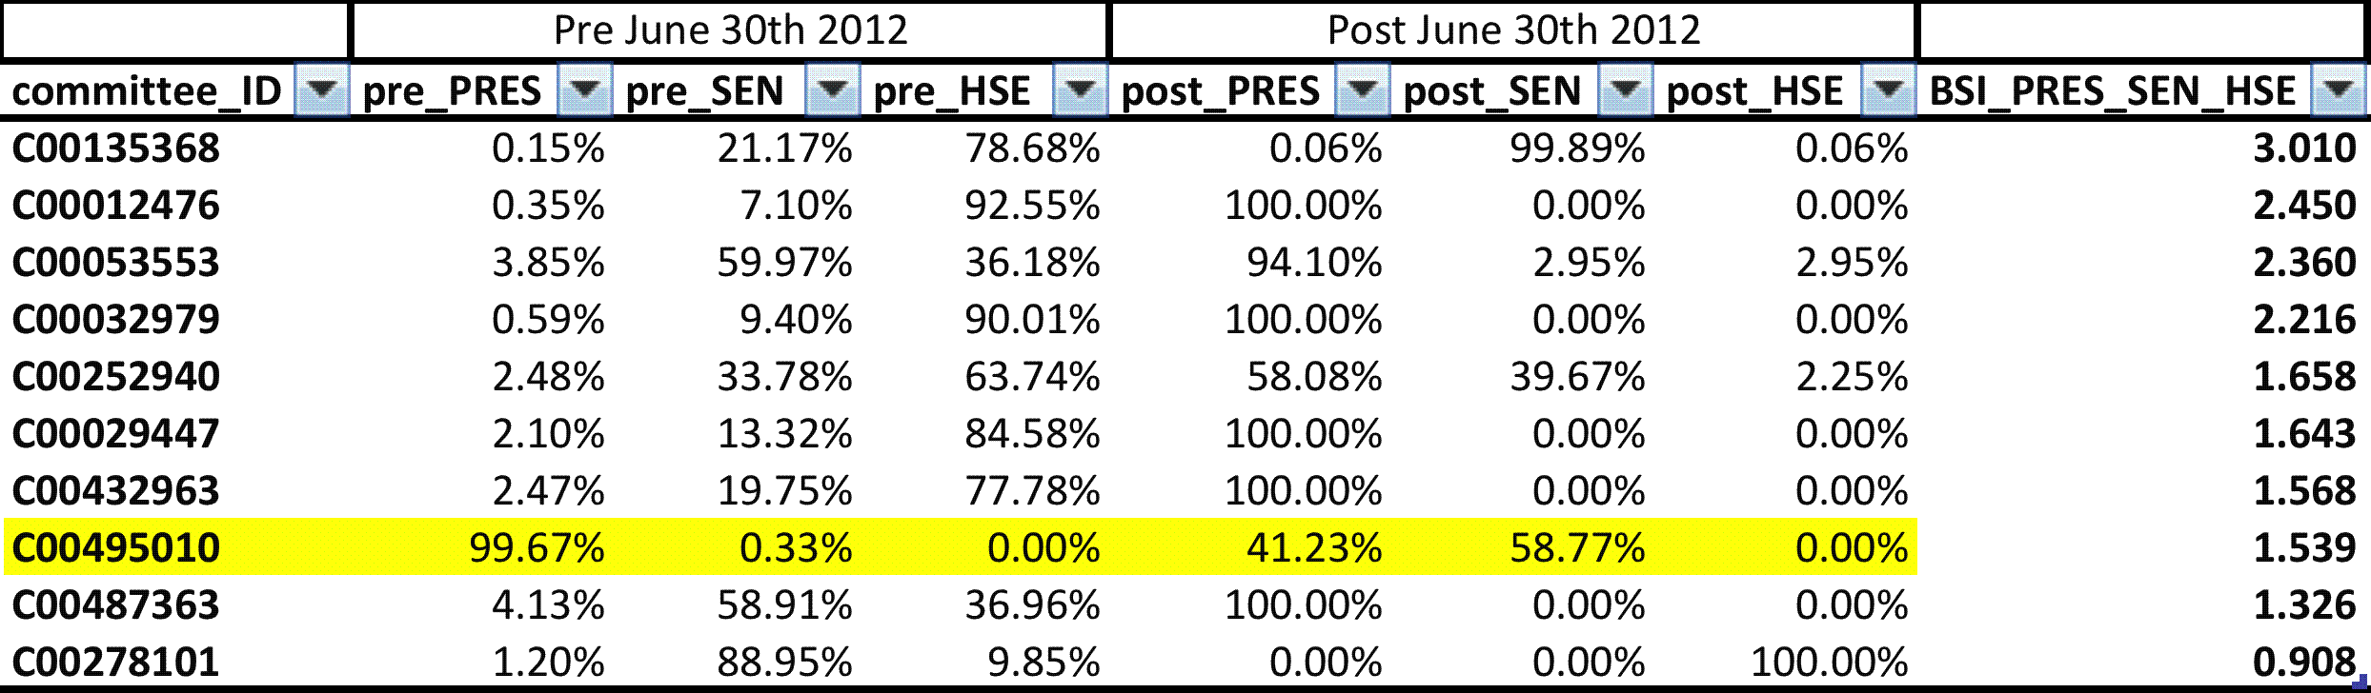
Behavior stability
index
Chase Davis
@chasedavis

Slide 5
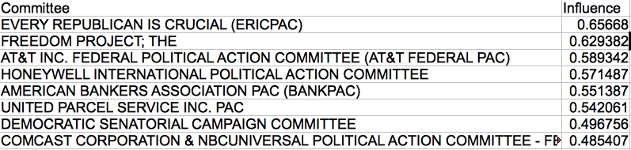
Concentration
as influence
Chase Davis
@chasedavis

Slide 6
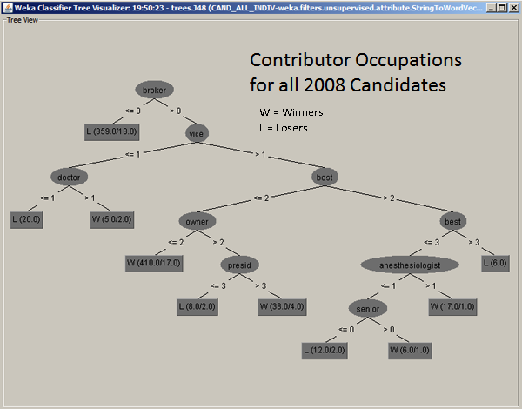
Who contributes
to whom?

Slide 7
Finding
coordination
with time series
correlation

Slide 8
Who contributes
to whom?

Slide 9
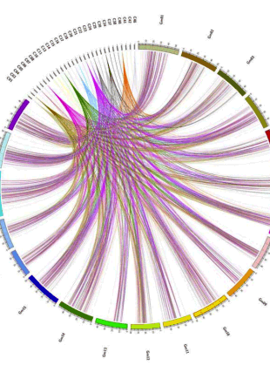
Annotating data
with Wikipedia

Slide 10
Discuss.

