Slide 1

1/23/17
Round Two
Nicole Anguiano, Chris Dellomes, Chris Franco

Slide 2






Project Description

Slide 3
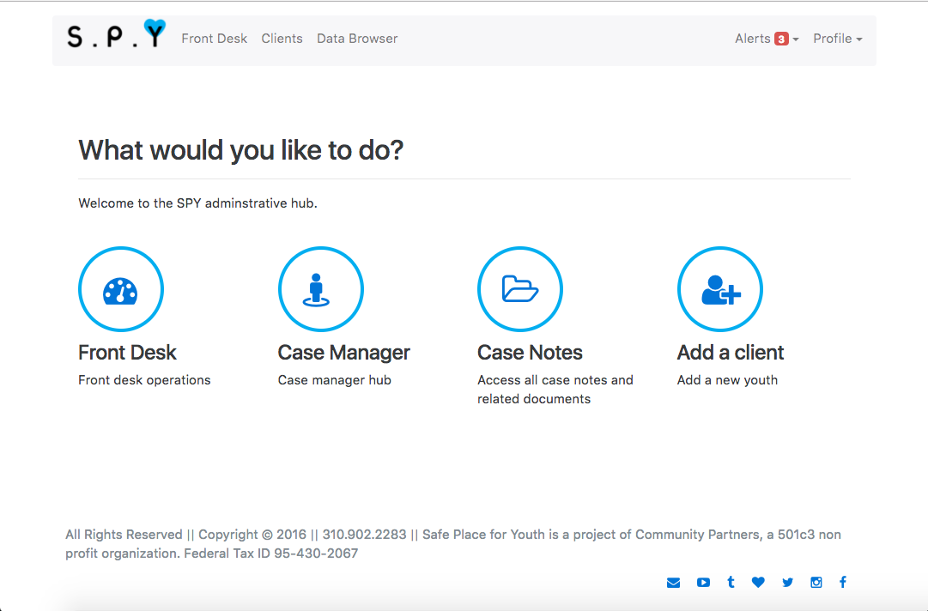
Users Point of View
(demo)

Slide 4





Operations and Technology
Frontend
Backend
(Client Server)
Database Server

Slide 5
Preliminary Development Schedule
Schedule:
https://teamup.com/ksdfb66fa4b11f6b5b
Milestones:
• Testing framework
• HIPAA compliance
• Interaction Design
• Minimum Viable Product

Slide 6
Questions?

