Slide 1
Loam: Soil Analysis
Graduate Project by
Christopher Diaz

Slide 2
Table of Contents
Intro to Loam: Soil Analysis
About
Features
Amplitude vs. Depth Plot
Amplitude vs. Depth vs. Dielectric Constant Plot
Volumetric Moisture Content and Recommendation
Tutorial/Demonstration

Slide 3
Table of Contents
Calculations and Assumptions
Extrapolating Data
Calculating the Dielectric Constant
Calculating the Volumetric Moisture Content
Determining the Upper and Lower Bounds of the Volumetric Moisture Content

Slide 4
Table of Contents
Frameworks and Libraries
ElectronJS
Cross-platform Capabilities
Plotly Compatibility
Selected to Learn a New Technology
Plotly

Slide 5
About Loam: Soil Analysis:
Software application created to visualize and analyze data reported from a soil sensor.
The user inputs the amplitude value reported from the sensor and the depth of the sensor
Loam produces two plots:
Amplitude vs. Depth
Amplitude vs. Depth vs. Dielectric Constant
Loam also informs the user on the volumetric moisture content and if any changes should be made to the soil

Slide 6
Features

Slide 7
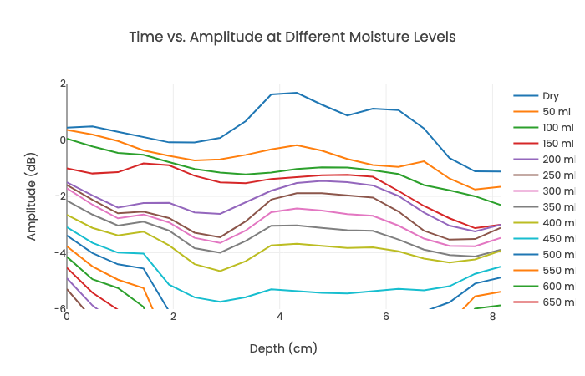
Amplitude vs. Depth Plot
Plot generated at start of the application
When user enters an amplitude and depth value, the point is plotted on the graph
Inputs are validated
Plot generated in constant time
Plot updated in constant time
Fig 1. Extrapolated Time vs. Amplitude at
Different Moisture Levels [1]

Slide 8
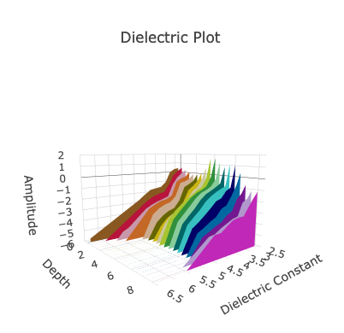
Amplitude vs. Depth vs. Dielectric Constant
Plot is also generated at application start
Contains extrapolated data
Dielectric constant is calculated based on input and obtained data to create a new point
Plot generated in O(n^2) where n is the index of the data used
Plot updated in constant time
Fig. 2 Extrapolated “Calibration Curve” [1]

Slide 9
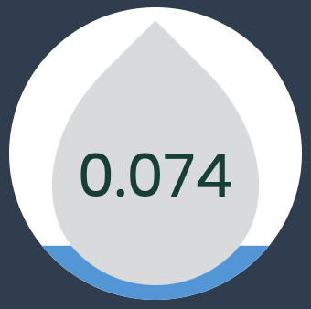
Volumetric Moisture Content and Recommendations
Volumetric Moisture Content calculated based on Dielectric Constant
Value given in the “droplet” within the application along with a visual representation of an acceptable or unacceptable moisture level
Updated in constant time
Fig. 3 Example Moisture Indicator

Slide 10
Demonstration

Slide 11
Calculations and Assumptions

Slide 12

Extrapolating Data
Datasets were extrapolated according to the client’s specifications
Equation used for linear extrapolation can be seen below [2]
$y=y1+\frac{ x− x1 }{x_{2} – x_{1}}(y2−y1)$ (Eq. 1)

Slide 13
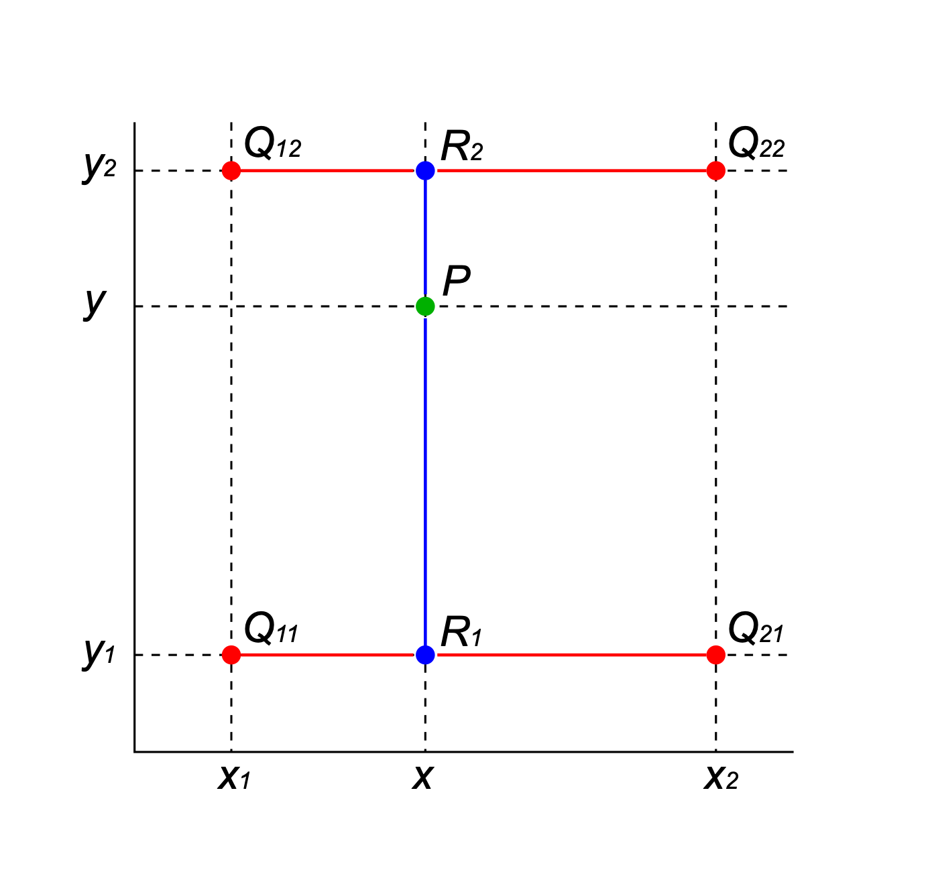
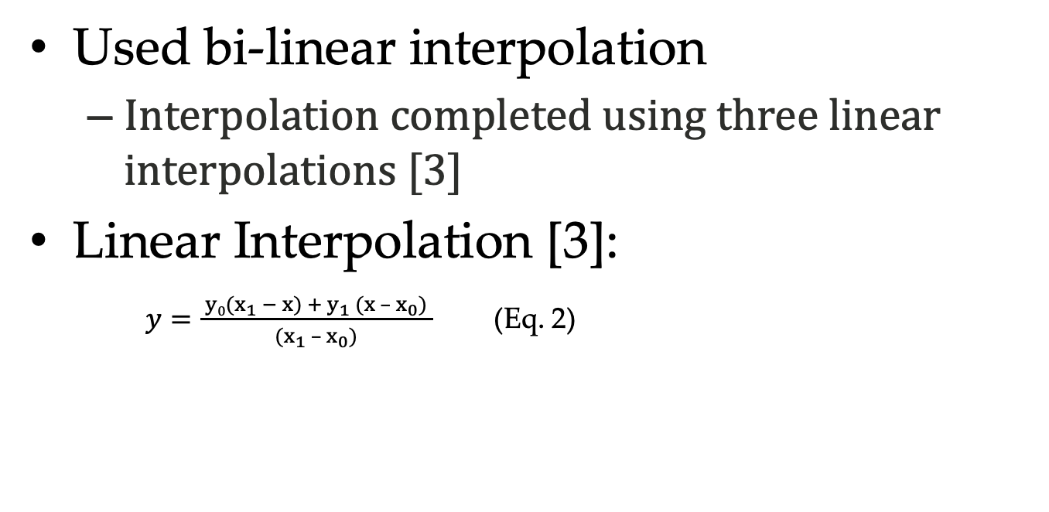
Calculating the Dielectric Constant
Used bi-linear interpolation
Interpolation completed using three linear interpolations [3]
Linear Interpolation [3]:
$y=\frac{ y0(x_{1} − x) + y_{1} (x – x_{0}) }{(x_{1} – x_{0})}$ (Eq. 2)
Fig. 4 Bilinear Interpolation [3]

Slide 14
Calculating Volumetric Moisture Content
Also used linear interpolation along with the following table:
Table 1. Volumetric Moisture vs. Dielectric Constant
Volumetric Moisture Content | Dielectric Constant
0 | 2.53
0.025 | 2.74
0.05 | 2.96
0.075 | 3.18
0.1 | 3.42
0.125 | 3.67
0.15 | 3.92
0.175 | 4.18
0.2 | 4.45
0.225 | 4.73
0.25 | 4.92
0.275 | 5.17
0.3 | 5.41
0.325 | 5.66
0.35 | 5.90
0.375 | 6.15
0.4 | 6.39

Slide 15
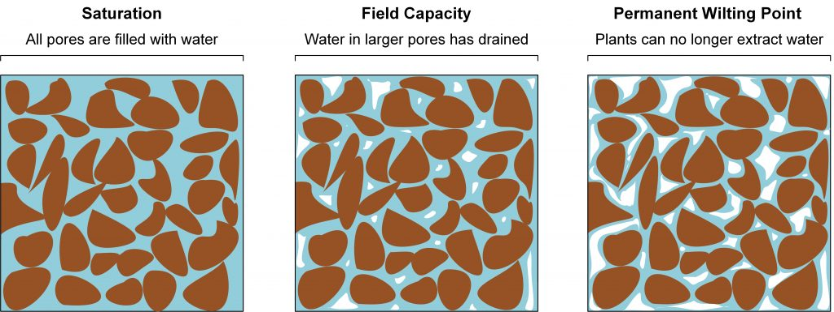
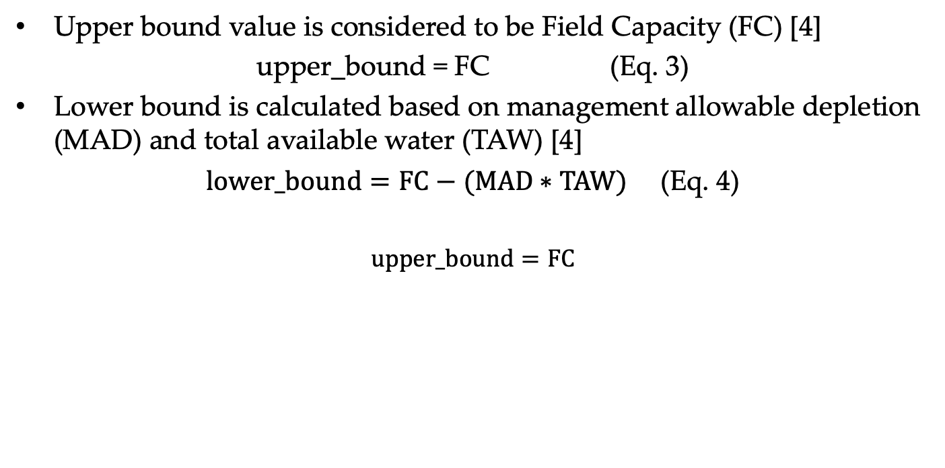
Determining Upper and Lower Bounds of the Volumetric Moisture Content
Upper bound value is considered to be Field Capacity (FC) [4]
upper_bound = FC (Eq. 3)
Lower bound is calculated based on management allowable depletion (MAD) and total available water (TAW) [4]
$lower_bound=FC−(MAD∗TAW)$ (Eq. 4)
$upper_bound=FC$
Fig. 5 Moisture Representations [4]

Slide 16
Frameworks and Libraries

Slide 17
ElectronJS
Runtime framework to create applications in HTML, CSS, and Javascript [5]
Cross-platform capabilities
Produce various file types in Electron Forge
Plotly compatibility
Helpful to learn a new technology

Slide 18
Plotly
Graphing library in JavaScript [6]
Capable of displaying three-dimensional and two-dimensional plots

Slide 19
References
[1] S. Dey, private communication, August 2022.
[2] X-engineer, “Linear Interpolation Extrapolation Calculator,” https://x-engineer.org/linear-interpolation-extrapolation-calculator/
[3] H. R. Kang, “Three-Dimensional Lookup Table with Interpolation,” in Computation Color Technology. SPIE Press, 2006, ch. 9, pp. 151 – 159.
[4] S. Datta, S. Taghvaeian, J. Stivers, “Understanding Soil Water Content and Thresholds for Irrigation Management,” Oklahoma State University. https://extension.okstate.edu/fact-sheets/understanding-soil-water-content-and-thresholds-for-irrigation-management.html (accessed Feb. 2, 2023).
[5] ElectronJS, “ElectronJS Docs,” https://www.electronjs.org/docs/latest/ (accessed Aug 2022).
[6] Plotly, “Plotly JavaScript Open Source Graphing Library,” https://plotly.com/javascript/ (accessed Aug 2022).

