Slide 1
Validation and Verification
02/25/2026

Slide 2
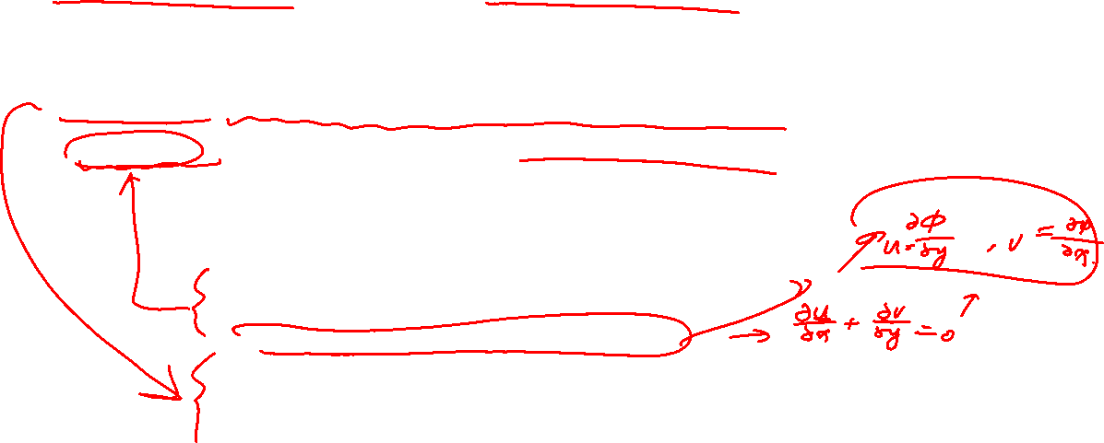
Verification versus Validation
Verification: demonstrates that you are solving the equations right
Validation: demonstrates that you are solving the right equations
7 steps of solving a problem using CFD
Determine appropriate mathematical model
Classification of partial differential equation
Transformation of mathematical model
Select grid pattern
Formation of discretized equations
Solution algorithm
Perform auxiliary calculations; postprocessing

Slide 3
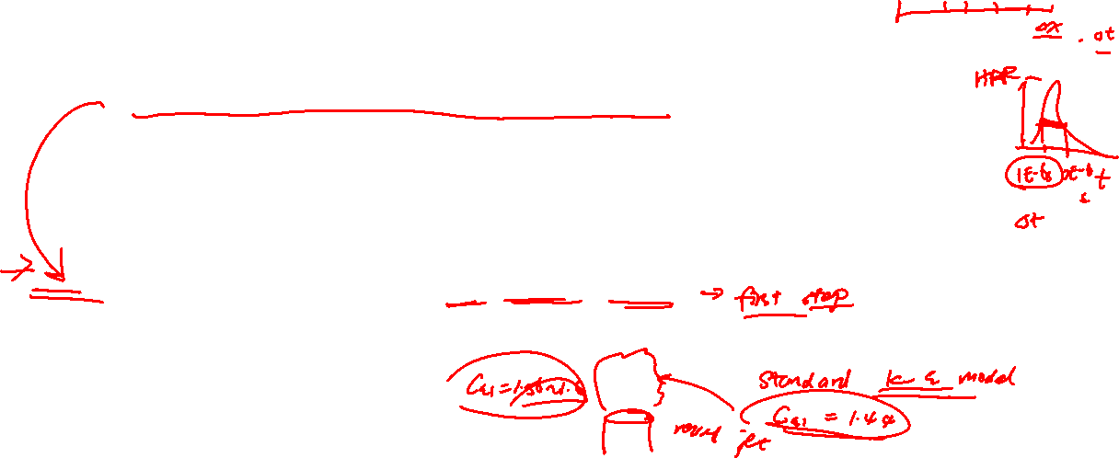
Verification must precede validation
Don’t expect reasonable conclusions when comparing to experimental results if you’ve got serious errors due to:
Selection of mesh spacing or time steps that are too large (try different mesh or time steps)
Selection of convergence criteria for iterative equation solution that are too loose (try different tolerance)
Programming errors in the computer code (a.k.a. bugs)
Errors in the specification of input for the simulation of the experiment
Errors in understanding of the code output
Grid convergence should always be demonstrated first, usually by performing the same calculations on three sets of mesh: fine, standard, coarse.
If parameter tuning (i.e., during specification of input) is performed on an un-converged grid, one might get the right answer because of error cancelation. Always perform parameter tuning after grid convergence study.

Slide 4

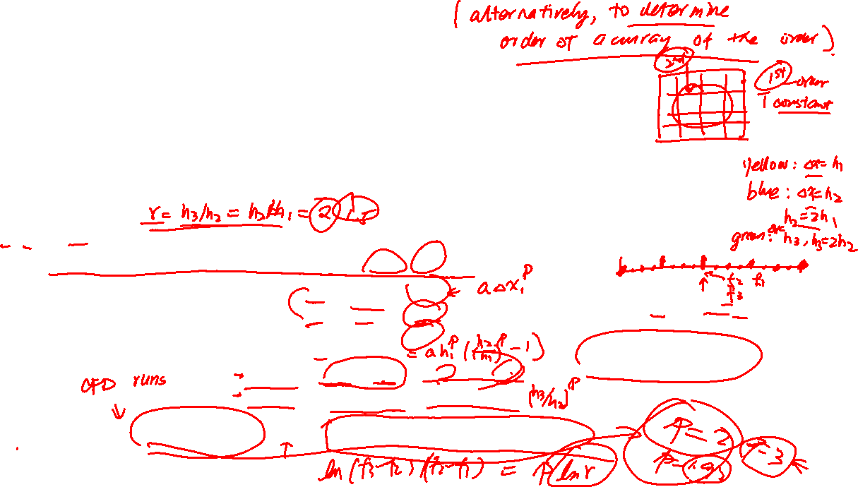
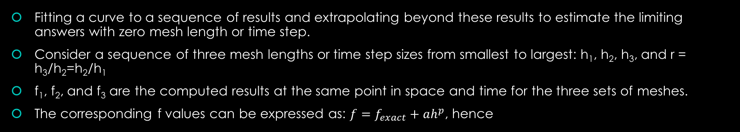


Mesh sensitivity study: Richardson Extrapolation
Fitting a curve to a sequence of results and extrapolating beyond these results to estimate the limiting answers with zero mesh length or time step.
Consider a sequence of three mesh lengths or time step sizes from smallest to largest: h₁, h₂, h₃, and r = h₃/h₂=h₂/h₁
f₁, f₂, and f₃ are the computed results at the same point in space and time for the three sets of meshes.
The corresponding f values can be expressed as: $f=f_{exact}+ah^{p}$, hence
$$f_{1}=f_{exact}+ah_{1}^{p}$$
$$f_{2}=f_{exact}+ah_{2}^{p}$$
$$f_{3}=f_{exact}+ah_{3}^{p}$$
Given f₁, and f₂, p can be used to estimate errors on the finest mesh
Subtracting the equations in pairs
$$f_{2}−f_{1}=ah_{2}^{p}−ah_{1}^{p}=a\left(r^{p}−1\right)h_{1}^{p}$$
$$f_{3}−f_{2}=ah_{3}^{p}−ah_{2}^{p}=a\left(r^{p}−1\right)h_{2}^{p}$$
${(f}_{3}−f_{2})/(f_{2}−f_{1})=r^{p}$ or ${p=ln⁡((f}_{3}−f_{2})/(f_{2}−f_{1}))/ln⁡(r)$

Slide 5
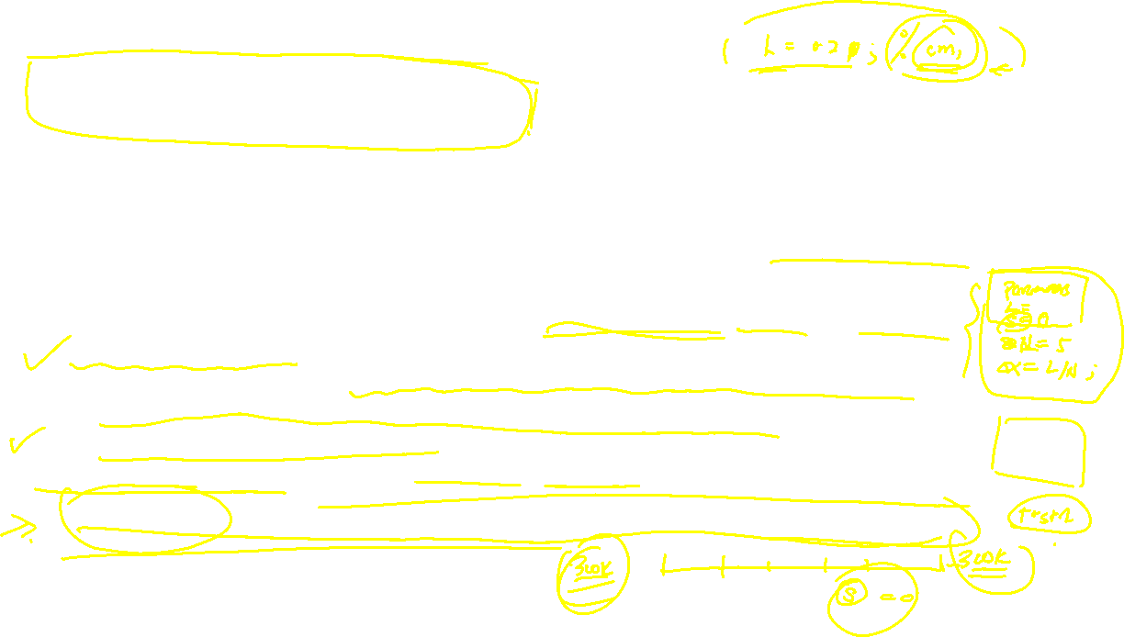
Programming errors
Programming errors occur regardless of programming practices-> test procedures must be in place to minimize the number of bugs that survive for any significant time
Three components of quality assurance are: documentation, testing and review.
Basic documentation should also include a clear written description of the model’s software implementation. More time should be spent documentating flow of data, revisions to data structures, and definitions of important variables.
A test plan should be constructed. A careful explanation is provided of a set of test problems that clearly exercise all new and revised programming.
Version control is important to keep track of the changes: check github.uconn.edu

Slide 6


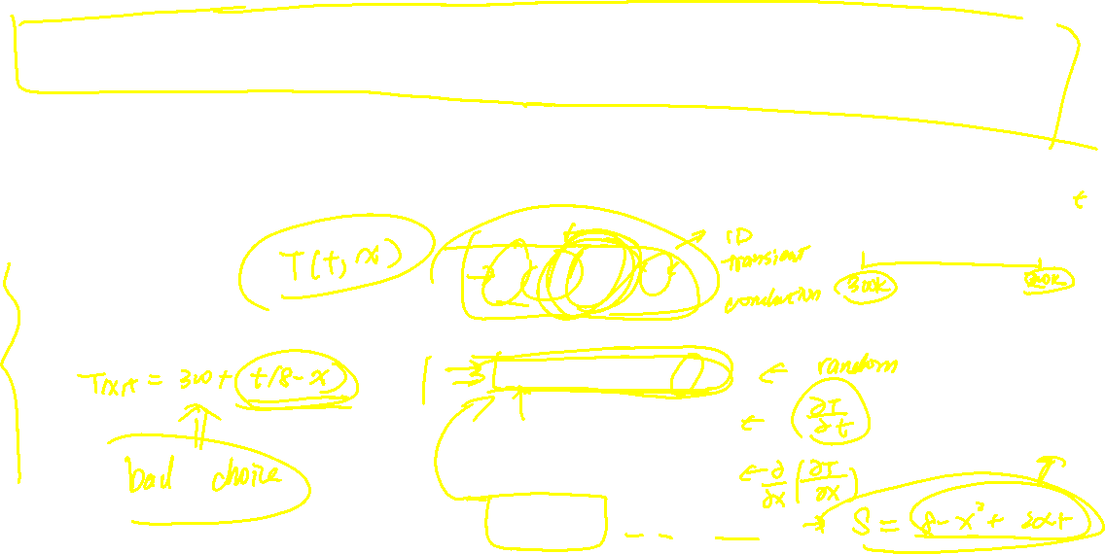
Method of manufactured solutions (MMS)
A way to verify coding and start with the basic PDF in the mathematical model for the problem at hand.
$$\frac{∂T}{∂t}−α\frac{∂^{2}T}{∂x^{2}}=S$$
Next, construct a solution T(x,t) that you like and run it through the differential operators:
T(x,t) = 300+t(8-x²)
$$\frac{∂T}{∂t}=$$
$$\frac{∂^{2}T}{∂x^{2}}=$$
$$\frac{∂T}{∂t}−α\frac{∂^{2}T}{∂x^{2}}=$$
Set S to be ($8−x^{2}+2αt$ ), and declare initial conditions to be T(x,0)=300 and boundary conditions to be T(3,t)=300 and T(-3,t)=300, your existing CFD code for the unsteady diffusion problem should be able to solve for it, and you will know the exact answer.

Slide 7
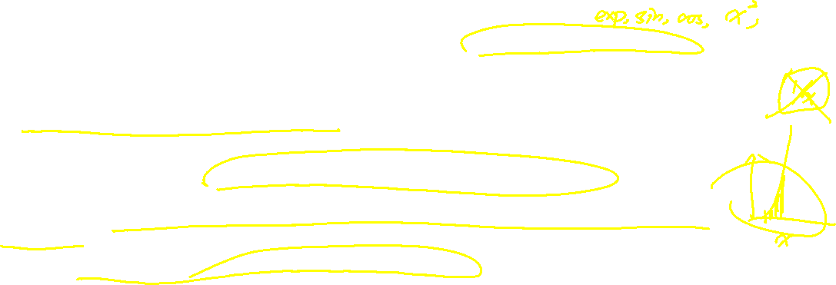
Method of manufactured solutions (MMS)
The manufactured solution should be assembled using smooth analytic functions (i.e., trigonometric, exponential, or polynomial functions). This ensures that the theoretical order of accuracy can be attained and also such functions are easy to differentiate.
The solution should be general enough to exercise every term in the governing equation, including all dependent variables.
The solution should have a sufficient number of non-trivial derivatives.
The solution should not be a strongly varying function of space and time or have a singularity.
There is no requirement on physical realism or robustness. If the code contains assumptions, such as positive solution or a positive equation term, make sure the manufactured solution satisfies those assumptions.

