Slide 1
The Transported Probability Density Function Method and its Relation to the Black-Scholes-Merton Equation
Christian DiPietrantonio
ME 5311: Computational Methods to Viscous Flows
University of Connecticut | Spring 2026

Slide 2

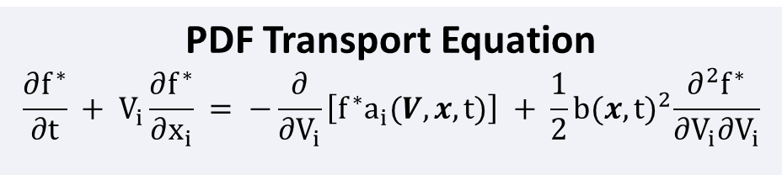
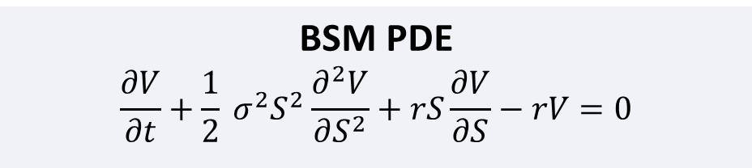
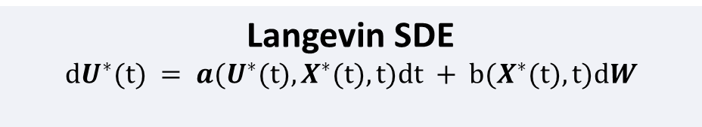
The Connection
Both equations are derived from SDEs of the same drift + diffusion form.
BSM PDE
$$\frac{∂V}{∂t}+\frac{1}{2} σ^{2}S^{2}\frac{∂^{2}V}{∂S^{2}}+rS\frac{∂V}{∂S}−rV=0$$
PDF Transport Equation
$$\frac{∂f^{∗}}{∂t} + V_{i}\frac{∂f^{∗}}{∂x_{i}} = −\frac{∂}{∂V_{i}}\left[f^{∗}a_{i}(V, x, t)\right] + \frac{1}{2}b{(x, t)}^{2}\frac{∂^{2}f^{∗}}{∂V_{i}∂V_{i}}$$
Stock Price SDE
$$dS = rSdt + σSdW$$
Langevin SDE
$$dU^{∗}(t) = a(U^{∗}(t), X^{∗}(t), t)dt + b(X^{∗}(t), t)dW$$
Finance (GBM / BSM) | CFD (Langevin / Fokker-Planck)
Stock price, S | Particle velocity, U*
Risk-free rate, r | Drift coefficient, a
Volatility, σ | Diffusion coefficient, b
Wiener process, dW | Vector-valued Wiener process, dW
Monte Carlo simulation | Lagrangian particle method
Notes:
On the left, we have the BSM PDE and on the right we have the PDF transport equation. (We can note that the BSM PDE is of the same form as many transport equations we have worked with this term.)
The key point is that both equations are derived from SDEs of the same drift + difusion form (deterministic drift + random fluctuations driven by a Wiener process). Both equations can also be derived using Ito's Lemma and stochastic calculus.
One key distinction that should be made is that the BSM equation computes the conditional expectation of a future payoff given the current state, then discounts it back to give the current option price. In other words, for BSM, you use the PDF at expiry to find the expected payoff, then discount it back to today (this is done implicitly with the SDE hedging described previously, but later we show how this is done explicitly with a Monte Carlo simulation).
One thing to note is that the drift and diffusion coefficients are constant for the Brownian Motion SDE, but depend on the particles current position and velocity for the Langevin equation. We will return to this later.

Slide 3
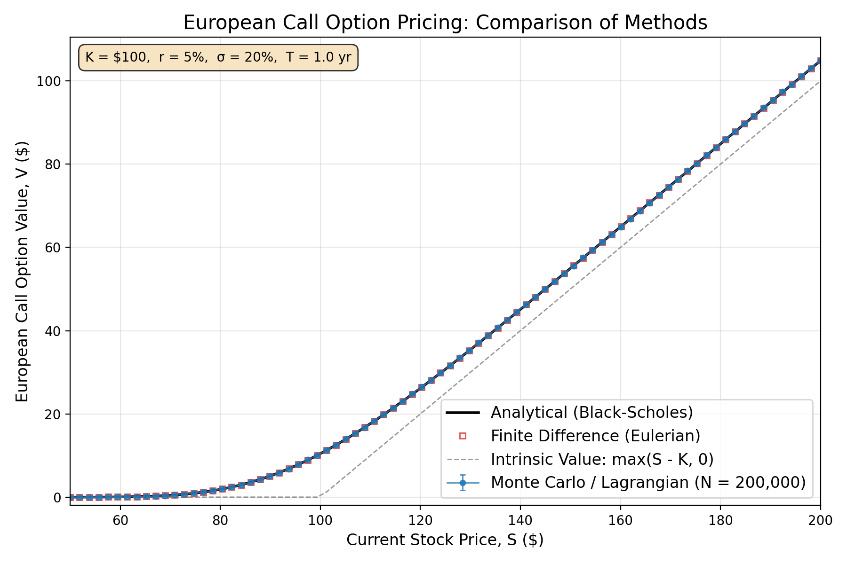
Results: Option Pricing
Analytical (Black-Scholes), Finite Difference (Eulerian), and Monte Carlo (Lagrangian) solution methods produce identical option values.
Notes:
To explore the different solution methods, I decided to write a python script to compare the two mentioned above for the BSM equation. The plot shows the option value for a European call versus stock prices.
The Eulerian approach solves the PDE directly on a fixed grid using implicit finite difference scheme, and second order central difference stencils for the first and second derivative terms. Doing so resulted in a tridiagonal system that was extremely similar to what we saw in Project 01 and Flip Classroom Exercise 01. This idea was inspired by Professor Zhao provided me with a repository for OpenFoam (more specifically finacialFoam), which executes solves the BSM equation using FVM.
The Lagrangian approach simulated 200,000 random stock price trajectories (GBM paths) for 80 stock prices between $50 and $200 using a Monte Carlo simulation, averaged the payoffs, and discounted them, back to present day value.

Slide 4
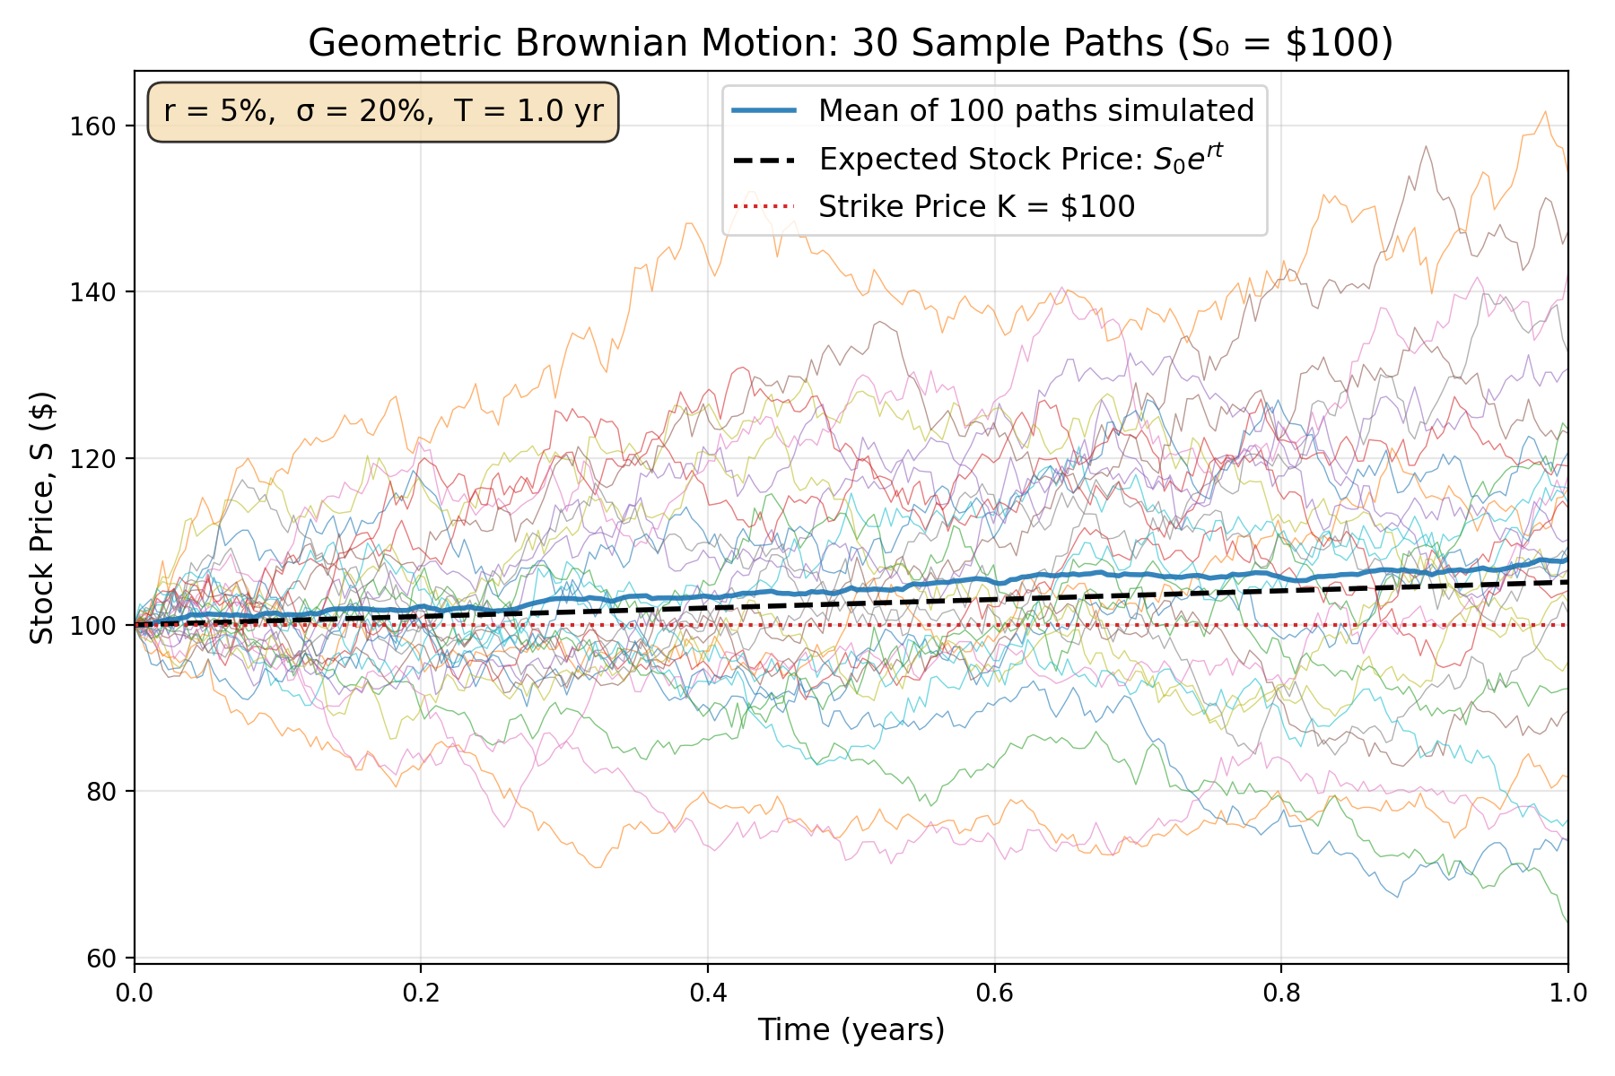
Results: Monte Carlo Visualization
Notes:
Here we can see an example of 30 paths sampled from 100 simulated paths, along with the mean and expected price.
We can now extract data from the full Monte Carlo analysis to construct the transport of the PDF of the stock price

Slide 5
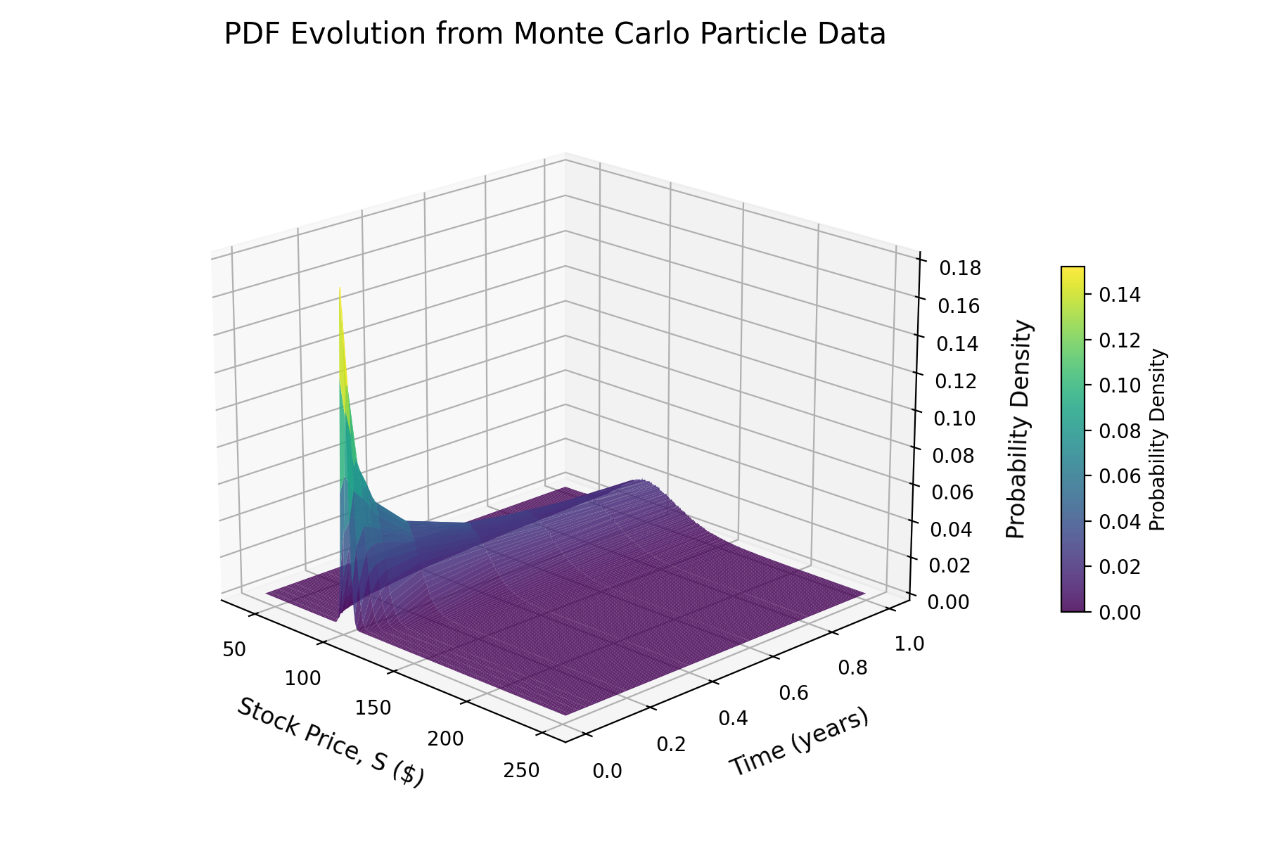
Results: PDF Transport
Notes:
Here is a 3D surface resembling the transport of the PDF of the stock price (constructed entirely from Monte Carlo particle data).
This is exactly how one can imagine the transported PDF method for a turbulent flow.

Slide 6
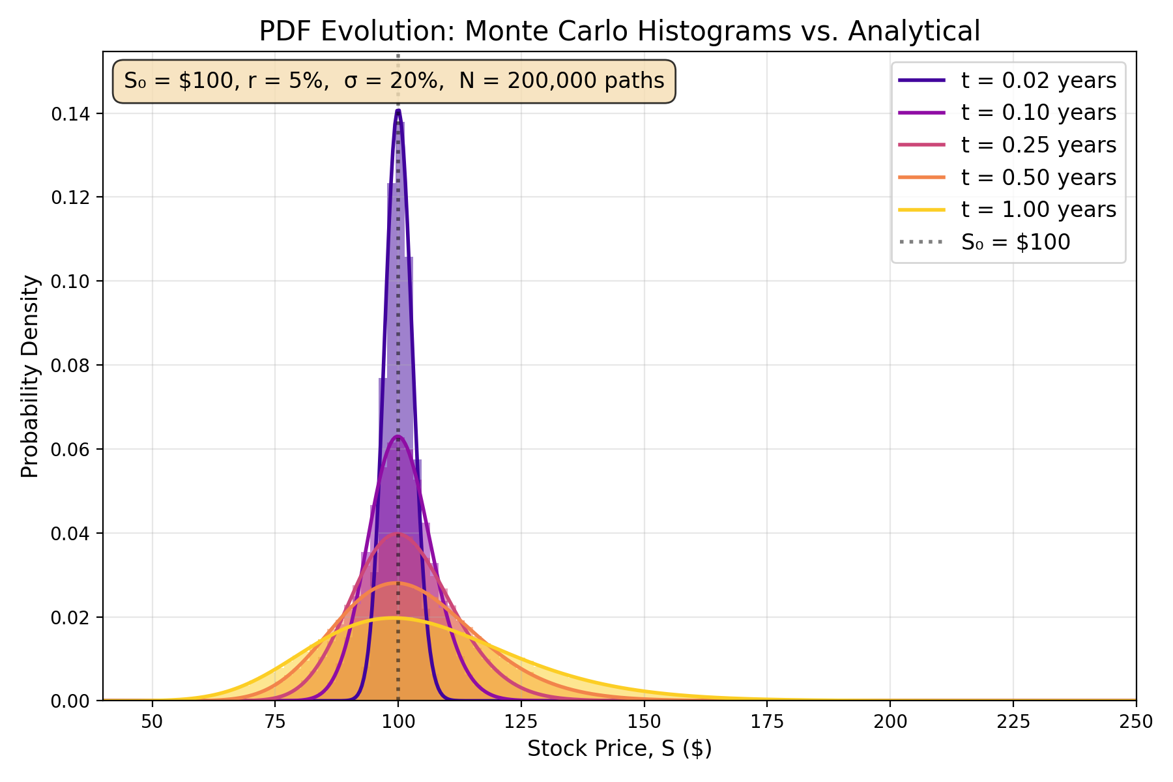
Results: PDF Transport
Notes:
This plot was created to help us visualize those concepts of drift and diffusion.
The shaded bars are pdfs constructed from Monte Carlo data plotted as histograms, and the solid curves are the exact analytical log-normal PDFs. Over time, the volatility spreads the distribution of possible stock prices, and the drift shifts it to the right.
The can conceptualize this for a turbulent flow, where drift can be thought of as where the average velocity tends to go, and diffusion as how strongly turbulence randomizes the velocity around the mean
The should note that Hull uses Ito's Lemma to show that, for our GBM model, the price of a stock at a given time follows a lognormal distribution. Therefore, we can use the standard equation for the probability density function of a lognormal variable. For the Langevin SDE, because the coefficients vary with respect to particle velocity/position and time, we don’t have this luxury, so we must construct the PDFs for given time steps using the data from the Monte Carlo simulation.

Slide 7
Conclusions
1.
The Black-Scholes-Merton PDE and the Fokker-Planck equation (forward Kolmogorov) are both derived from SDEs of the same drift-diffusion form, establishing a direct mathematical connection between financial derivative pricing and the transported PDF method in CFD.
2.
Both Eulerian (finite difference/finite volume) and Lagrangian (Monte Carlo/particle) methods produce results consistent with each other and with analytical solutions.
3.
Monte Carlo particle simulations can reproduce the results obtained from analytical probability density functions.
4.
The Black-Scholes-Merton equation can serve as a validation problem for Lagrangian particle methods because closed-form solutions exist for both the SDE and the PDF.
5.
Advancements in financial modeling and computational fluid dynamics are mutually beneficial.
Notes:
Finally, to recap what we discussed:
The BSM the Fokker-Planck (forward Kolmogorov equation) are both derived from SDEs of the same form. This directly connects financial derivative pricing to the transported PDF method in CFD.
- Second, the same results (validated against the exact analytical formula) can be obtained from both Eulerian and Lagrangian methods as demonstrated with the BSM equation.
Third, Monte Carlo particle simulations reproduce the analytical PDF
Fourth, BSM is actually a great validation problem because closed-form solutions exist for both the SDE and the PDF. In turbulent flows, these may not exist, which is why particle methods become essential.
Finally, Advancements in financial modeling and computational fluid dynamics are mutually beneficial. Numerical methods/variance reduction can transfer directly between CFD and quantitative finance, so techniques/methods developed in either discipline can be utilized by/applied to problems in the other.
One other thing we should note is although I did use a Eulerian solution method for demonstration here, Professor Zhao (and Pope) mention that this isnt really feasible for high dimensional Joint PDFs.
Thank you!

Slide 8
References
[1] Black, F. & Scholes, M. (1973). "The pricing of options and corporate liabilities." Journal of Political Economy, 81(3), 637–654.
[2] Merton, R.C. (1973). "Theory of rational option pricing." Bell Journal of Economics and Management Science, 4(1), 141–183.
[3] Hull, J.C. (2022). Options, Futures, and Other Derivatives, 10th ed. Pearson.
[4] Shreve, S.E. (2004). Stochastic Calculus for Finance II: Continuous-Time Models. Springer.
[5] Pope, S.B. (2000). Turbulent Flows. Cambridge University Press.
[6] Baxter, M. & Rennie, A. (1996). Financial Calculus: An Introduction to Derivative Pricing. Cambridge University Press.
[7] Montgomery, D.C., Runger, G.C., & Hubele, N.F. (2011). Engineering Statistics, 5th ed. Wiley.

Slide 9
Backup

Slide 10
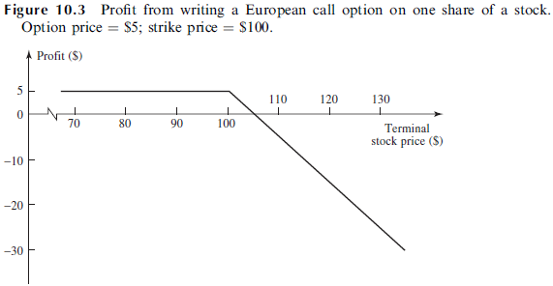
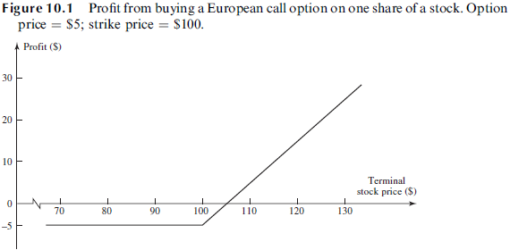

Financial Derivatives: Options
Derivatives: A financial instrument whose value depends on (or derives from) the values of other, more basic, underlying variables.
Stock Options: A derivative whose value is dependent on the price of a stock.
Call Option: Gives the holder the right, but not the obligation, to buy the underlying asset by a certain date for a certain price.
Put Option: Gives the holder the right, but not the obligation, to sell the underlying asset by a certain date for a certain price.
European Options: Can only be exercised on the expiration date.
American Options: Can be exercised at any time up to the expiration date.
Strike Price: The price at which the asset may be bought or sold in an option contract.
$$V=\max\left(S_{T}−K, 0\right)$$

Slide 11
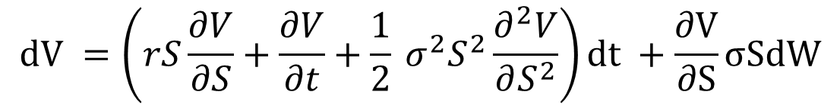

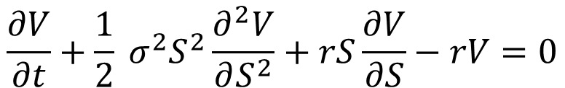
The Black-Scholes-Merton Equation
Black, Scholes (1973) and Merton (1973) independently derived the following PDE for pricing European options:
Black-Scholes-Merton PDE
$$\frac{∂V}{∂t}+\frac{1}{2} σ^{2}S^{2}\frac{∂^{2}V}{∂S^{2}}+rS\frac{∂V}{∂S}−rV=0$$
This equation can be derived from the Geometric Brownian Motion SDE for stock prices:
$$dS = rSdt + σSdW$$
V = option value S = stock price r = risk-free rate σ = volatility dW = Wiener process
Itô’s Lemma:
$$dV =\left(rS\frac{∂V}{∂S}+\frac{∂V}{∂t}+\frac{1}{2} σ^{2}S^{2}\frac{∂^{2}V}{∂S^{2}}\right)dt +\frac{∂V}{∂S}σSdW$$

Slide 12
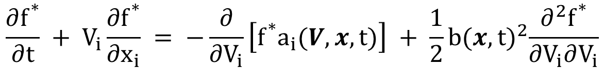

The Transported PDF Method
In a turbulent flow, the velocity field $U(x, t)$ is random (Pope, 2000). The exact transport equation for the Eulerian PDF of the velocity, $f(V; x, t),$ derived from the Navier-Stokes equations is expressed as
$$\frac{∂f}{∂t}+V_{i}+\frac{∂f}{∂x_{i}}=−\frac{∂}{∂V_{i}}\left[f \left\langle \frac{DU_{i}}{Dt} | V\right\rangle \right]$$
The equation for the evolution of the conditional PDF of the particle velocity $f^{∗}(V|x;t)$ is expressed as:
$$\frac{∂f^{∗}}{∂t} + V_{i}\frac{∂f^{∗}}{∂x_{i}} = −\frac{∂}{∂V_{i}}\left[f^{∗}a_{i}(V, x, t)\right] + \frac{1}{2}b{(x, t)}^{2}\frac{∂^{2}f^{∗}}{∂V_{i}∂V_{i}}$$
Which can be derived from the following stochastic differential equation for a generalized Langevin Model using Itô Calculus
$$dU^{∗}(t) = a(U^{∗}(t), X^{∗}(t), t)dt + b(X^{∗}(t), t)dW$$
a(U*(t), X*(t), t) = drift coefficient b(X*(t), t) = diffusion coefficient dW = Vector Valued Wiener process

Slide 13
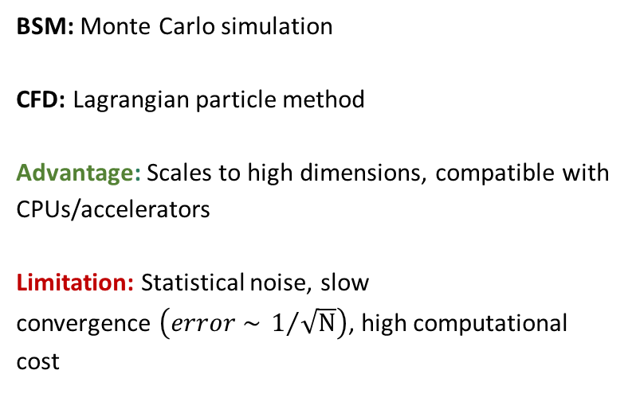
Solution Methods
Eulerian (Grid-Based)
Lagrangian (Particle-Based)
Solve the PDE directly on a fixed grid
Simulate random trajectories
Methods: Finite Volume, Finite Difference, Finite element
Advantage: No statistical noise
Limitation: Scales poorly to high dimensions
BSM: Monte Carlo simulation
CFD: Lagrangian particle method
Advantage: Scales to high dimensions, compatible with CPUs/accelerators
Limitation: Statistical noise, slow
convergence $\left(error \sim 1/{\sqrt{N}}\right)$, high computational cost

Slide 14
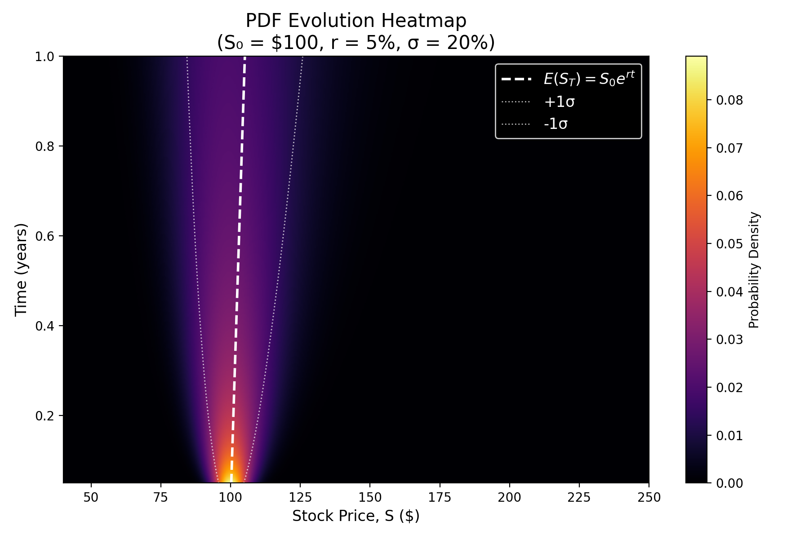
Results: PDF Transport

Slide 15
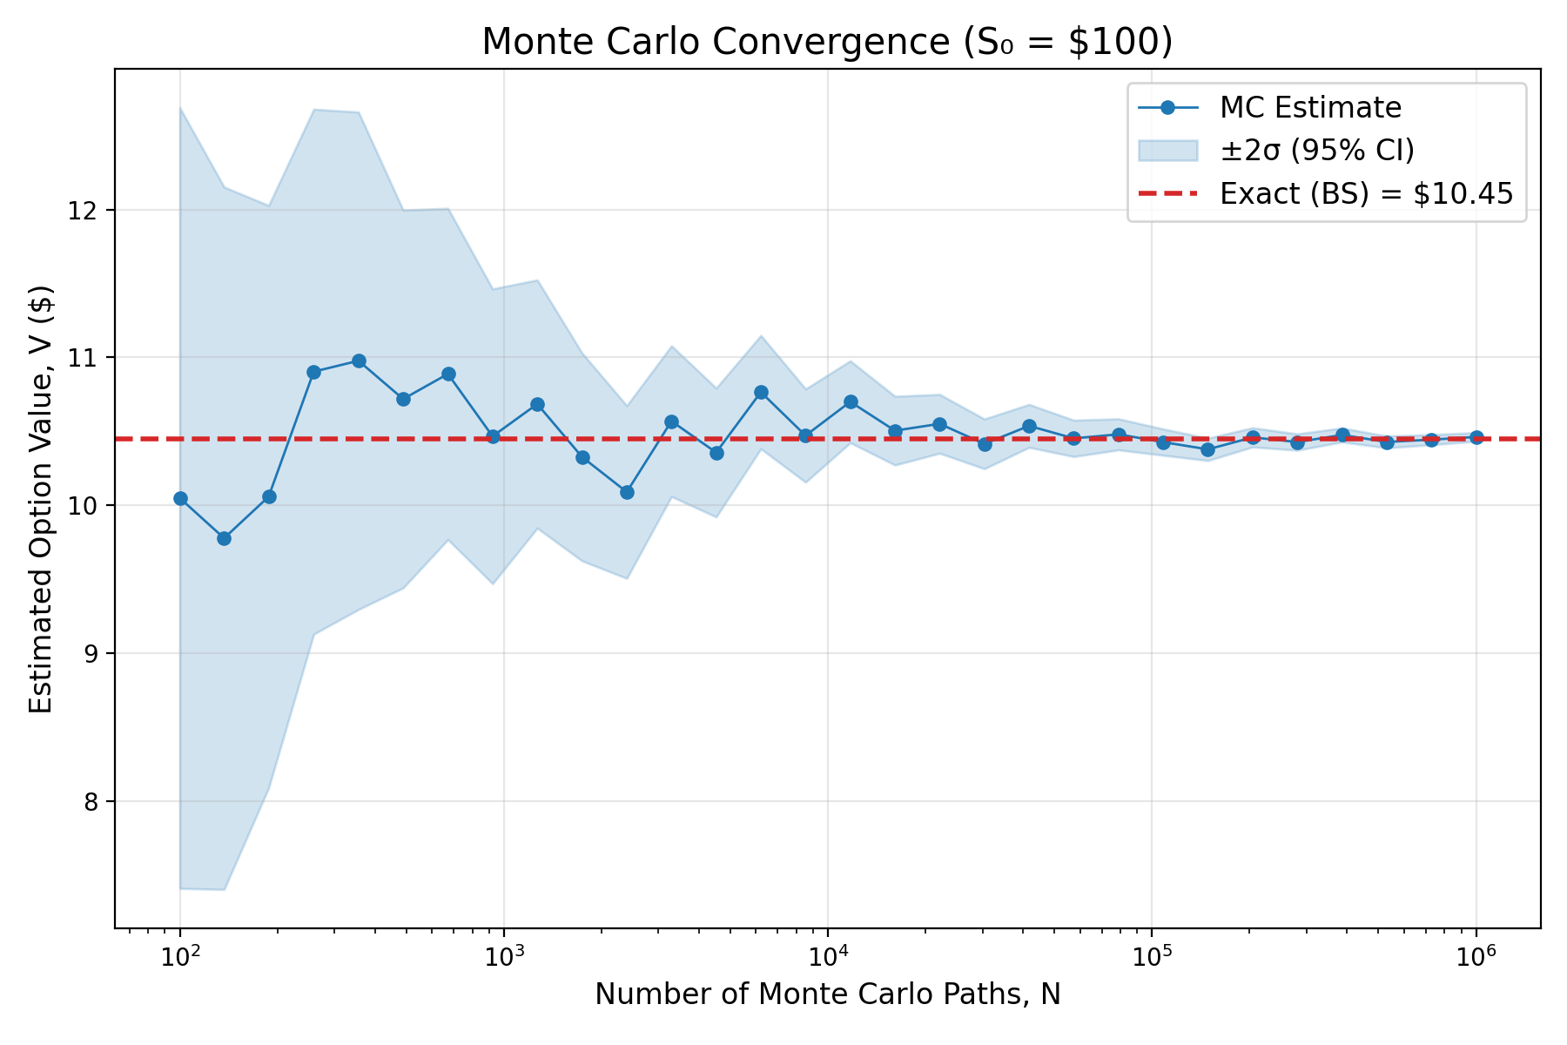
Monte Carlo Convergence

