Slide 1
Principles of Dimensional Modeling

Slide 2
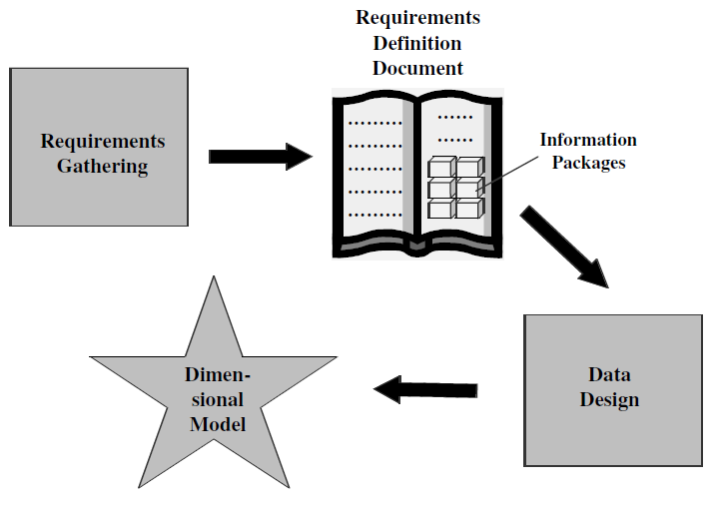
Requirements to Design

Slide 3
Dimensional analysis
Data will be collected in terms of
  Dimensions
  Hierarchies
  Facts or measures
And presented using Information Package Diagrams (IPD)

Slide 4
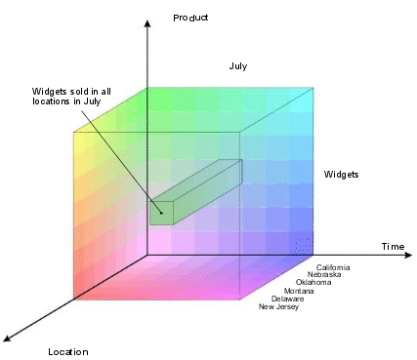
Business Dimensions

Slide 5
Retail chain
Time dimension
  Monthly sales of a product
  Units sold when a discount was offered
Product dimension
  Sales of different products
Clerk dimension
  Efficiency of the salesman by the amount of sales
Store dimension
  Sales of a product at various stores
  Customer Dimension
  Promotion Dimension

Slide 6
Student performance
Time dimension
  Student performance on weekly, monthly, yearly basis
Semester dimension
  Analyses performance of every semester
Subject dimension
  Show student performance subject-wise

Slide 7
Manufacturing company
Time dimension
  Monthly/ quarterly/ yearly report
Ship-from/ ship-to
  Maximum products shipped from/to which locale
Product
  Sales of different products
Ship mode
  Sales of products on basis of the mode of shipment

Slide 8
Airlines business
Time dimension
Flight dimension
Customer dimension
Timings dimension
Airport dimension
Fare class dimension
Definition

Slide 9
Hierarchies
Paths for drilling down or rolling up while analysing data at various levels of detail.
  E.g., time dimension has hierarchy starting from a single day going up to entire year.
Every dimension is organised into a hierarchy of levels, corresponding to data at different levels of granularity.
When level l₁ < l₂, we say l₁ rolls up to l₂. (lowest level being the most detailed)

Slide 10
Metrics or Facts
The requirements must represent two key elements
  what should be analysed (dimensions)
  evaluation criteria (measures)
The numbers that the users analyse are the measurements, facts or metrics that measure the business.
E.g., for a retail chain, metrics for analysing can be actual sales, forecast sales, price, discount etc

Slide 11
ER Model v/s Dimension Model
ER diagram is a complex diagram, used to represent multiple processes. A single ER diagram can be broken down into several DM diagrams.
In DM, we prefer keeping the tables de-normalized, whereas in a ER diagram, our main aim is to remove redundancy
ER model is designed to express microscopic relationships between elements. DM captures the business measures
DM is designed to answer queries on business process, whereas the ER model is designed to record the business processes via their transactions.
ER Modeling | Dimensional Modeling
The Transaction Processing Model | The data warehousing model
Optimize update | Optimized for retrieval
Minimize data redundancy | Maximize understandability

Slide 12
The star schema
Data Modeling Technique to map multidimensional decision support data into a relational database
4 Components
  Dimensions
  Facts
  Attributes
  Attribute Hierarchies

Slide 13
Dimensions
Qualifying characteristics that provide additional perspectives to a given fact
  DSS data is almost always viewed in relation to other data
Dimensions are normally stored in dimension tables

Slide 14
Dimension table
Contain information about a particular dimension.
  Dimension table key
  Textual attributes
  Attributes not directly related
  Not normalized
  Drilling down, rolling up
  Multiple hierarchies
  Fewer number of records

Slide 15
Facts
Numeric measurements (values) that represent a specific business aspect or activity
Stored in a fact table at the center of the star scheme
Contains facts that are linked through their dimensions
Can be computed or derived at run time
Updated periodically with data from operational databases

Slide 16
Fact table
Contains primary information of the warehouse
  Concatenated key
  Data grain
  Fully additive measures
  Semi-additive measures
  Table deep, not wide
  Sparse data
  Degenerate dimensions

Slide 17
Attributes
Dimension Tables contain Attributes
Attributes are used to search, filter, or classify facts
Dimensions provide descriptive characteristics about the facts through their attributes
Must define common business attributes that will be used to narrow a search, group information, or describe dimensions. (ex.: Time / Location / Product)
No mathematical limit to the number of dimensions (3-D makes it easy to model)

Slide 18
Attribute Hierarchies
Provides a Top-Down data organization
  Aggregation
  Drill-down / Roll-Up data analysis
Attributes from different dimensions can be grouped to form a hierarchy

Slide 19
DIMENSONAL
MODEL
PRODUCT
product_key (PK)
SKU
description
brand
category
TIME
time_key (PK)
SQL_date
day_of_week
month
FACT
time_key (FK)
store_key (FK)
clerk_key (FK)
product_key (FK)
customer_key (FK)
promotion_key (FK)
dollars_sold
units_sold
dollars_cost
STORE
store_key (PK)
store_ID
store_name
address
district
floor_type
CUSTOMER
customer_key (PK)
customer_name
purchase_profile
credit_profile
address
CLERK
clerk_key (PK)
clerk_id
clerk_name
clerk_grade
PROMOTION
promotion_key (PK)
promotion_name
price_type
ad_type

Slide 20
Star schema for a retail chain
Time Dimension Table
Time key
Year
Quarter
Month
Week
Date
Sales Fact Table
Time key
Product key
Customer key
Store key
Mode key
Actual sales
Unit Sales
Actual Bill Price
Discount
Customer Dimension Table
Customer key
Name
Age
Income
Gender
Marital status
Store Dimension Table
Store key
Name
City
State
Op from year
Product Dimension Table
Product key
Name
Brand
Category
Colour
Price
Payment Mode Dimension Table
Mode key
Payment mode
Interest rate

Slide 21
Star Schema characteristics
Star schema is a relational model with one-to-many relationship between the fact table and the dimension tables.
De-normalized relational model
Easy to understand. Reflects how users think. This makes it easy for them to query and analyse the data.
Optimizes navigation.
Enhances query extraction.
Ability to drill down or roll up.

Slide 22
Snowflake schema
A variation of the star schema, in which all or some of the dimension tables may be normalized.
Eliminates redundancy
Generally used when a dimension table is wide.
Saves space
Complex querying is required.

Slide 23
Snowflake schema
Sales Fact Table
Time key
Product key
Customer key
Store key
Mode key
Actual sales
Forecast sales
Price
Discount
Customer Dimension Table
Customer key
Name
Age
Income
Gender
Marital status
Time Dimension Table
Time key
Year
Quarter
Month
Week
Date
Salesperson Dimension Table
Salesperson key
Name
City key
Category dimension table
Category key
Category name
Product Dimension Table
Product key
Name
Brand key
Category
Colour
Price
Payment Mode Dimension Table
Mode key
Payment mode
Interest rate
Brand dimension table
Brand key
Brand name
Category key
City dimension table
City key
City name

Slide 24
Slowly Changing Dimensions
(Addresses, Managers, etc.)
Type 1: Store only the current value
Type 2: Create a dimension record for each value (with or without date stamps)
Type 3: Create an attribute in the dimension record for previous value

