Slide 1
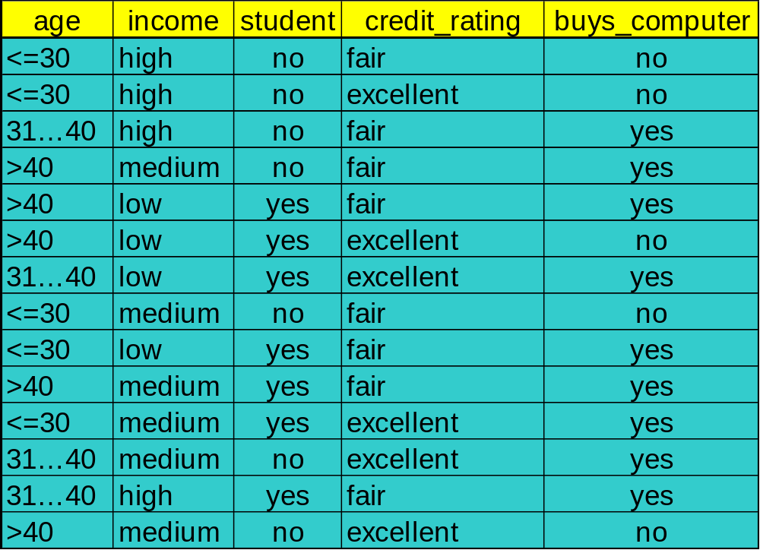
Decision Tree Induction: Training Dataset
This follows an example of Quinlan’s ID3 (Playing Tennis)

Slide 2






Attribute Selection: Information Gain
Class P: buys_computer = “yes”
Class N: buys_computer = “no”
means “age <=30” has 5 out of 14 samples, with 2 yes’es and 3 no’s. Hence
Similarly,

Slide 3
Output: A Decision Tree for “buys_computer”
age?
<=30
overcast
>40
31..40
student?
yes
credit rating?
no
yes
excellent
fair
no
yes
no
yes

