Slide 1
Introduction to Data Mining

Slide 2
Introduction
Data is produced at a phenomenal rate
Our ability to store has grown
Users expect more sophisticated information
How?
UNCOVER HIDDEN INFORMATION
DATA MINING

Slide 3
Applications of Data Mining
Gaming
Business
CRM
Market Basket Analysis
Decision Making

Slide 4
Few More….
Science and Engineering: bioinformatics, genetics, medicine, education and electrical power engineering
Human Rights: Government Records
Sensor Data Mining: Ex: air pollution monitoring
Music data mining: to discover relevant similarities among music corpora (radio lists, CD databases) for the purpose of classifying music into genres in a more objective manner

Slide 5
Data Mining
Objective: Fit data to a model
Potential Result: Higher-level meta information that may not be obvious when looking at raw data
Similar terms
Exploratory data analysis
Data driven discovery
Deductive learning

Slide 6
Data Mining Algorithm
Objective: Fit Data to a Model
Descriptive
Predictive
Preferential Questions
Which technique to choose?
Classification/Clustering
Answer: Depends on what you want to do with data?
Search Strategy – Technique to search the data
Interface? Query Language?
Efficiency

Slide 7
Database Processing vs. Data Mining Processing
Query
Well defined
SQL
Query
Poorly defined
No precise query language
Output
Fuzzy
Not a subset of database
Output
Precise
Subset of database

Slide 8
Query Examples
Database
Data Mining
Find all credit applicants with last name of Smith.
Identify customers who have purchased more than $10,000 in the last month.
Find all customers who have purchased milk
Find all credit applicants who are poor credit risks. (classification)
Identify customers with similar buying habits. (Clustering)
Find all items which are frequently purchased with milk. (association rules)

Slide 9
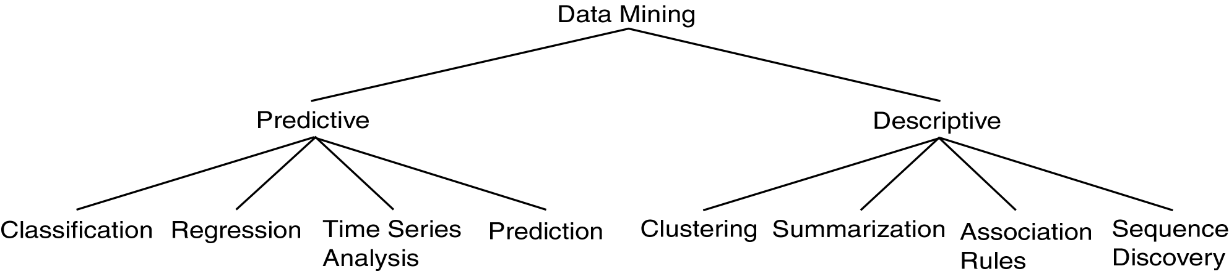
Data Mining Models and Tasks

Slide 10
Basic Data Mining Tasks
Classification maps data into predefined groups or classes
Supervised learning
Pattern recognition
Prediction
Ex: Credit Card

Slide 11
Regression is used to map a data item to a real valued prediction variable.
Ex: Investing based on income
Clustering groups similar data together into clusters.
Unsupervised learning
Segmentation
Partitioning
Ex: Grouping Customers

Slide 12
Basic Data Mining Tasks (cont’d)
Summarization maps data into subsets with associated simple descriptions.
Characterization
Generalization
Link Analysis uncovers relationships among data.
Affinity Analysis
Association Rules
Sequential Analysis determines sequential patterns.
Ex: Web Pages

Slide 13
Time Series Analysis
Example: Stock Market
Predict future values
Determine similar patterns over time
Classify behavior

Slide 14
Data Mining Development
Relational Data Model
SQL
Association Rule Algorithms
Data Warehousing
Scalability Techniques
Similarity Measures
Hierarchical Clustering
IR Systems
Imprecise Queries
Textual Data
Web Search Engines
DATA MINING
Bayes Theorem
Regression Analysis
EM Algorithm
K-Means Clustering
Time Series Analysis
Algorithm Design Techniques
Algorithm Analysis
Data Structures
Neural Networks
Decision Tree Algorithms
HIGH PERFORMANCE

Slide 15
Data Mining Metrics
Usefulness
Return on Investment (ROI)
Accuracy
Space/Time

Slide 16
Data Mining vs. KDD
Knowledge Discovery in Databases (KDD): process of finding useful information and patterns in data.
Data Mining: Use of algorithms to extract the information and patterns derived by the KDD process.

Slide 17
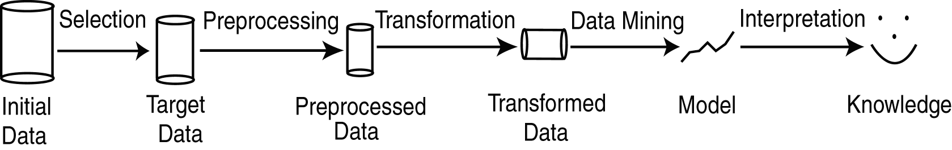
KDD Process
Selection: Obtain data from various sources.
Preprocessing: Cleanse data.
Transformation: Convert to common format. Transform to new format.
Data Mining: Obtain desired results.
Interpretation/Evaluation: Present results to user in meaningful manner.

Slide 18
KDD Issues
Human Interaction
Overfitting
Outliers
Interpretation
Visualization
Large Datasets
High Dimensionality

Slide 19
KDD Issues (cont’d)
Multimedia Data
Missing Data
Irrelevant Data
Noisy Data
Changing Data

Slide 20
Social Implications of DM
Privacy
Profiling
Unauthorized use

Slide 21
Related Concepts
Goal: Examine some areas which are related to data mining.

Slide 22
Related Concepts Outline
Database/OLTP Systems
Fuzzy Sets and Logic
Information Retrieval(Web Search Engines)
Dimensional Modeling
Data Warehousing
OLAP/DSS
Statistics
Machine Learning
Pattern Matching

Slide 23
DB & OLTP Systems
Schema
(ID,Name,Address,Salary,JobNo)
Data Model
ER
Relational
Transaction
Query:
SELECT Name
FROM T
WHERE Salary > 100000
DM: Only imprecise queries

Slide 24
Fuzzy Sets and Logic
Fuzzy Set: Set membership function is a real valued function with output in the range [0,1].
f(x): Probability x is in F.
1-f(x): Probability x is not in F.
EX:
T = {x | x is a person and x is tall}
Let f(x) be the probability that x is tall
Here f is the membership function
DM: Prediction and classification are fuzzy.

Slide 25
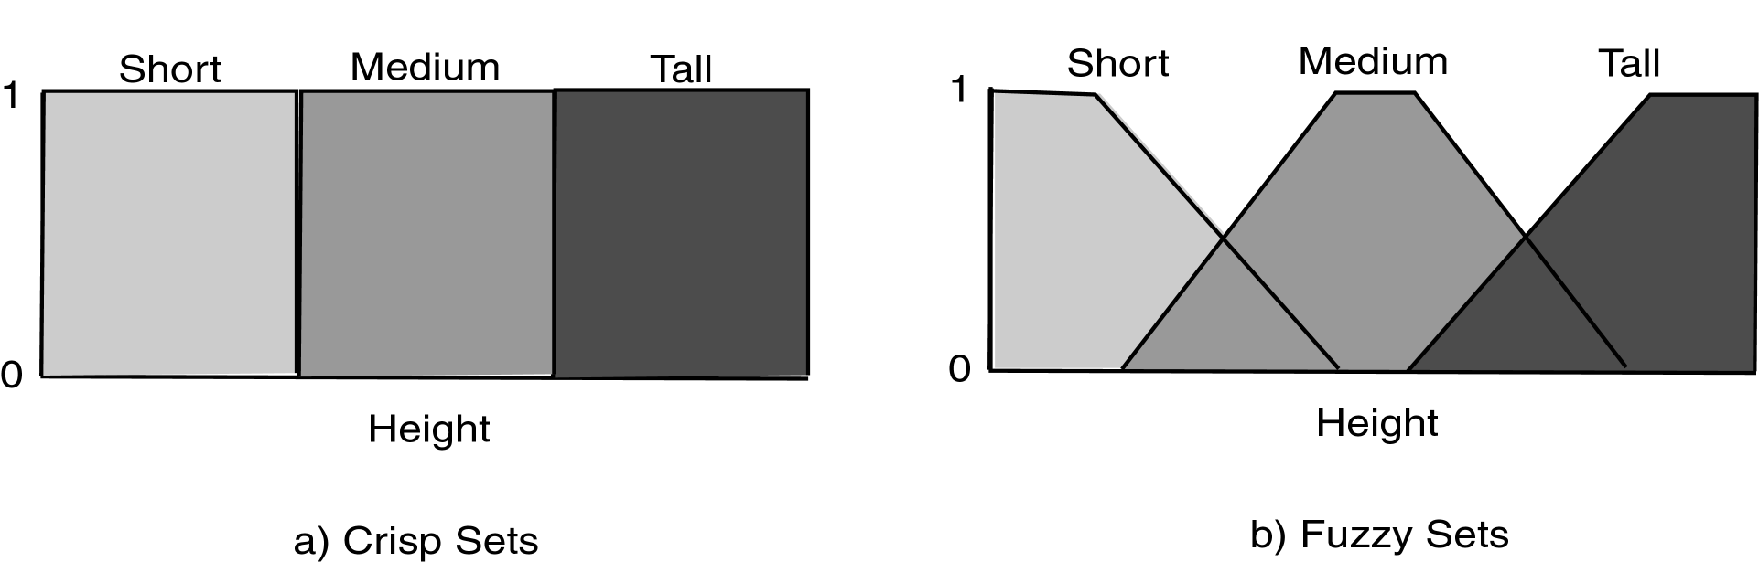
Fuzzy Sets

Slide 26
Classification/Prediction is Fuzzy
Loan
Amnt
Reject
Reject
Accept
Accept
Simple
Fuzzy

Slide 27
Information Retrieval
Information Retrieval (IR): retrieving desired information from textual data.
Library Science
Digital Libraries
Web Search Engines
Traditionally keyword based
Sample query:
Find all documents about “data mining”.
DM: Similarity measures;
Mine text/Web data.

Slide 28
Information Retrieval (cont’d)
Similarity: measure of how close a query is to a document.
Documents which are “close enough” are retrieved.
Metrics:
Precision = |Relevant and Retrieved|
|Retrieved|
Recall = |Relevant and Retrieved|
|Relevant|

Slide 29
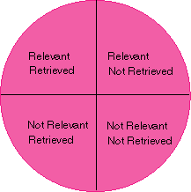
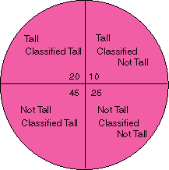
IR Query Result Measures and Classification
IR
Classification

Slide 30
Dimensional Modeling
View data in a hierarchical manner more as business executives might
Useful in decision support systems and mining
Dimension: collection of logically related attributes; axis for modeling data.
Facts: data stored
Ex: Dimensions – products, locations, date
Facts – quantity, unit price
DM: May view data as dimensional.

Slide 31
Relational View of Data

Slide 32
Dimensional Modeling Queries
Roll Up: more general dimension
Drill Down: more specific dimension
Dimension (Aggregation) Hierarchy
SQL uses aggregation
Decision Support Systems (DSS): Computer systems and tools to assist managers in making decisions and solving problems.

Slide 33
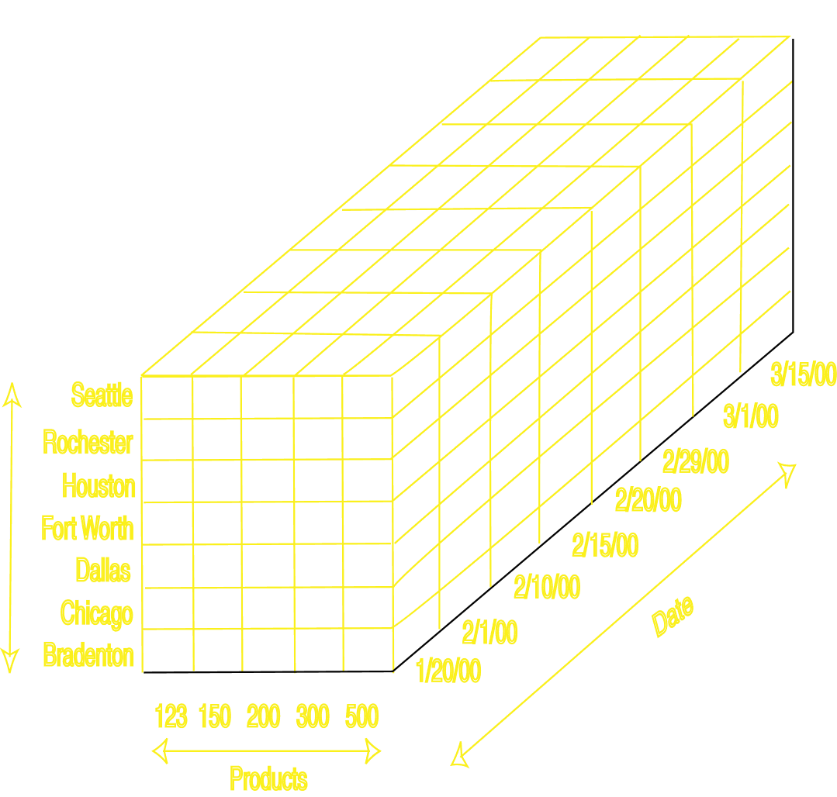
Cube view of Data

Slide 34
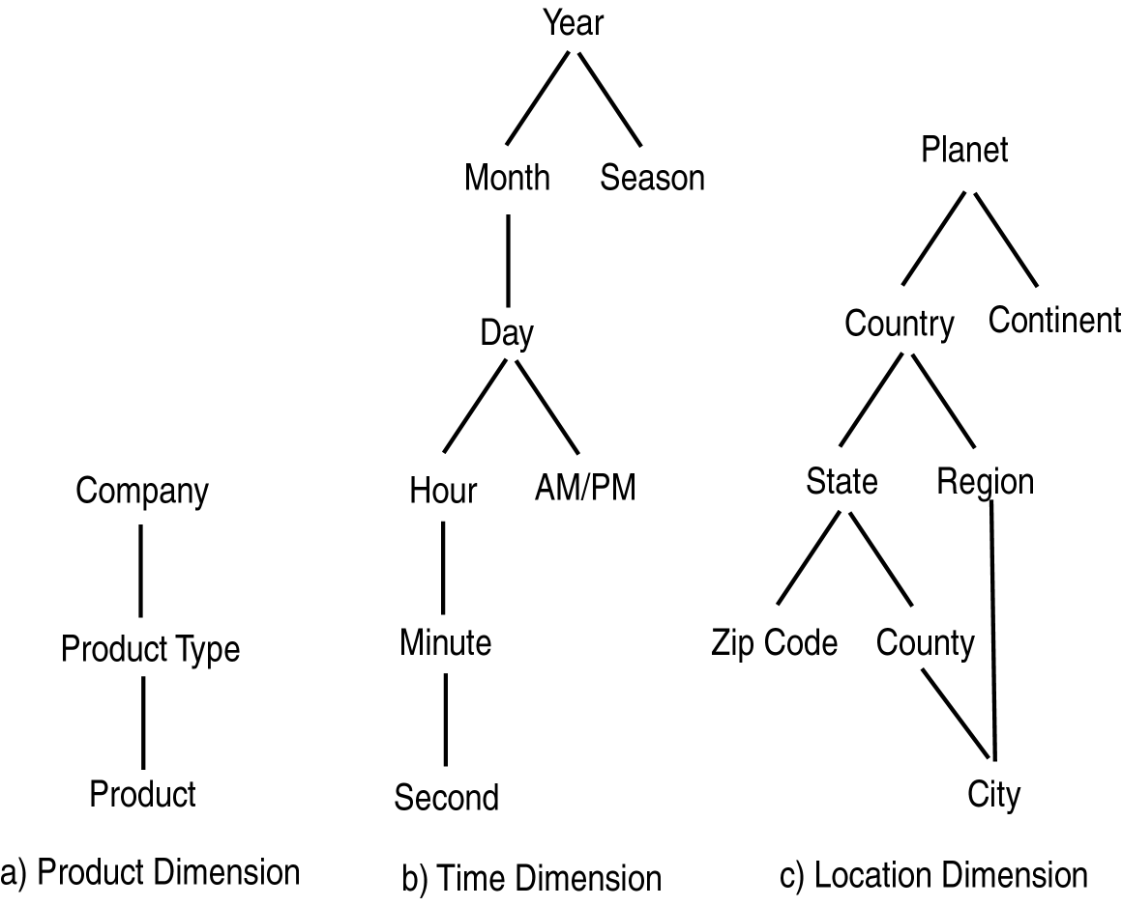
Aggregation Hierarchies

Slide 35
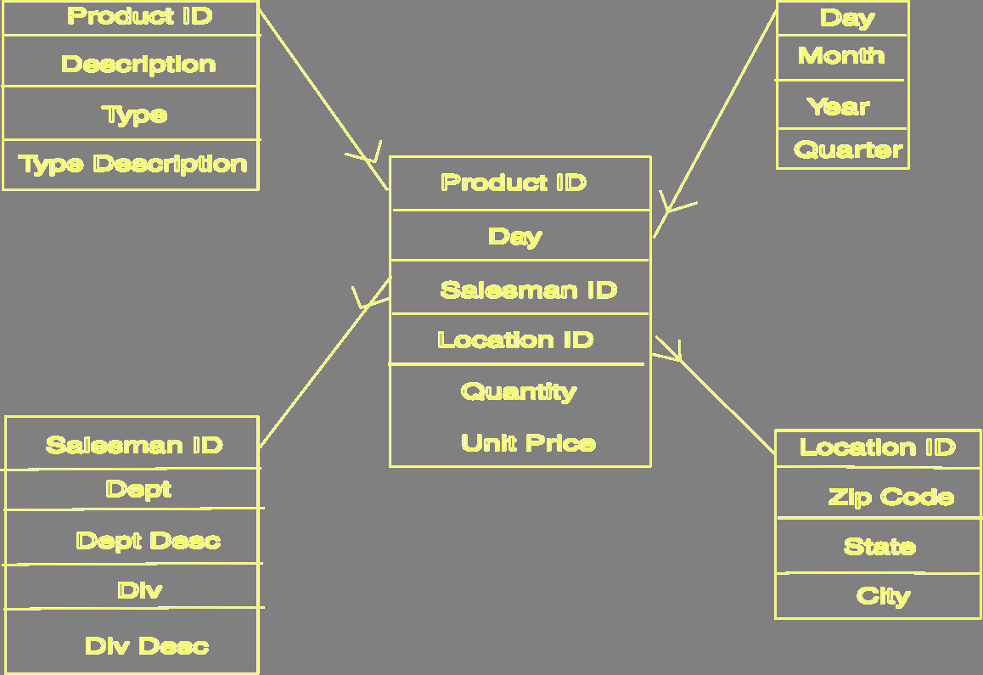
Star Schema

Slide 36
OLAP
Online Analytic Processing (OLAP): provides more complex queries than OLTP.
OnLine Transaction Processing (OLTP): traditional database/transaction processing.
Dimensional data; cube view
Visualization of operations:
Slice: examine sub-cube.
Dice: rotate cube to look at another dimension.
Roll Up/Drill Down
DM: May use OLAP queries.

Slide 37
OLAP Operations
Roll up
Drill Down
Slice
Dice

