Slide 1
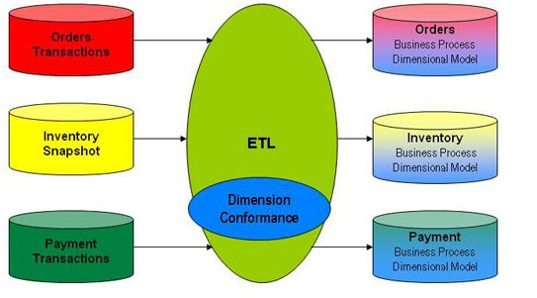

Analysis and Modeling Basics

Slide 2

Joke First, Serious Later
Consultant: So, your company is into data warehousing? How many data marts do you have?
Project Manager: Eleven.
Consultant: That’s great. But why so many?
Project Manager: Ten mistakes.

Slide 3
Preamble
OLTP and DW planning is different in term of requirements clarity
Planning DW is about solving users’ problems and providing strategic information to the user.
OLTP systems are primarily data capture systems. On the other hand, data warehouse systems are information delivery systems.
Unlike an OLTP system, which is needed to run the day-to-day business, no immediate payout is seen in a decision support system.

Slide 4
Dimensional Analysis
The users are generally unable to deﬁne their requirements clearly.
For most of the users, this could be the very ﬁrst data warehouse.
How can you build something the users are unable to deﬁne clearly and precisely?
Need different approach of requirements gathering.

Slide 5
Dimensional Analysis (cont'd)
They can tell you what measurement units are important for them, how they combine the various pieces of information for strategic decision making.
Although the actual proposed usage of a data warehouse could be unclear, the business dimensions used by the managers for decision making are not nebulous at all

Slide 6
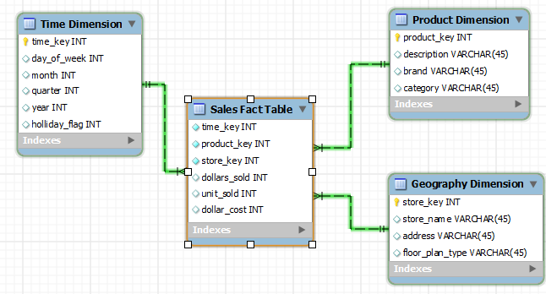
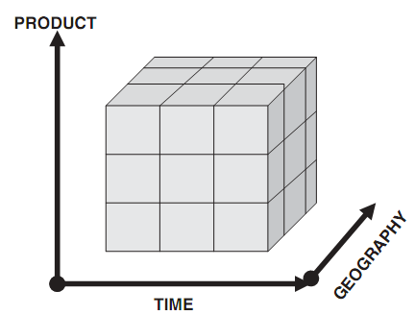
Dimensional Analysis “in Action”

Slide 7
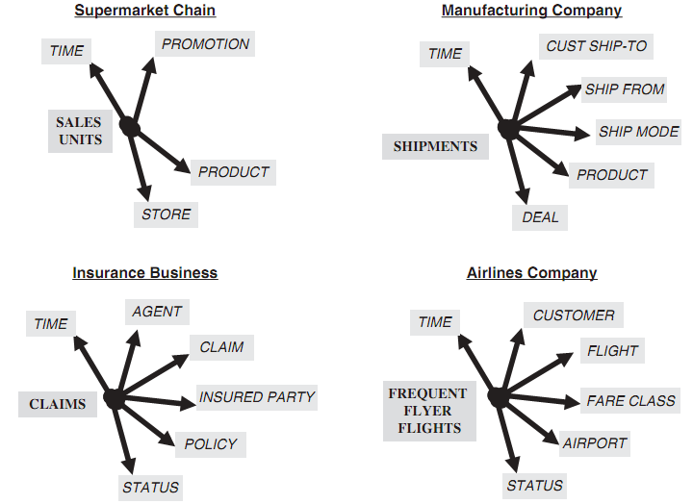
More Complex Dimensional Model

Slide 8
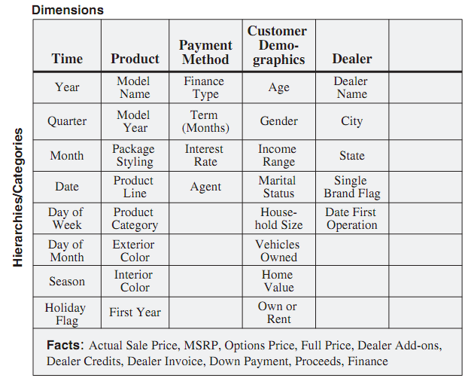
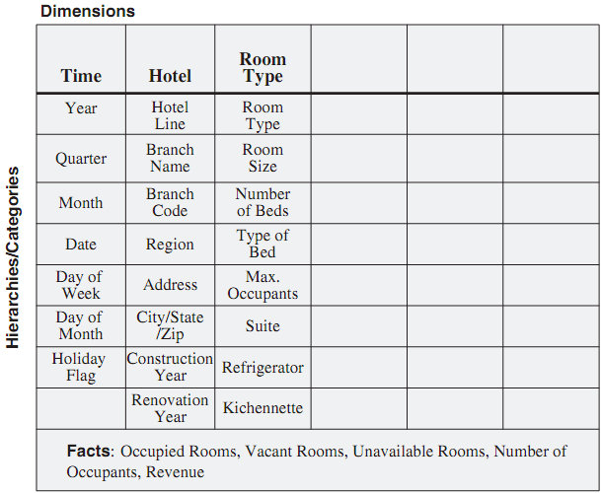
Information Packages
The business dimensions and their hierarchical levels form the basis for all further development phases.
The dimension hierarchies are the paths for drilling down or rolling up in our analysis

Slide 9

Requirements Gathering Methods
Interview
Types of Questions
Open Ended Question
These open up options for interviewees to respond
Closed Question
These allow limited responses to interviewees
Probes
These are really follow-up questions. Probes may be used after open-ended or closed questions
Questionnaires
Group Session

Slide 10

Sample Expectation from Interviews
Senior Executives
Dept. Managers
IT Dept. Professionals
Organization objectives
Criteria for measuring success
Key business issues, current & future
Problem identification
Vision and direction for the organization
Anticipated usage of the DW
Departmental objectives
Success metrics
Factors limiting success
Key business issues
Products & Services
Useful business dimensions for analysis
Anticipated usage of the DW
Key operational source systems
Current information delivery processes
Types of routine analysis
Known quality issues
Current IT support for information requests
Concerns about proposed DW

Slide 11
Requirements as the Driving Force for Data Warehousing

Slide 12
Preamble
If accurate requirements deﬁnition is important for any operational system, it is many times more important for a data warehouse
extremely important that your datawarehouse contains the right elements of information in the most optimal formats
Every task that is performed in every phase in the development of the data warehouse is determined by the requirements
Every decision made during the design phase is totally inﬂuenced by the requirements.

Slide 13
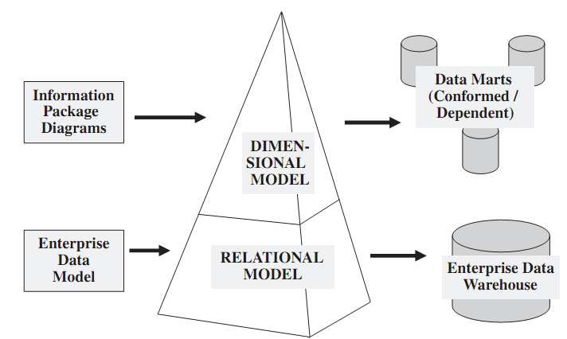
Data Design

Slide 14
Data Design (cont'd)
Structure for Business Dimensions
  Importance of having the appropriate dimensions and the right contents in the information package diagrams.
Structure for Key Measurements
  Users measure performance by using and comparing key measurements
  In order to review using proper key measurements, DW has to guarantee the information package diagrams contain all the relevant keys.
Levels of Detail
  DW needs to provide drill-down and roll-up facilities for analysis
  How deep detail of data is needed in DW

Slide 15
Data Design “in Action”
Structure for
Business Dimensions
Levels of Detail
Structure for
Key Measurements

Slide 16
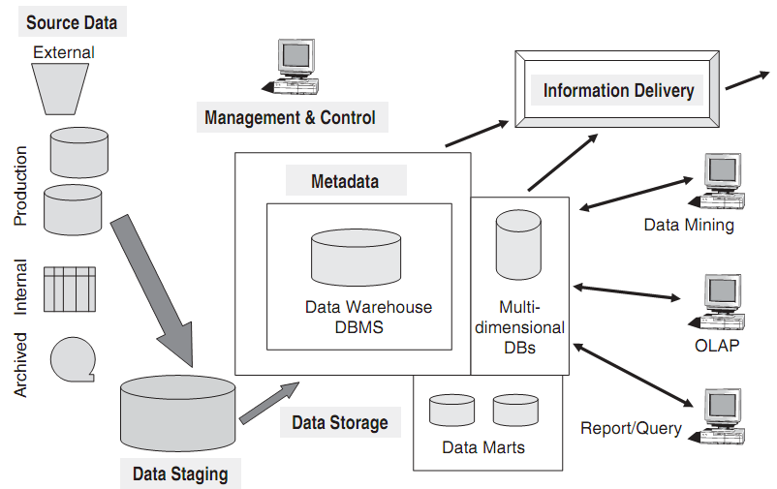
The Architectural Plan

Slide 17
Source Data
Production Data: Data get from operational system. Normally include financial system, customer relationship system, manufacturing system, etc.
Internal Data: Private data keep by internal organization. Could be spreadsheets, documents, even departmental database
Archived Data: Old data that is already not to be used in operational system.
External Data: Data from outside systems, it can also from outside company. This type of data usually do not conform internal format

Slide 18
Data Staging
Extract
Transform
Load
Bad data lead to bad decision,
data quality in data warehouse is sacrosanct
ETL process ensure data to be ready stored and processed in DW.
In many cases data need to be extracted from sources in different scheme, different vendor, even in different format of flat files.
If data extraction for a DW poses great challenges, data transformation presents even greater challenges.
Data need to be cleaned from misspelling, resolution conflict, duplication, setting default missing values, etc.
Initial load moves very large volumes of data. After that data staging will continuously extract the changes from sources.

Slide 19
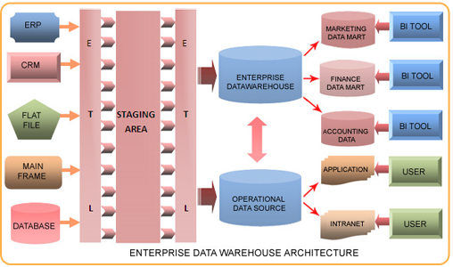
Sample Architecture

Slide 20
Data Storage Specifications
DBMS Selection
  User requirements affect the selection of the proper DBMS.
  Choice of the DBMS may be conditioned by its tool kit component.
  Features to be considered: Level of User Experience, Types of Queries, Need for Openness, Data Loads, Metadata Management, Data Repository Locations, Data Warehouse Growth.
Storage Sizing
  Determined by how many data source and how much the data will grows continuously.
  If DW is expected to support Online Analytical Processing OLAP, then how much OLAP is necessary.

Slide 21
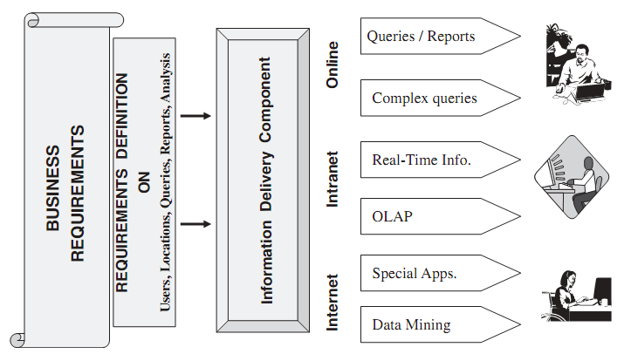
Information Delivery Strategy

Slide 22
Metadata
Operational Metadata:
When deliver information to the end-users, you must be able to tie that back to the original source data sets. Operational metadata contain all of this information about theoperational data sources.
Extraction and Transformation Metadata:
Storing information of extraction frequencies, extraction methods, and business rules for the data extraction.
End-User Metadata:
Navigational map of the data warehouse, allows the end-users to use their own business terminology and look for information in those ways.

