Slide 1
Designing Corporate Hackathons with a Purpose - Critique
Team 1
Presentation by:
Chen Sun – Class ID: 23
Tian Chen Xie – Class ID: 25
Critique by:
Khalid Dhabbah – Class ID: 6
Corey Doss – Class ID: 8

Slide 2
General Criticism of the Review Article
Positive Criticism
It is a very well written review article with a bird’s eye view of many different hackathon styles/configurations. The authors go into great detail about positive/negative factors surrounding each discussed type of hackathon.
Negative Criticism
Because it is a review article (or could possibly even be considered an editorial), there is no hard data presented directly within the article supporting any of the claims made. Our team did not dive into the article’s references.

Slide 3
Positive Details
Many hackathon aspects are carefully considered and elaborated upon, and benefits of different types of hackathons are discussed.
Different goals/motivations driving the organizers and participants are touched upon.
Different design choices are considered and discussed, including competitive and collaborative hackathons.

Slide 4
Potential Concerns
The article is very broad when discussing different configurations for hackathons. On one hand, this is good, because the authors try to cover as much ground as possible – on the other hand, the scope of the article is very wide and several different design choices and goals are discussed.
(For example, see Table 1)
This can make it difficult for the reader to come to a conclusion about which kind of hackathon they may want to consider organizing and/or participating in.

Slide 5
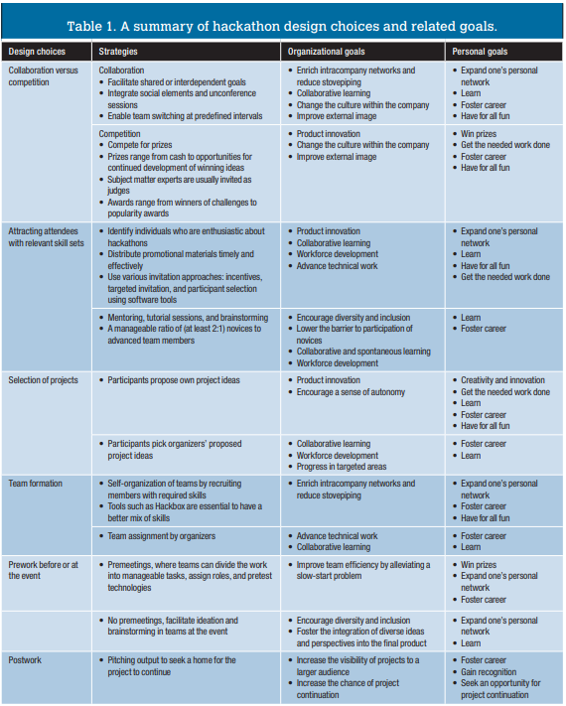

Slide 6
Potential Concerns
Despite the scope of the article (in relation to hackathons) being very generally broad, the authors explicitly state they chose to narrow their focus to corporate hackathons.
Again, this would be helpful if the entirety of the article focused solely on corporate hackathons, but since the authors chose to draw from past authored studies and experiences, the focus does not seem to have been narrowed much, if at all.

Slide 7
Question #1
In your personal opinion(s), is there a best general configuration for all hackathons? Or will there always be different aspects that require customization based upon the attendees and the organizers?

Slide 8
Question #2
What do you believe to be the greatest benefits to be gained from participating in a hackathon? For the organizers? And for the attendees?

Slide 9
Question #3
Do you think it would be best if participants were able to prepare ahead of the hackathon kickoff? Or do you believe this would have a detrimental impact on the competition and/or collaboration between different teams?

Slide 10

Thank you !

