Slide 1
Structural Design Pattern:
Adapter Design Pattern
Team 1
Presentation by:
Khalid Dhabbah – Class ID: 6
Corey Jason Doess – Class ID: 8
Chen Sun – Class ID: 23
Tian Chen Xie – Class ID: 25

Slide 2
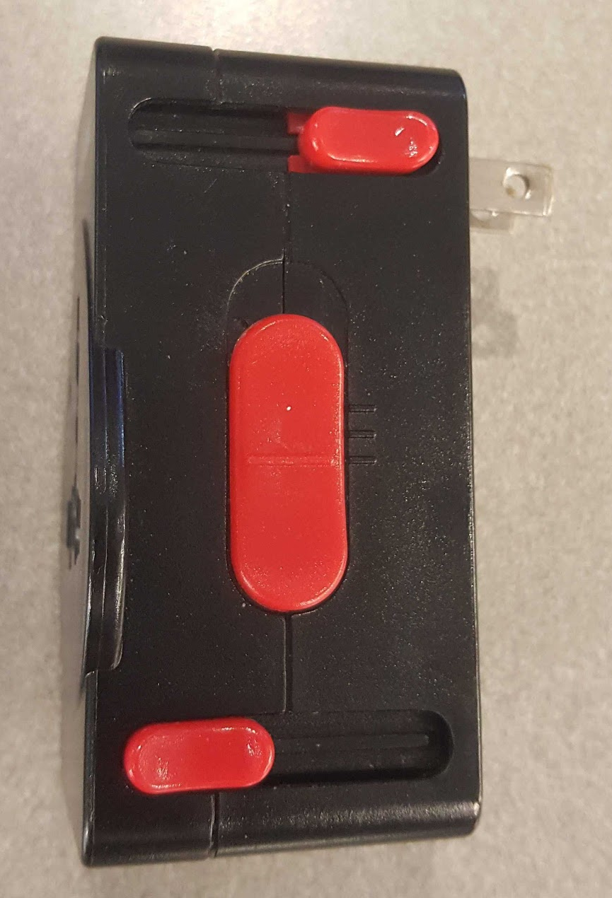
Adapter Design Pattern: Story
Adapter Design Pattern: convert the interface of a class into another one.
A simple analogy is the electrical adapter, which we use in life. We use it when we travel to another countries.

Slide 3
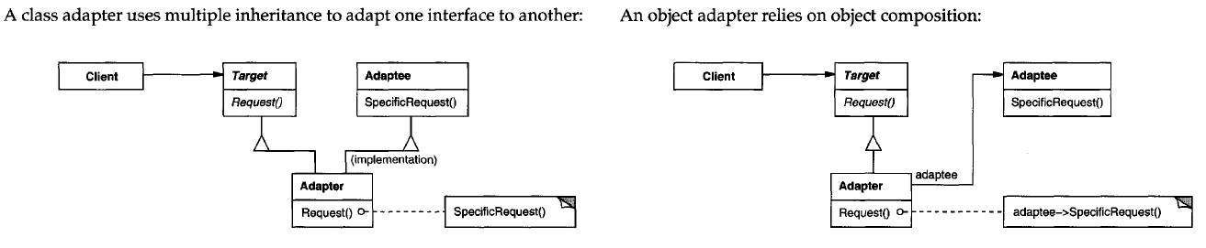
UML Design
Erich Gamma ... [and others]. Design Patterns : Elements of Reusable Object-Oriented Software. Reading, Mass. :Addison-Wesley, 1995. Print.

Slide 4
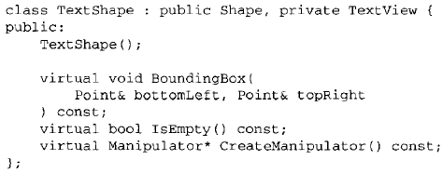
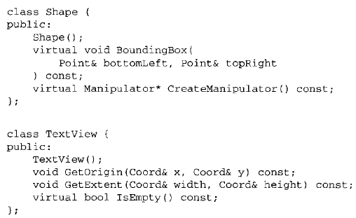
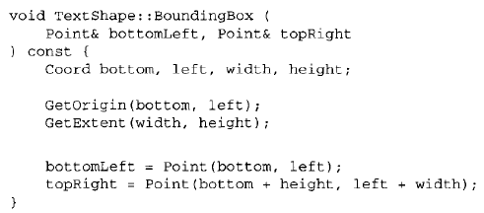


Code (Class Adapter)
Erich Gamma ... [and others]. Design Patterns : Elements of Reusable Object-Oriented Software. Reading, Mass. :Addison-Wesley, 1995. Print.

Slide 5
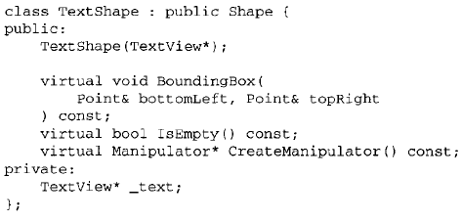
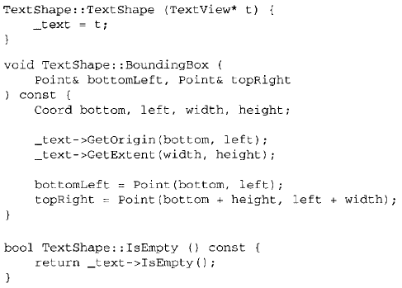

Code (Object Adapter)
Erich Gamma ... [and others]. Design Patterns : Elements of Reusable Object-Oriented Software. Reading, Mass. :Addison-Wesley, 1995. Print.

Slide 6
Quiz
The adapter allows us not to access the interface of an existing class from another interface. (True, False)
Is it Possible to use two adapters?
What is the difference between class adapter and object adapter?

