Slide 1
Azure Data Platform
Edgars Ozols

Slide 2
Agenda
Blobs
Queues
Tables
DocumentDb
Search
Demo

Slide 3
Azure Storage Blobs

Slide 4
Two Types of Blobs Under the Hood
Block blob
Page Blob

Slide 5
Block blob
Targeted at streaming workloads
Each blob consists of a sequence of blocks
Each block is identified by a Block ID
Size limit 200GB per blob
Optimistic Concurrency via Etags

Slide 6
Page blob
Targeted at random read/write workloads
Each blob consists of an array of pages
Each page is identified by its offset from the start of the blob
Size limit 1TB per blob
Optimistic or Pessimistic (locking) concurrency via leases

Slide 7
Blob Storage Concepts
http://{account}.blob.core.windows.net/{container}/{blobname}
Account
Container
Blob
Pages/Blocks
PIC01.JPG
images
Block/Page
PIC02.JPG
contoso
Block/Page
videos
VID1.AVI
Notes:
Slide Objectives
Understand the hierarchy of Blob storage
Speaker Notes
The Blob service provides storage for entities, such as binary files and text files.
The REST API for the Blob service exposes two resources:
Containers
Blobs.
A container is a set of blobs; every blob must belong to a container.
The Blob service defines two types of blobs:
Block blobs, which are optimized for streaming.
Page blobs, which are optimized for random read/write operations and which provide the ability to write to a range of bytes in a blob.
Blobs can be read by calling the Get Blob operation. A client may read the entire blob, or an arbitrary range of bytes.
Block blobs less than or equal to 64 MB in size can be uploaded by calling the Put Blob operation.
Block blobs larger than 64 MB must be uploaded as a set of blocks, each of which must be less than or equal to 4 MB in size.
Page blobs are created and initialized with a maximum size with a call to Put Blob.
To write content to a page blob, you call the Put Page operation. The maximum size currently supported for a page blob is 1 TB.
Notes
http://msdn.microsoft.com/en-us/library/dd573356.aspx
Using the REST API for the Blob service, developers can create a hierarchical namespace similar to a file system. Blob names may encode a hierarchy by using a configurable path separator. For example, the blob names MyGroup/MyBlob1 and MyGroup/MyBlob2 imply a virtual level of organization for blobs. The enumeration operation for blobs supports traversing the virtual hierarchy in a manner similar to that of a file system, so that you can return a set of blobs that are organized beneath a group. For example, you can enumerate all blobs organized under MyGroup/.

Slide 8
Storage queue

Slide 9
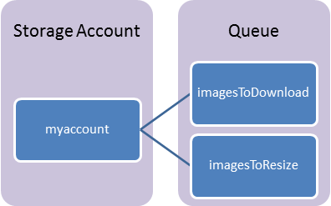
Queue components
Storage Account – All access
Queue – Set of messages
Messgae – Any format, up to 64 KB

Slide 10
Queue considerations
Messages are ordered but not guaranteed FIFO.
Message will be processed at least once.
Message may be processed more than once.
.DequeueCount increases every time.
-> Processing must be idempotent.

Slide 11
Storage Table

Slide 12
Table Storage Concepts
Account
Table
Entity
Name =…
Email = …
customers
Name =…
EMailAdd=
contoso
Photo ID =…
Date =…
photos
Photo ID =…
Date =…
Notes:
Slide Objectives
Understand Tables
Speaker Notes
The Table service provides structured storage in the form of tables.
The Table service supports a REST API that is compliant with the ADO.NET Data Services REST API.
Developers may also use the .NET Client Library for ADO.NET Data Services to access the Table service.
Notes
http://msdn.microsoft.com/en-us/library/dd573356.aspx

Slide 13
No Fixed Schema
 | FIRST | LAST | BIRTHDATE
 | Wade | Wegner | 2/2/1981
 | Nathan | Totten | 3/15/1965
 | Nick | Harris | May 1, 1976
FAV SPORT
Canoeing
Notes:
Slide Objectives
Understand Flexible Entities
Speaker Notes
Tables store data as entities.
A table can contain entities of any shape
There is no fixed schema
There is no schema checking
There is no strong typing- not that Birthdate is stored as both a datetime value and as a string
Not that we can add additional columns
Notes
http://msdn.microsoft.com/en-us/library/dd573356.aspx

Slide 14
Table Storage Details
Entity can have up to 255 properties
Up to 1MB per entity
PartitionKey & RowKey are mandatory properties
Composite key which uniquely identifies an entity
They are the only indexed properties
Defines the sort order

Slide 15
DocumentDB

Slide 16
DocumentDB Overview
A NoSQL document database-as-a-service, fully managed by Microsoft Azure.
For cloud-designed apps when query over schema-free data; reliable and predictable performance; and rapid development are key. First of its kind database service to offer native support for JavaScript, SQL query and transactions over schema-free JSON documents.
Perfect for cloud architects and developers who need an enterprise-ready NoSQL document database.

Slide 17
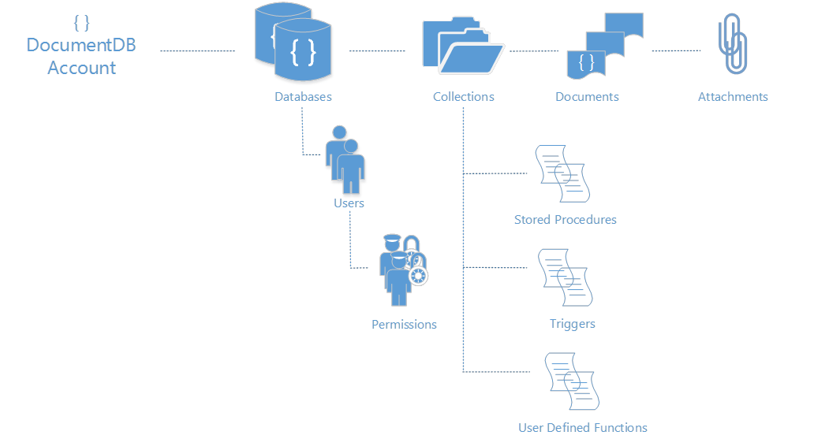
Resource model
https://myaccountname.documents.azure.net/dbs/{id}/colls/{id}/docs/{id}

Slide 18
Search service

Slide 19
Functionalaty
Simple HTTP/JSON API for creating indexes, pushing documents, searching
Keyword search with user-friendly operators (+, -, *, “”, etc.)
Hit highlighting
Faceting (histograms over ranges, typically used in catalog browsing)

Slide 20
Suggestions (auto-complete)
Rich structured queries (filter, select, sort) that combines with search
Scoring profiles to model search result relevance
Geo-spatial support integrated in filtering, sorting and ranking

Slide 21
DEMO
https://github.com/cjee/CloudDayRigaData

Slide 22
Questions?
https://github.com/cjee/CloudDayRigaData

