Slide 1
Adding Creatures and PCs

Slide 2
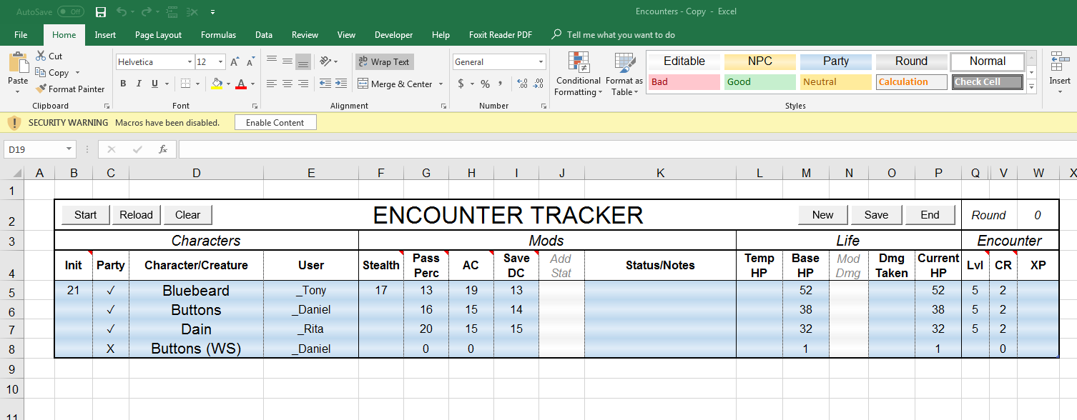
Enable Macros

Slide 3
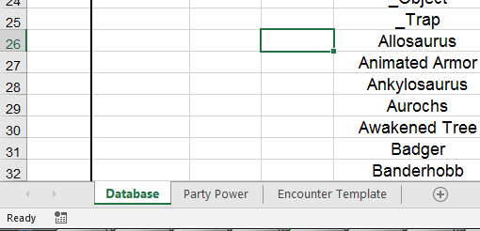
Select Database Sheet

Slide 4
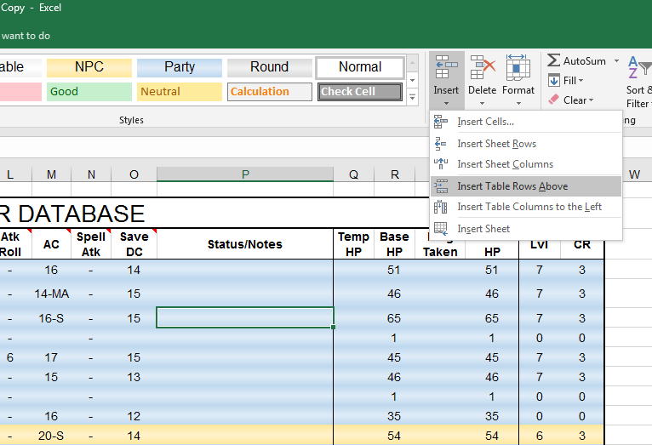
Insert Character/Creature
Click anywhere inside table
“Insert Table Rows Above”
Alternatively, highlight entire row and press Ctrl + “+”

Slide 5
Fill in fields
For PC
Character/Creature
Base HP
Character Level
User
Other fields are optional
For Monsters
Character/Creature
Base HP
Challenge Rating
Init
Other fields are optional

Slide 6
Setting Up Encounters

Slide 7
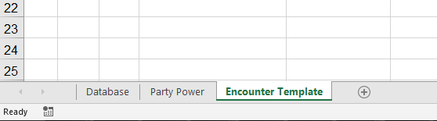
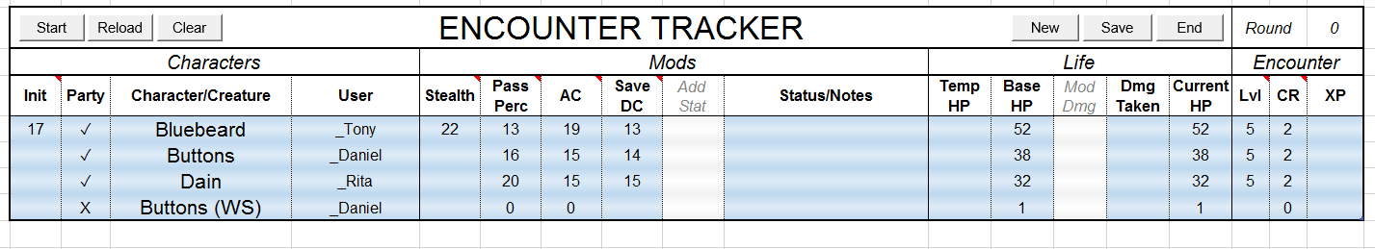
Setup Encounter Template
Select Encounter Template Sheet
Populate encounter tracker table with PCs

Slide 8
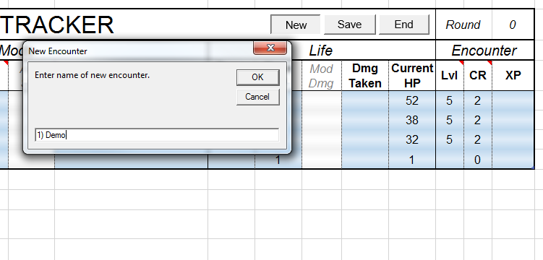
Create New Encounter
Click “New”
Creates new sheet with party

Slide 9
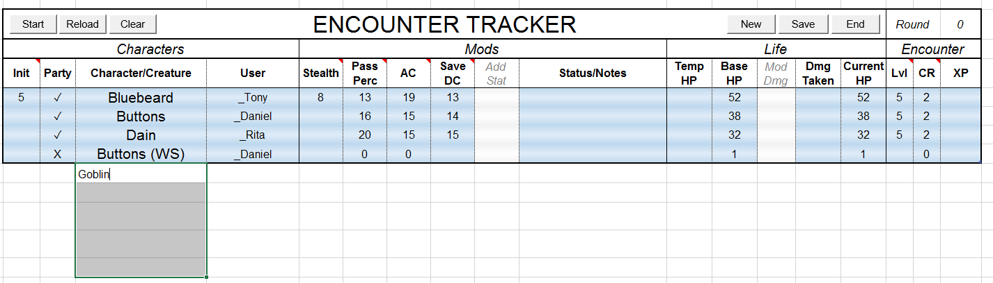
Build Encounter
Add creatures to encounter

Slide 10
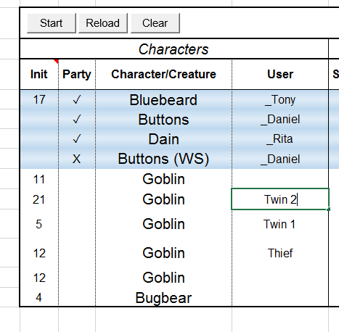
Specifying Encounter
Label specific characters if necessary

Slide 11
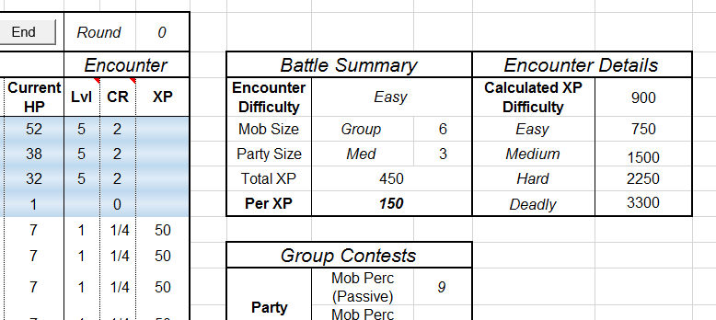
Checking Encounter
Check for intended difficulty

Slide 12
Running Encounters

Slide 13
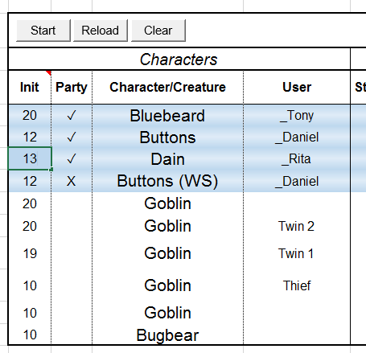
Initiative
Enter Inits
Creatures should automatically update
Press start to sort

Slide 14
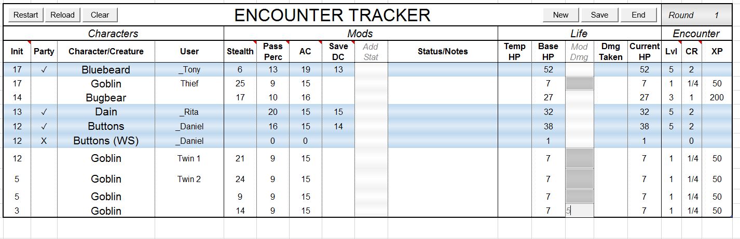
Damage/Status
Enter in “Mod Dmg” cell
Use negative for healing
Ctrl + Enter to enter into multiple selected cells

Slide 15
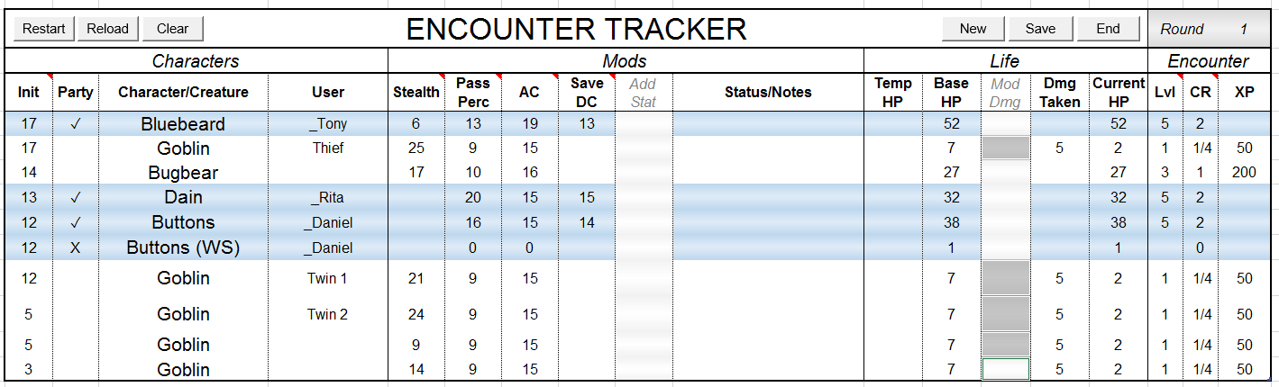
Damage/Status
Enter in “Mod Dmg” cell
Use negative for healing
Ctrl + Enter to enter into multiple selected cells

Slide 16
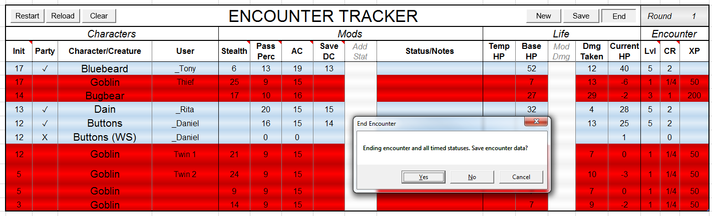
Ending Encounter
End button
(Optional) save damage and statuses of PCs to database for future encounters

Slide 17
Extra Tips

Slide 18
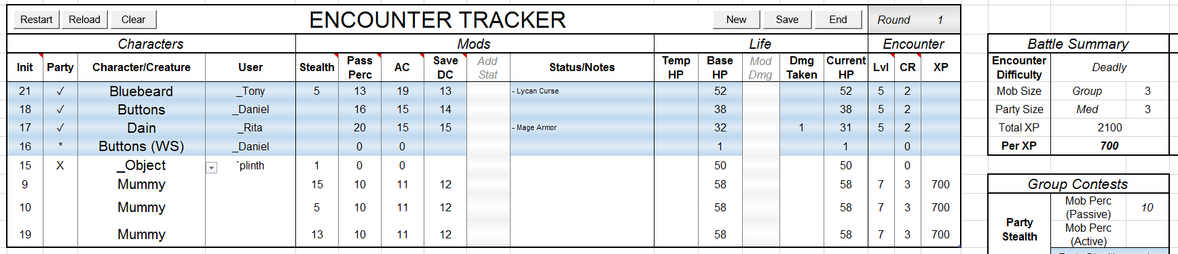
“Party” Label
Proper labelling for Encounter Difficulty calculation
✓ for PCs in party
* for companions/familiars/wild shapes (to ignore in Party Size)
X for objects (to ignore in Mob Size)

Slide 19
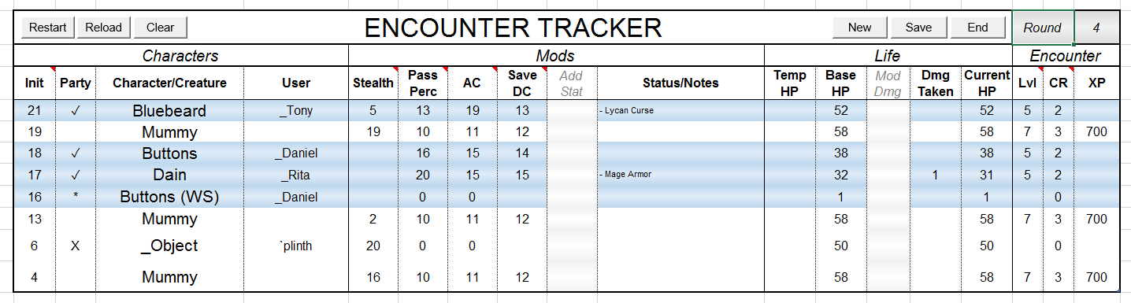
Encounter Buttons
Restart – rerolls initiative and reorders
Reload – reloads info from Database
Resets player dmg/status to last save
Resets monsters health to 0

Slide 20
Encounter Buttons
Clear – deletes entire table
New – create new encounter
Save – save PC and NPC dmg/status to Database

Slide 21
Encounter Buttons
End – clears initiatives and resets round to 0
Round – double-click to increase round #

Slide 22
Roller Update

Slide 23
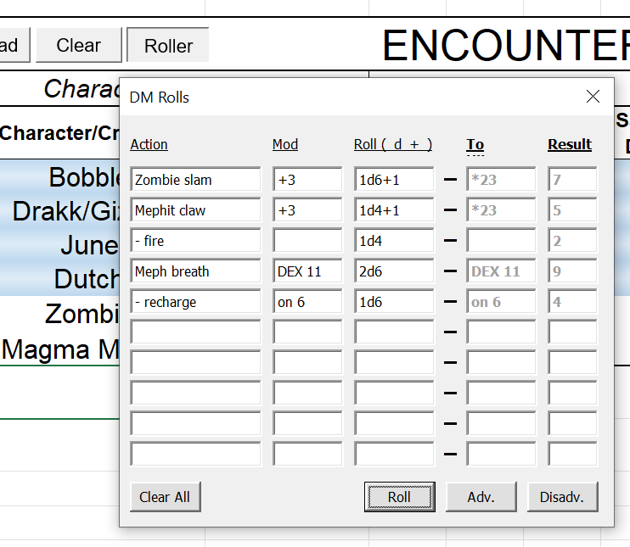
Using Roller
Input creature actions beforehand
Saves upon closing panel
Use Mod for notes if no roll
Automatically rolls for creatures
Nat 20s set to do max damage to prevent randomness
Does one roll for all actions, so roll multiple times for different results

