Slide 1
Compass

Slide 3
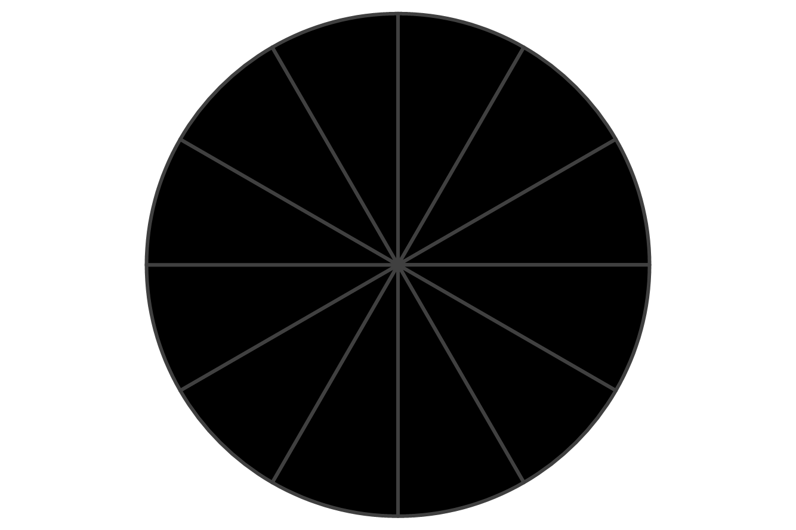

Slide 6
0
11
1
10
2
9
3
8
4
7
5
6

Slide 7
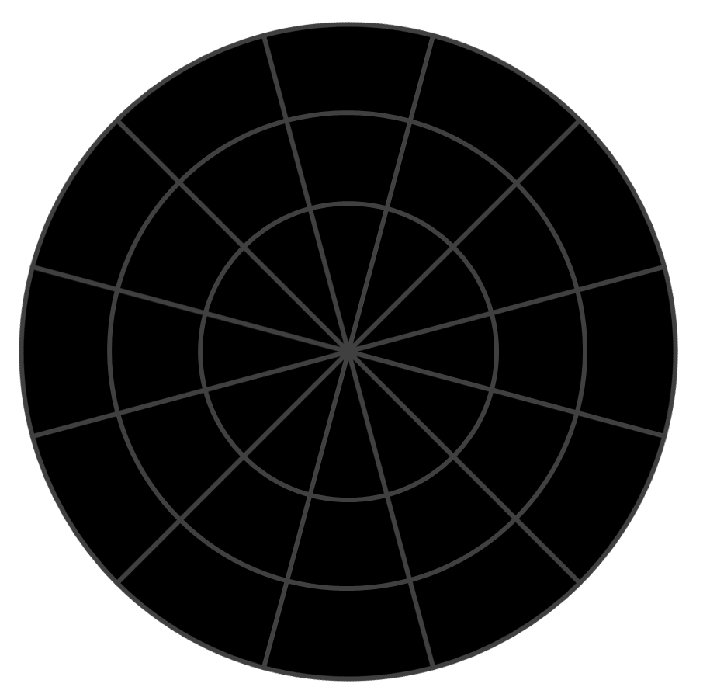
V_{in}
Gnd
Clk
Dat
Notes:
Check how resistance affects capacitance readings
Multiplex to SDA and SCL lines

Slide 8
Snowflake

Slide 13
