Slide 1

Animal Center Outcomes
By Alberto Melchor-Maldonado &
Christian-John Forcadilla

Slide 2
Use-Case Description
An animal shelter is able to…
Check donations from an Adoptee
View an animal entry
Edit an animal entry
Create an outcome for an animal
An adoptee is able to…
Make donations to a shelter
Request a visit
Check an animal outcome

Slide 3
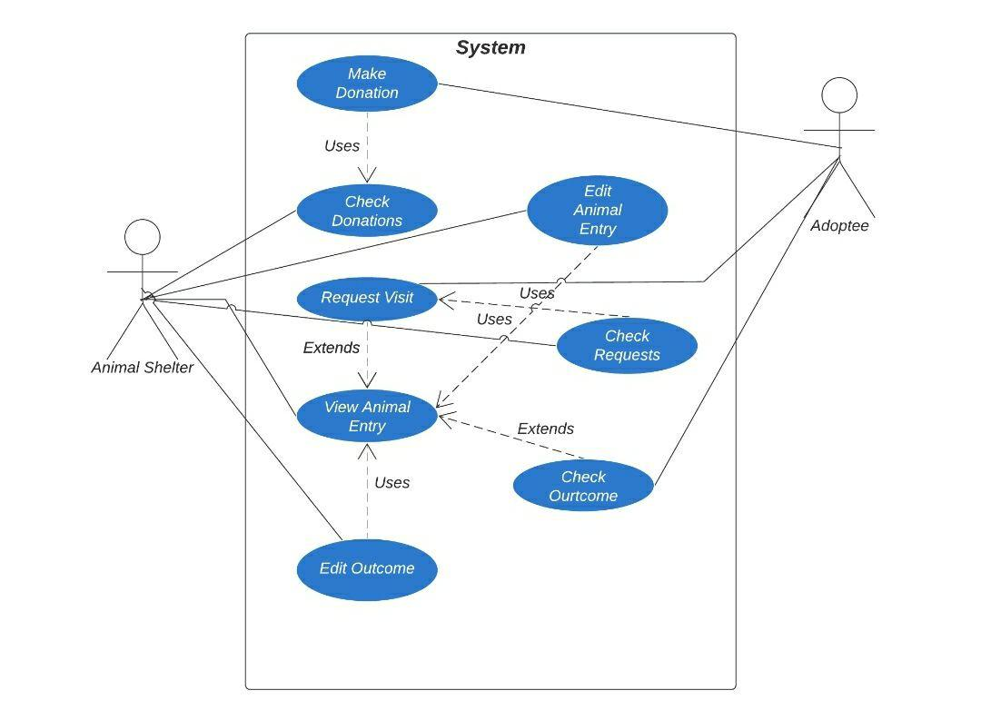
Use-Case Diagram

Slide 4
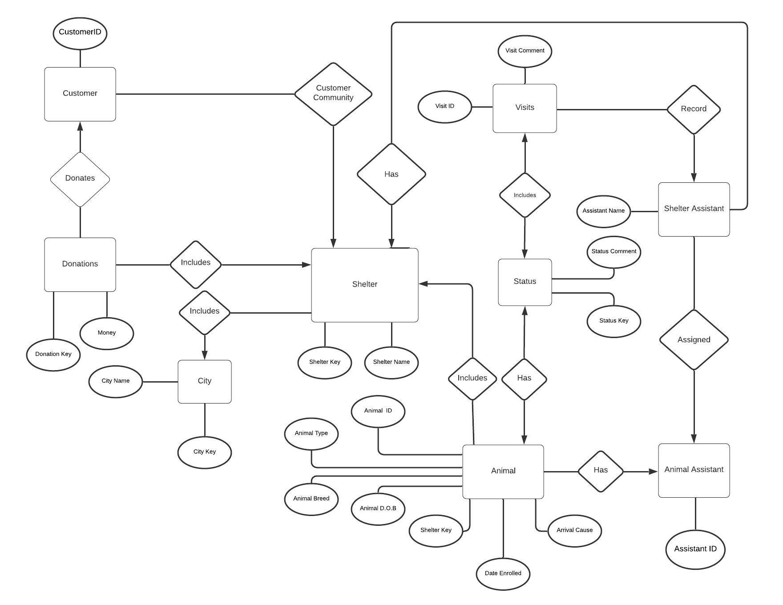
E/R
Diagram

Slide 5
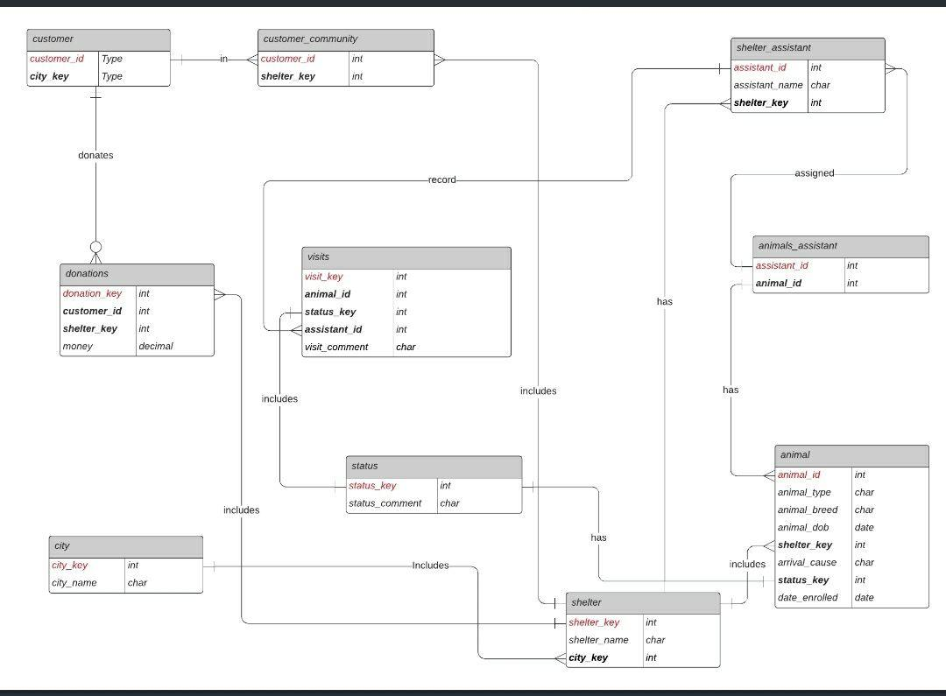
Relational
Diagram

