Slide 1
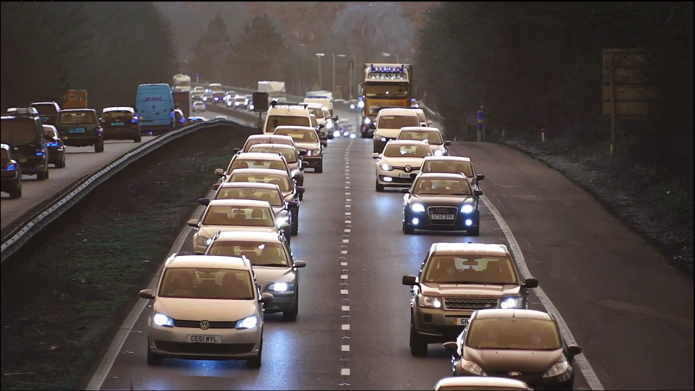

Slide 2
video source
data
preprocessing
output format checking
QA/QC
model
billing
camera zones

