Slide 1
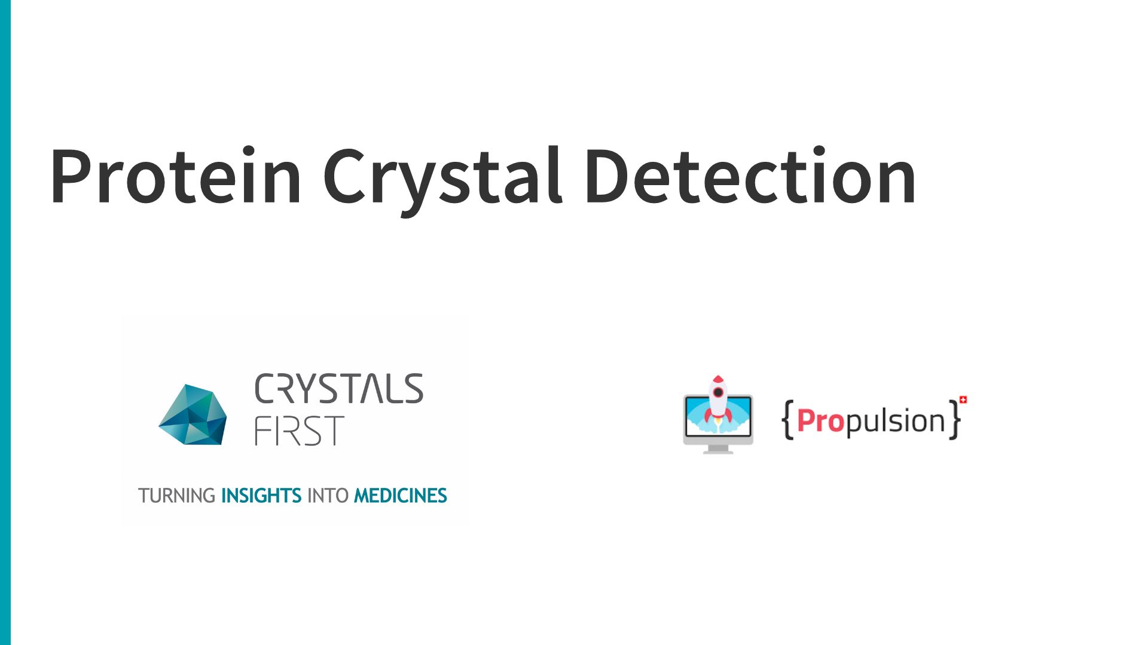

Slide 2
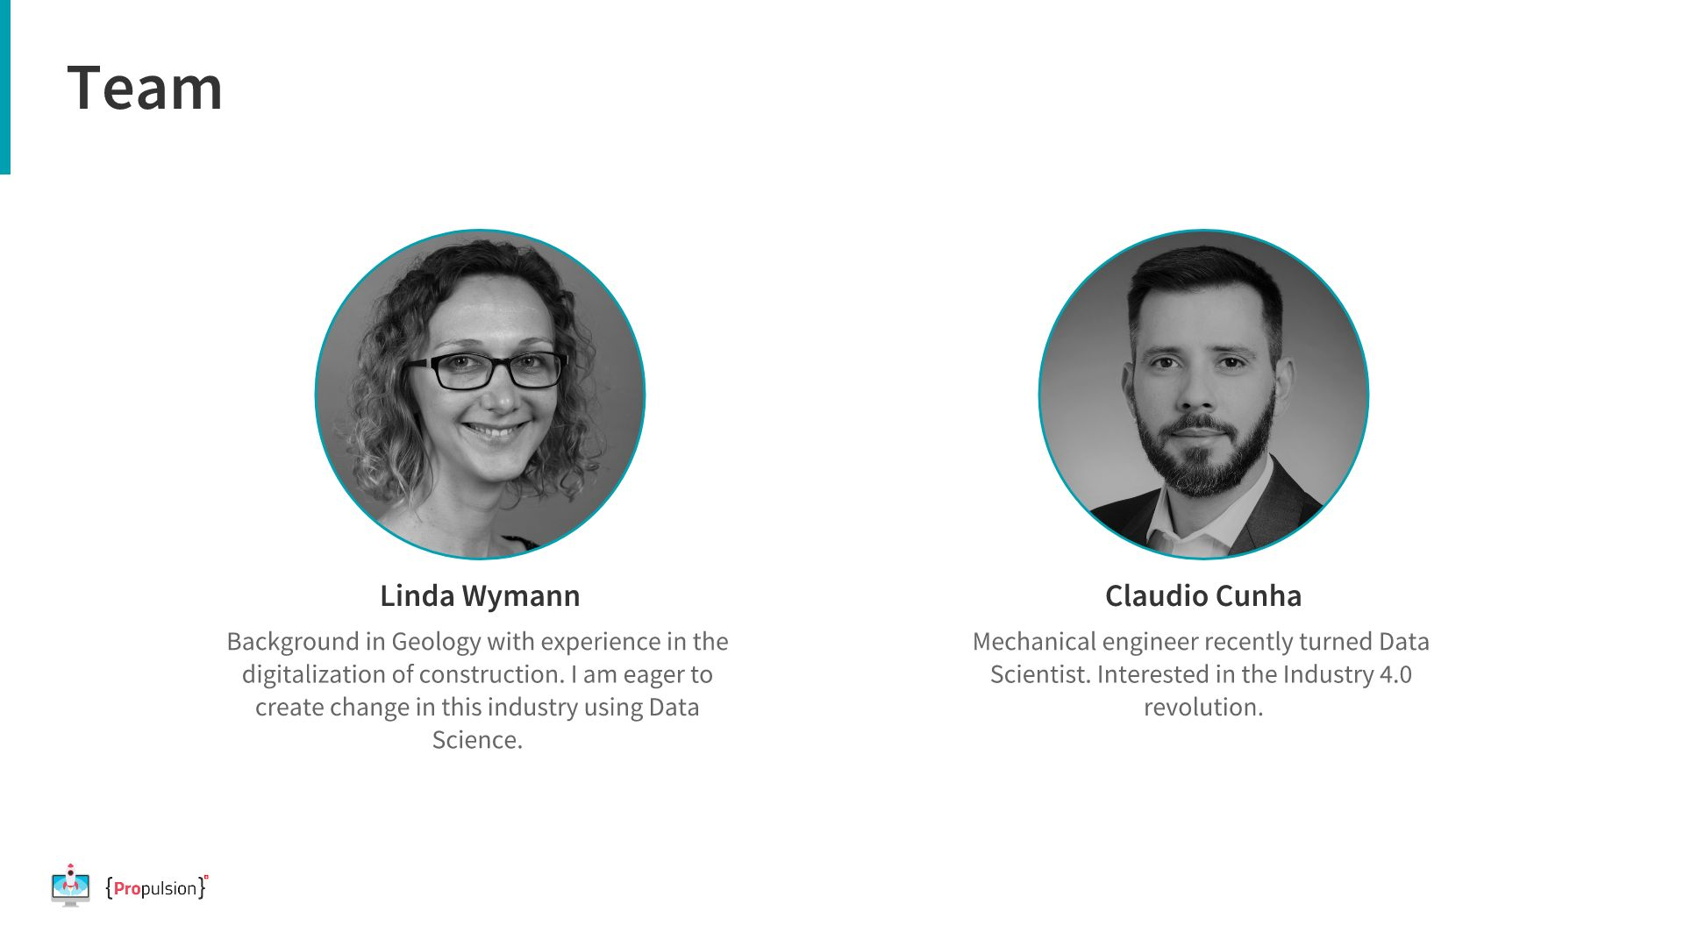
Notes:
Linda: Even tough I have studied Geography and Geology, I changed to the built environment quickly and have been working in constuction and the HVAC industruy in Switzerland, mainly in the digital world of constuction which is called BIM, Biuilding Information Modeling. Claudio:

Slide 3
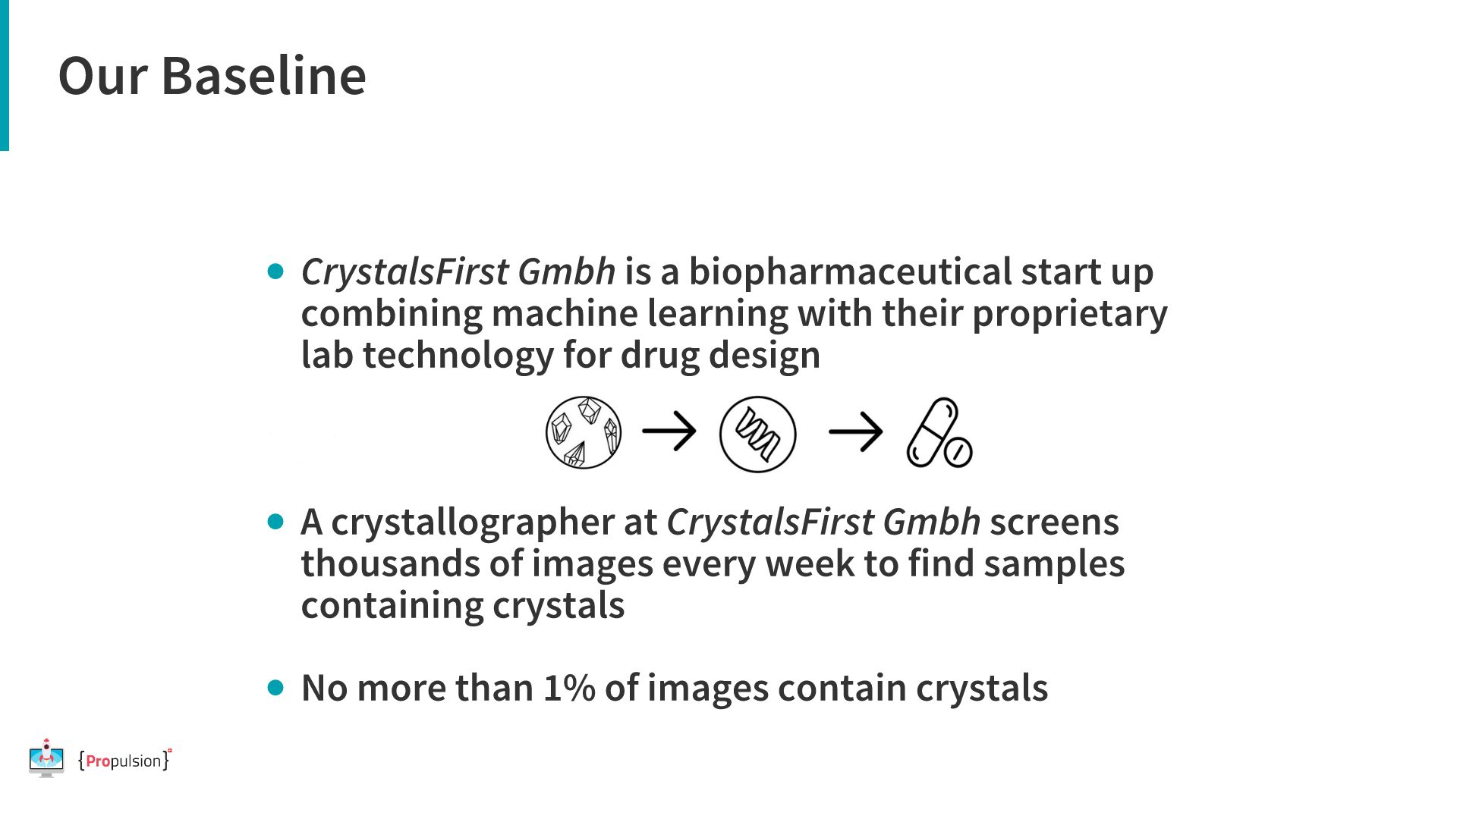
Notes:
- who is crystals first - what do they do and what for: they need to find crystals to derive 3D crystal stuctures in proteins which could potentially lead to new drugs on the market. Crystals could lead to finding new protein structures which can be used to create new drugs

Slide 4
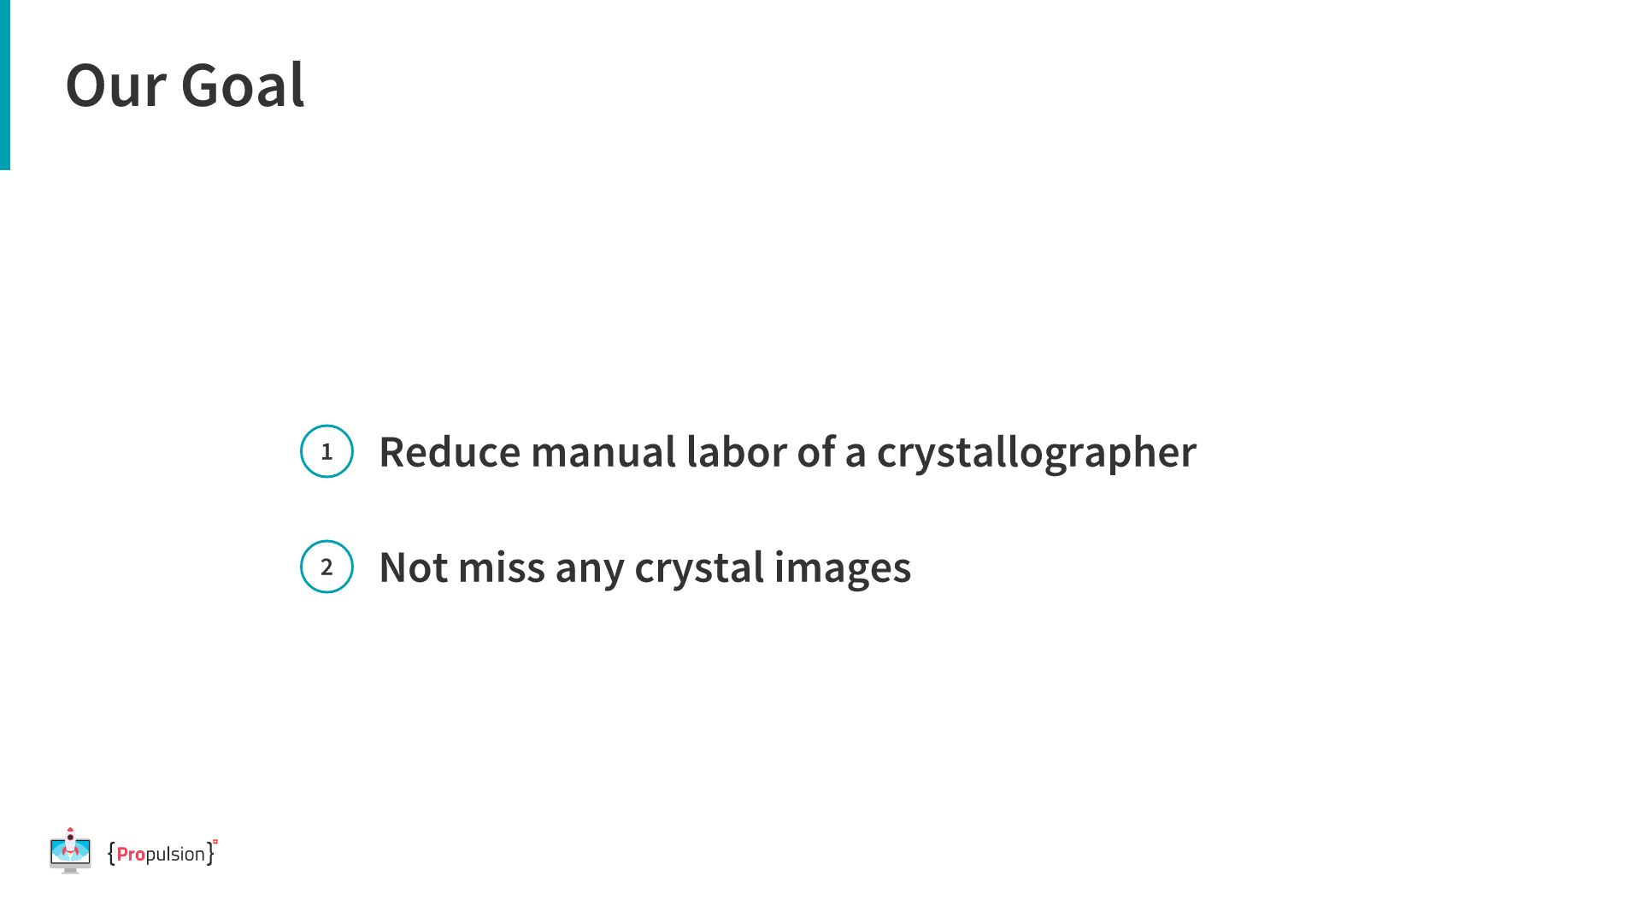

Slide 5
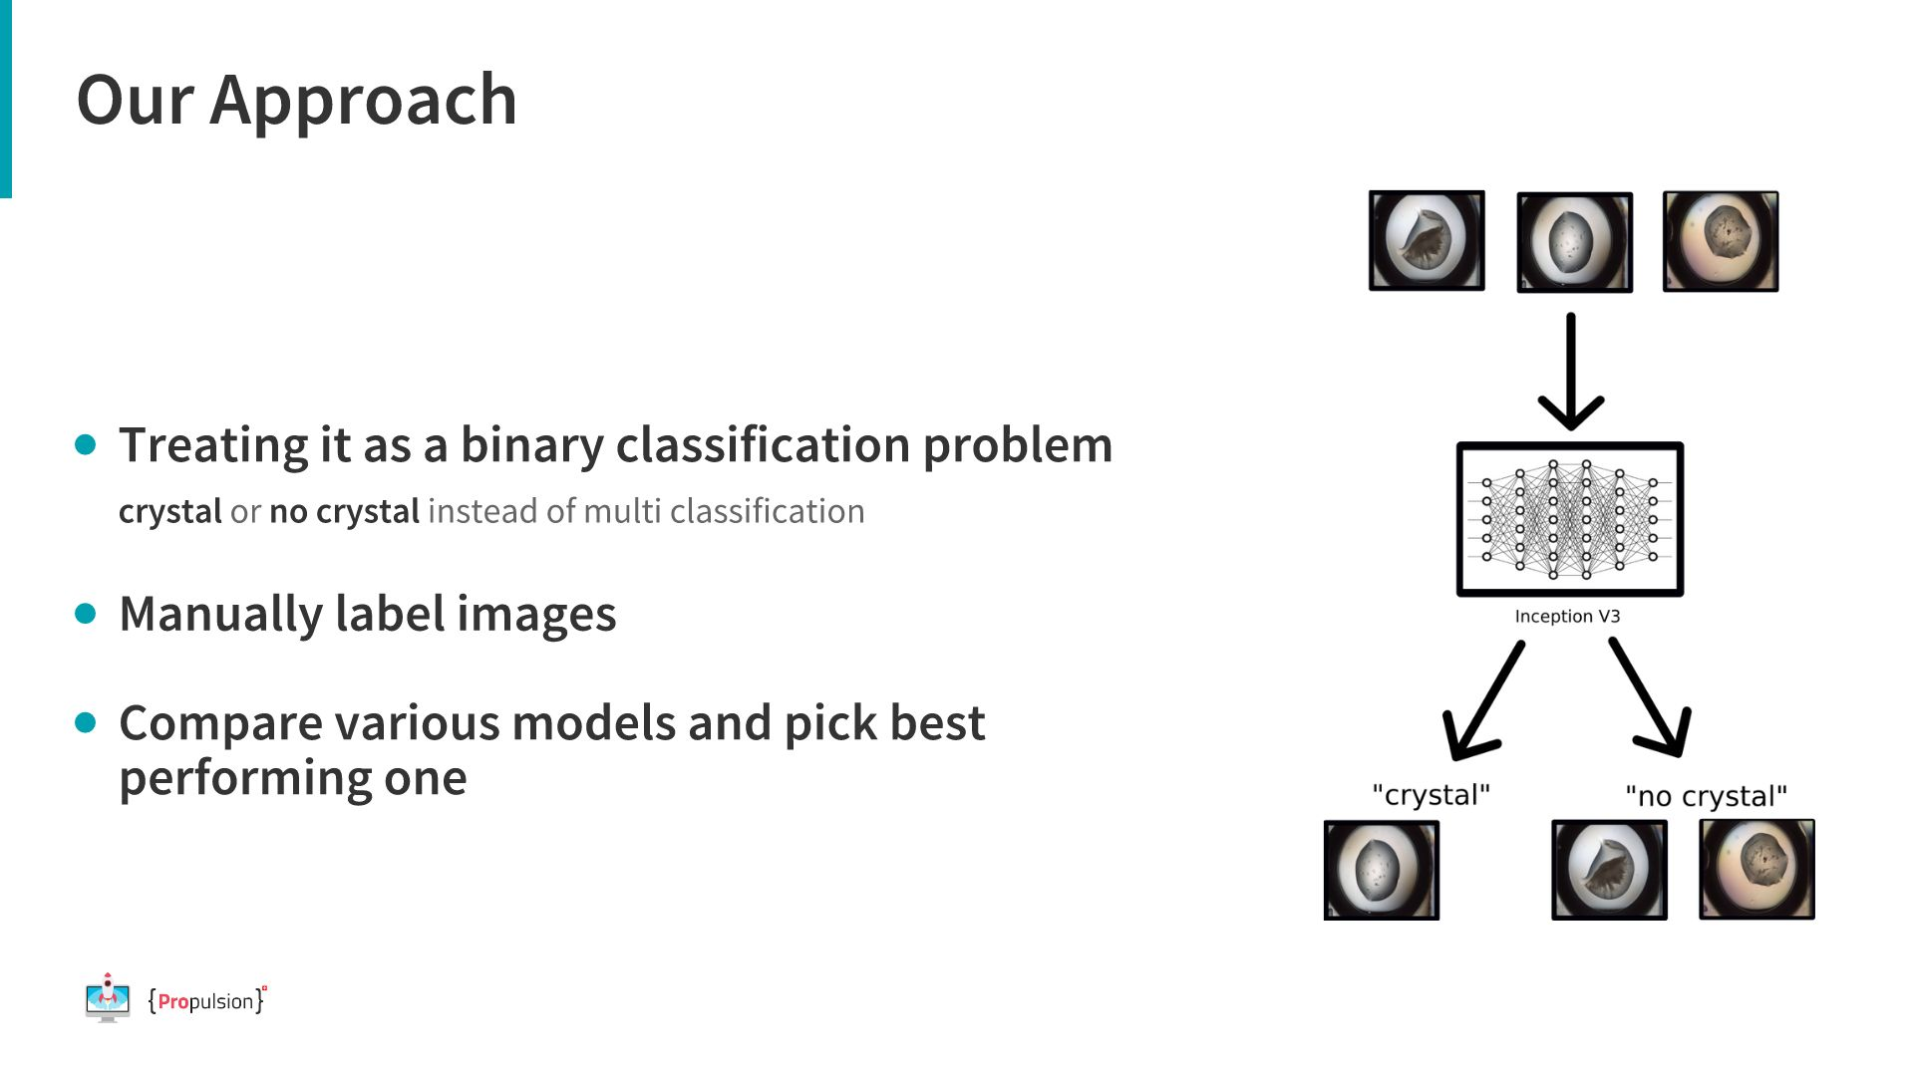
Notes:
To tackle the task of detecting crystals we first had to label images. ...and to reduce manual labor,

Slide 6
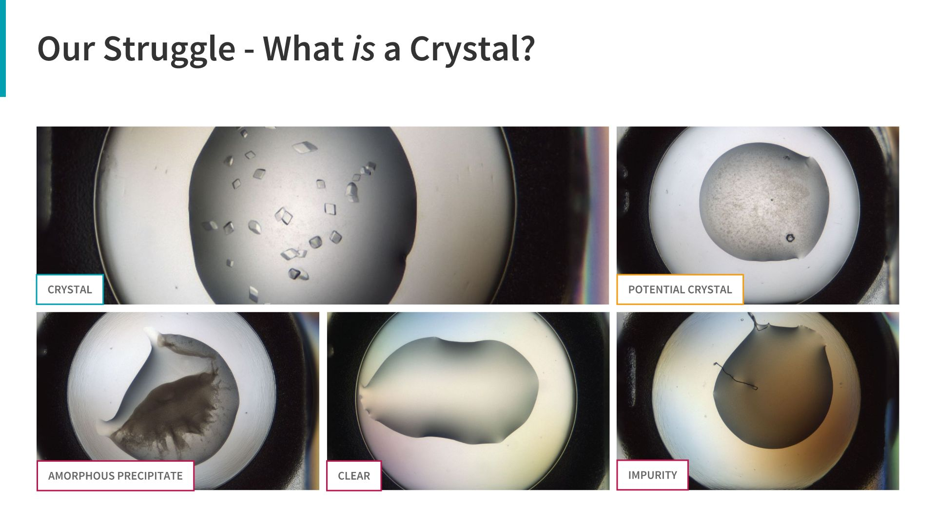
Notes:
- this image obviously contains crystals and this one obviously does not, it's actually amorphous precipitate. - But what about this one? This is a potential crystal and an expert would have a second look. - but what does an algorithm do in that case? - one of our main issues was that we didn't have enough crystal images and had to integrate such "possibly crystal" images to teach the model. - This did not turn out because the model didn't learn well to differentiate between crystal and no crystal. - Rarity of data

Slide 7
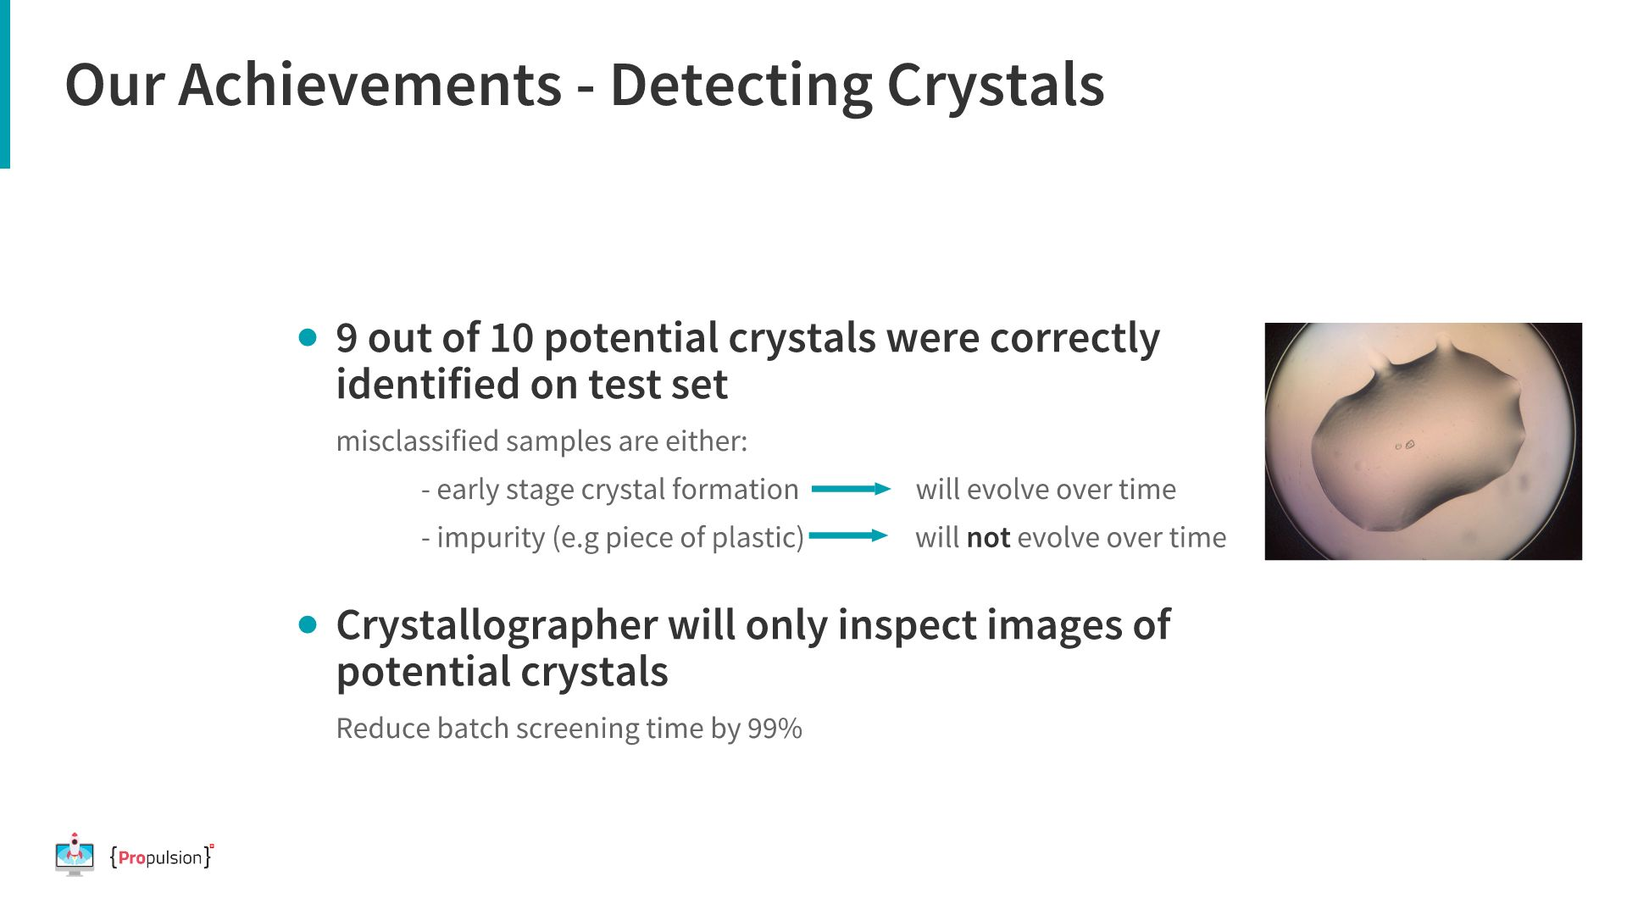

Slide 8
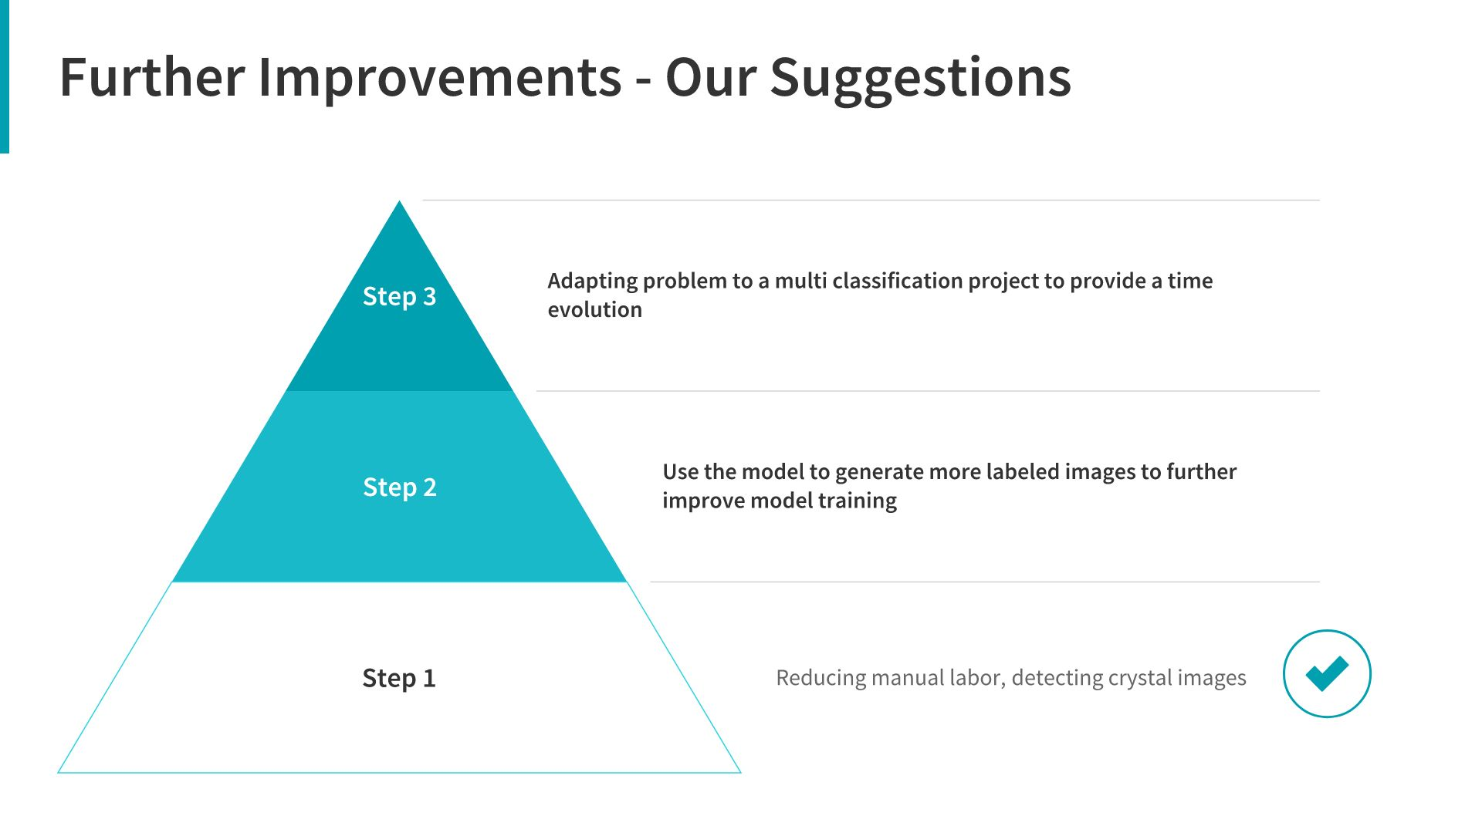

Slide 9
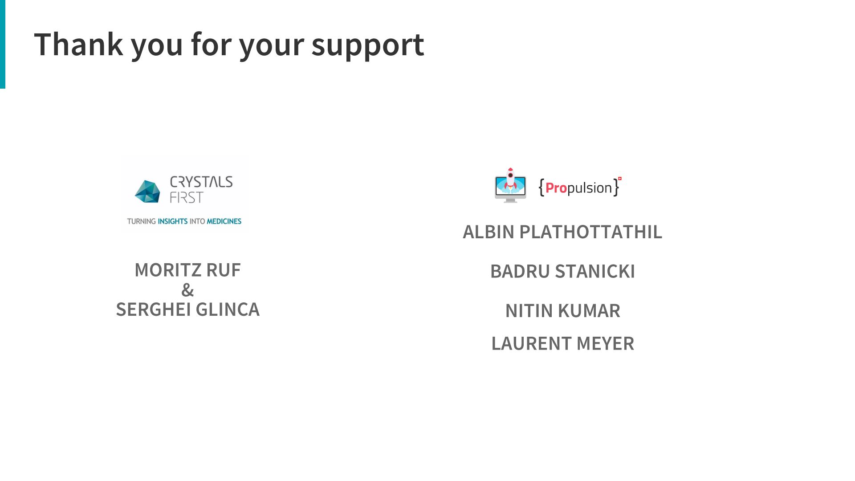

Slide 10

Notes:
Linda: Even tough I have studied Geography and Geology, I changed to the built environment quickly and have been working in constuction and the HVAC industruy in Switzerland, mainly in the digital world of constuction which is called BIM, Biuilding Information Modeling. Claudio:

