Slide 1

Master of Science: Applied Data Science Portfolio Milestone
Connor Gendron
NetID: cgendron
SUID: 96559-2353

Slide 2
Portfolio Milestone: Introduction
The Applied Data Science Master’s program at Syracuse University rigorously prepares its students for a future in the field through underlying theories in addition to hands on work. The program introduces students to a variety of data science disciplines and the appropriate tools for each job. In the past eighteen months working through my classes I have gotten exposure to several tools for the first time, such as Access, SQL, Python, R, Idea, and Weka, while honing my skills in more familiar tools like Excel.
I used these tools in all my courses but chose projects from these 4 to demonstrate my proficiency in data science:
IST 707: Data Analytics
IST 736: Text Mining
IST 718: Big Data Analytics
IST 659: Data Admin Concepts & Database Management

Slide 3
Portfolio Milestone: Objective
The goal of the portfolio milestone is to demonstrate mastery of the 7 learning objectives for the Applied Data Science program:
Describe a broad overview of the major practice areas in data science
Collect and organize data
Identify data via visualization, statistical analysis, and data mining
Develop alternative strategies based on the data
Develop a plan of action to implement the business decisions derived from the analyses
Demonstrate communication skills regarding data and its analysis for managers, IT professionals, programmers, statisticians, and other relevant professionals in their organization
Synthesize the ethical dimensions of data science practice(e.g. privacy)

Slide 4
Project Overview 1: IST 707 Data Analytics
Fantasy Football Analysis

Slide 5
IST 707: Data Analytics
Project Introduction
The goal of this project was to generate actionable data from a set of football statistics.
Using R the data set was cleaned, explored, mined, and analyzed for anything that can provide an edge in fantasy football.
This included fantasy point predictions, statistics that best correlate to fantasy point production, and positional impact on point production.

Slide 6
IST 707: Data Analytics
Data Set
The data set was a combination of 3 different data categories for NFL players from 1970-2016
One for basic player data including age, name, etc.
One that compiled career statistics
Lastly there was a category for individual game logs.
Data Preparation
After initial exploration we decided to focus on career stats and game logs for Quarter Backs, Running Backs, Wide Receivers, and Tight Ends.
We were then able to generate formulas to find fantasy point production for the different positions.
QB Fantasy=(PassYards * .04) + (TD* 6) + (Ints * (-1)) + ((RushYards - SackYards)*.1)
RB/WR/TE Fantasy=(Rec * .5) + (RecYards * .1) + (TDs * 6) + (RushYards * .1)
Cost= 3500 + (326.086957*Fantasy)

Slide 7
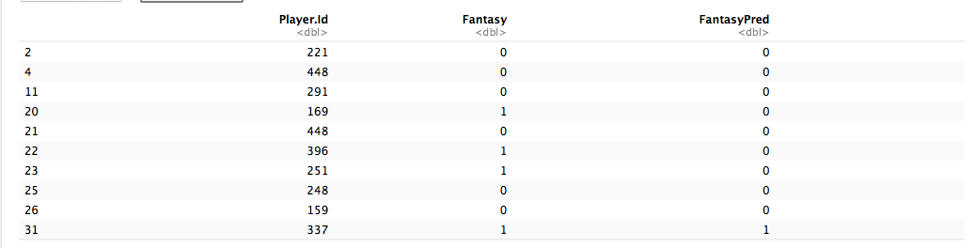
IST 707: Data Analytics
The first tool we used was SVM to predict , on a binary basis, whether or not a given player would score 15 or more fantasy points in a game.
Due to the size of the data a subset was created to focus on quarterback scores.
This analysis yielded 55.47% accuracy

Slide 8
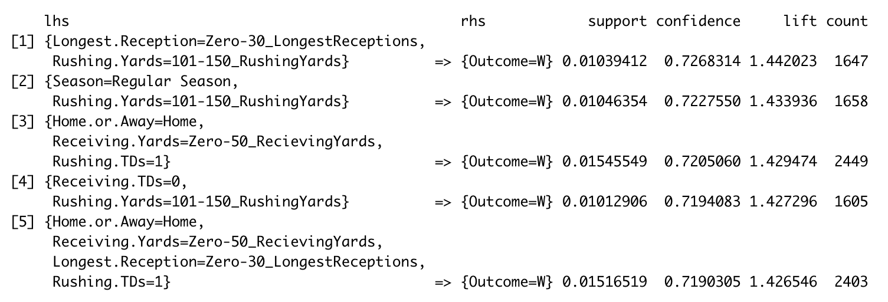
IST 707: Data Analytics
We also used association rule mining to find statistical situations that best predict winning a football game.

Slide 9
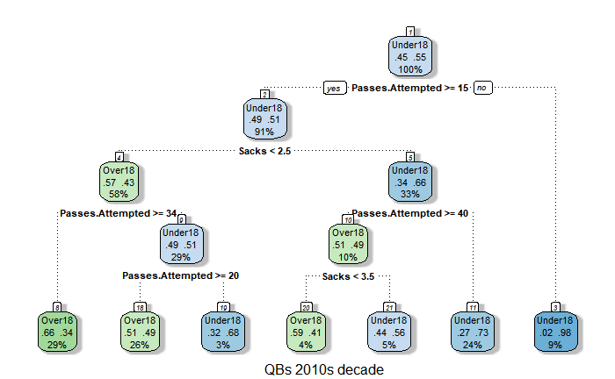
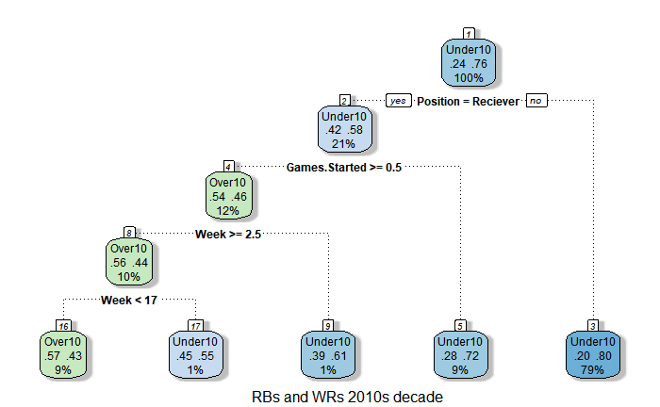
IST 707: Data Analytics
Our last analytic method was to predict fantasy points using decision trees.
These resulted in a more intensive understanding of the driving factors behind fantasy point production.

Slide 10
Satisfied Learning Objectives
Identify data via visualization, statistical analysis, and data mining:
Throughout the process in this project data visualizations were used for exploring data, highlighting interesting findings and finally in expressing analytic results. Statistical analysis was crucial to many of the insights we generated and informed decisions made with more complex analytics. Finally, association rule mining among other data mining techniques were used to identify noteworthy trends/relationships within the data.
Demonstrate communication skills regarding data and its analysis for managers, IT professionals, programmers, statisticians, and other relevant professionals in their organization:
Part of the final project was an in-class presentation of the most important findings that our group made. During the presentation we were able to effectively express useful insight in a manner that could be equally valuable to managers and programmers. Using a combination of visualizations and relevant technical information we were able to get our message across.

Slide 11
Project Overview 2: IST 736 Text Mining
Presidential Nomination Speeches

Slide 12
IST 736: Text Mining
Project Introduction
The goal for this project was to explore the text of republican and democratic party presidential nomination speeches by the nominees to see if the text can be used to predict things like the economic state of the country and who would eventually win the presidency.
The data was first scraped and then collected into a csv file which we loaded into python for our cleaning, mining and analysis.
In the end we used both supervised and unsupervised learning techniques to establish our findings.

Slide 13
IST 736: Text Mining
Data Set
The data set is made up of the full text for 55 of the 60 nomination speeches from 1900-2016
The 5 missing speeches were from the period of 1900-1920
In addition to the speech text research was done to create binary indicators for our different labels
On the right is a list of the different categories we tried to predict by labeling the speeches according to our research findings.
Categories for Prediction Included:
Win or lose?
Party
Unemployment rate
GDP growth
Interest rates
Inflation
Dow volume
Presidential approval
Tax rate change
Real income growth
Incumbency?
Sentiment

Slide 14
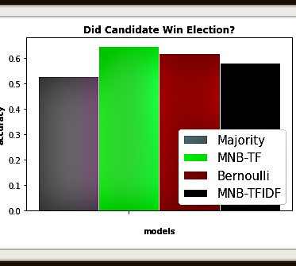
IST 736: Text Mining
The first supervised machine learning method was the comparison of different Naïve Bayes results, outlined on the right.
We trained the Naïve Bayes on speeches labeled as winning or losing the election and then tested the algorithms to see if we could predict a president based on their nomination speech.
The results showed that the text provided enough for Naïve Bayes to outperform random guessing suggesting that nomination speeches could help predict a president.
The best result came from the Multinomial Naïve Bayes using Term Frequency with approximately 65% accuracy.

Slide 15
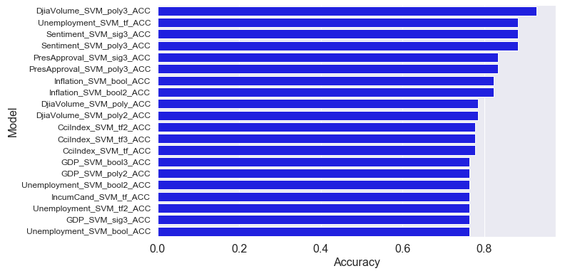
IST 736: Text Mining
To the right are the top 20 results in terms of accuracy when using SVM to predict our different text labels.
These results reinforce the idea from our Naïve Bayes analysis that nomination speech text can have a predictive value.
The easiest labels for the SVM to predict were economic indicators like the Dow Jones Volume and Unemployment. Followed by speech sentiment and presidential approval.
These results outperformed the Naïve Bayes, all exceeding 70% accuracy with a high of 94%.

Slide 16
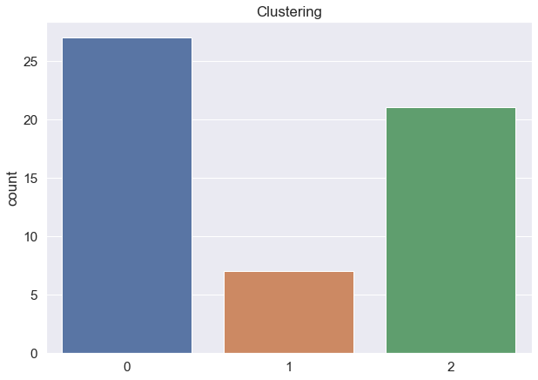
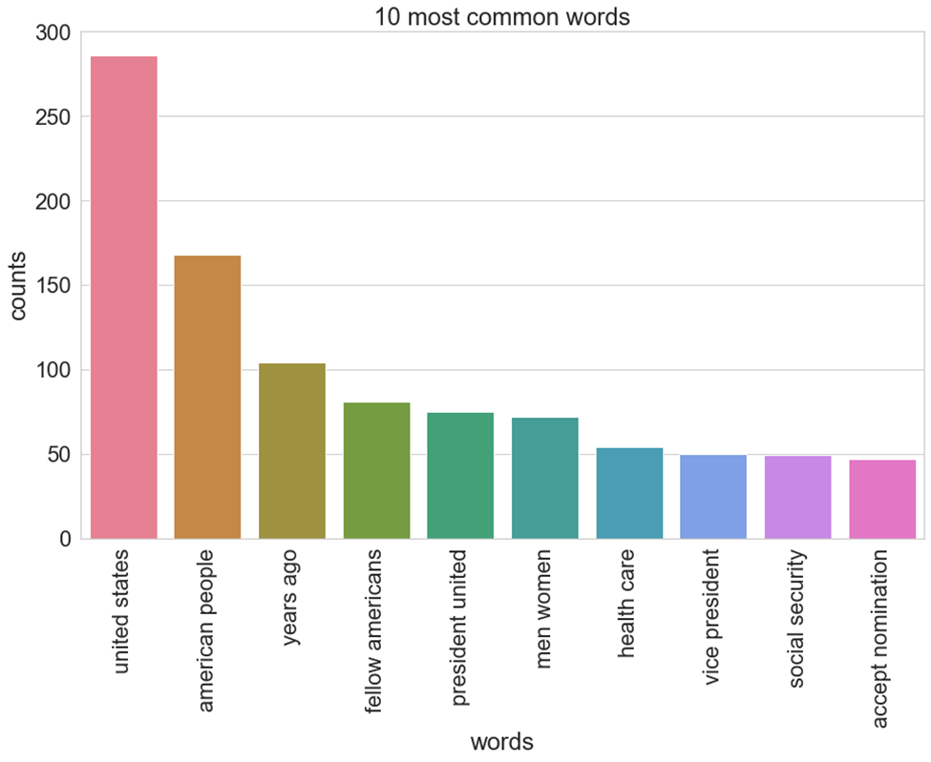
IST 736: Text Mining
Our last area of exploration involved unsupervised machine learning, analyzing the text without any of our labels.
The top figure on the right shows the different clusters of nomination speeches. The K-means clustering here tended to group speeches temporally suggesting speech patterns changed over time.
The bottom figure shows the most common two-word phrases in the corpus. These results are largely intuitive covering expected topics like “united states”, ”health care”, and “social security”.

Slide 17
Satisfied Learning Objectives
Develop alternative strategies based on the data:
Early on in the data gathering phase we were planning to focus our project on whether or not text analysis on nomination speeches could be used to predict presidential elections. Later on we expanded our predictions to include different labels such as presidential party, poll status and economic indicators. In the end our most promising results came when predicting economic indicators like the unemployment rate.
Ethical dimensions of data science practice:
When working with political data it is important to avoid biases and present the data objectively. To this end we wanted to have as much representation from each party as possible by using nomination speeches for both major parties. Furthermore, party affiliation was not considered in most computer analyses. Finally, the results were presented through an apolitical lens where the focus was on success rates for our predictive analyses and other interesting finds.

Slide 18
Project Overview 3: IST 718 Big Data Analytics
Kaggle NFL Big Data Bowl

Slide 19
IST 718: Big Data Analytics
Project Introduction
The goal for this project was to use the Kaggle NFL dataset to generate actionable insights relating to real time NFL coaching situations like play calling.
Once the data was loaded into python we had to clean and transform the data before finally generating new features to use in our analysis.
This analysis was used to map plays graphically, create animations to show player movement on given plays and generate an application to assist in situational play calling.

Slide 20
IST 718: Big Data Analytics
Data Set
The Kaggle NFL Big Data Bowl was originally a competition to see if rushing yards gained per play can be predicted by machine learning.
The dataset consisted of player, movement, positional, weather, and stadium data.
This data could be used to map play formations for offense and defense on a given play.
In addition other factors such as who the home and away teams were was factored in.

Slide 21
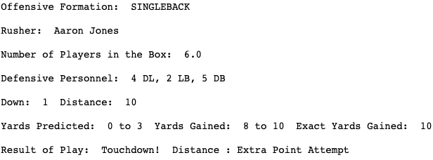
IST 718: Big Data Analytics
Using the positional data we were able to generate visual representations of the different plays in the data set.
These graphics were beneficial in making sense of otherwise abstract coordinate points and putting our data into an understandable format for stake holders.

Slide 22
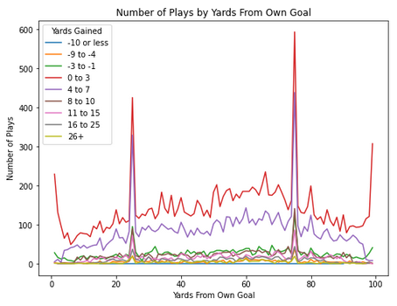
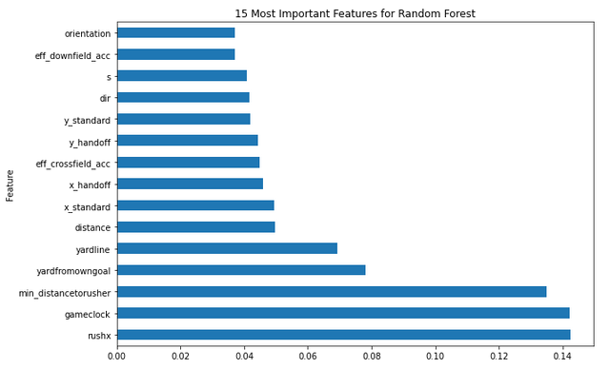
IST 718: Big Data Analytics
We conducted predictive analytics using multiple methods to see which one gave us the best predictive value for each play.
The top figure shows a convolutional neural network’s predictions for yards at various positions on the field.
The yards gained were binned according to the legend and the result was an accuracy of 20.14%
The bottom figure shows the most important features for our random forest predictions.
Random forest gave us the best results with an accuracy of 43.93%

Slide 23
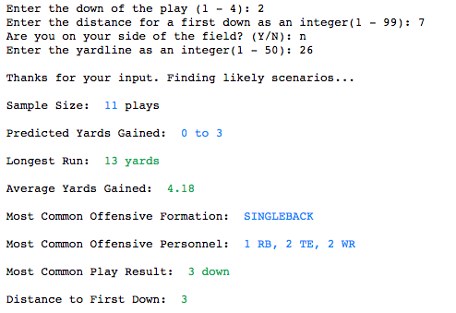
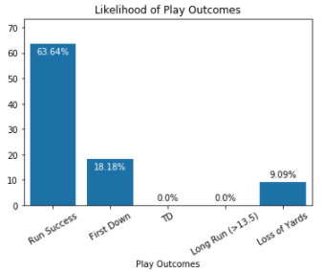
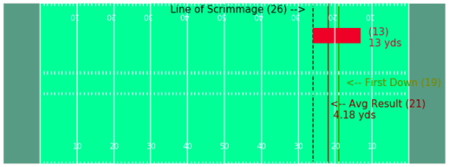
IST 718: Big Data Analytics
From the information we gathered throughout the project we were able to generate an interactive application for coaches.
Given the play down, distance for first down, and field position we could generate play calling suggestions based on our random forest predictions and historical data.
To the right is a compressed example of the output our application was able to generate.

Slide 24
Satisfied Learning Objectives
Describe a broad overview of the major practice areas in data science:
Most of the projects for this program involved many of the major practice areas within data science, however, this project required the most intense application of them. The data engineering was extensive, we had to reformat the entire dataset, and generate new features from essentially the raw components. The exploratory analysis and some of our most useful insights came from our data mining and statistical analysis. Our data mining results were incorporated into an interactive python application intended to aid in play calling strategy. Using data visualization techniques, we were able to capture and express our most important findings in impactful ways.
Develop a plan of action to implement the business decisions derived from the analyses:
After the initial results it was clear we needed a way to implement our findings in a practical way for them to have any noteworthy impact. We were able to combine the results from our best performing algorithm with insights we gained while data mining to create an interactive python application. The idea of the application is to provide the stakeholder, in this case a football coach, instantaneous feedback and play suggestions given their current circumstances. The implementation of this application takes the best of our insights and can give relevant actionable information to the stakeholder in real time, responding to real criteria.

Slide 25
Project Overview 4: IST 659 Data Admin Concepts and Database Management
Video Game Database

Slide 26
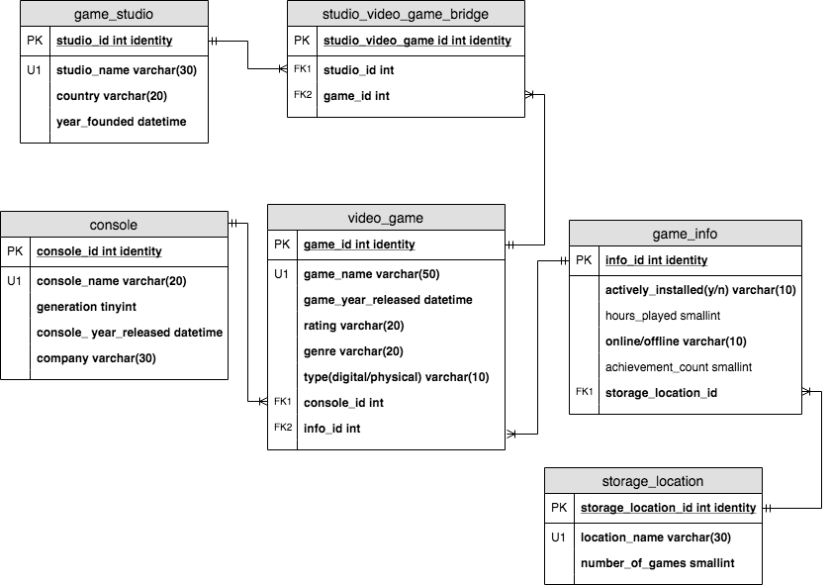
IST 659: Data Admin Concepts & Database Management
Data set
To create this database I hand recorded the fields of information I wanted to store.
The data was gathered from physical video game cases in my collection in addition to digital descriptions available for downloaded games.
The data was then stored in SQL according to the logical diagram on the right.

Slide 27
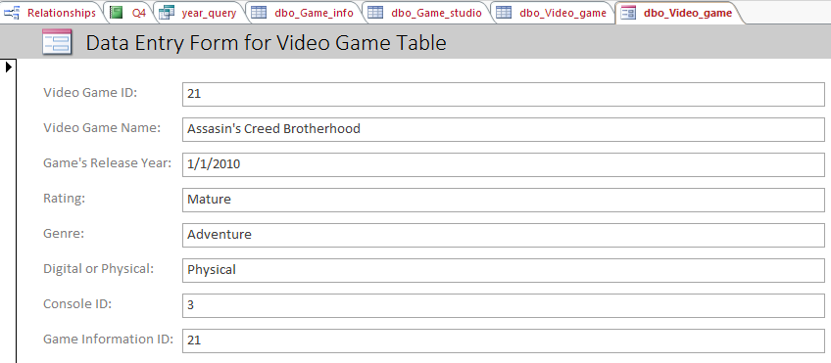
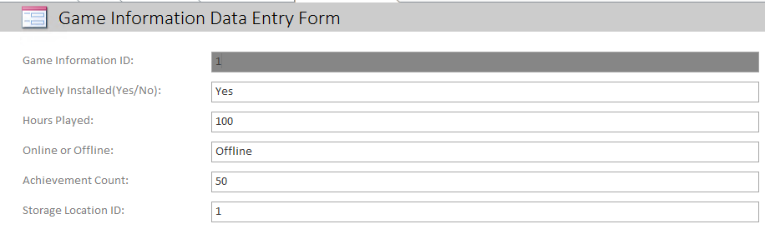
IST 659: Data Admin Concepts & Database Management
After the initial database setup in SQL I was able to connect the database to Microsoft access.
Through Microsoft access I was able to create a new, user friendly interface for uploading game information to the database.
The top form is used to fill in data for the video game table from my logical diagram and the bottom form is used to enter data into the Game Information table.
Through access the data entry became much easier.

Slide 28
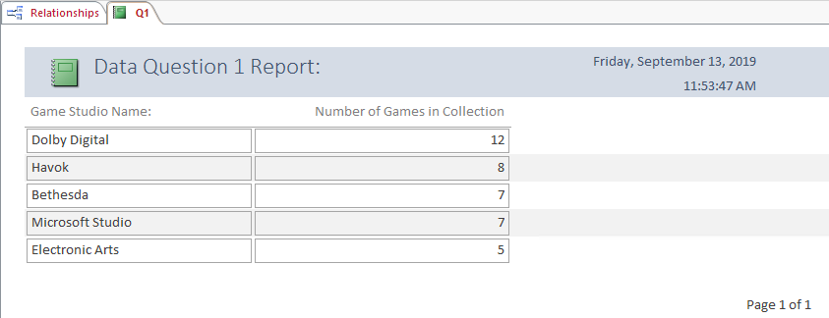
IST 659: Data Admin Concepts & Database Management
Once the data was put into the database format it was queried to find out more information on the collection.
The first question I wanted to answer was which game studio is most prevalent in the collection.
To the right are the top 5 most common game studios in the collection.

Slide 29
Satisfied Learning Objectives
Collect and organize data:
Most of the data for this project had to be classified, organized and copied over by hand. The raw data, however, came in multiple media as some games had physical copies while others only existed digitally. The collection process involved manually scanning game cases and digital descriptions for the appropriate data points, additionally online resources were used to find unlisted information. Once the underlying data was gathered it had to be organized to fit the relational model. This database format allows for the most complete control of the data collection and organization process, including the datatype, data rules, and format necessary for data entry.

Slide 30
Conclusion
This portfolio has been a collection of data science projects that best exemplify the 7 Core learning objectives for the Applied Data Science program.
Throughout the presentation, specific examples are cited during each project where a particular learning objective was satisfied.
These are the most demonstrable examples, but the core learning objectives were integral parts of other classes, assignments, and projects.
Throughout the program each learning objective is applied repeatedly to ensure responsible data practices, from collection through to presentation and even implementation.
These methods foster an environment that equips new data scientists with the skills necessary to make their own findings and express them in meaningful ways.

Slide 31
References:
Fantasy Football Analysis: https://www.kaggle.com/kendallgillies/nflstatistics
Presidential Nomination Speeches: https://www.presidency.ucsb.edu/,
https://www.danielsoper.com/sentimentanalysis/default.aspx
https://www.thebalance.com/unemployment-rate-by-year-3305506
https://www.officialdata.org/, https://stooq.com/q/d/?s=%5Edji&c=0
https://fraser.stlouisfed.org/files/docs/publications/histstatus/hstat_1957_cen_1957.pdf
https://fred.stlouisfed.org/series/MEHOINUSA672N
https://www.taxpolicycenter.org/statistics/historical-highest-marginal-income-tax-rates
https://news.gallup.com/poll/1669/general-mood-country.aspx
https://inflationdata.com/Inflation/Consumer_Price_Index/HistoricalCPI.aspx?reloaded=true

Slide 32
References cont’d
NFL Big Data Bowl: https://www.kaggle.com/c/nfl-big-data-bowl-2020/data
Video Game Database: compiled from my own collection.
Portfolio github repository link: https://github.com/cjgendro/Connor-Gendron-Data-Science-Portfolio

