Slide 1
Water mask for SWOT rivers
Fangfang Yao¹, Colin Gleason², J. Toby Minear¹
¹Cooperative Institute for Research in Environmental Sciences (CIRES), University of Colorado Boulder
²Department of Civil and Environmental Engineering, University of Massachusetts Amherst

Slide 2
Data and method
Sub-meter
cloud-free
Pléiades images
SWORD
data
Reaches
Reach nodes
SWORD
data
Bounding
box
Max width
flow direction
Reach ROIs
Node ROIs
Masked
Pléiades images
Masked
Pléiades images
NDWI
NDWI
Water mask
raster (0.5 m)
Water mask
vector (10 m)
Summary csv (ID, area, etc)
Summary csv (ID, area, etc)
Water mask
vector (10 m)
Water mask
raster (0.5 m)

Slide 3
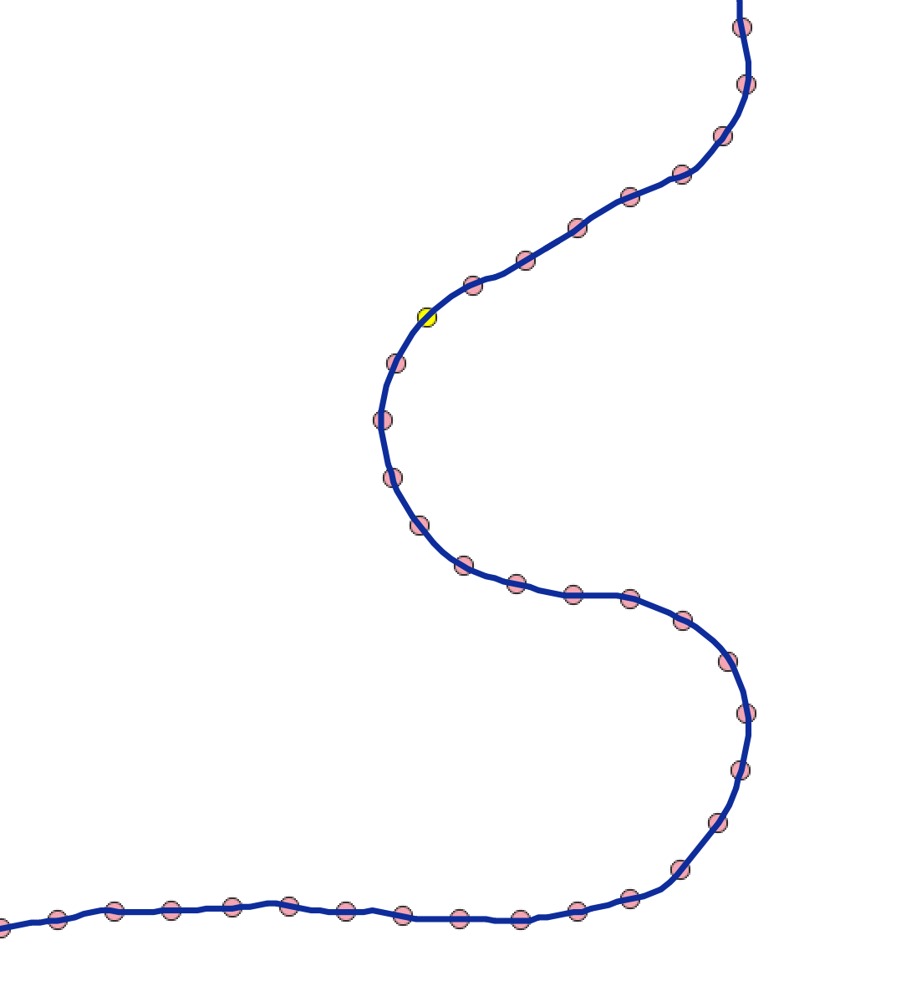
Illustration on node ROI generation
SWORD node
SWORD reach

Slide 4

Illustration on node ROI generation
Max width at node b
Reach section
Flow direction
Channel cross section
Max width at node a

Slide 5
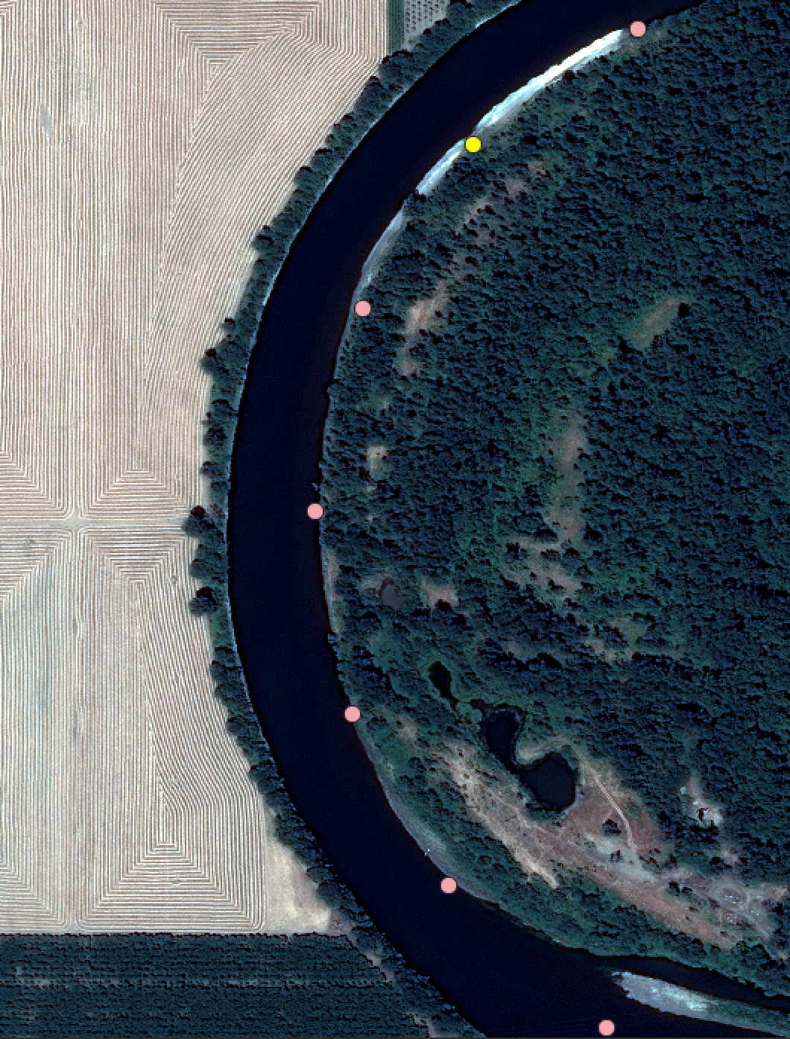
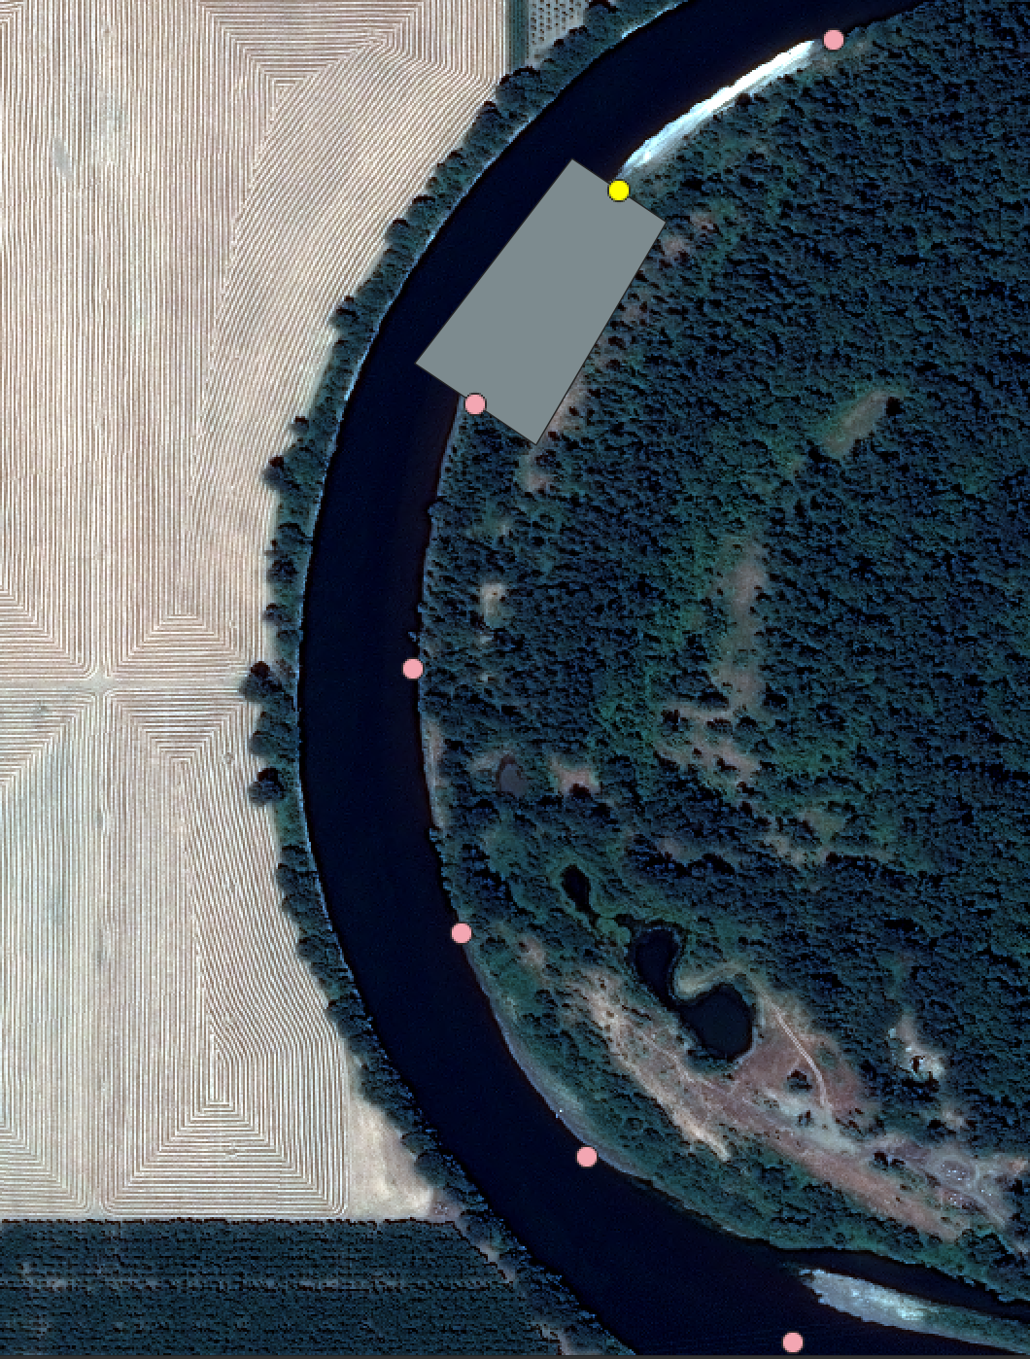
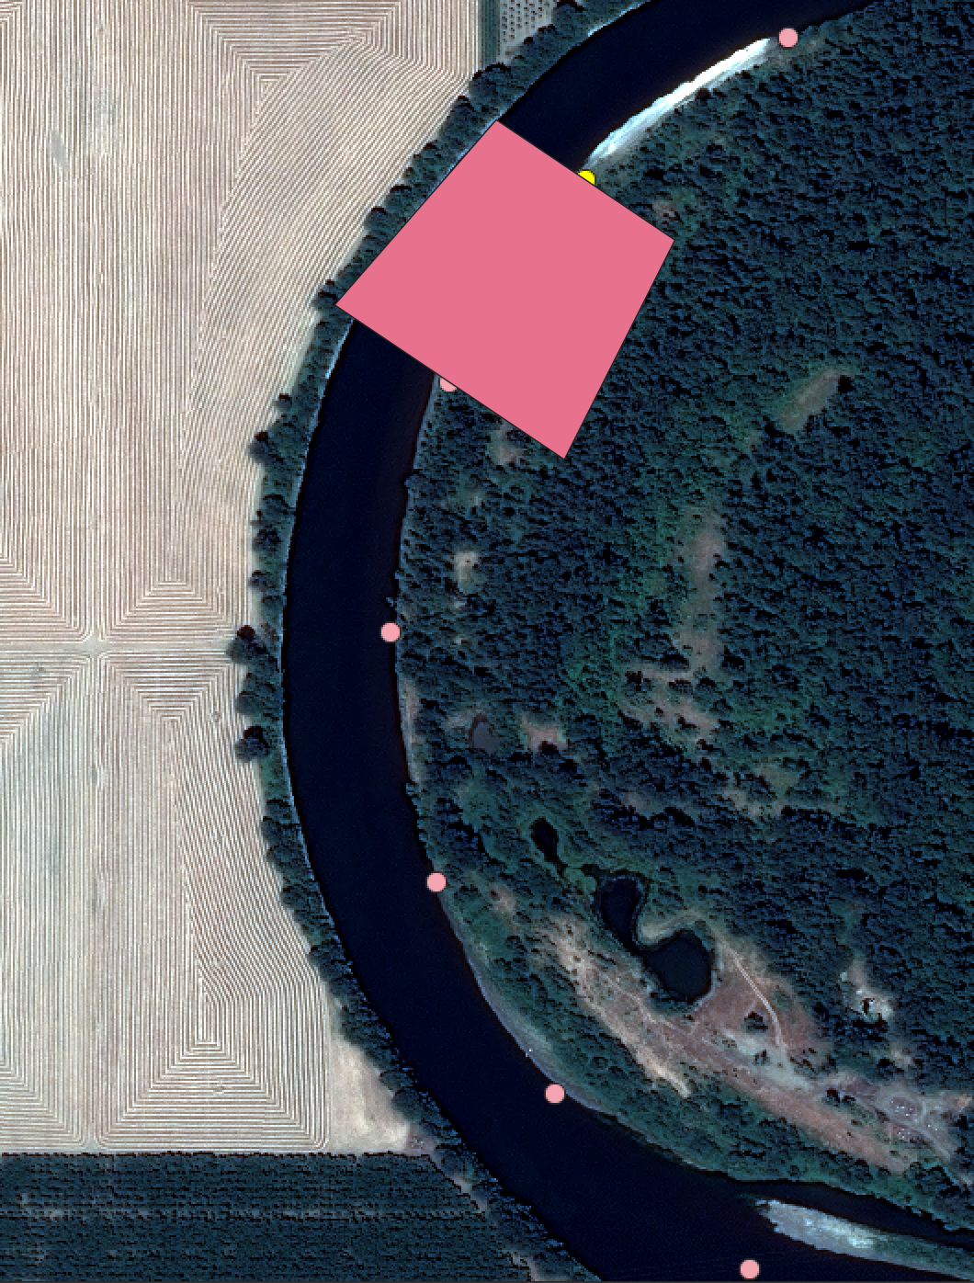
Errors in SWORD and solutions
Original data
Node ROI based on max width
Add a scaling factor on max width

Slide 6

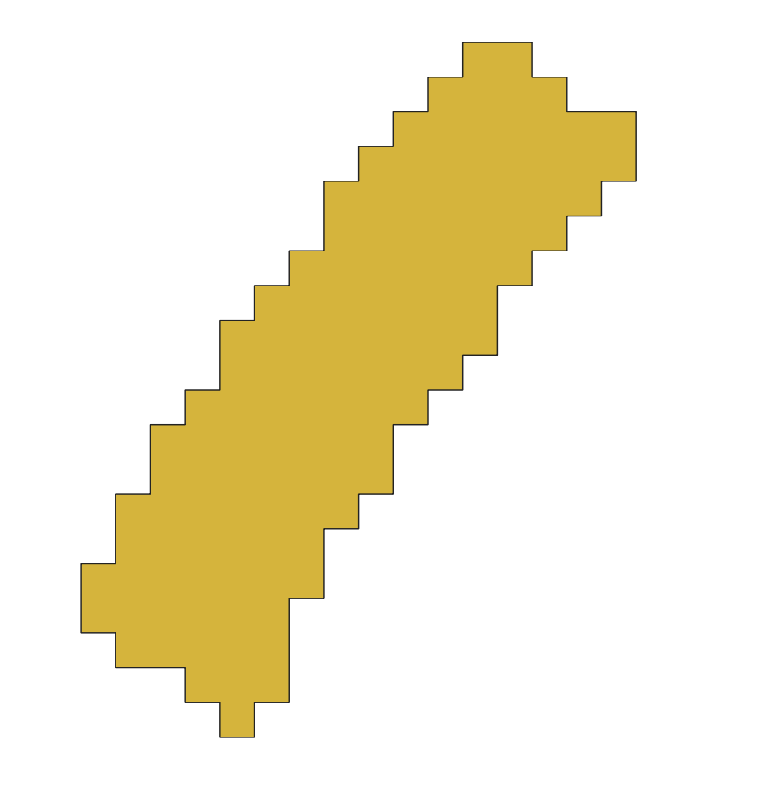
Derived data deliverables
Water mask raster (0.5 m)
TIFF format
Water mask vector (10 m)
Shapefile format
Summary file
csv format
ReachID | NodeID | Area_m2 | Area_err_m2 | Date | Time (to be added)
78220000231 | 78220000230031 | 18,523.07 | 1,944.18 | 2022-07-25
78220000231 | 78220000230041 | 17,121.51 | 1466.07 | 2022-07-25
78220000231 | 78220000230051 | 17,868.71 | 1459.57 | 2022-07-25

