Slide 1

Lab Book 1.0. Waveguides
Student: Andreoli Giorgio, Molinos Candela

Slide 2
Instructions General
SCRIPTS
From GitHub →
Fork the repo: https://github.com/cccanvas-upv/cifoin-lab1.git
Clone the repo using VSCode
Run the Jupyter Notebook:
WAVEGUIDES_Student.ipynb
W (width)
W (width)
Core
Core
h_core
h
(height)
Cladding
Cladding
Slab
h_slab
deep waveguide
shallow waveguide

Slide 3
Learning outcome #1 – Effective index of a waveguide
INSTRUCTOR:
Present Python and GDSFactory: materials, output, results.
Explain how to run a simulation for a particular cross-section.
Showcase how to change between shallow and deep waveguide.
Describe how to change the wavelength and width for the waveguide analysis.
Describe the outputs.
ALL EXAMPLE #1: waveguide width 1.2 µm, deep wvg, wavelength start and end same 1.55 µm → all ”Run”
ALL: Follow instructor, that will show how to 1) plot mode, 2) explore the results (neff …)

Slide 4
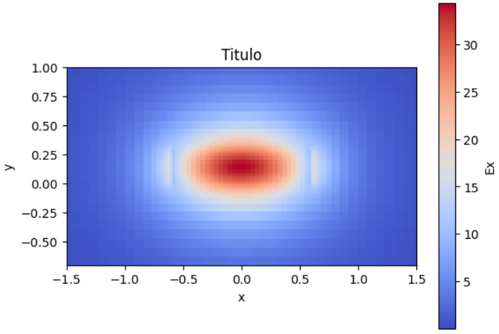
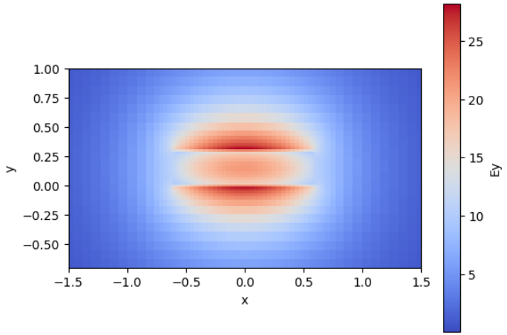
Results from LO.1
The effective indexes are: for TE0 1.605, for TM0 1.528, for TE1 1.450, for TM1 mode 1.433.
Because the indexes for TE and TM 1 modes are lower than the cladding index, they are not guided and so we only have the 2 guided fundamental modes. Shown above are the field cross section plot of the 2 aforementioned modes TE0 and TM0 respectively. TE0 is shown through the x component, since it is horizontally polarized. Being the waveguide wider than taller this causes TE to be better confined than TM and to therefore have a larger effective index. On the other hand, the vertically polarized TM0 field is shown via its y component. These 2 are the only present guided modes.

Slide 5
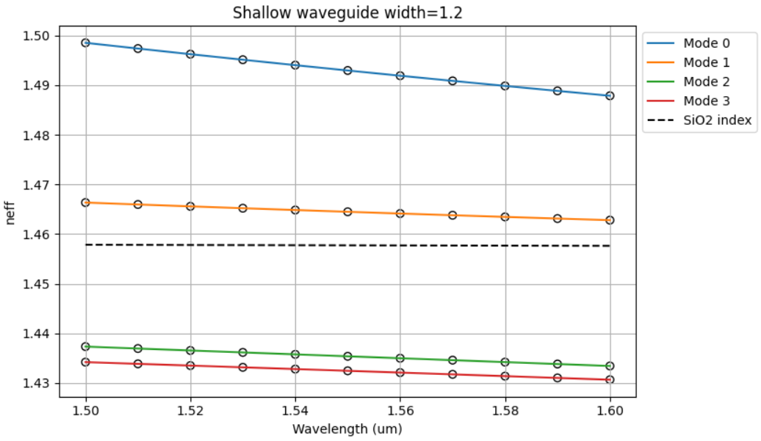
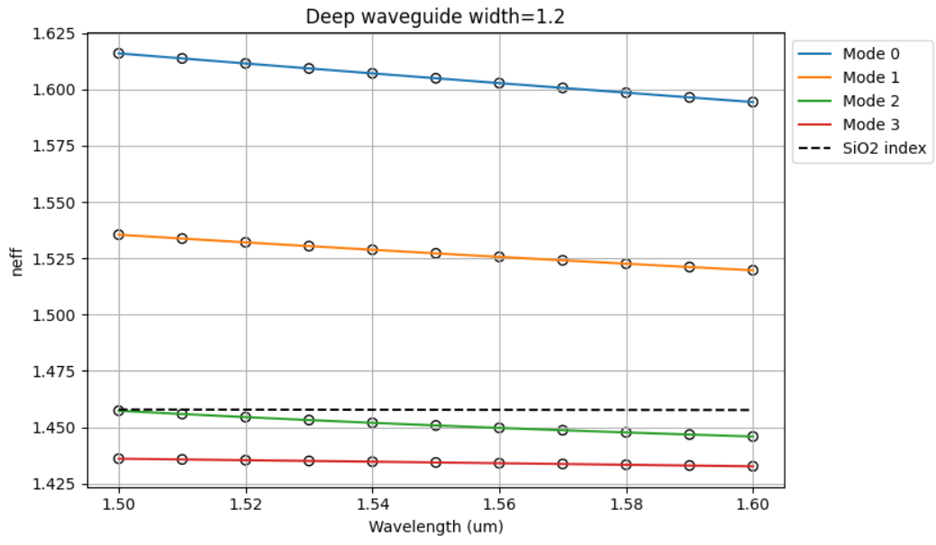
Learning outcome #2 – Wavelength behavior Wavelength 1.5-1.6 µm (step 0.01 µm) – width 1.2 µm
shallow waveguide
Paste plot here
deep waveguide
Paste plot here
slab = 150nm
High refractive index is indicative of stronger field confinement in the core, therefore lower dispersion in the cladding. As the wavelength increases, its size compared to the core increases as well, causing higher dispersion in the cladding and therefore the refractive index decreases. The Fundamental mode 0 is the one providing higher confinement, while as we look at higher order modes, the index decreases for each one of these since the higher number of lateral lobes increases trasversal complexity and causes higher dispersion. For these same reasons the Deep waveguide provides higher indices since the confinement is aided by the thicker core. As commented during the laboratory we see that for bot waveguides we only have mode 0 and mode 1 propagating while mode 3 and 4 have a lower index than that of the material, causing these modes to not be properly guided(higher leakiness)

Slide 6
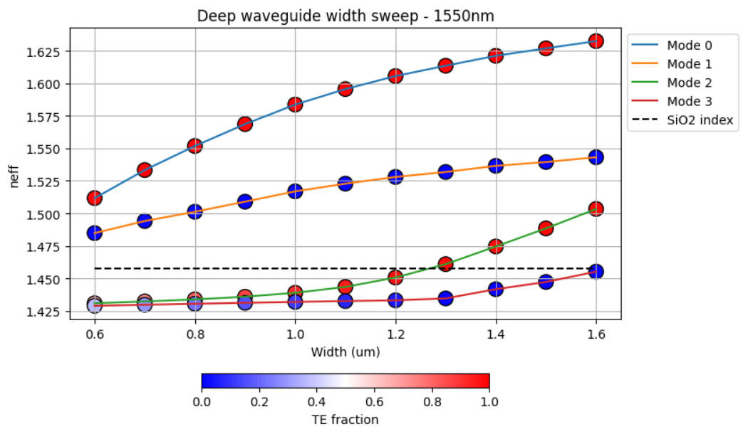
Learning outcome #3 – Width dependence Width 0.6 - 1.6 µm (step 0.1 µm) – Wavelength 1.55 µm
As for the previous scenario, here an increase in the width provides better lateral confinement, increasing the index. For higher, already better guided modes, the increase in more gradual, while it is rapid in case of mode 2 and 3 since larger width allows for propagation in the waveguide, while for lower values these 2 modes were not present. In fact mode 2 starts appearing at a width of around 1.25 μm while mode 3 at 1.6 μm. Polarization is affected since highly dependent on the field conditions at the boundaries. For guided modes we do not have a noticeable variation since they are already well confined and their field distribution is “stable”, but for unguided modes, as their index exceeds the one of the cladding, their polarization better aligns with that of TE and TM modes respectively.
So as a mode is confined, increasing its confinement does not affect its already balanced field alignment, but as a mode goes from unbounded to effectively confined, the field aligns inside the waveguide, affecting the previously chaotic polarization and making it oriented as expected.

Slide 7
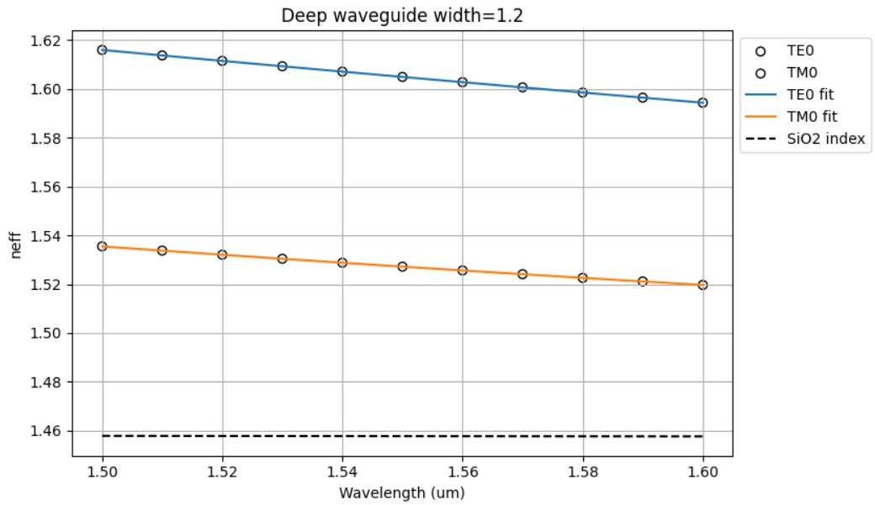
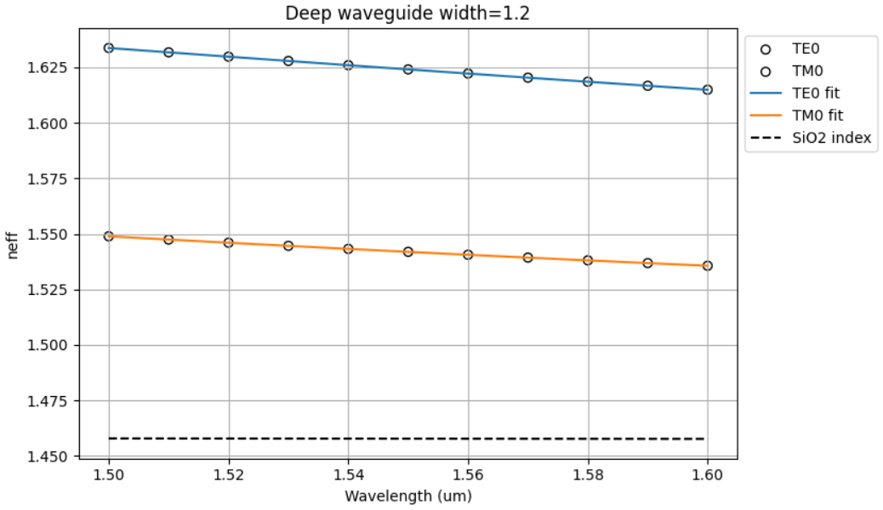


Learning outcome #4 – Waveguide compact model - Find the compact models of the following waveguides: Deep waveguide, h=300nm, w=1.2um - Shallow waveguide, core h=300nm, slab h=150 nm, w = 1.2um
shallow waveguide
neff_TE0 vs $λ$ with the second-degree polynomial fit
& neff_TM0 vs $λ$ with the second-degree polynomial fit
deep waveguide
neff_TE0 vs $λ$ with the second-degree polynomial fit
& neff_TM0 vs $λ$ with the second-degree polynomial fit
slab: 150nm
For deep waveguide for TE0 mode n1=1.6049 n2=-0.2161 n3=0.0973 the group index for TE0 mode is ng=1.9399 the dispersion for TE0 mode is D=1.0067e-15 for TM0 mode n1=1.5271 n2=-0.1579 n3=0.15383 the group index for TM0 mode is ng=1.7720 the dispersion for TE0 mode is D=1.5906e-15. For the shallow waveguide, which has a slab of 150 nm, or TE0 mode n1=1.6241 n2=-0.1882 n3=0.0956 the group index for TE0 mode is ng=1.9157 the dispersion for TE0 mode is D=9.8954e-16 for TM0 mode n1=1.5418 n2=-0.1326 n3=0.1480 the group index for TM0 mode is ng=1.7474 the dispersion for TM0 mode is D=1.5305e-15.
As previously commented for n1 the index is higher for te mode thanit is for tm because the slab is wider than taller and te is polarized horizontally. The shallow waveguide also provides better confinement by introducing a slab of high index material around the core. The group index ng is lower for TM which means this mode travels slightly faster than TE in this waveguide and the presence of the slab decreases ng, helping to limit the dependancy on the wavelength and improving the group velocity.
Lastly the dispersion coefficient is aboundantly higher for TM since this mode is closer to the cutoff frequency, being the frequency at which the mode stops to be guided, and for the same reason the presence of the slab for the shallow case, helps limiting the dispersion for both modes, since it improves their confinement.

Slide 8
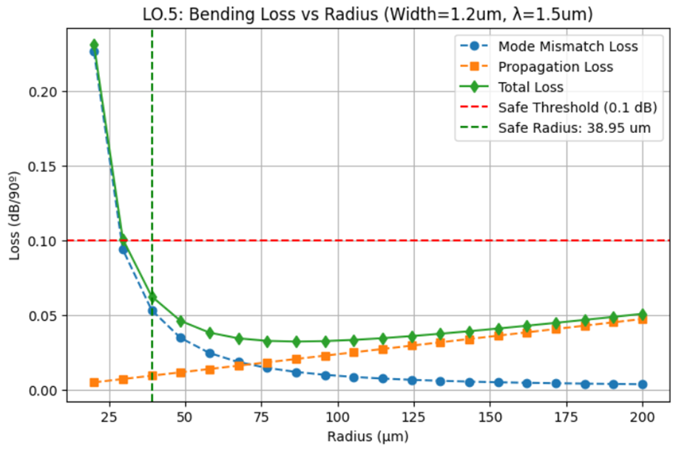
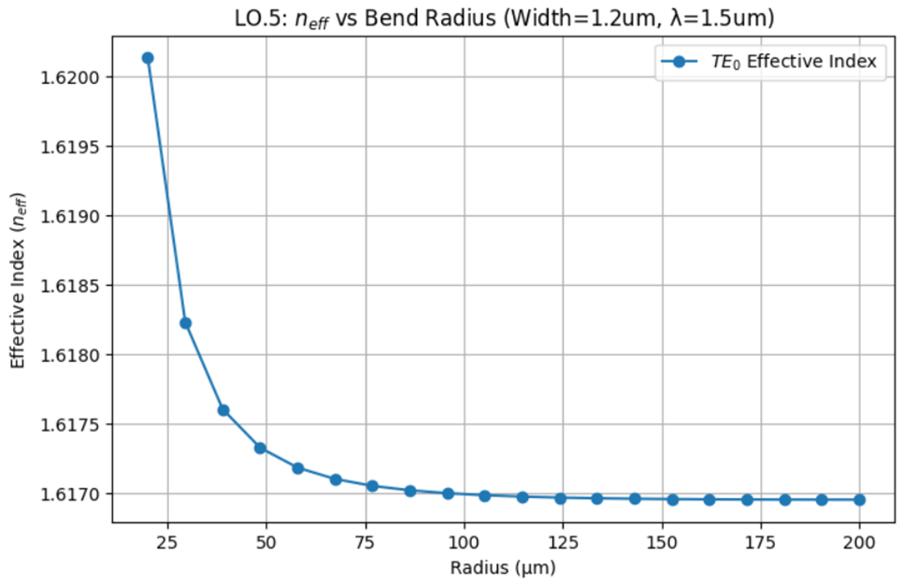
Learning outcome #5 – Bend waveguide radius vs. loss – deep Find neff_TE0 for wvl 1.55 µm, width 1.2 µm for R=25,50,75,100, 125,150 µm
deep waveguide
Paste Total Loss (dB/90º) vs R & neff_TE0 vs R
The loss is dominated by the mode mismatch for low radius values because strong physical bending shifts the mode significantly toward the edge of the waveguide causing stronger radiation in the cladding (reduced containment of the mode). The exact same shape is observed for the effective index which increases as the bending becomes stronger, because it is an index of how much the mode differs from the straight case. As the bending becomes gentler this effect is reduced exponentially until propagation loss becomes more significant, because of this we have an optimal radius which causes the total loss to be minimized at around 75 . As the radius decreases the total path throughout which attenuation happen becomes longer and that is why propagation loss increases. So the bending makes the mode different from the one of a straight waveguide, causing mismatch, passed a certain value the mode is approximately equal to the straight case.

Slide 9
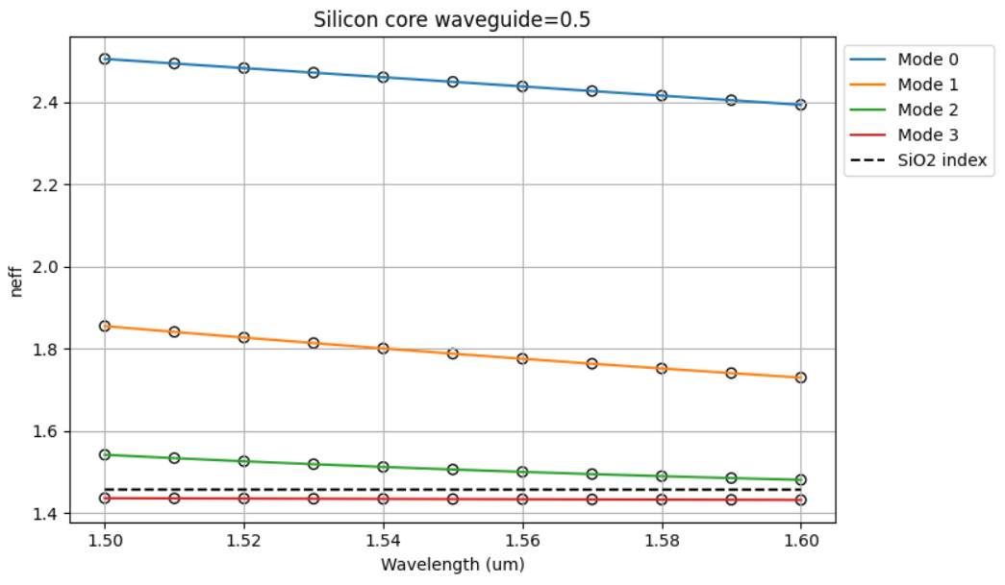
EXTRA 1: LO2 with Silicon (Si) core and 220 nm height and 500 nm width
On the upper graph we se the wavelength dependency of the first 4 modes for the silicon waveguide, on the lower side we present again the same graph for the deep waveguide of the previous examples.
The higher refractive index of Silicon has an immediately evident effect, rising the effective indexes of all modes substantially such that TE1 results over the containment threshold and is therefore guided, where the one of the Silicon Nitrate case is below the threshold.
It's important to mention that this behaviour is observed for a Silicon waveguide which is much smaller in size compared to the Silicon Nitrate one. For this reason the new waveguide shows great preliminary results for use cases where we need a compact that must sustain multiple modes in its smaller area

Slide 10
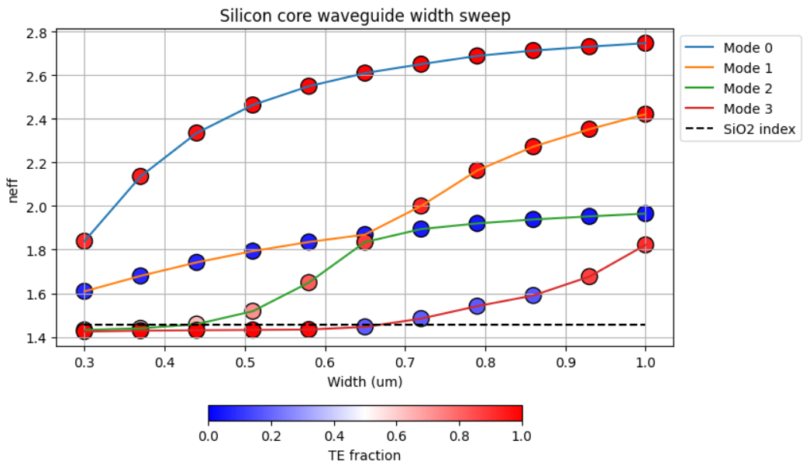
EXTRA 2: width dependance for Silicon core wavelegth
Like for the previous slide, we see a clearly higher overall index, for the same reasons we have just stated. An important observation is in the behaviour of modes TM0 and TE1 that show an example of anticrossing.
Due to the extreme close confinement of modes in the Silicon, and due to the high refractive index contrast between cladding and core, these 2 modes get very close, as TM0 rises slowly and the lower TE1 rises much faster. Instead of swapping, having TE1 surpass TM0, both modes have a modal switch passing from one polarization to the opposite.

Slide 11
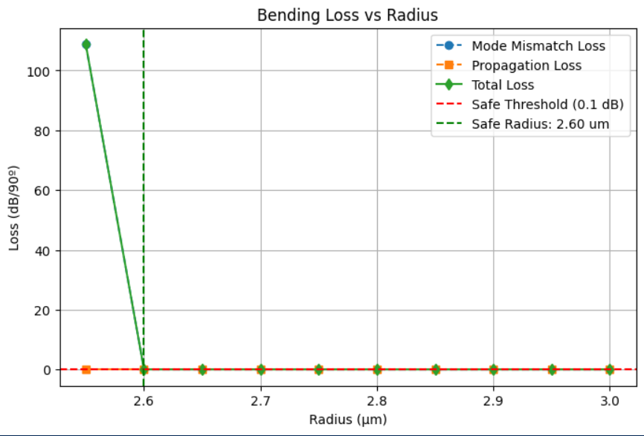
EXTRA 3: safe radius calculation for Silicon core wavelength
Here we show the approximate safe radius for the Silicon core waveguide which shows to be of an extremely low value.
This low Radius acts as a switch, because for lower values the loss spikes almost instantly with a near vertical shape, whereas for values just above it the behaviour is immediately identical to that of a straight waveguide. This proves the great robustness to bending mismatch losses of this silicon waveguide, aided by the strong confinement capacities of its core.

Slide 12

Thank you

