Slide 1

Lab Book 3.0 Circuits and Compact Models
Student: Candela Molinos Rodriguez-Murcia, Giorgio Andreoli

Slide 2
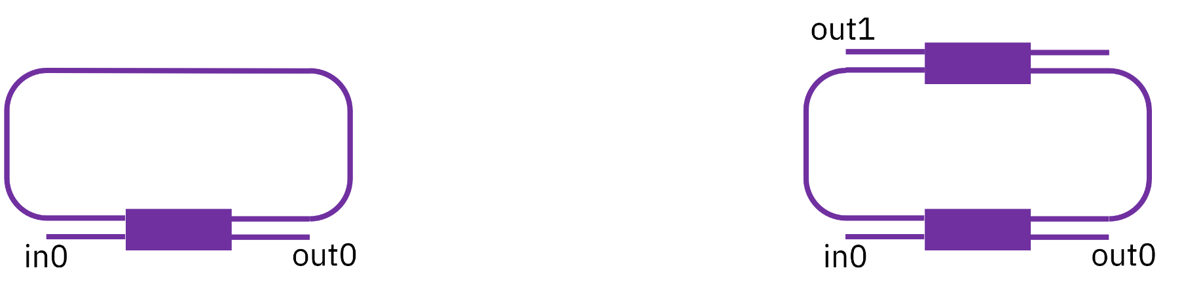
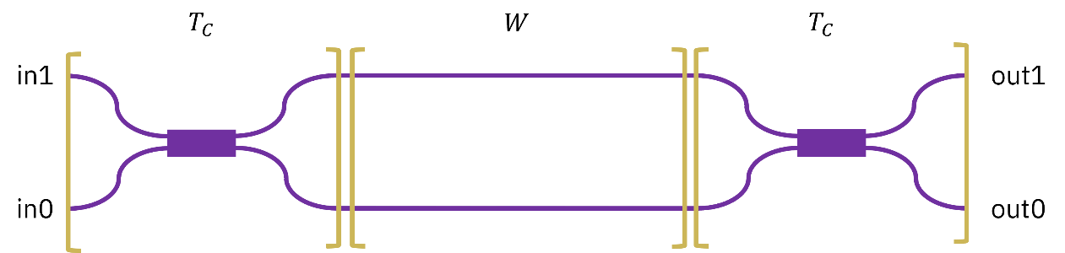
Instructions General
SCRIPTS
From GitHub →
Fork the repo: https://github.com/cccanvas-upv/cifoin-lab3.git
Clone the repo using VSCode
Run the Jupyter Notebook:
CIRCUITS_&_COMPACT_MODELS.ipynb
Devices to be studied:
Mach-Zehnder Interferometer (MZI)
Ring Resonators (RR)

Slide 3
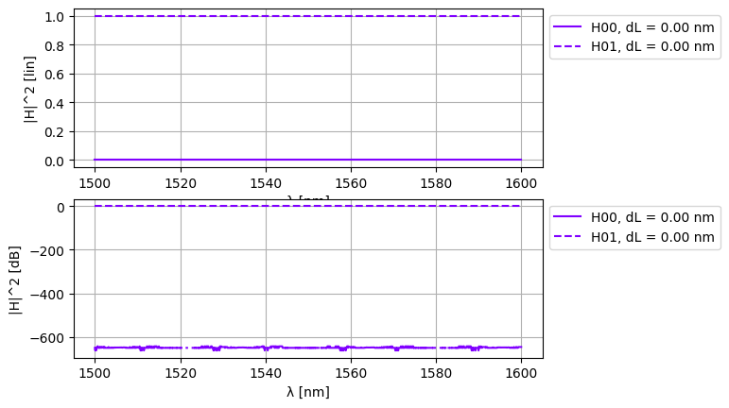
Learning outcome #1a – Perfectly balanced MZI
INSTRUCTOR:
Present Python and GDSFactory implementation of the Compact Models and Circuit Model
Describe how to simulate usin SAX library
Describe the outputs.
ALL EXAMPLE #1:
wvl [1500-1600] step 0.001
dL = 0
Kin = Kout = 0.5 for all wvl
MZI transfer functions
Paste plot here
if dL = 0 we have perfect destructive interference at the output, due to the couplers being both symmetrical and introducing both a pi/2 phase shift. The resulting overlapsing signals are identical and out of phase

Slide 4
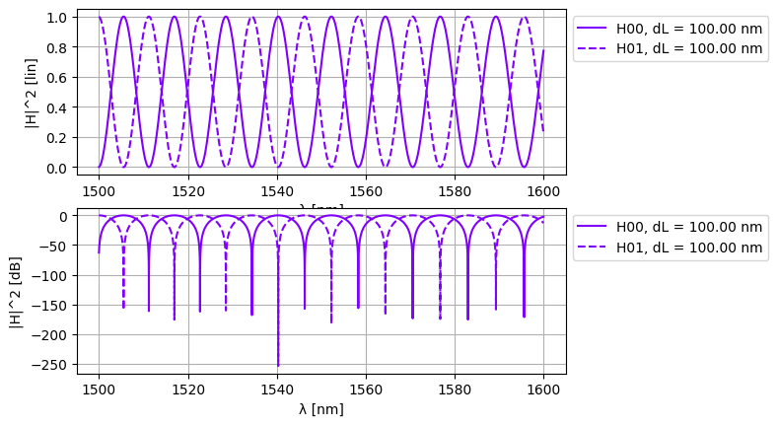
Learning outcome #1b – Unbalanced MZI
Setting dL to 100 µm creates a path length difference that makes the phase shift depend on wavelength, so the output oscillates sinusoidally. H00 and H01 are always complementary. The FSR from the formula is about 5.72 nm and this matches what the plot shows.
FSR =
λ² / (n_g · L) =
(1.55 µm)² / (2.0 · 50 µm) =
24.025 nm

Slide 5
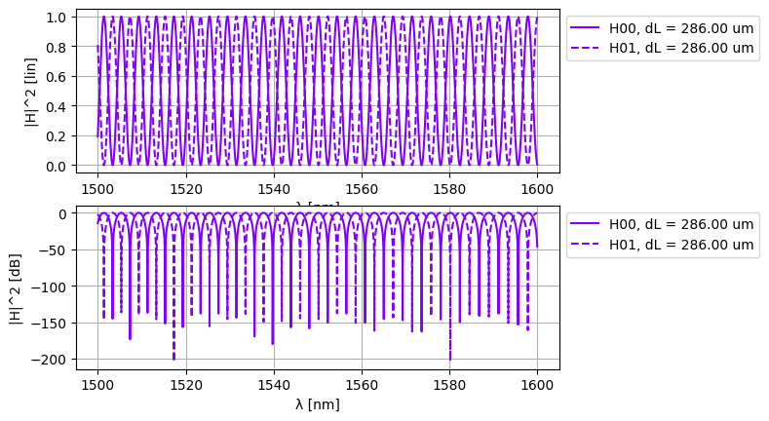

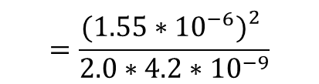
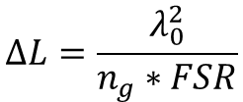
Learning outcome #2 – MZI Design
Design a MZI with FSR = 10 nm at 1550 nm
$$ΔL=\frac{λ_{0}^{2}}{n_{g}∗FSR}$$
$$=\frac{{(1.55∗{10}^{−6})}_{}^{2}}{2.0∗4.2∗{10}^{−9}}$$
$$=286.25 um$$
To get FSR equal to 2 nm we need dL equal to 286 µm from the formula dL equal to lambda squared divided by ng times FSR. The simulation with this value gives fringes spaced exactly 2 nm apart across the full window, confirming the design works.

Slide 6
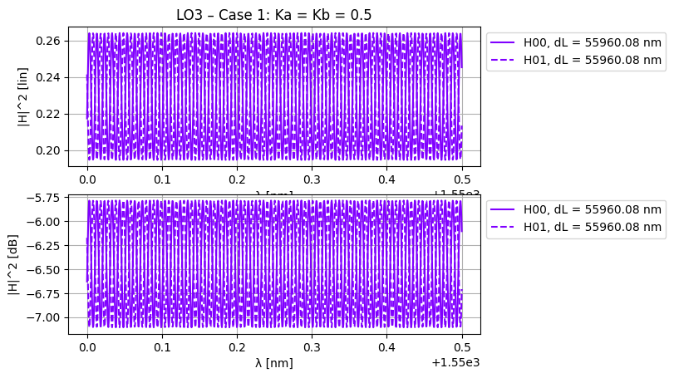
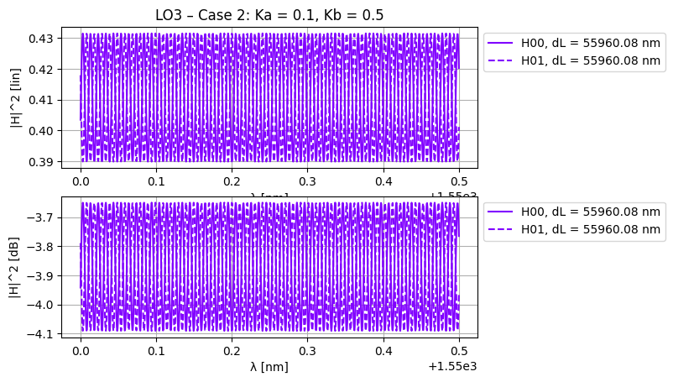
Learning outcome #3 – Delay imbalance with loss
Fringe visibility
Case 1. Simulate for Ka = Kb = 0.5 for all wvl
Case 2. Simulate for Ka=0.1 for all wvl
Kb=0.5 for all wvl
In Case 1 with Ka equal to Kb equal to 0.5 there is an interference pattern but the visibility is low. The long arm is about 57 mm longer so it loses around 22 dB more than the short one, which makes the two signals very unequal at the output and gives an ER of about 1.25 dB. In Case 2 with Ka equal to 0.1 most of the power stays in the short arm so there is almost nothing left in the long arm to interfere with. The fringes nearly disappear and the ER drops to around 0.4 dB. The key point is that interference only works well when the two amplitudes are similar.

Slide 7
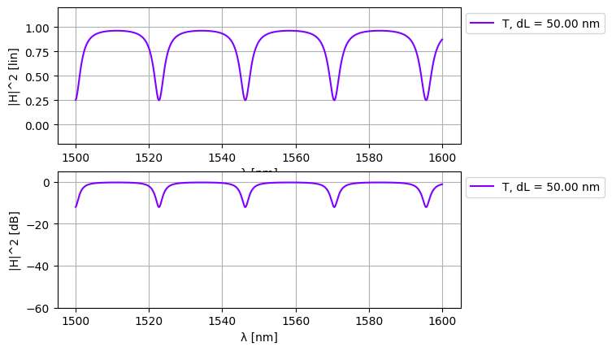
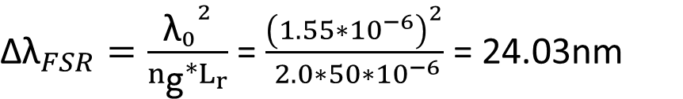
Learning outcome #4 – Ring Resonator
Single ring resonator – most simple case Constant coupler K (no wavelength variation)
The ring shows periodic dips every 24 nm. Between resonances transmission stays near 1 and at resonance light couples into the ring and gets absorbed by propagation loss. The FSR calculated from the formula with ng equal to 2.0 and L equal to 50 µm gives exactly 24.025 nm which matches the plot.
${\text{Δλ}}_{FSR}=\frac{{{\text{λ}}_{0}}^{2}}{n_{\text{g}}∗L_{r}}$ = $\frac{{\left(1.55∗{10}^{−6}\right)}^{2}}{ 2.0∗50∗{10}^{−6}}$ = 24.03nm

Slide 8
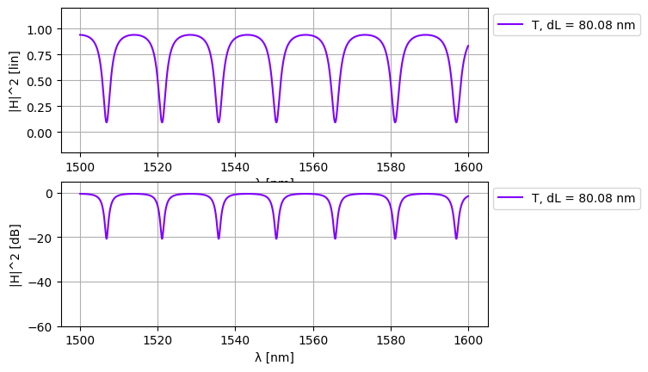
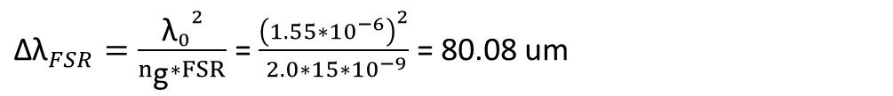
Learning outcome #5 – Ring resonator design
Design the perimeter for a FSR = 15 nm.
${\text{Δλ}}_{FSR}=\frac{{{\text{λ}}_{0}}^{2}}{n_{\text{g}}∗FSR}$ = $\frac{{\left(1.55∗{10}^{−6}\right)}^{2}}{ 2.0∗15∗{10}^{−9}}$ = 80.08 um
The simulation confirms FSR = 15 nm.
With K = 0.5 and loss = 0.02 dB/µm the ring is over-coupled, the notch reaches about −20 dB but not infinity. To hit critical coupling you need K = 1 − a², where a² is the round-trip power transmission. With loss = 0.02 dB/µm and L = 80.08 µm the round-trip loss is 1.6 dB, giving a² = 0.69, so K_crit ≈ 0.31. Setting K to that value would make the notch go to −∞ theoretically.

Slide 9
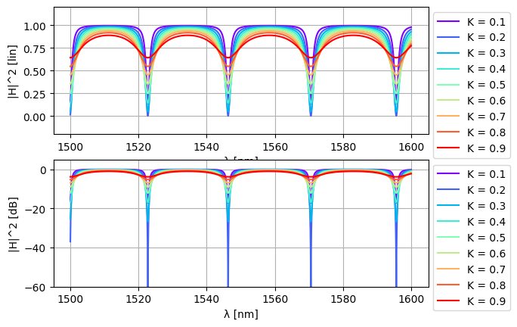
Learning outcome #6a – Effect of K Change K value between 0.1 and 0.9 in steps of 0.1
As K goes from 0.1 to 0.9 the dips get wider and shallower. At K equal to 0.2 the dip reaches zero which means critical coupling, the point where the coupled power exactly matches the internal round trip loss. Below 0.2 the ring is under coupled and the dip does not reach zero. Above 0.2 it is over coupled and the dip rises back up. So K equal to 0.2 is the closest case to critical coupling in this sweep.

Slide 10
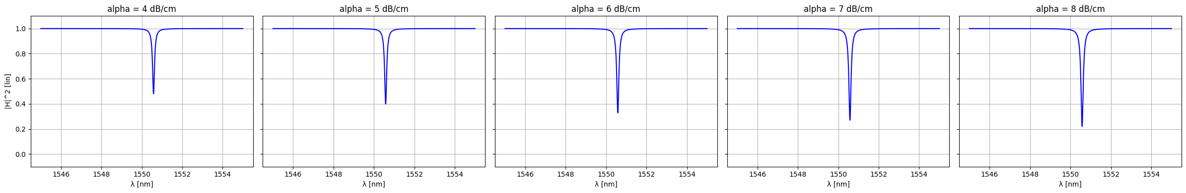
Learning outcome #6b – Effect of loss
Change losses value between 0 and 8 dB/cm in steps of 1
With K fixed at 0.04 and increasing loss from 4 to 8 dB per cm the dips get progressively deeper. This happens because higher loss pushes the critical coupling condition closer to the K value we are using. All cases are still over coupled but 8 dB per cm is the closest to critical coupling since its dip goes the lowest.

Slide 11

Thank you

