Slide 1

Lab Book 3.0 Circuits and Compact Models
Student: Giorgio Andreoli, Candela Molinos Rodríguez-Murcia

Slide 2
Instructions General
SCRIPTS
From GitHub →
Fork the repo: https://github.com/pascualmunoz/cifoin-lab4.git
Clone the repo using VSCode
Open folder / repo in VSCode
Open terminal: uv sync
Run the Jupyter Notebook:
LAYOUT_STUDENT.ipynb
Points
LO1: 3 points
LO2: 3 points
LO3: 1 points
LO4: 3 points

Slide 3
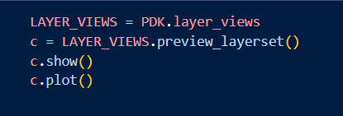
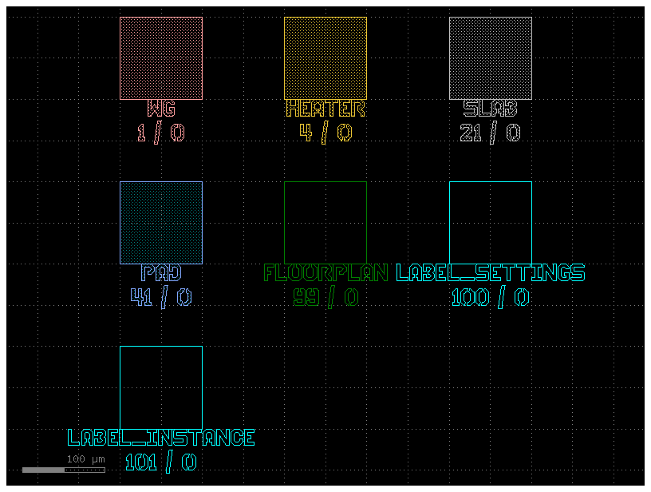
Learning outcome #1a – Notebook section 1. Technology “We will work with the demo UPVfab PDK. Let's view the layer distribution of this PDK”
A PDK is a Process Design Kit, a collection of rules, models and pre-built components that tells you how to design chips for a specific fabrication process.
In general, the layers for layout in a PDK represent the different physical materials and fabrication steps that make up the chip, each one corresponding to something that gets deposited, etched or patterned during manufacturing.
For our particular PDK we find the following layers, with number and label/description:
WG 1/0, the main waveguide layer where light travels, HEATER 4/0, the metal heater used for thermal tuning, SLAB 21/0, the partial etch slab region for rib waveguides, PAD 41/0, the electrical contact pads for wire bonding, FLOORPLAN 99/0, the die boundary and dicing lines, LABEL SETTINGS 100/0, layer for design labels and annotations, LABEL INSTANCE 101/0, layer for instance reference labels.

Slide 4
Learning outcome #1b – Notebook section 1. Technology – 1 slide per component “Use your design results from Lab2 and Lab3 to create layout instances of your designed components: DCs, MMIs, MZIs & Ring Resonators”
Describe component. Example: this is the MMI we designed in Lab2, it is a 2x2 with paired interference, target coupling constant K = 0.5. The relevant dimensions are W_MMI = XX µm L_MMI = YY µm and the I/O positions with respect to center are at +/- dY µm

Slide 5
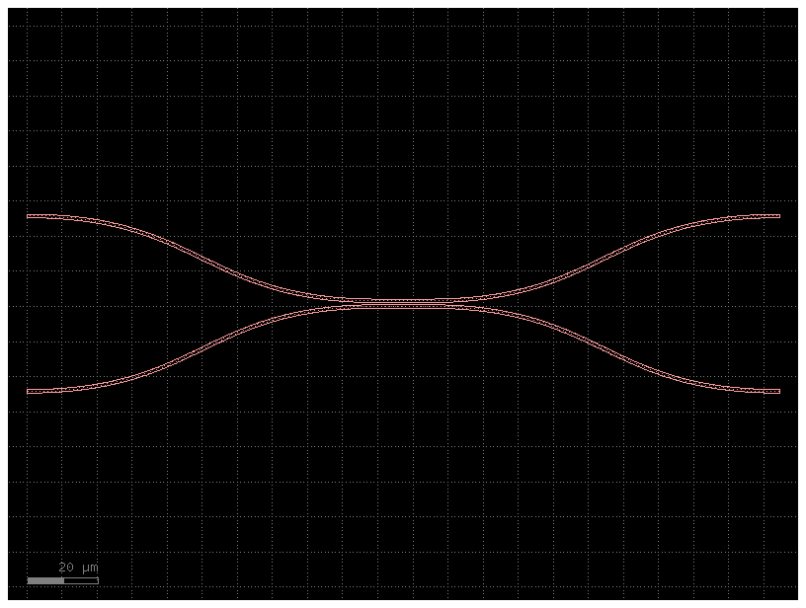
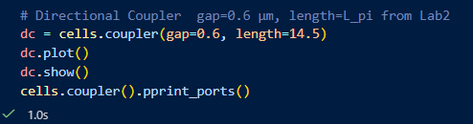
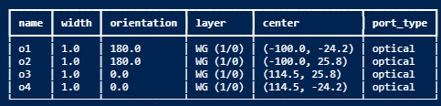
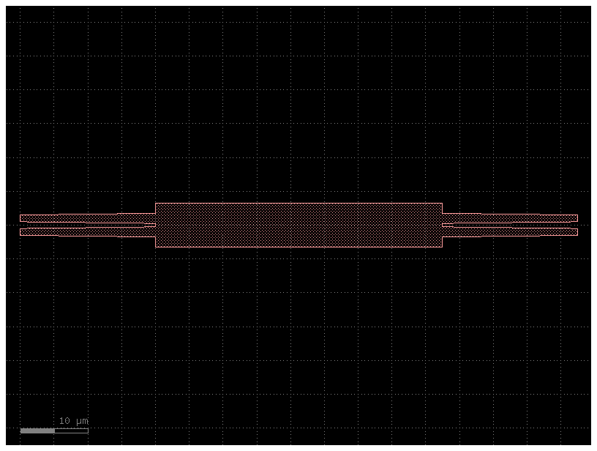
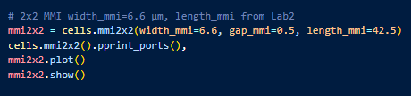
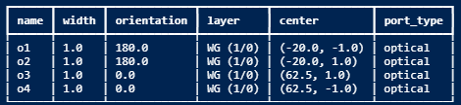
Directional Coupler This is the directional coupler designed in Lab2. It uses evanescent coupling between two parallel waveguides. The waveguide has gap equal to 0.6 µm, and the coupling length is set to Lpi/2 equal to 14.5 µm to achieve a 50/50 power split at 1.55 µm.
2x2 MMI This is the 2x2 MMI coupler designed in Lab2. It uses multimode interference to split the input signal equally between two output ports, targeting a coupling constant K equal to 0.5. The MMI body width is 6.6 µm, the length is 42.5 µm, and the I/O waveguide positions are at plus and minus 1.0 µm from the center.

Slide 6
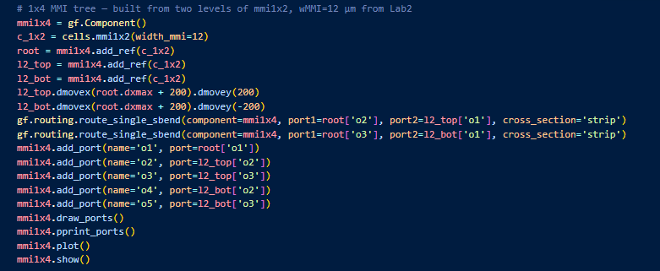
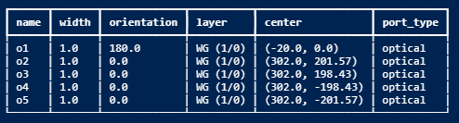
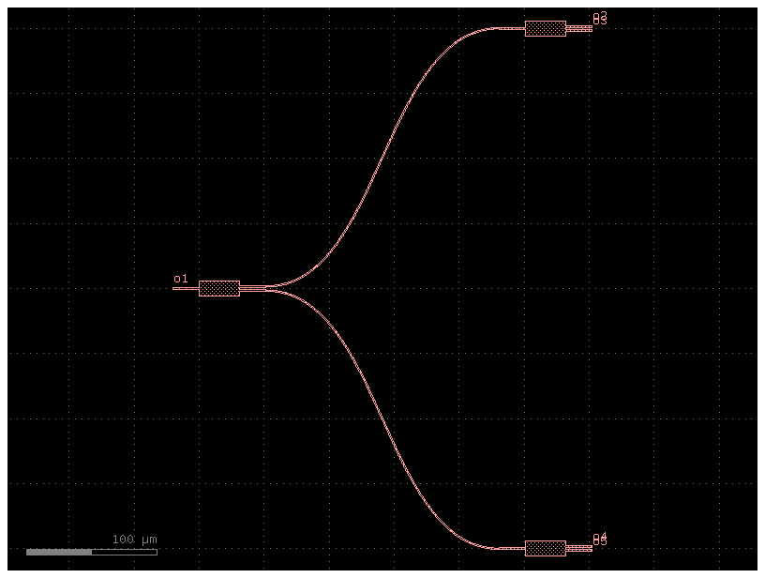
There is no pre-existing 1x4 MMI for cell. , only 1x2 or 2x2, therefore this component could only be achieved with the gf.Component() of the next practice Block
1x4 MMI This is the 1x4 MMI coupler designed in Lab2. It splits a single input into four equal outputs using multimode interference. The MMI body width is 12 µm and the device is built as a two level tree of 1x2 MMI stages.

Slide 7
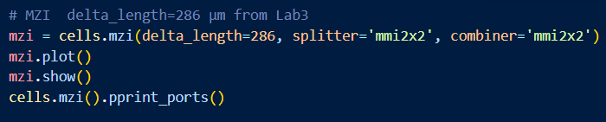
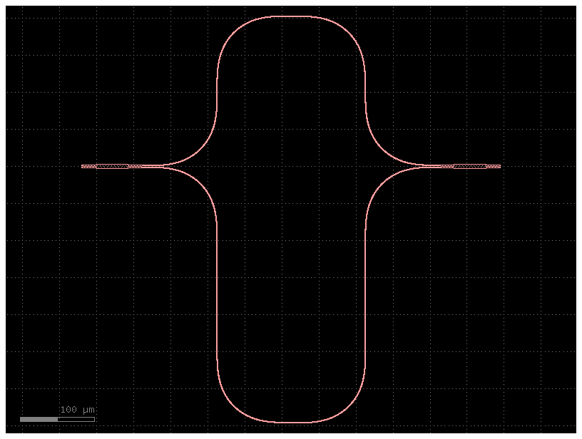
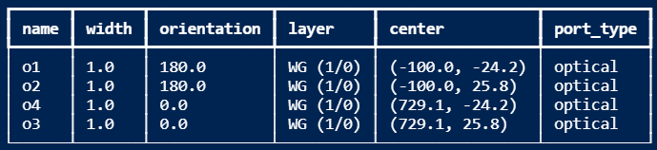
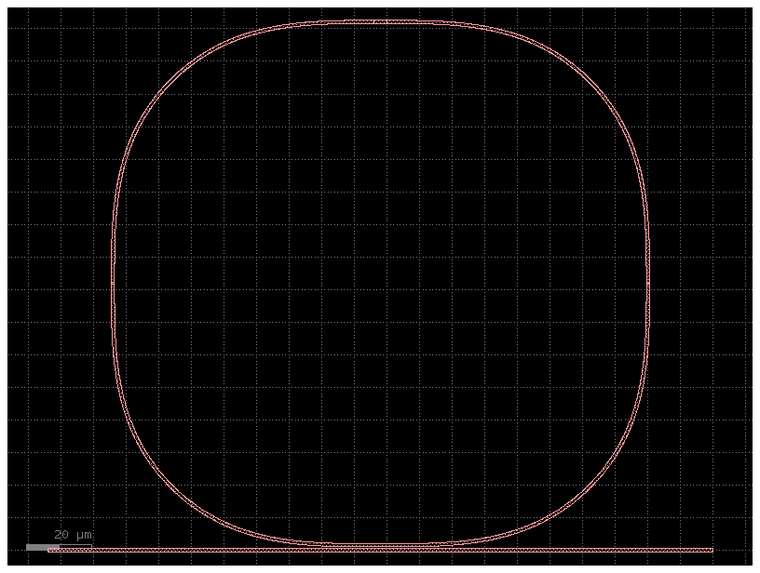
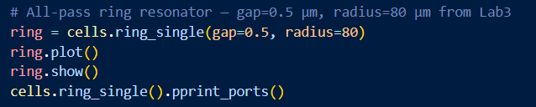
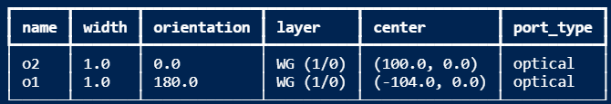
MZI This is the unbalanced Mach-Zehnder Interferometer designed in Lab3. It uses two 2x2 MMI couplers as splitter and combiner, with an arm length difference of 286 µm chosen to achieve a free spectral range of 2 nm at 1.55 µm, using a group index of 2.0.
Ring Resonator This is the all-pass ring resonator designed in Lab3. It uses a 2x2 MMI as the coupler with coupling constant K equal to 0.5. The ring perimeter is 80.08 µm, chosen to achieve a free spectral range of 15 nm at 1.55 µm with a group index of 2.0.

Slide 8
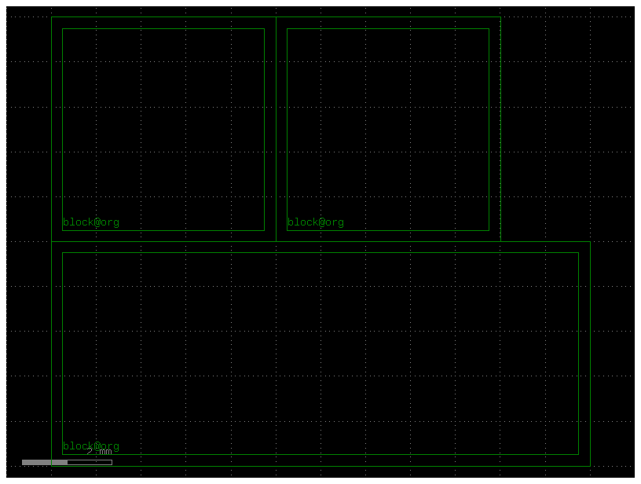
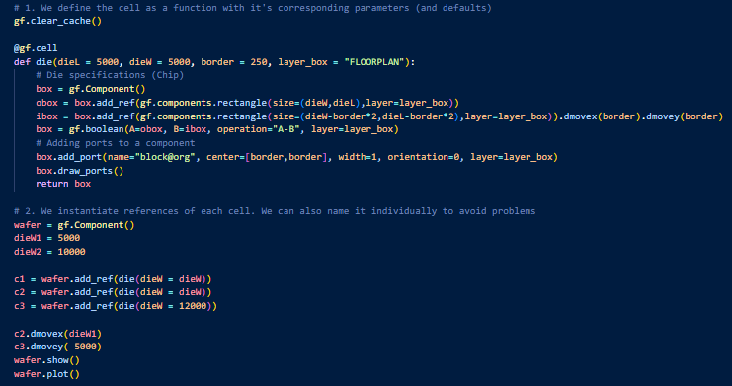
Learning outcome #2a – Notebook section 2. Layout Fundamentals “Once that we have a working 'new' component, we shall convert it into a Cell. This will allow us to have a hierarchical design”
This is the die cell built in Lab4 Section 2. It is a parametric chip boundary with a dicing border of 250 µm, defined as a reusable cell that can be instantiated multiple times with different dimensions. Three instances are shown here on a wafer, each with a different width

Slide 9
Learning outcome #2a – Notebook section 2. Layout Fundamentals – 1 slide per component “Use your design results from Lab2 and Lab3 to create layout instances of your designed components: DCs, MMIs, MZIs & Ring Resonators” → Make cells for all your components

Slide 10
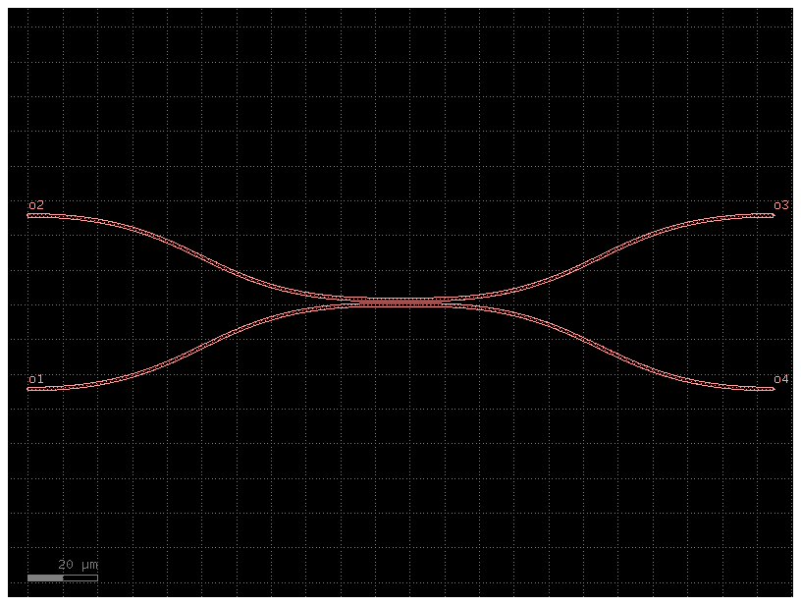
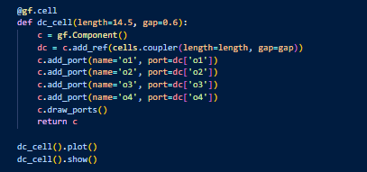

Slide 11
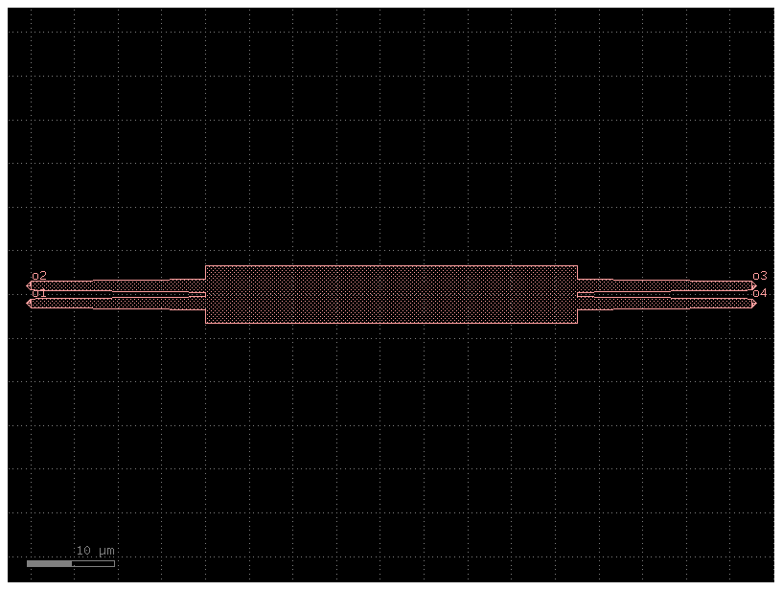
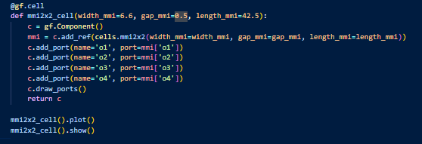

Slide 12
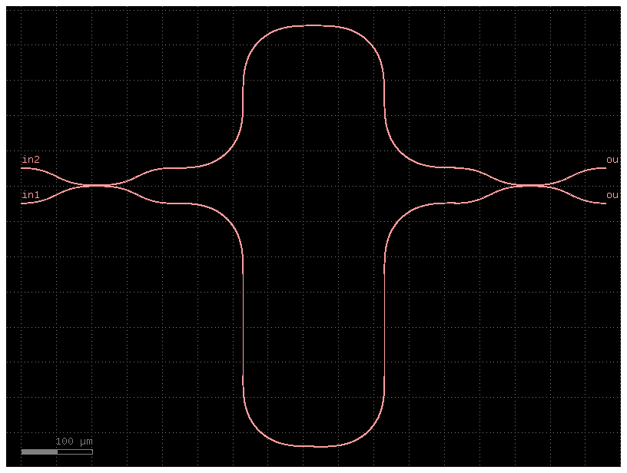
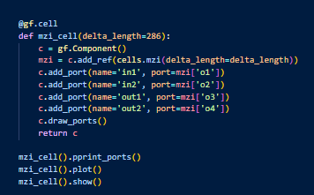

Slide 13
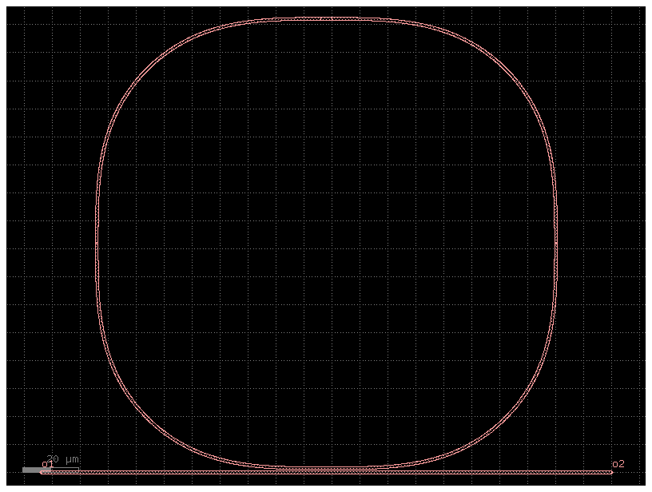
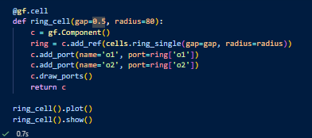

Slide 14
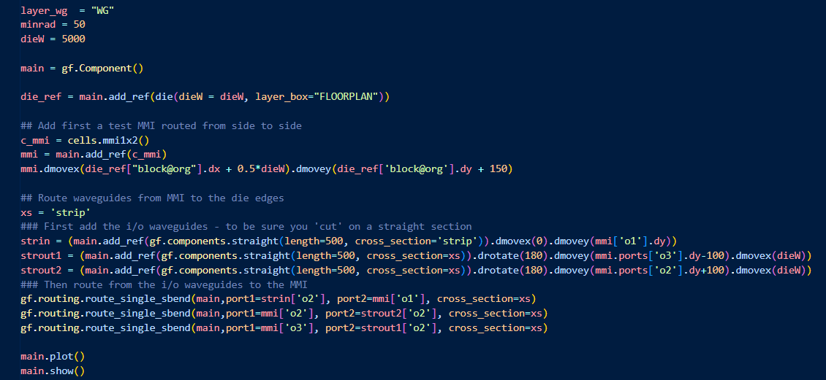
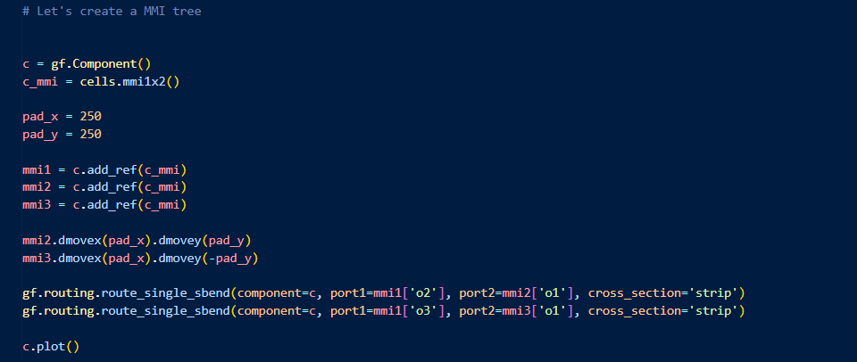
Learning outcome #3 – Notebook section 3. Complete layout
This block creates the main die component and places a 1x2 MMI at its center. It then adds input and output waveguides at the die edges and routes them to the MMI ports using S-bend connections, producing a complete side to side optical path across the chip.
This block is a prototype cell for an MMI tree, used to test the component interactively before wrapping it into a reusable cell function.

Slide 15
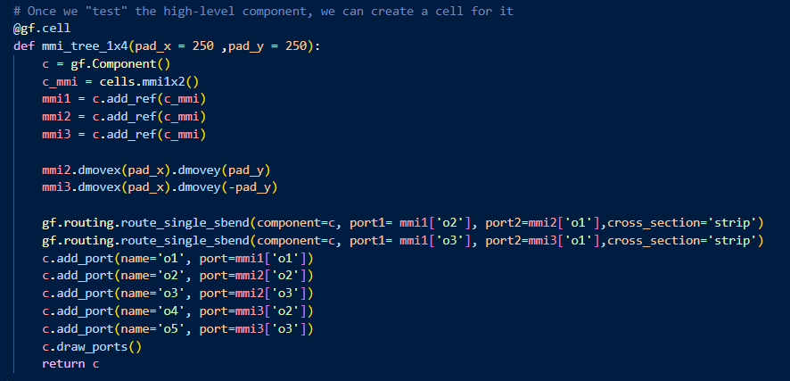
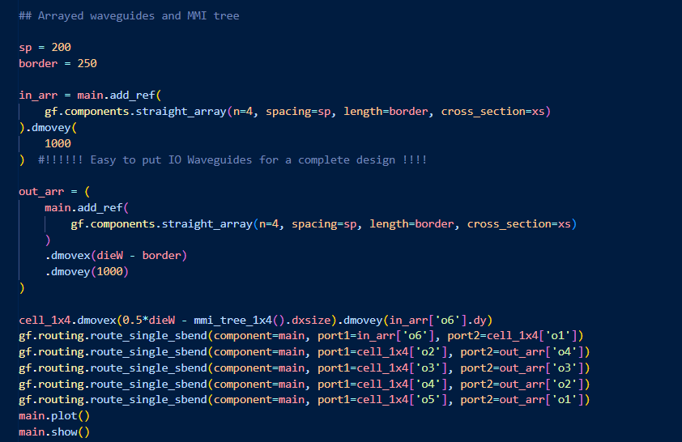
This block defines the 1x4 MMI tree as a parametric cell. It places three 1x2 MMI instances, routes the two outputs of the root MMI to the inputs of the two second level MMIs using S-bends, and exposes all five output ports plus the single input port.
This block instantiates the 1x4 MMI tree inside the main component, adds arrays of four input and output waveguides at the die edges, positions the tree at the center of the die, and connects all ports to the waveguide arrays using S-bend routing.

Slide 16
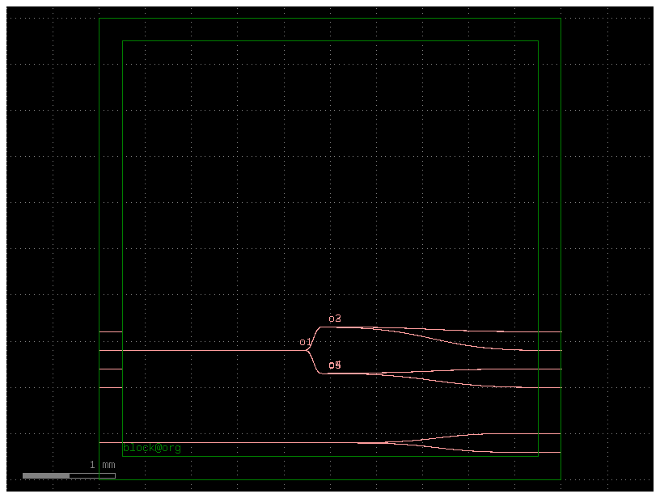

Slide 17
Learning outcome #4 – Notebook section 4. Exercises – 1 slide per bullet point
Code for …
Part a) Creating components
- Create a cell component for a unbalanced MZI, using 2x2 50:50 MMIs with arm length difference as parameter
- Create a cell component based on the previous, where the arms have thermal tuners on top of each one
- Create a cell component for an all-pass ring resonator, using 2x2 50:50 MMIs, with extra length parameter for different perimeters
- Create a cell component based on the previous, where the ring has a thermal tuner on top along all the perimeter
- Create a cell component based on existing GDSfactory spiral components, with length as parameter
Part b) Creating die
- Create a die W = 5 mm x L = 10 mm
- Create an array of I/Os spaced at 250 µm (as much I/Os as the width allows)
- Create a cell component of this die, with I/Os accessible to connect
Part c) Floorplaning and die layout
- Make an instance of the die as host component for your layout
- Add 3 sets of 3 straight waveguides, from left to right of the die, top, middle and bottom of the die
- Add 2 of each of the components above, with different lengths
- Connect all your components to the I/Os

Slide 18
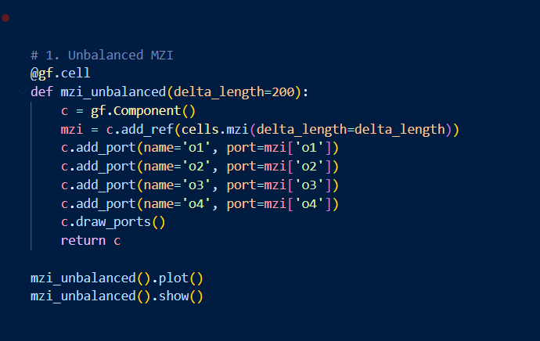
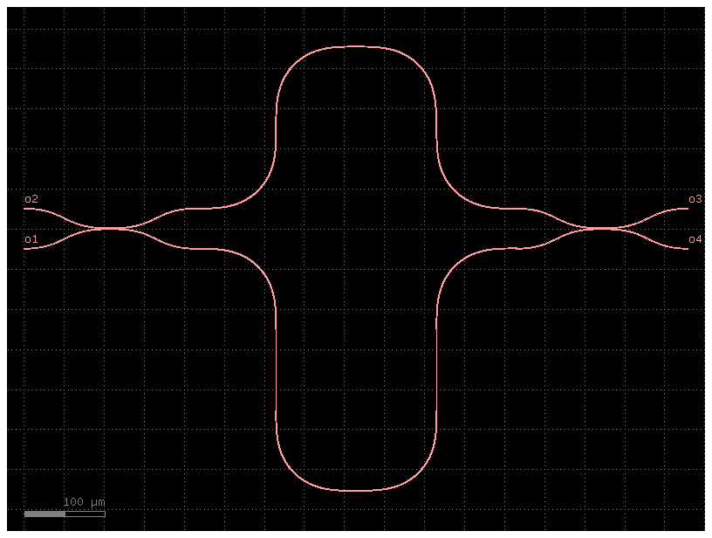
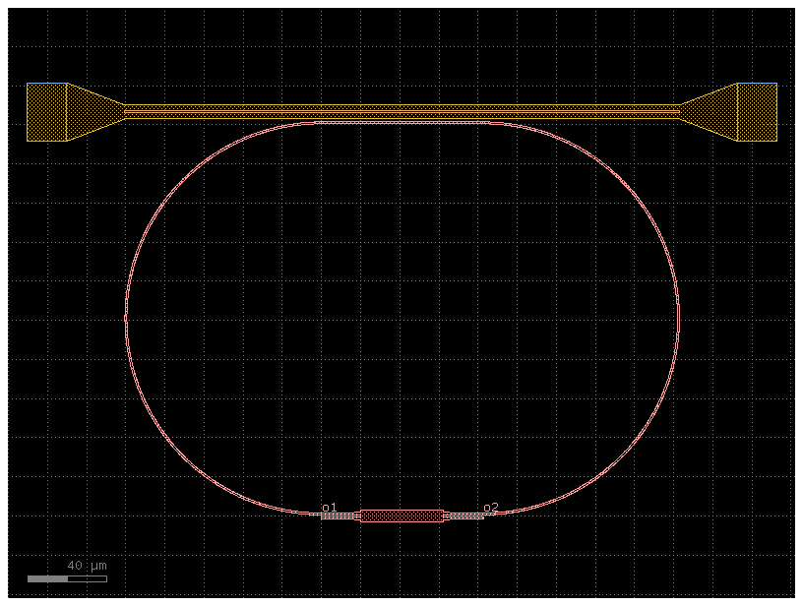
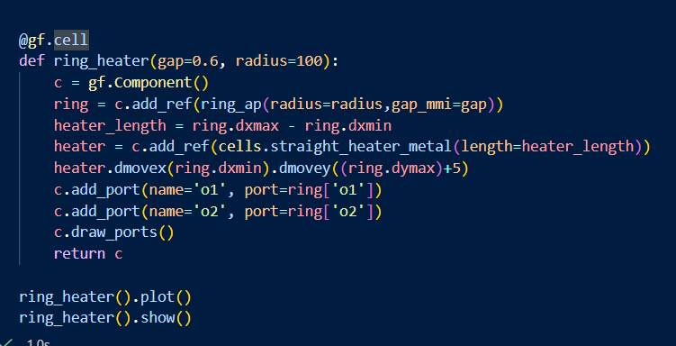
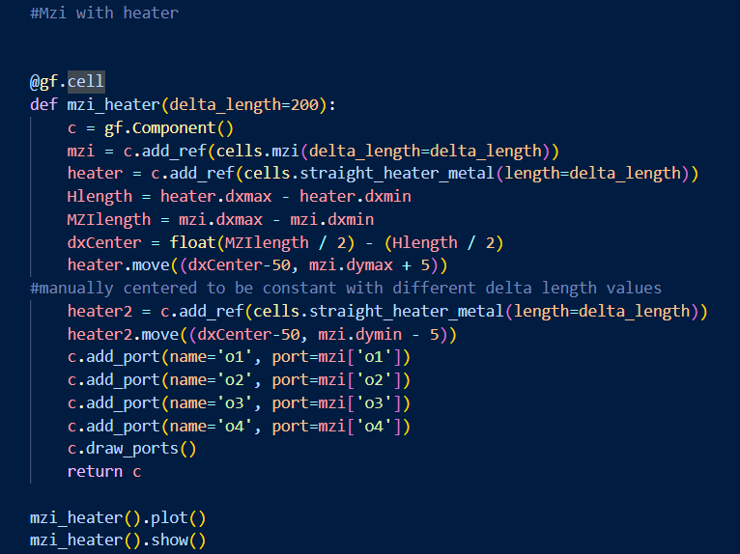
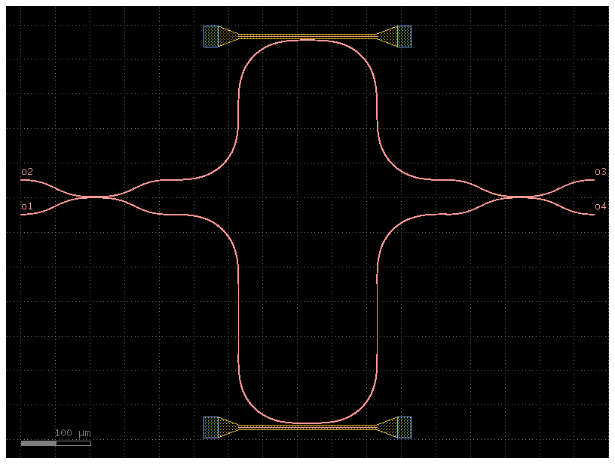
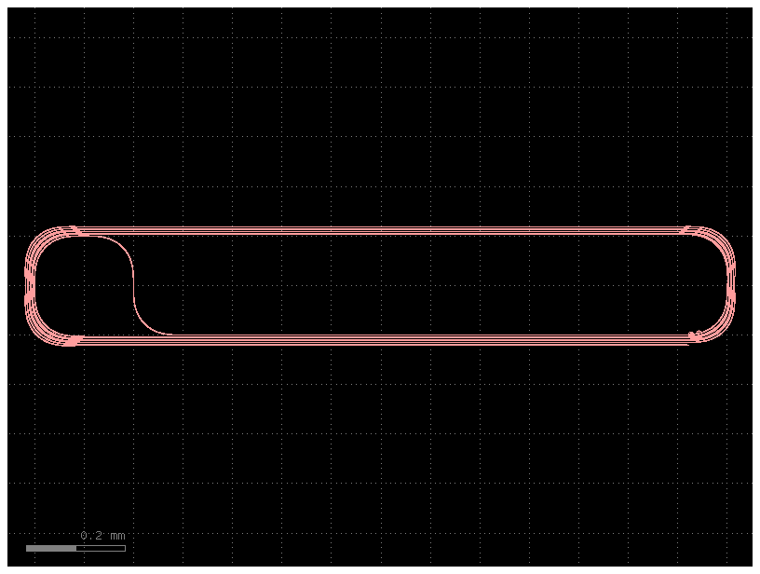
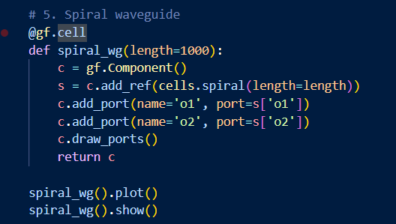
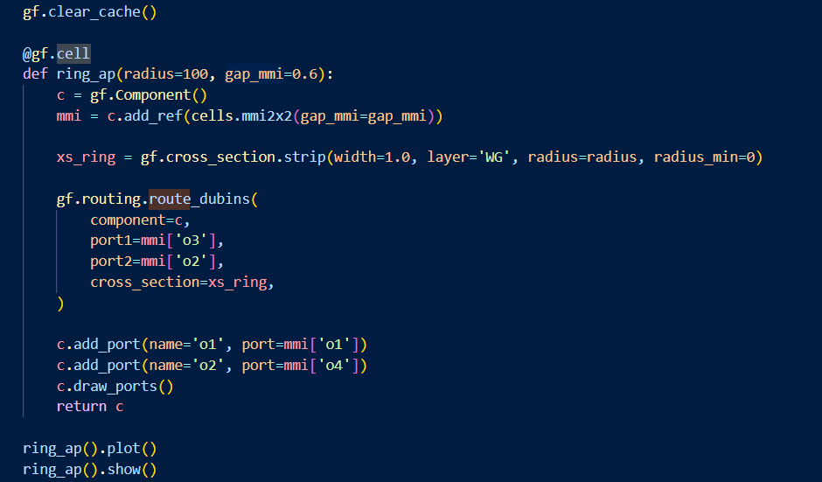
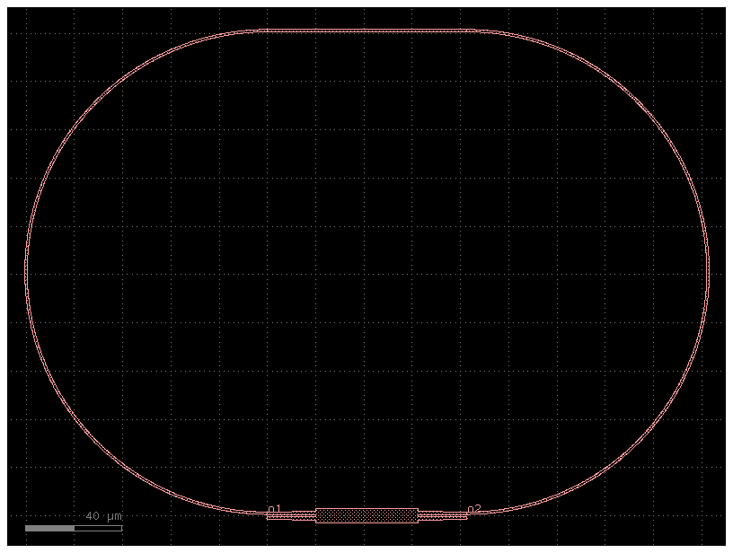
4 part a

Slide 19
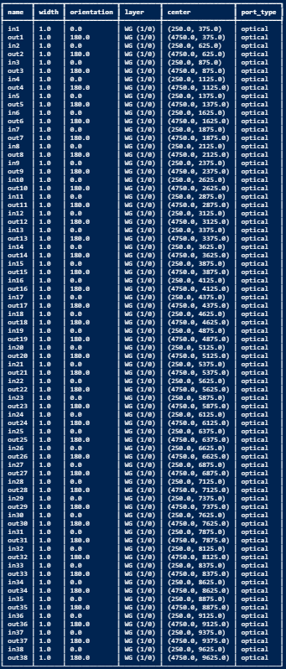
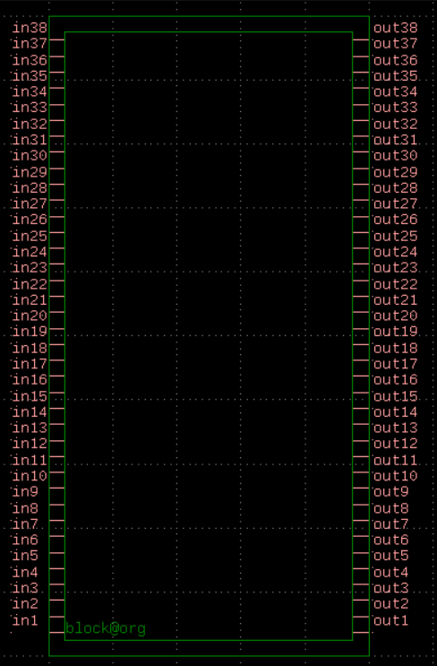
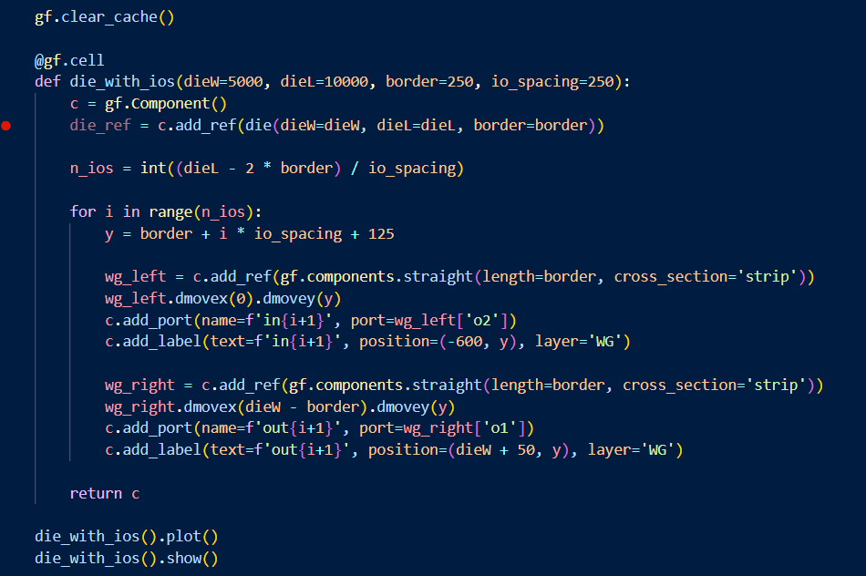
4 part b

Slide 20
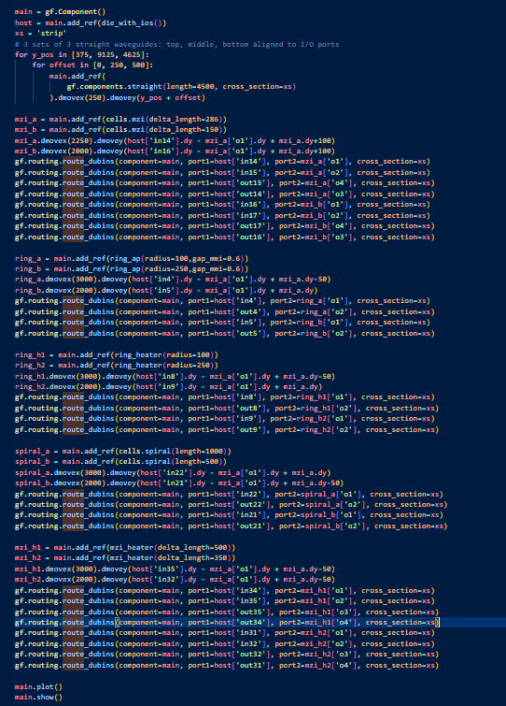
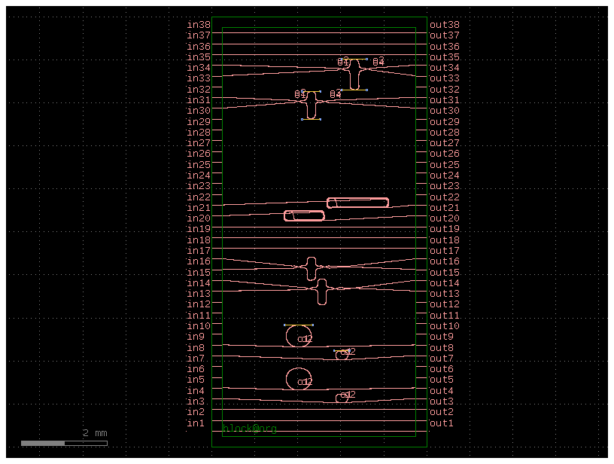
4 part 3

Slide 21

Thank you

