Slide 1
Data Automation Christopher Greenwood

Slide 2
Automation
Quantitative analyses a big part of psychology research
How can we make this work easier and improve quality?
Answer: Automation
Can’t automate the analytic decisions ☹
Can automate the analytic output ☺

Slide 3
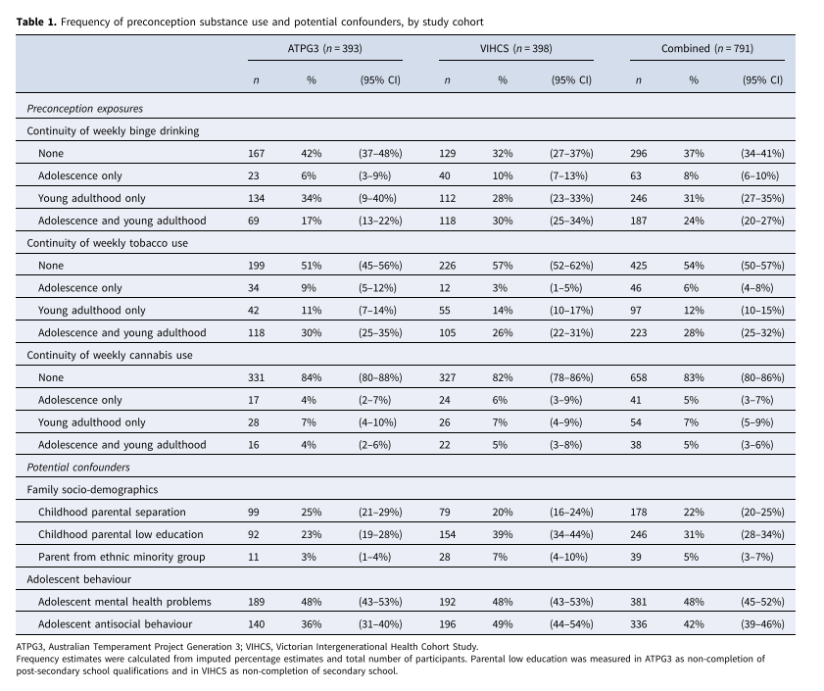
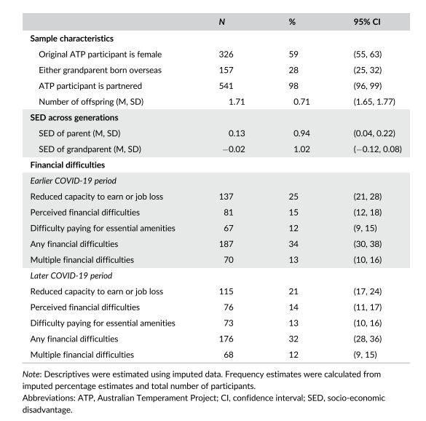
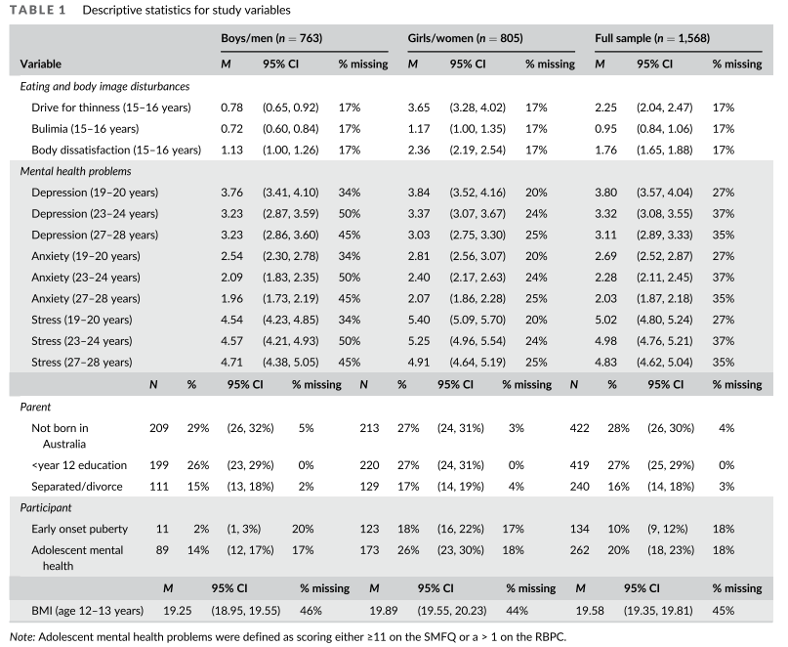
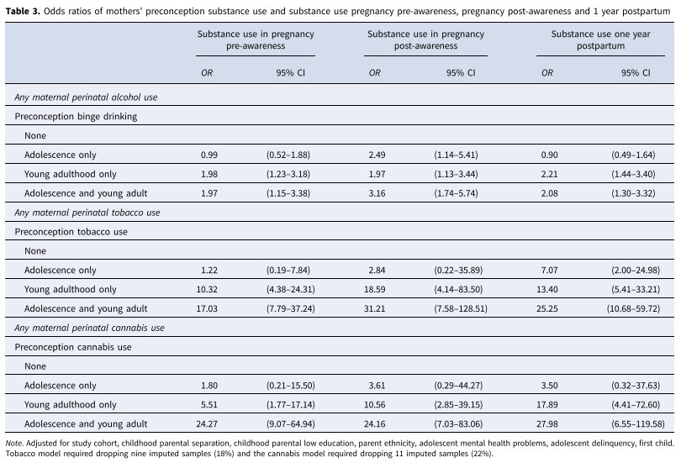
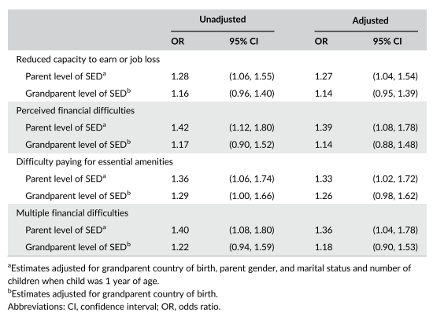
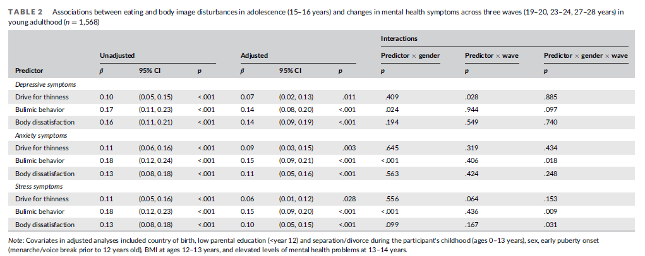
Table generation – context
700+ numbers

Slide 4
Table generation
Table generation one aspect of quantitative analyses we can (often) automate
Use code, so there is a learning curve
Why would we want to automatically generate tables?
Reduce human error from copy-pasting/rounding/formatting numbers
Save time
Almost every analysis I do now automates the tables!

Slide 5
Table generation
I see table automation as a pattern finding game
What values do we need?
Table 1. Descriptives vs Table 2. Regression models
Categorical vs continuous data
n/% vs M/SD vs b/95% CI/p
Statistical programs display values in the output windows
Where these are stored and how to refer to them

Slide 6
Table generation
WARNING: code/numbers incoming
Don’t worry about the code
If you can match numbers you can do this
Once you get the hang of it – helps you to plan ahead!
https://github.com/cjgreenwood/TableAutomation

Slide 7
Categorical data example
Descriptives Table
 | n | % | 95% CI
Variable 1 – level 1
Variable 1 – level 2
Variable 2 – level 1
Variable 2 – level 2
Variable 2 – level 3

Slide 8
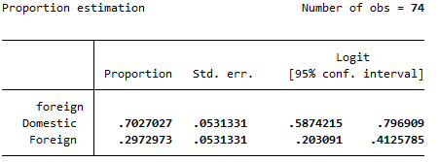

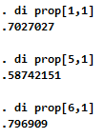
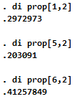
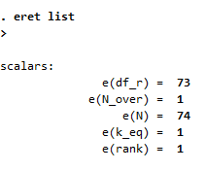
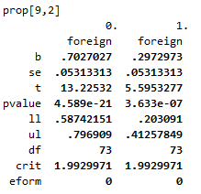
Categorical data example
foregin: Domestic
foreign: Foreign

Slide 9
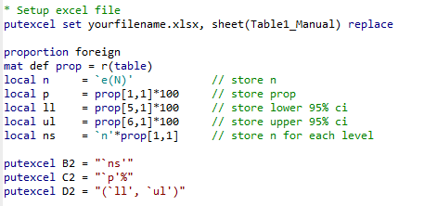
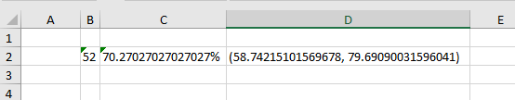
Getting to excel
So far, this feels like a lot of work
Wow – 3 columns
Numbers aren’t even rounded
Could probably copy/paste faster
This where the power of loops come in

Slide 10
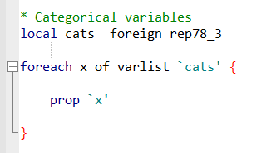
Getting to excel with loops
prop foreign
prop ???
prop rep78_3

Slide 11
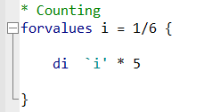
Getting to excel with loops
di 1 * 5
di ? * 5
di 2 * 5
etc etc

Slide 12
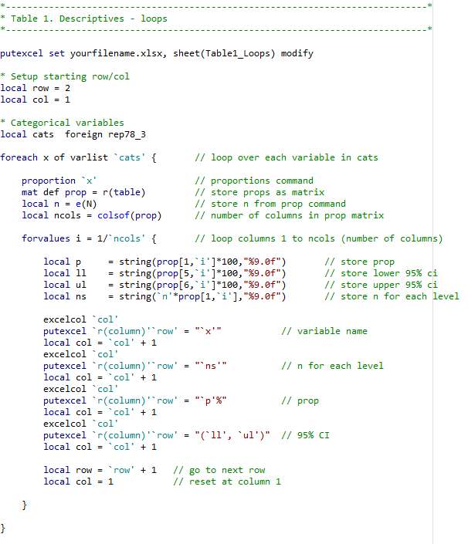
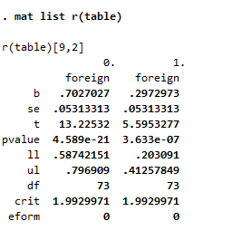
Getting to excel with loops

Slide 13
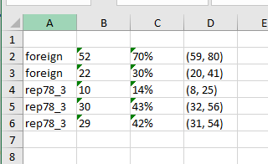
Getting to excel with loops

Slide 14
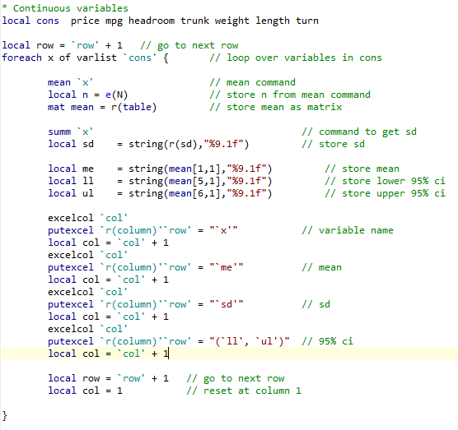
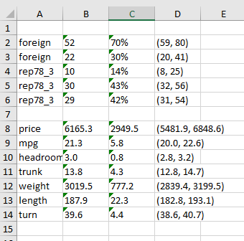
Continuous data example

Slide 15
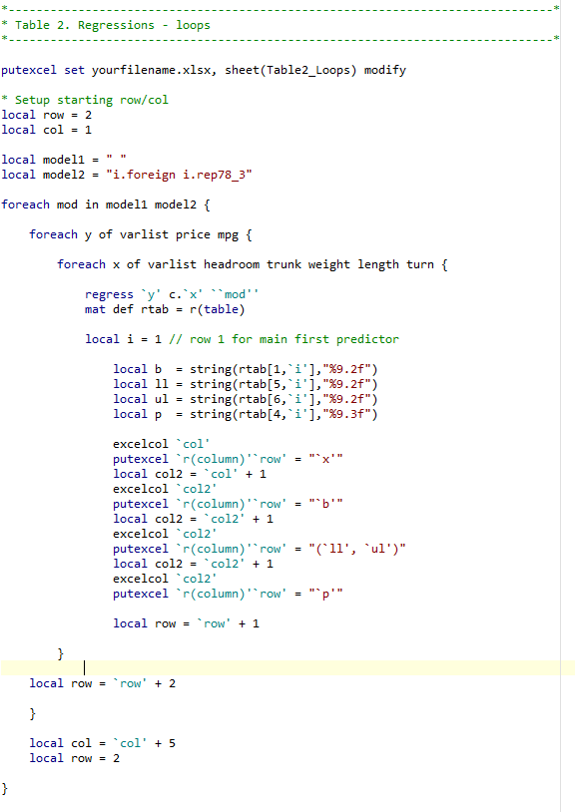
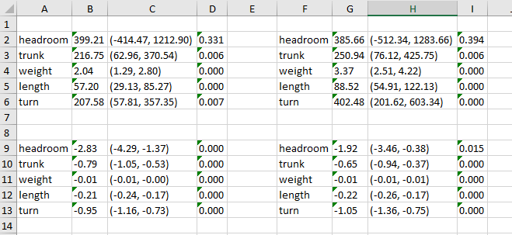
Regression example

Slide 16
Table generation summary
Looks daunting – Code is long, loops can be confusing
Not perfect, no headings, no variable labels
BUT
Once setup, can use multiple times
Only need to edit very few lines of code
No more copy-pasting numbers!!!!

