Slide 1
Memory – ROM and RAM

Slide 2
Acronyms
RAM - Random Access Memory
ROM - Read Only Memory
EPROM - Erasable and Programmable ROM
EEPROM - Electrically Erasable PROM
CAS - Column Address Strobe
CMOS - Complementary Metal Oxide
Semiconductor
CS - Chip Selection
OE - Output Enable
RAS - Row Address Strobe
SDRAM - Synchronous Dynamic RAM
SLDRAM - Synchronous-Link DRAM
SRAM - Static Random Access Memory
WE - Write Enable

Slide 3
ROM - Basics
ROM - Read Only Memory
Nonvolatile and hard to change
Used for operating systems and boot loaders
  e.g. Buffalo is the standard 6811 µC boot loader
  BIOS (Award, etc… )
For this class the ROM will hold the monitor program that will be created later in the semester.

Slide 4
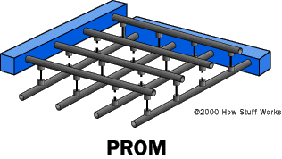
ROM Basics – What’s inside?
Columns and rows
Each intersection or “cell” has a “fuse” linking them
Programming the PROM requires breaking the fuse
  Programmer sends a
  specific amount of
  current to the cell
  Hence “Burning”

Slide 5
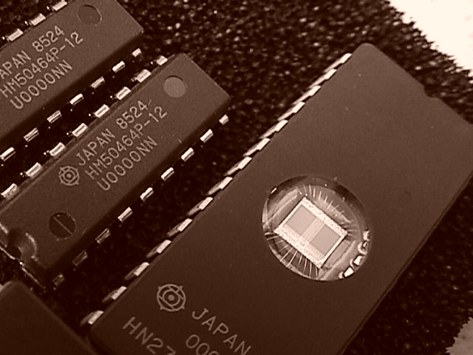
Types of ROM
PROM – Programmable ROM
MPROM - Masked PROM
  Mass produced, cheap, cannot be reprogrammed
EPROM – Erasable PROM
  Erased with UV light
EEPROM – Electrically EPROM
  Erased with electric field
Flash Memory

Slide 6
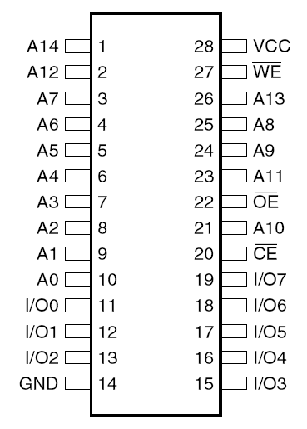
EEPROM Pinout - 28C256-15
VPP – Programming Voltage
*CE – Chip enable
  Low power mode when off
*OE – Output enable
  Chip is still on
A0-A14 Address Bus
I/O0-I/O7 Data Bus
  Can be byte wide 0-7
  Can be word wide 0-15*

Slide 7
EEPROM Programming
When EEPROM is erased all bits are set to 1
Programming
  VPP voltage must be supplied to program
    Different VPP voltage for different chips read spec sheets
  Bits can only be “cleared” or set to 0
    If you mess up then you have to erase the whole EEPROM and start over again
  Make sure your EEPROM is compatible with the school’s ROM burner! See:
  http://www.logicaldevice.com/SOFTWARE/ChipMaster-6000XPU_ALL.pdf

Slide 8
Flash vs. EEPROM
Flash is actually a type of EEPROM
Benefits of flash vs EEPROM
  Flash can erase bigger memory blocks than EEPROM so it can erase memory faster
More about flash
    NOR flash is a replacement for rom systems, for example EEPROM
    NAND flash is more of a replacement for memory storage devices
    NAND flash also takes up to 60% the amount of space as NOR flash

Slide 9
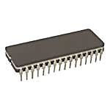
Suggestions
Use EEPROM
  Reprogrammable
  Easy to Erase
    Does not need to be removed from board
    No need for UV light

Slide 10
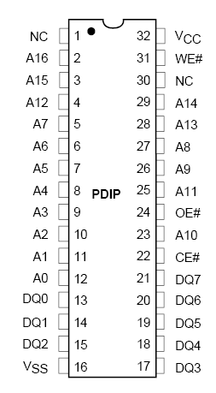
Flash Memory - 29F010-90
Similar to EEPROM in benefits
  Easy to reprogram
Make sure your chip can be programmed by the school’s burning program
  .S19 will be generating by easy68K
  LabTool is the burning program
  It is on the computers in the Microcomputer Design Lab

Slide 11
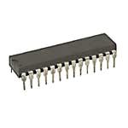
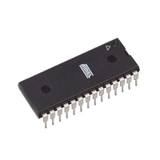
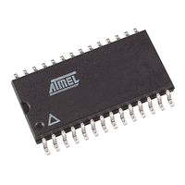
Suggested Chips
EEPROM (Recom.)- 28C256-15
  256KBIT (32kbyte x 8 bit wide)
  DIP-28
    74843
    Digikey: AT28C256-15PU-ND
  Surface Mount (28-SOIC)
    Digikey: AT28C256-15SU-ND
  Two of them needed since 16 bit data bus on CPU
Flash - 29F010-90
  1MB (128k x 8)
  DIP-32
    Two of them needed
Be sure to use two 8-bit wide ROM chips, as the school’s ROM burner is only 8 bits wide

Slide 12
Random Access Memory
Can access any address in memory
Fast memory access
Read and Write capabilities
Volatile

Slide 13
Types of RAM
Static RAM (SRAM) – does not require external refresh
  Used in a lot of embedded things, CPU caches, etc.
  Used in CPLDs
Dynamic RAM (DRAM) – requires an external refresh
  Used in larger memory applications such as regular computer RAM (eg. SDRAM – Synchronous Dynamic RAM)

Slide 14
SRAM vs. DRAM
Easier to use
Faster
Larger
More expensive
Requires more power
Use: Memory Cache
More difficult to use
Slower
Smaller
Cheaper
Requires less power
Use: Main Memory
Word Line
Word Line
Bit Line
Bit Line
Bit Line

Slide 15
Recommendation
“What’s the difference between static RAM and dynamic RAM? Static RAM works and dynamic RAM doesn’t!” –L.T. Hauck in Byte (July 1978)
Even though SRAM is much more expensive, when dealing with 64k of RAM, this is a matter of a few dollars. This is easily rationalized when budgeting in the Tylenol® needed for DRAM.

Slide 16
Selection Tips
When selecting RAM:
Choose SRAM, it’s just easier
Make sure to have a total of 16bits for the data bus (i.e. one 16bit, two 8bit, or four 4bit.)
Have at least 64Kb total, no more than 1Mb/chip
Make sure it is compatible (voltage levels, logic)
There are many choices.

Slide 17
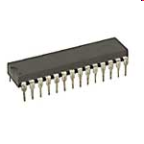
Suggested Chips
1. The 43256-10L 32k X 8 Static RAM.
  2 chips needed in parallel for full 16bit data bus. Total size = 64Kb
2. 62256LP-85 - 32k x 8 Static RAM
3. CY7C1020 - 32K x 16 Static RAM - Cypress Semiconductor
Notes:
CMOS voltages?

Slide 18
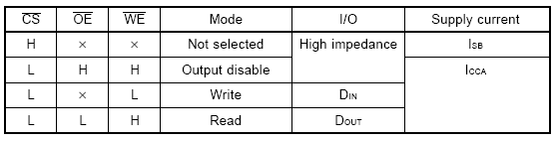
Truth Table

Slide 19
Memory and the 68K CPU
Address bus is shared
  Requires a circuit to map memory to correct location (RAM, ROM, I/O port)
    Pages 417-418 in textbook have example of how to construct a memory map.
    Map circuit can be CPLD: Basically you input the address and use AND/OR logic output RAM, ROM, or I/O selection.
    This may be covered more fully in future presentations.

Slide 20
Timing
Page 306 in the textbook has a couple of useful color pages demonstrating the timing of the interaction between a 68000 and RAM.

Slide 21
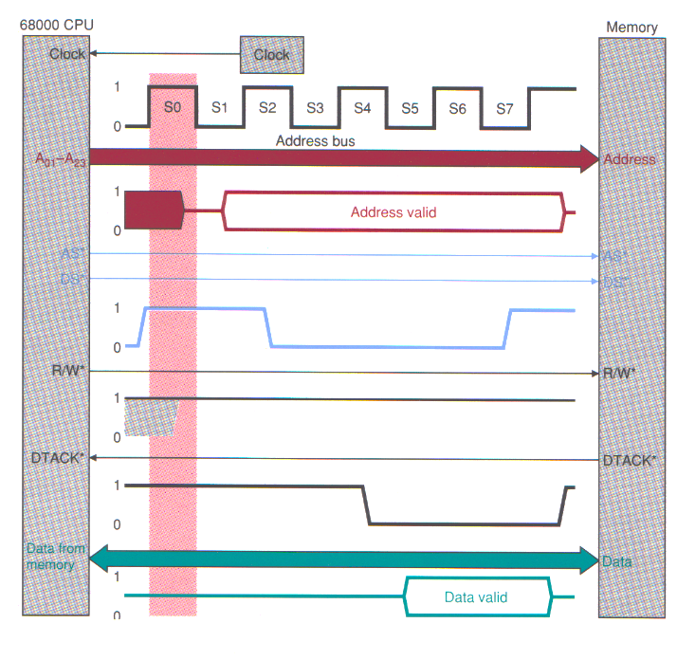

Slide 22
Summary
Two RAM (if 8 bits each) chips are needed
  Use Static RAM (SRAM).
Two ROM chips are needed
  Make sure they are compatible with our ROM burner.
You can map memory using CPLD AND/OR logic
  In from CPU
    Upper address bus bits, UDS, LDS
  Out to each chip
    CS, OE

Slide 23
References
http://xtronics.com/memory/how_EPROM-works.htm
http://computer.howstuffworks.com/rom1.htm
http://gallery.hd.org/_c/electronics/EPROM-and-other-chips-on-anti-static-foam-1-DHD.jpg.html?sessionVar=spider&sessionVarLocale=es

Slide 24

Extra Info (for reference only)

Slide 25
SRAM
Hold data without external refresh
  Simplicity : don’t require external refresh circuitry
  Speed: SRAM is faster than DRAM
  Cost: several times more expensive than DRAMs
  Size: take up much more space than DRAMs
  Power: consume more power than DRAMs
  Usage: level 1 or level 2 cache
Word Line
Bit Line
Bit Line

Slide 26
DRAM
Refresh circuit : storage decay in ms
DRAMs take up much less space, typically ¼ the silicon area of SRAMs or less (one transistor and a capacitor)
Word Line
Bit Line

Slide 27
DRAM Refresh
Refresh Frequency:(4ms – 64ms)
  4096 word RAM -- refresh each word once every 4 ms
  Assume 120ns memory access cycle
  This is one refresh cycle every 976 ns (1 in 8 DRAM accesses)!
  But RAM is really organized into 64 rows
  This is one refresh cycle every 62.5 μs (1 in 500 DRAM accesses)
  Large capacity DRAMs have 256 rows, refresh once every 16 μs
RAS and CAS are signals that tells the DRAM to accept the given address as a row or column address.¹
  RAS = row address strobe
  CAS = column address strobe
RAS-only Refresh (cycling, no CAS cycling)
  External controller remembers last refreshed row
Some memory chips maintain refresh row pointer
  CAS before RAS refresh: if CAS goes low before RAS, then refresh
¹ http://www.princetonusa.com/html/support/glossary.asp

Slide 28
DRAM Technologies
Conventional DRAM
Fast Page Mode (FPM) DRAM
Extended Data Out (EDO) DRAM
Synchronous DRAM (SDRAM)
Double Data Rate SDRAM (DDR SDRAM)
Direct Rambus DRAM (DRDRAM)
Synchronous-Link DRAM (SLDRAM)

Slide 29
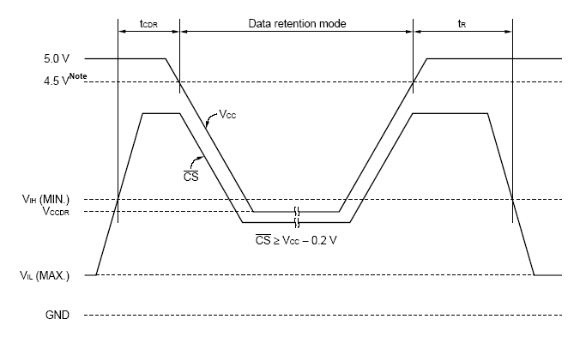
CMOS Low Power mode
When the CMOS SRAM is idle, its power can be reduced drastically
See Figure 5.33 on page 349 in textbook.

