Slide 1

Cheryl Hung
Gesture-controlled robotics
using motion capture
Wednesday 18th February 2009
Detica, London

Slide 2


About Me
Computer Science finalist at King's College, University of Cambridge
  Student representative on Staff-Student Consultative Committee for two years

Slide 3
Course structure
Three year BA Computer Science
First year shared between Computer Science and Natural Sciences
Project manager for group project in second year
Personal project in final year

Slide 4
Dissertation
Timetable
17 Oct 08
Proposal submission (2000 words)‏
30 Jan 09
Progress report and presentation to overseers
15 May 09
Thesis submission (10 000 words)‏
Contributes a quarter of overall degree classification
Main objective:
  “Display a range of Computer Science skills involved in the design, implementation and testing of a significant computer system”

Slide 5
Motivations
Personal strengths
  Research, project management and report writing
Inspiration
  Consumer products vs. robotics
Undergraduate researcher at Computer Laboratory
  Human-computer Interaction
Other interests
  Artificial intelligence and machine learning
  Ubiquitous computing
  Engineering
  Psychology

Slide 6
Gesture-controlled robotics using motion capture

Slide 7
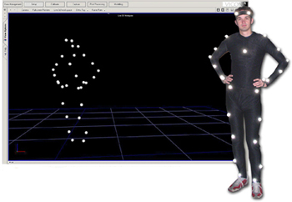
Motion capture
Reduces limitations of machine vision
Optical systems
  passive and active markers
  marker-less
Non-optical
  inertial, gyroscope based
  mechanical exo-skeleton
Computer Laboratory’s Vicon system

Slide 8
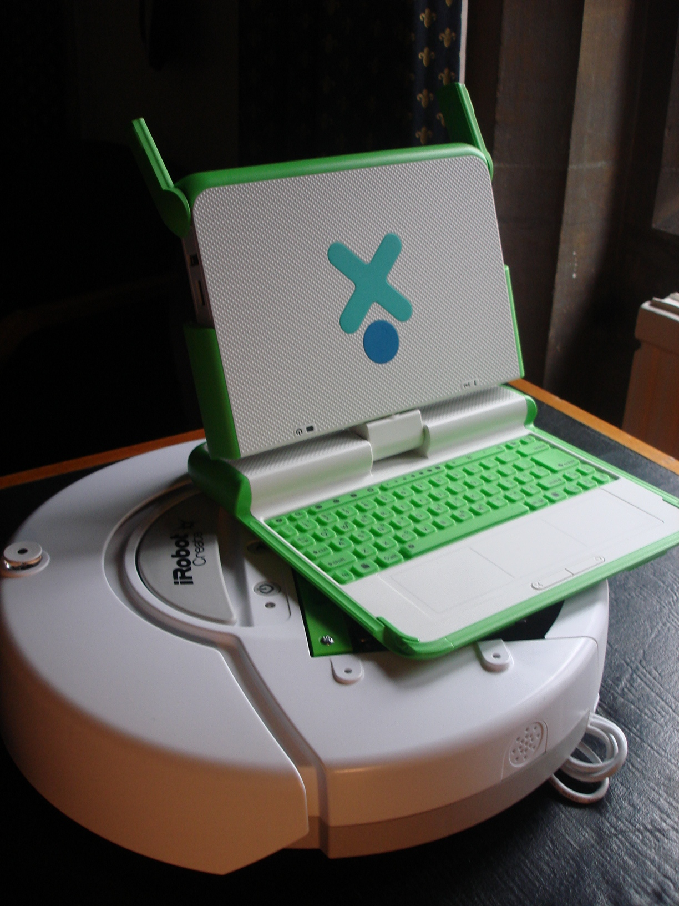
Robotics
Lego Mindstorms
iRobot Roomba
iRobot Create
Custom built
With modification
Commodity hardware
Requirements
  Cheap, light, sensors, existing APIs
OLPC XO laptop
Multiple users
Funding
  2 x £250 grant, final cost £585

Slide 9
Gesture recognition
Body, face, arms, hands...
Each user wears two gloves and a belt
Five gestures
  accelerate, decelerate, turn left, turn right, stop/start
Real-time performance is crucial for control

Slide 10
Languages, libraries and tools
Python framework
  ease of development, readability
C++ gesture recognition libraries
  Python wrappers
  performance
Java mocap client
  Jython for interoperability
Subversion repository and bug tracker
  Hosted on Google Code

Slide 11
Algorithms
Gestures are inherently ambiguous
Solution: train the system on prerecorded examples
Choose two for comparison and evaluation: ANN and HMM

Slide 12
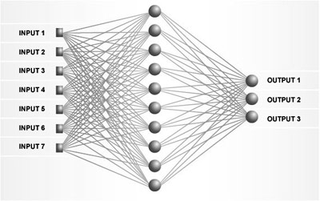
Artificial Neural Networks
Neurobiology inspired "connectionist" approach
Used for data modelling, classification and data mining

Slide 13
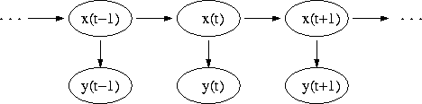
Hidden Markov Models
Bayesian modelling “stochastic" approach
Used for temporal recognition, bioinformatics and machine translation

Slide 14
System overview
Applications
Integration with live mocap data and robots
Multi-user interaction
Competition
Project status
Milestones every two to five weeks
Currently training the statistical models with pre-recorded data
Virtual robots and mocap

Slide 15
Conclusions
Comparison metrics
Early predictions
  HMMs likely to be more powerful and with better performance
  ANNs likely to be more accurate on training set
Psychology
  number of features needed for human to recognize a gesture compared to a machine

Slide 16
Thank you
Questions
Cheryl Hung

