Slide 1
Cheryl Hung
  Gesture-controlled robotics
  using motion capture
Friday 24th April 2009
Computer Laboratory, Cambridge

Slide 2

Course structure
About Me
Three year BA Computer Science
Personal project in final year
Computer Science finalist at King's College, University of Cambridge

Slide 3

Dissertation
Main aim:
  “Display a range of Computer Science skills involved in the design, implementation and testing of a significant computer system”
Motivations:
  Human-Computer Interaction
  Artificial intelligence and machine learning
  Consumer products vs robotics

Slide 4
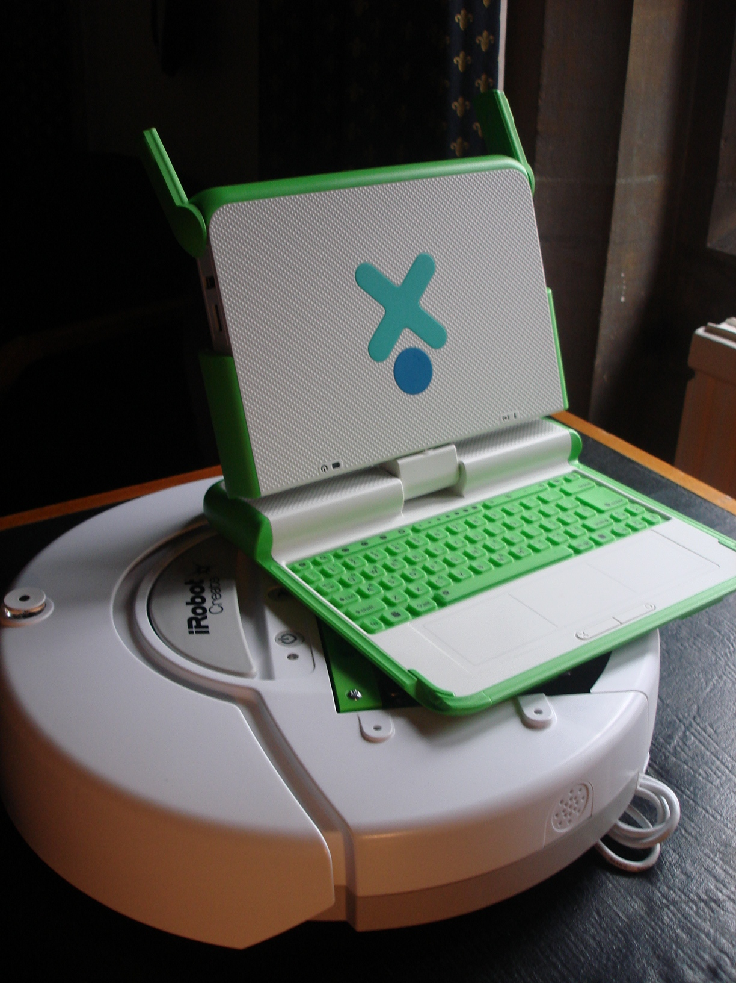
Robotics
Lego Mindstorms
iRobot Roomba
iRobot Create
Custom built
With modification
Commodity hardware
Multiple players each controlling one robot
Requirements
  Cheap, light, bump sensors
OLPC XO laptop for wireless control

Slide 5
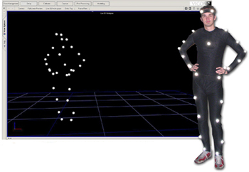
Motion capture
Optical systems
  Infra-red cameras with passive markers
Provides 3D (x,y,z) positions and rotations
Computer Laboratory’s
Vicon system

Slide 6
Gesture recognition
Five gestures
  accelerate, decelerate, turn left, turn right, stop/start
Each player described by a body and two arms
Real-time performance is crucial for control
Gestures are inherently ambiguous
Solution: train the system on prerecorded examples

Slide 7
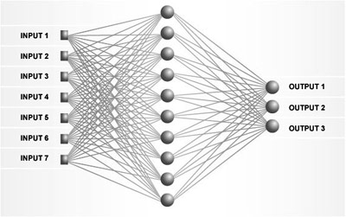
Artificial Neural Networks
Neurobiology inspired "connectionist" approach
Used for data modelling, classification and data mining

Slide 8
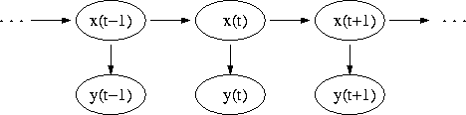
Hidden Markov Models
Bayesian modelling “stochastic" approach
Used for temporal recognition, bioinformatics and machine translation

Slide 9
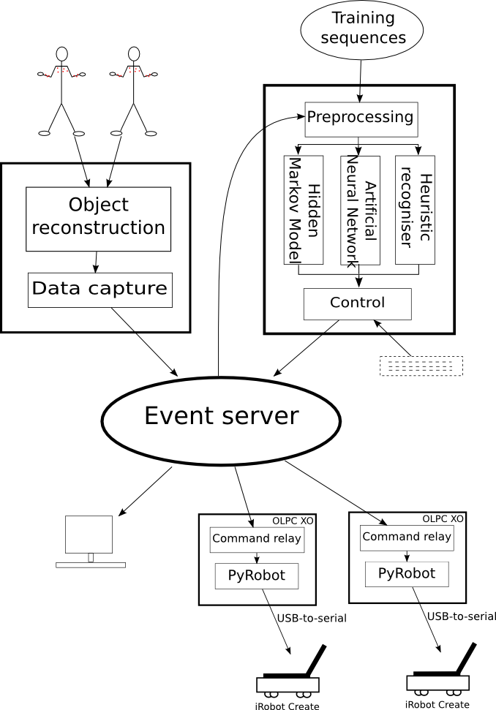
Thank you
  Questions
Cheryl Hung

