Slide 1
Recessions and Job Recovery
What can the 2001 and 2008 recession job numbers tell us about the current one?

Slide 2
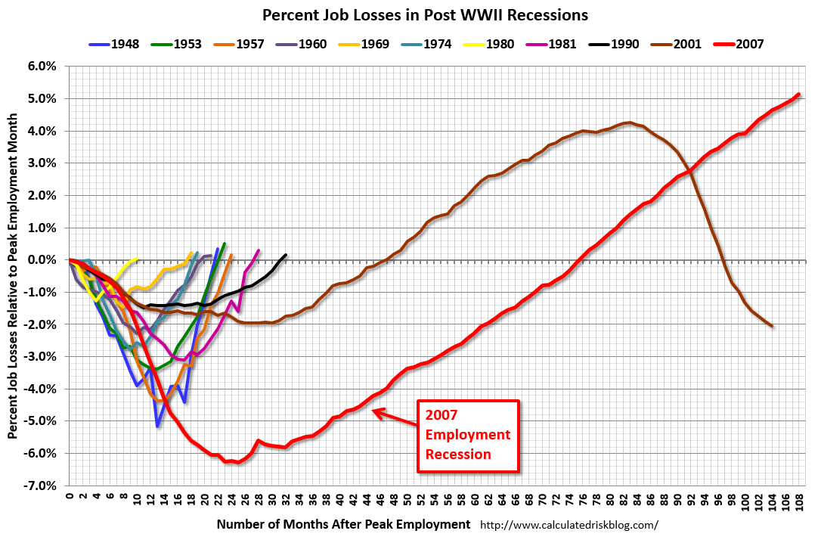
Motivation
Notes:
I’m 38, and this is my 3rd recession in my adult life. We’ve gotten worse at dealing with recessions, so I want to see what we can learn from the past and what it tells us about the current one.

Slide 3
Dataset
Datapoints: Every county in the United States.
Features:
  Political data: Partisan control of state legislatures, governorships, and state budget (expenditures).
    County-level political data not easily accessible
  Population: US. Census estimates for 2001, 2008, and 2019
  Industry Makeup: percentage of jobs in each county belonging to each NAICS industry (BLS QCEW)

Slide 4
Sacrifices
No political data:
  District of Columbia
    Budget numbers not archived easily, no legislative body
    Much of actual power resides in U.S. Congress anyway
  Puerto Rico/ Virgin Islands
    Political parties differ, legislative body is unique
Cities/MicroSAs:
  Often straddle state lines
Alaska:
  County lines reclassified between 2001 and 2008 (probably just renaming)

Slide 5
Targets:
post-peak
pre-peak
nadir
recover
Recovery: post-peak >= pre-peak (True, False)
Decline Time, Recovery Time: # of quarters b/w (pre-peak & nadir, nadir & recover)
  Unable to calculate (lost half of Sunday)
Delta: post-peak - pre-peak
Delta per capita – Delta / Population

Slide 6
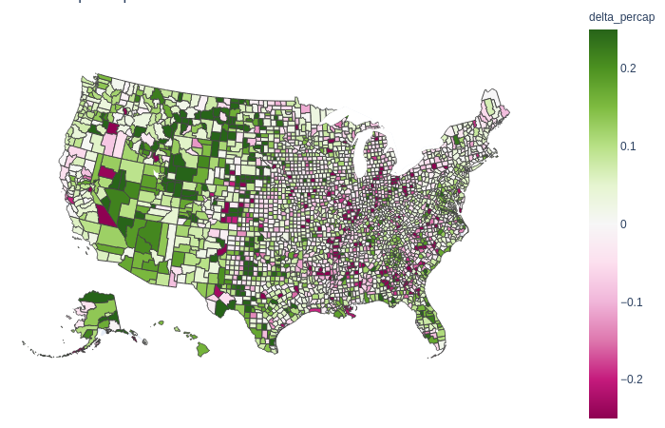
Exploratory Data Analysis
2001 Job Growth (per capita)

Slide 7
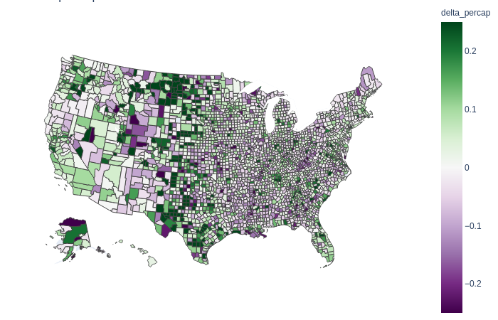
Exploratory Data Analysis
2008 Job Growth (per capita)

Slide 8
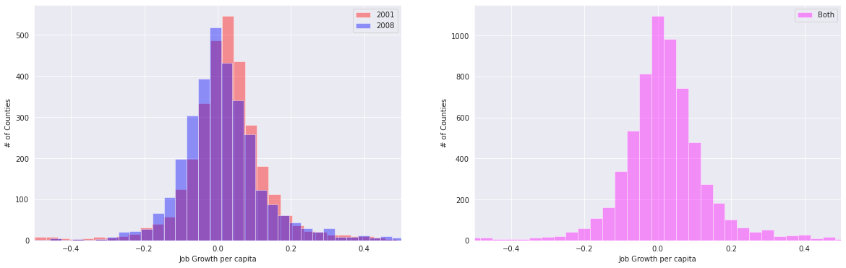
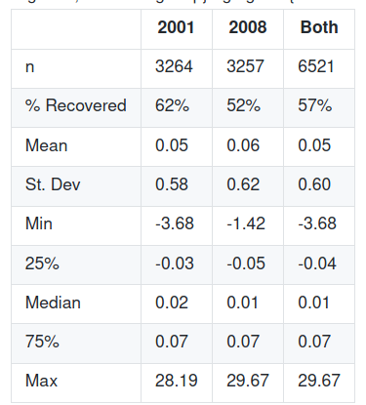
Exploratory Data Analysis
Mostly normally distributed
2008 performed worse that 2001
  Despite 5.5 years beyond general recovery (as opposed to < 2)
Loving, TX- may warrant investigation
Approx 4 counties ouside of (-.5, +.5)

Slide 9
Journey to a model – Dim. Reduction
Attempted PCA, SVD, and NMF.
  Used Logistic Regression to test initial results
  PCA and SVD gave similar results
  NMF did not play nicely with scaled data
    Abandoned, not a good use of time.

Slide 10
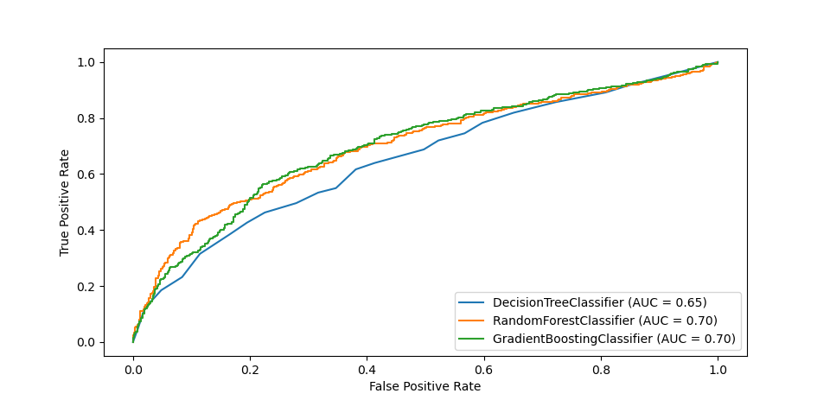
GridSearch: Tuesday
Used Google Colab Pro to run parallel searches
Started with 3 classifiers: Decision Tree, Random Forest, and Gradient Boosting
Not happy with initial results, tried removing PCA
  Computation savings not worth the tradeoff

Slide 11
GridSearch: Wednesday
Re-tuned original three models without PCA
Attempted Dense Multilayer Perceptitron Network:
  Could not justify time investment/computation cost to keep tuning
    Accuracy below 45%
Added four Naive Bayes
Started XGBoost GridSearch
  This is still running (Friday 12pm, will update results)

Slide 12
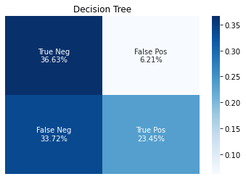
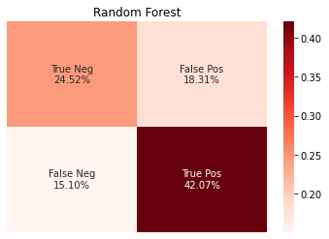
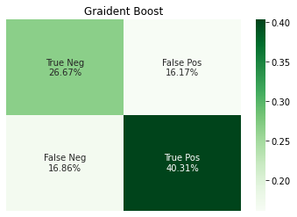
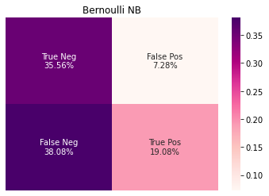
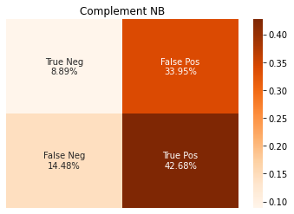
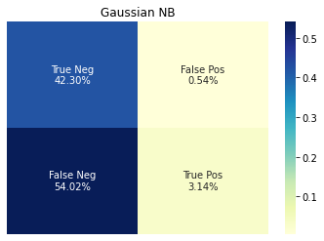
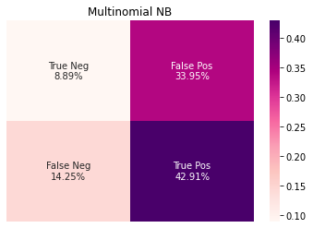
Confusion Matrices
Original three:
Naive Bayes:

Slide 13
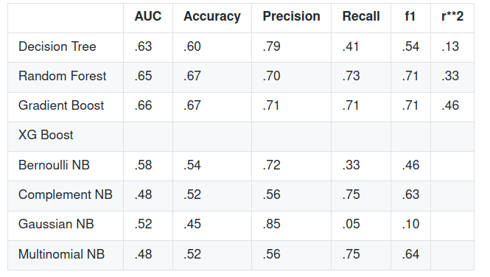
Model Performance
No clear reason to prefer False Negatives over False Positives:
  Relied on f1 score
No clear reason to prefer False Negatives over False Positives:
  Relied on f1 score
Random forest barely beats Gradient Boost, but by less than .01 (hidden in the rounding)
Ran Regressors with the same Hyperparameters- Gradient Boosting has a better r2. Gradient Boost wins!

Slide 14
Feature Importance
Not an important avenue to explore
But wanted to determine if Political Variables have enough effect to be included.
Some noticeable effect from state budget feature (~0.005), but none of the other ones could arguably make a difference.
Dropping political variables from the model means I can re-add all the cities, MicroSAs, Commonwealths, and D.C.

Slide 15
Future plans:
Solve the "time to recover" problem, and produce a model to predict that.
Update the prediction data with 2020 population/industry.
Run the models using monthly rather than quarterly data, which might provide additional insight.
Run the models on wages rather than raw job numbers.
Use Flask to make a "report card" on a given area, allowing a user to look up an area and see its history, performance, and forecast.

