Slide 1

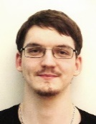
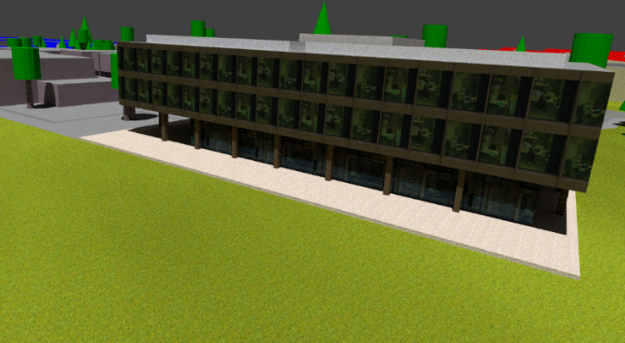




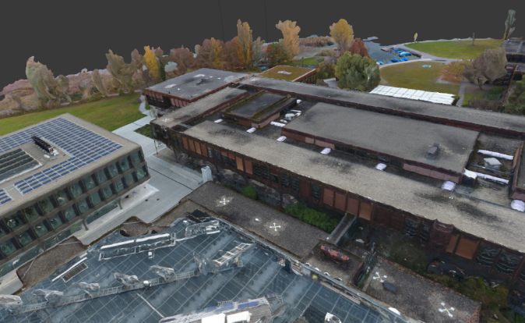
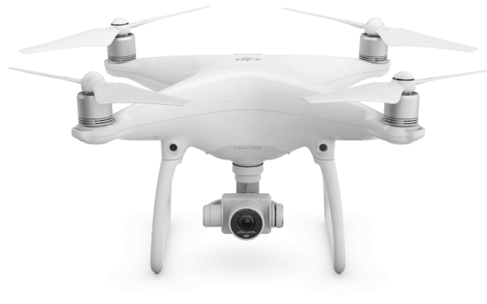
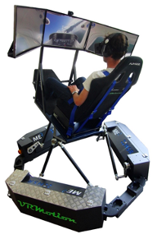
Preparation of 3D Data for HSR-Game with Motion
Foto
Advisor: Prof. Stefan Keller
Co-Examiner: -
Project Partner: ICOM
Term Project Autumn Term 2016
Subject area Informatics
Sophie Somerton Joel Hochreutener
Project aim
recognizable 3D model of the HSR
transferable to other areas
optimized for gaming
Resources
Drone
Camera
Software
Tutorials
Used Software
Approaches
Opensource | OSM and OSM2World
Commercial | Camera with Agisoft
 | Drone with Pix4D
Results
Detailed Workflow to each Approach
3D models of the research centre of HSR
Evaluation of Approaches (table below)
Preview
Base ready for HSR-Game with 6DoF Motion-Simulators
 | OSM2World Approach | Photogrammetry Approach
additional Equipment needed | - | reflex camera or drone
licensing cost | Free | 185 CHF - 3590 CHF (Agisoft) 3200 CHF - 7900 CHF (Pix4D)
approx. expenditure of time (worst case) | 70 hours | 60 hours (reflex camera) 40 hours (drone)
approx. expenditure of time (best case) | 40 hours | 25 hours
Suitability of the result, strong points | without texturing very quick generated sharp edges each object is represented as a separate object, editable suited for ground level near object model | faster to create able to depict any object very realistic great for aerial overview models
Expandability of area | whole workflow needed to be done again, but time consuming work points such as texturing are reduced | Easy to add a new area part, may need to add additional tie points (time consuming)

