Slide 1
Webpack Sharing

Slide 2

内容概要
模块化
webpack核心配置
webpack优化
实例

Slide 3
模块化
JS 模块化
CSS 模块化
namespace
commonjs
amd/cmd/umd
esm
OOCSS
SMACSS
BEM
CSS Mdodules
…

Slide 4
namespace
库名.类别名.方法名
Var BussinessA = {}
BussinessA.type = BussinessA.type||{}
BussinessA.type.method = function(){}
Var BussinessB = {}
BussinessB.type = BussinessB.type||{}
BussinessB.type.method = function(){}

Slide 5
Commonjs
1个文件就是一个模块
通过module.exports暴露模块接口
通过require引入模块
同步执行
node环境，浏览器无法使用

Slide 6
AMD
Async Module define
使用define定义模块
通过require加载模块
requireJS
依赖前置，提前执行

Slide 7
CMD
common Module definition
一个文件为一个模块
通过define定义模块
通过require加载模块
seaJS
尽可能的懒执行

Slide 8
UMD
universal Module definition
通用解决方案
三个步骤
是否支持AMD
是否支持commonjs
如果都不支持，暴露为全局变量

Slide 9
ESM
EcmaScript Module
一个文件一个模块
Export / import

Slide 10
Webpack支持
ESM（webpack推荐的）
CommonJS
AMD/UMD（了解即可）

Slide 11
Webpack简介

Slide 12
Webpack由来
It’s a funny story how I started with webpack. Before getting addicted to JavaScript, I also developed in Java. I tried GWT (Google Web Toolkit) in that time. GWT is a Java-to-JavaScript Compiler, which has a great feature: code splitting. I liked this feature and missed it in existing JavaScript tooling. I opened an issue to an existing module bundler, but it did not go forward. Webpack was born.
Somehow the Instagram frontend team discovered an early version of webpack and started to use it for instagram.com，One of the reasons for adoption of webpack by Instagram was code splitting

Slide 13
Webpack study
https://survivejs.com/webpack/foreword/
https://webpack.js.org
https://webpack.docschina.org/

Slide 14
Webpack是设么
A bundler for javascript and friends. Packs many modules into a few bundled assets. Code Splitting allows for loading parts of the application on demand. Through "loaders", modules can be CommonJs, AMD, ES6 modules, CSS, Images, JSON, Coffeescript, LESS, ... and your custom stuff

Slide 15
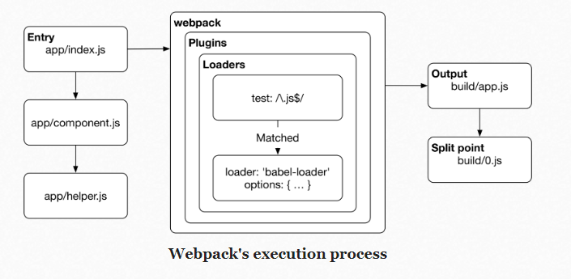
Webpack执行流程

Slide 16
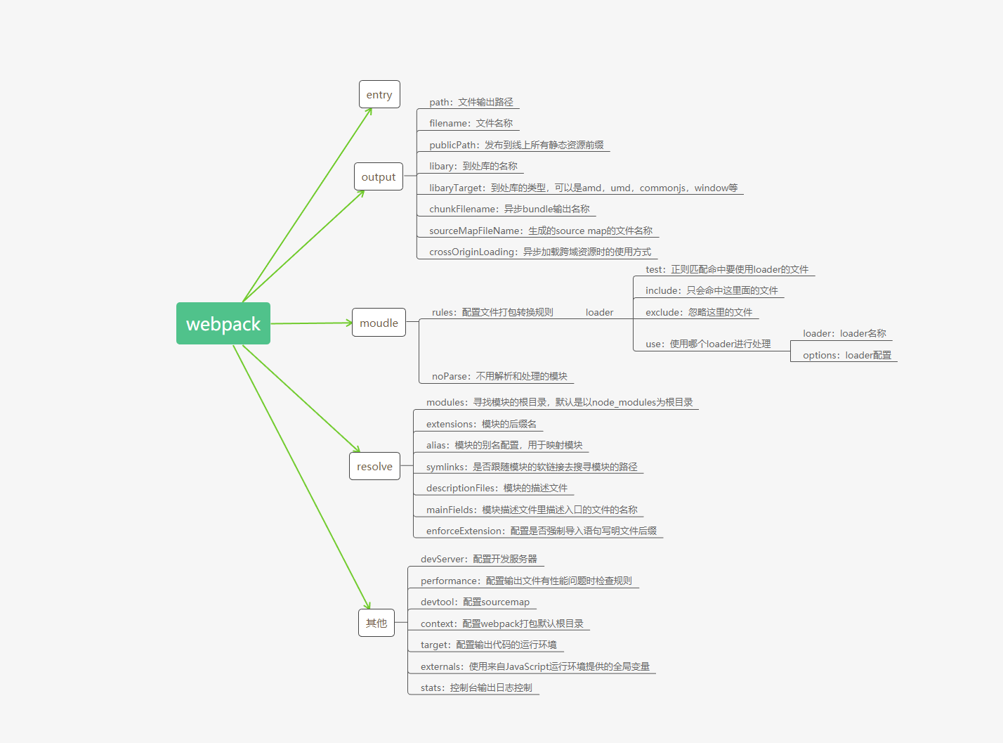
Webpack核心配置

Slide 17
常用Loaders
编译相关
babel-loader ，ts-loader
样式相关
style-loader, css-loader, less-loader, sass-loader, postcss-loader
文件相关
url-loader, file-loader, img-loader
模块相关
import-loader，export-loader
…

Slide 18
常用Plugins
Html-webpack-plugin
Common-chunk-webpack-plugin
Define-webpack-plugin
Bananer-webpack-plugin
Clean-webpack-plugin
Copy-webpack-plugin
Pulifycss-webpack-plugin
Minify-css-webpack-plugin
Limit-chunk-plugin
Provide-plugin
Uglifyjs-plugin
…

Slide 19
webpack优化
运行时优化：
提取公共代码
代码分割和懒加载
Tree shaking
长缓存配置
打包编译优化：
分开vendor和app，dllplugin，dllReferencePlugin
UglifyjsPlugin，parallel，cache
HappyPack
模块检索配置

Slide 20
Webpack history
Webpack v1.0.0
编译打包
HMR
代码分割
文件处理
Webpack v2.2.0
Tree shaking
ES module
动态Import
新的文档
Webpack v3.0.0
Scope Hoisting
Magic comments
Webpack 4.0.0
零配置
Mode
切分，压缩内置
Webpack 5 beta
vote
2014.2.20
2017.1.18
2017.6.19
2018.2.4
2019

Slide 21
Demo for example

