Slide 1
MTG Differential Gene Expression in Alzheimer Disease by cortical layer
Couger Jaramillo
16 Jan 2026

Slide 2
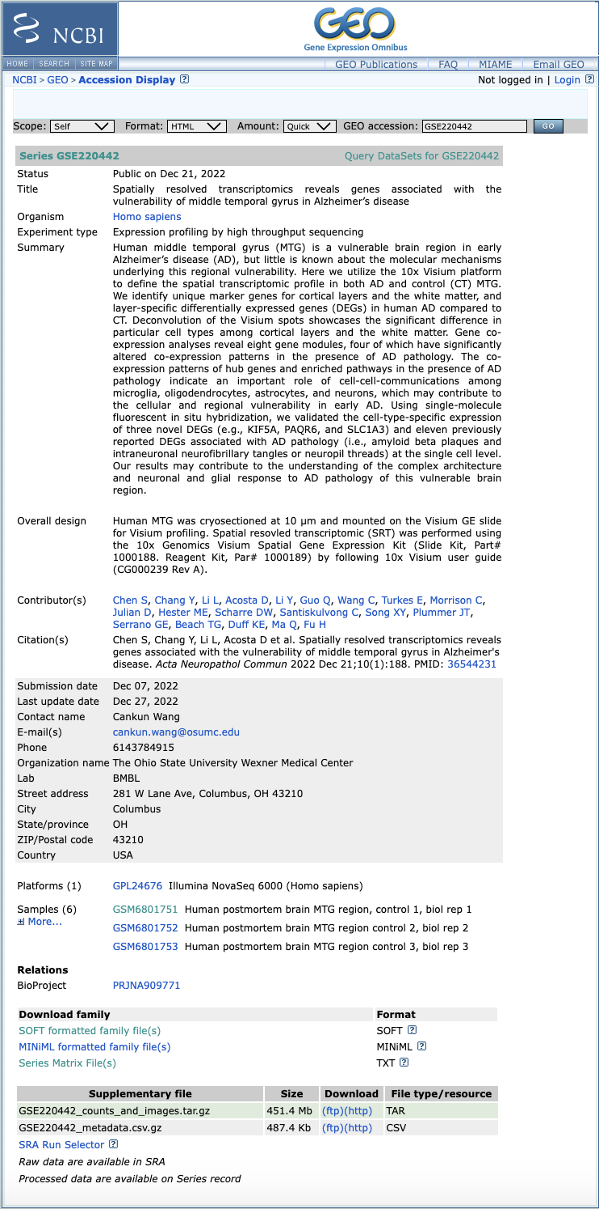
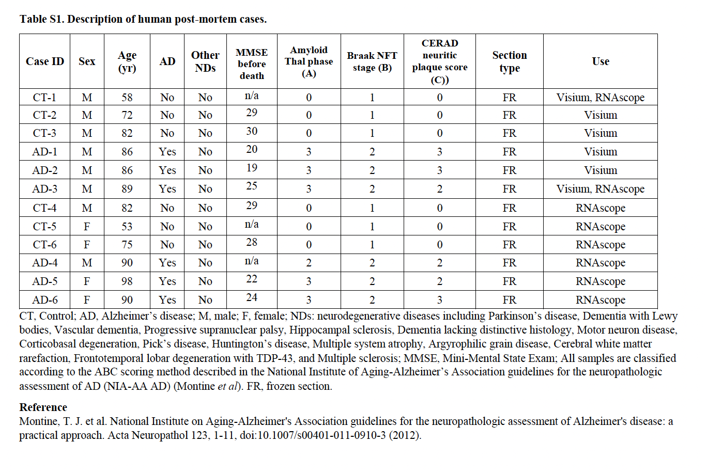
Dataset Selection

Slide 3
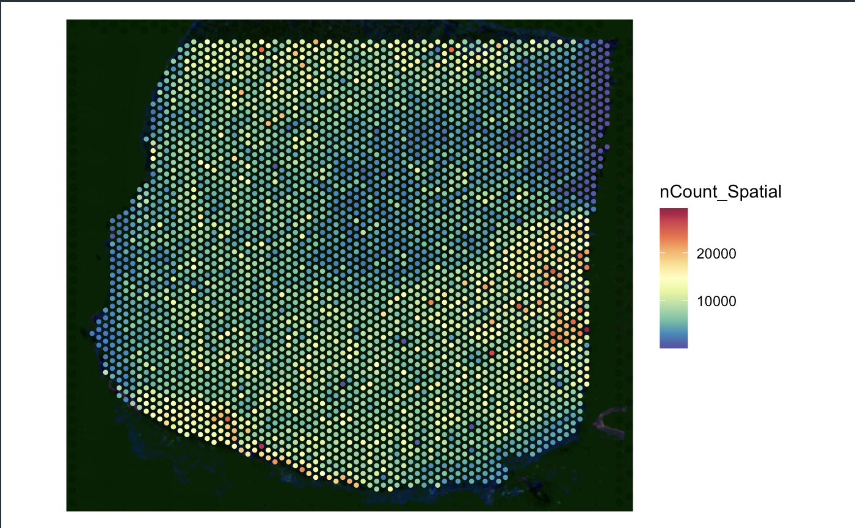
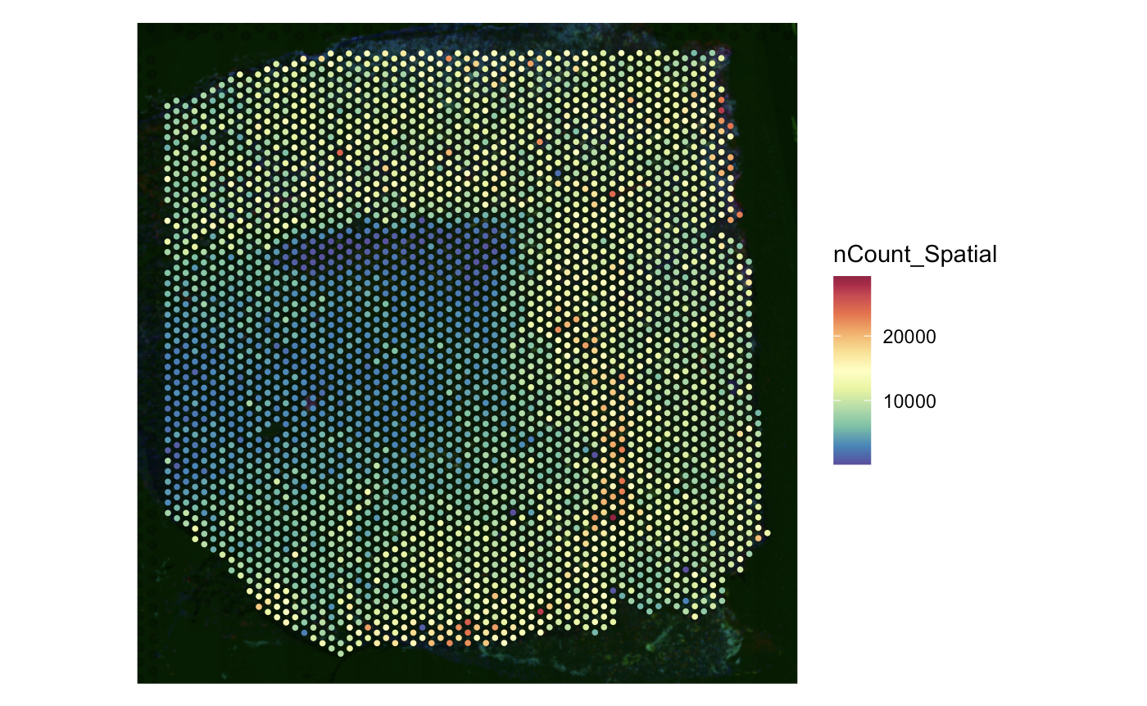
Loading 10x Data

Slide 4
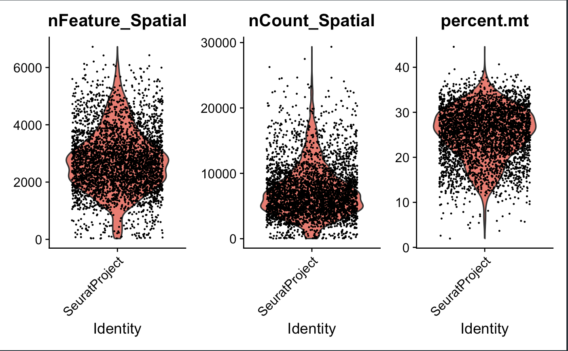
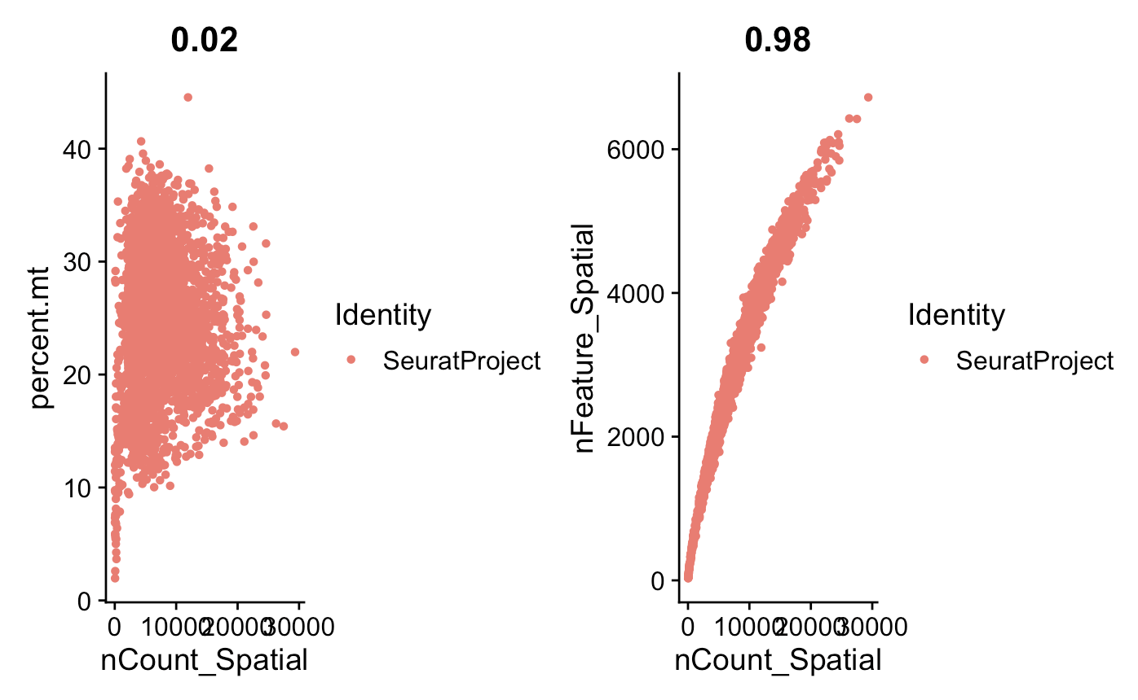
Preprocessing Data: control

Slide 5
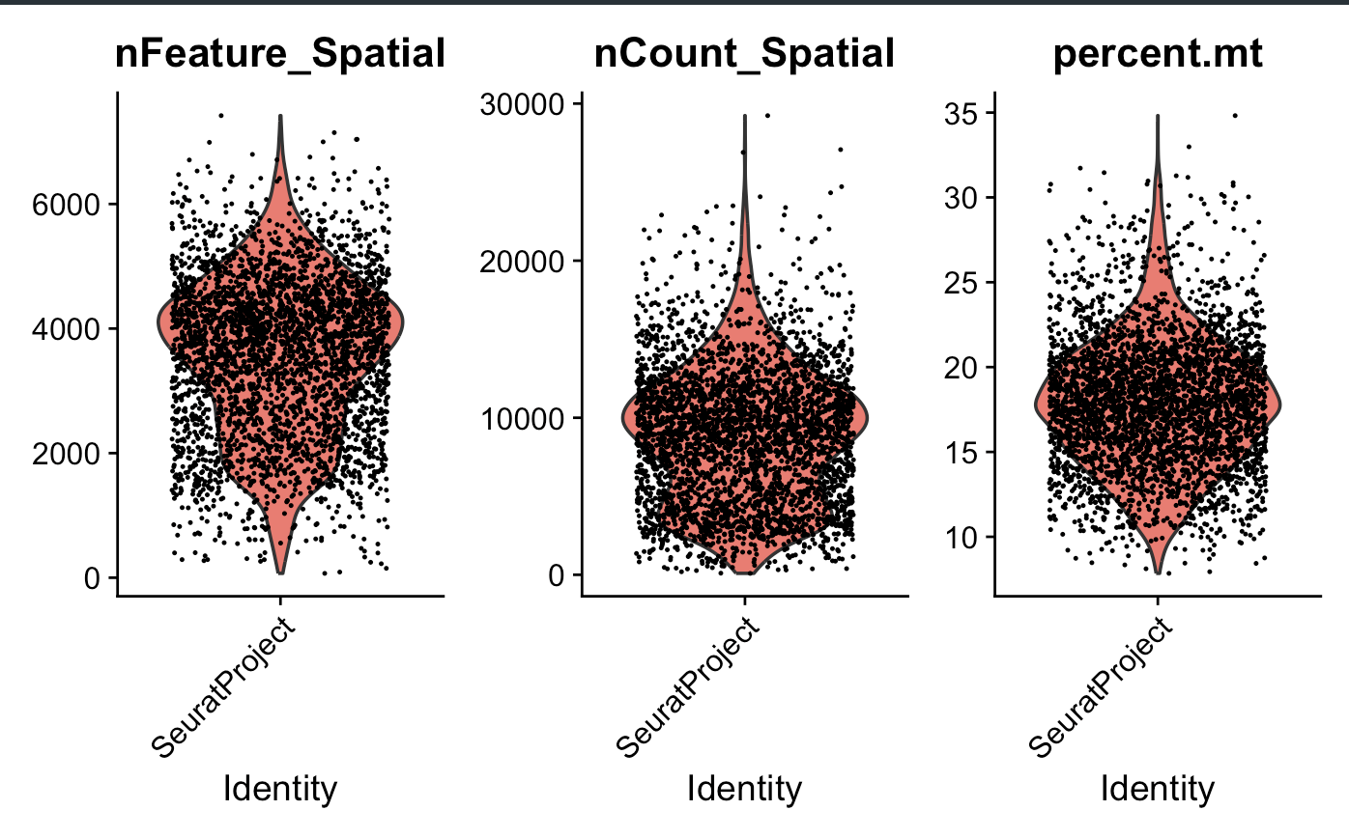
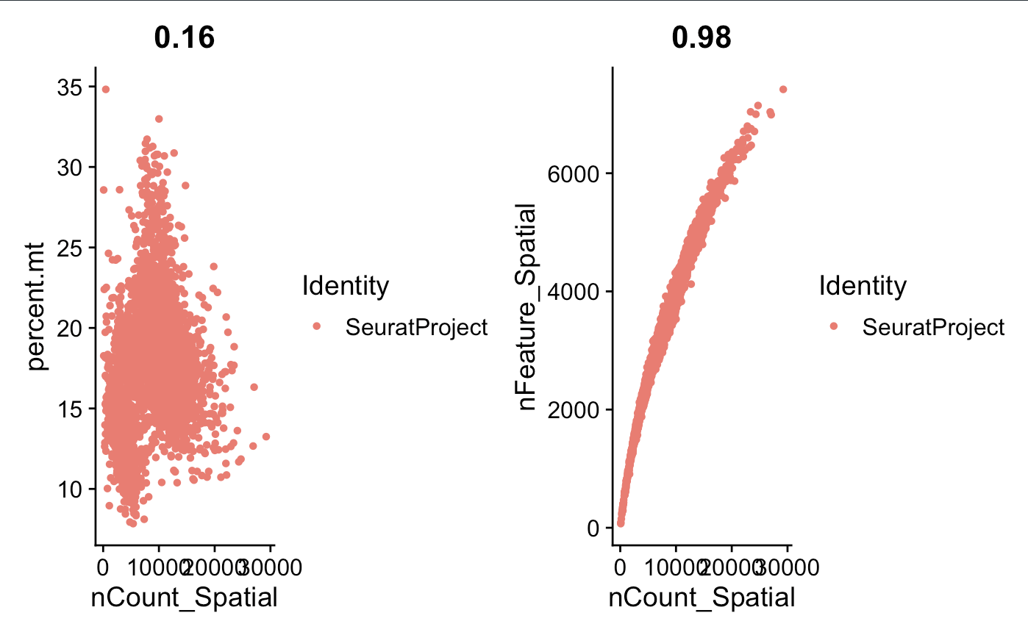
Preprocessing Data: AD

Slide 6
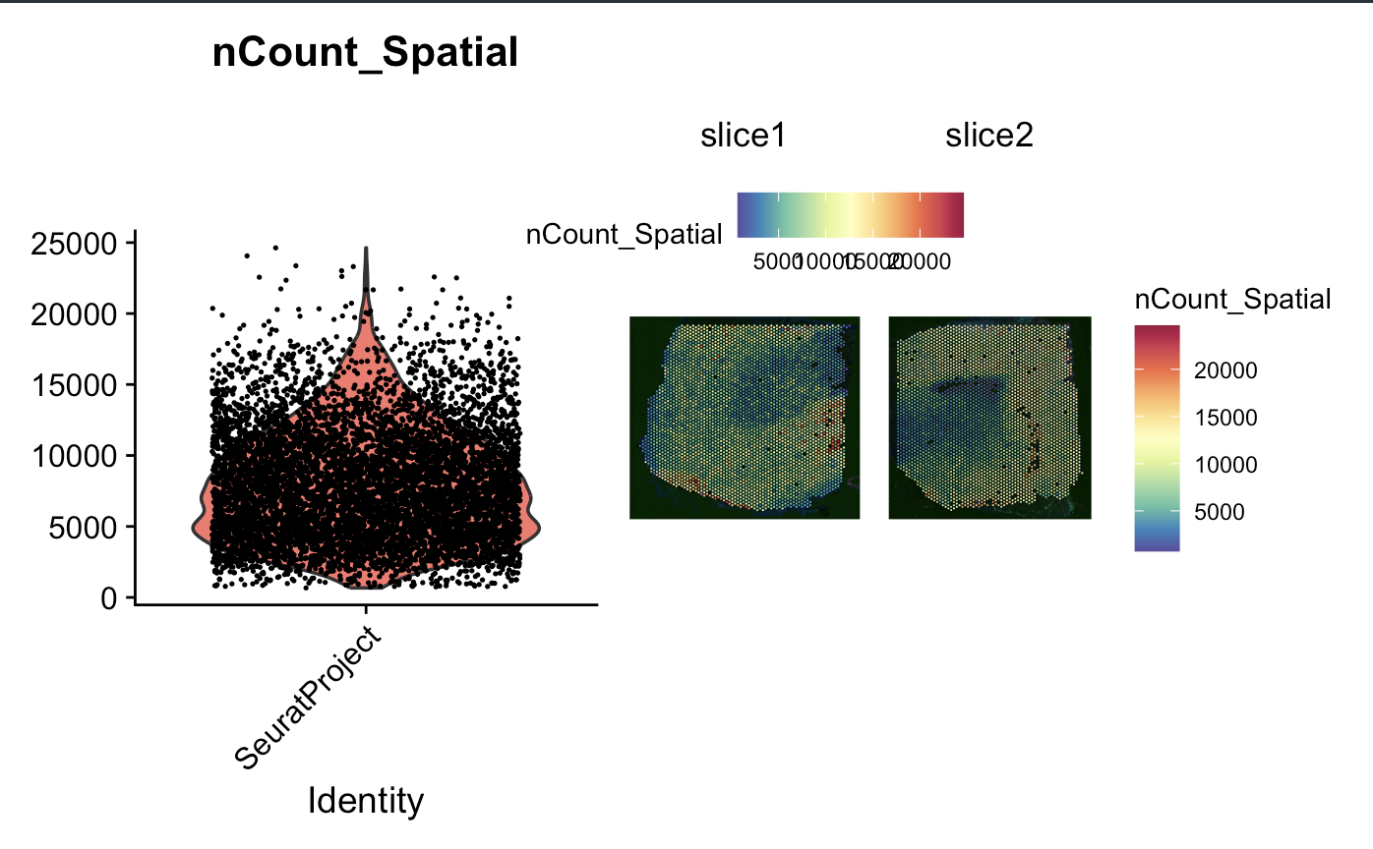
Merging Data

Slide 7
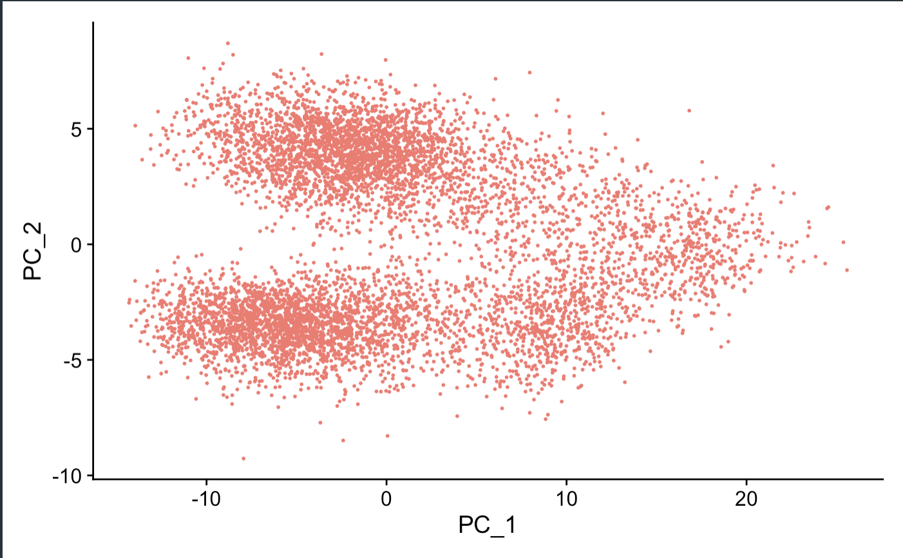
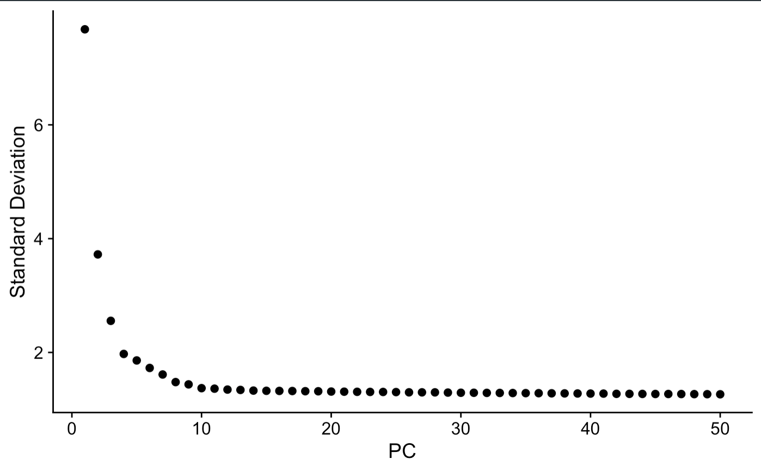
Dimensionality Reduction & Clustering

Slide 8
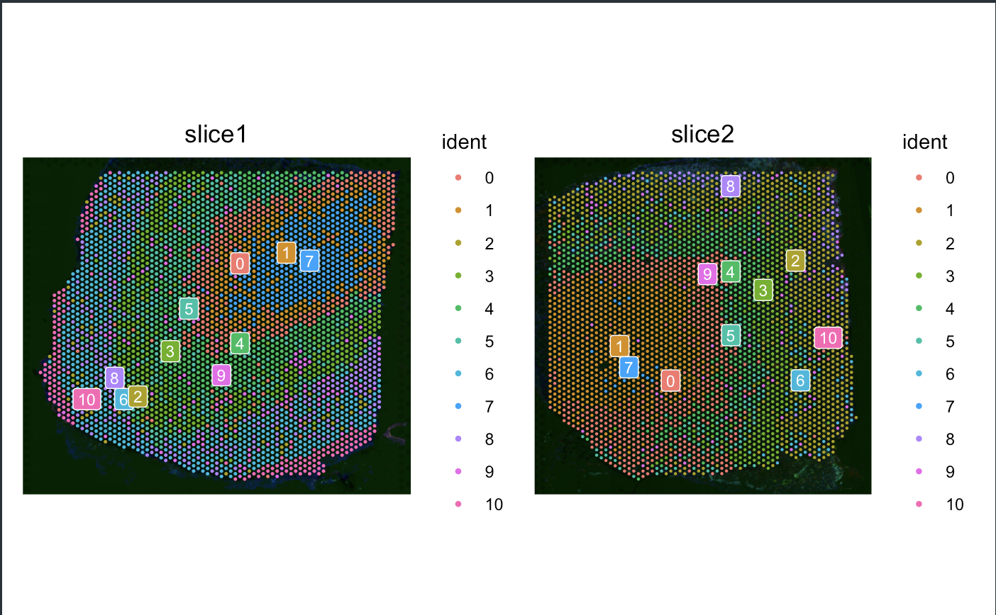
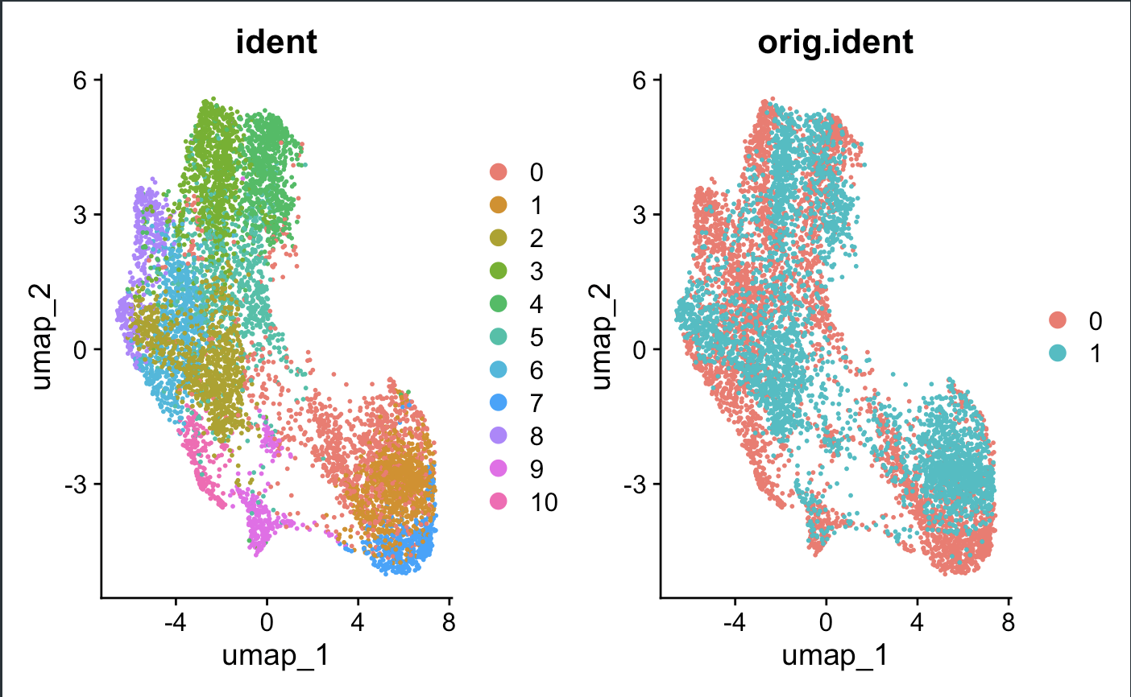
Dimensionality Reduction & Clustering

Slide 9
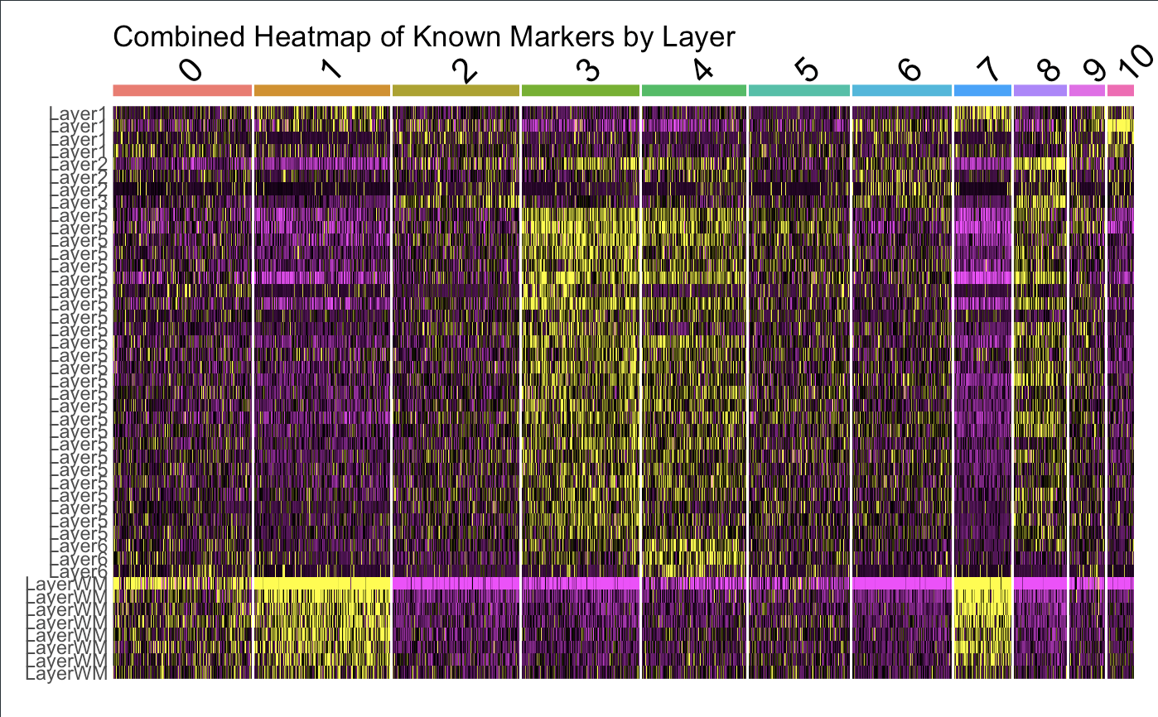
Identifying Cortical Layers by Heatmpap of canonical markers

Slide 10
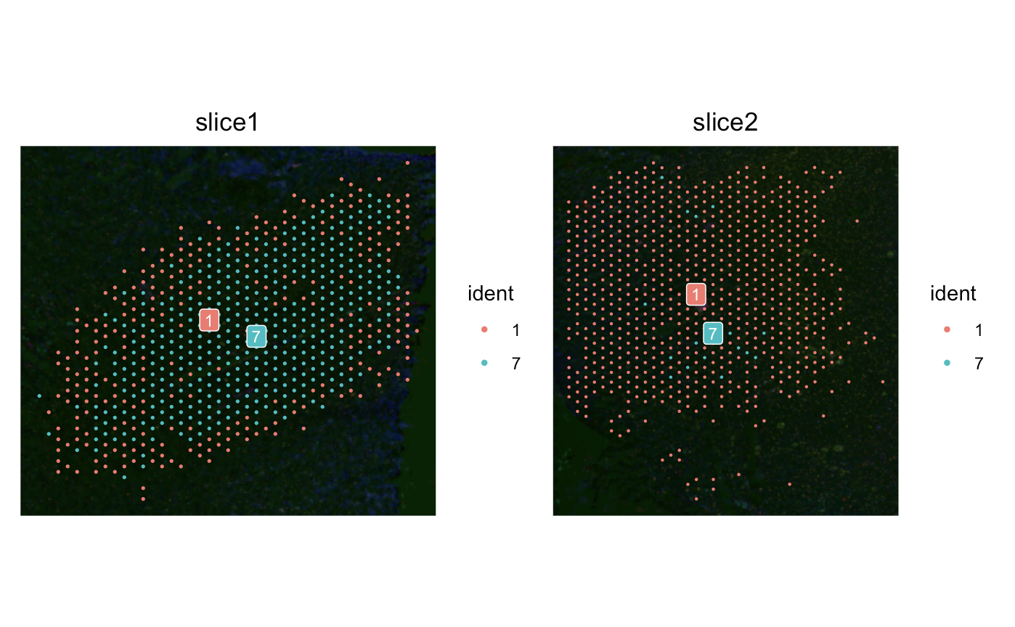
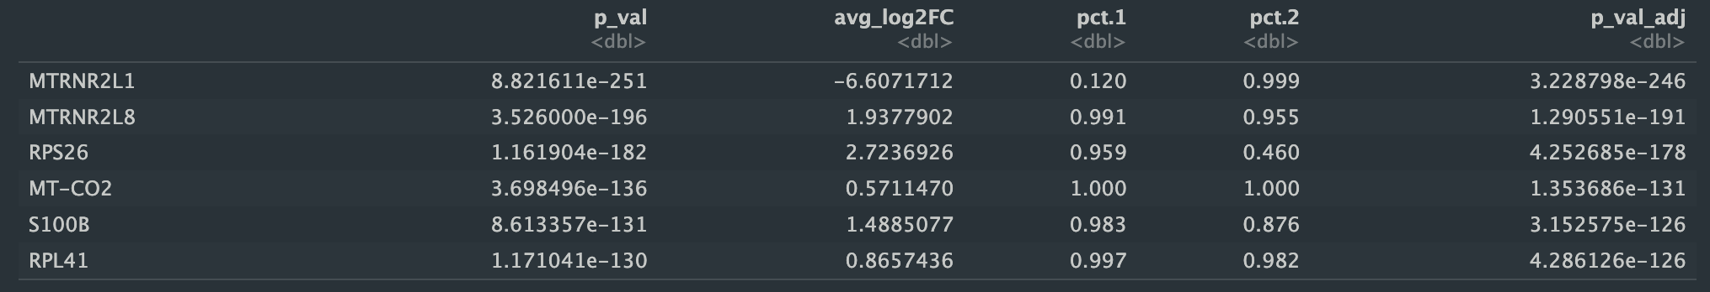
Subsetting WM and Representative Cortical Layer

Slide 11
DEGs: WM
Gene | Adjusted P value | Biological Significance
MTRNR2L1 | 3.228798e-246 | Predicted to be involved in negative regulation of execution phase of apoptosis.
MTRNR2L8 | 1.290551e-191 | Predicted to be involved in negative regulation of execution phase of apoptosis.
RPS26 | 4.252685e-178 | Encodes a ribosomal protein that is a component of the 40S subunit
MT-CO2 | 1.353686e-131 | Predicted to be involved in mitochondrial electron transport, cytochrome c to oxygen and positive regulation of vasoconstriction.
S100B | 3.152575e-126 | Regulation of a number of cellular processes such as cell cycle progression and differentiation; may function in neurite extension

Slide 12
DEGs: Cortical Layer 5
Gene | Adjusted P value | Biological Significance
MTRNR2L1 | 2.778286e-253 | Predicted to be involved in negative regulation of execution phase of apoptosis.
GFAP | 1.657914e-239 | This gene encodes one of the major intermediate filament proteins of mature astrocytes.
MTRNR2L8 | 6.752977e-235 | Predicted to be involved in negative regulation of execution phase of apoptosis.
MT-CO3 | 1.024688e-220 | Predicted to contribute to cytochrome-c oxidase activity. Involved in respiratory chain complex IV assembly.
CLU | 9.690414e-212 | The protein encoded by this gene is a secreted chaperone that can under some stress conditions also be found in the cell cytosol. It has been suggested to be involved in several basic biological events such as cell death, tumor progression, and neurodegenerative disorders.

Slide 13
