Slide 1
GP-RareLink
Reading the rare-disease literature with a language model, and checking its work
Interim overview for collaborators · 2026-11-09
Rare Genomics Institute with the Stanford Open Virtual Assistant Lab · funded by Anthropic's AI for Science program
Notes:
Welcome. This is a short overview of GP-RareLink, a project that reads the published literature on rare genetic diseases with a language model, turns it into structured records, and checks every value against its source. It is funded by Anthropic's AI for Science program and run by the Rare Genomics Institute with the Stanford OVAL lab. You are seeing interim results, for internal review.

Slide 2
A variant published once, and then lost
When a child with a rare disease is finally diagnosed, the responsible variant is often reported in a single case report and never submitted to a public database. The laboratory testing the next child searches ClinVar and finds nothing.
The knowledge exists. It is scattered across thousands of papers, in prose and tables no database can query, and hand curation has never kept up.
Alexander disease is the example on the right: a 2024 review counts the published variants and patients; ClinVar holds a fraction of them.
182
distinct causative variants published for Alexander disease (2024 review)
550
published patients with Alexander disease
76
pathogenic or likely-pathogenic ClinVar records for the gene (release 2026-10-12)
Notes:
Here is the problem. When a child with a rare disease is diagnosed, the responsible variant is often reported once, in a case report, and never submitted to the public databases. A laboratory testing the next child searches ClinVar and finds nothing. For Alexander disease alone, a 2024 review counts 182 causative variants in 550 published patients, but ClinVar holds 76 pathogenic or likely pathogenic records for the gene. The knowledge exists; it is scattered across papers no database can query.

Slide 3
The question, and the rules behind it
Can a language model, reading with strict rules, do the first pass of curation: which variant, in which person, with which clinical features, each value tied to the sentence it came from, at an accuracy we can measure rather than assume?
1
Quote everything
2
Hold out the answer key
3
Decide the rules first
A value without a verbatim quote is not allowed. A script looks up every quote in the paper. "Not reported" is a valid answer; a paper's silence never becomes a "no".
ClinVar and OMIM are never shown to the model. Code that reads papers cannot read them; a test fails if it could. They are compared afterwards, by a separate harness.
Prompts, forms and the analysis plan were frozen on 2026-10-20, after a one-disease pilot. Changes since are logged as numbered deviations.
Notes:
So the question is whether a language model, reading with strict rules, can do the first pass. Two rules make the answer checkable. First, every value the model records must carry a verbatim quote from the paper, and a script confirms the quote is really there. Second, the databases we want to fill, ClinVar and OMIM, are never shown to the model. They are held out as the answer key. And the whole analysis plan was frozen before the main run, so what you see is what we said we would report.

Slide 4
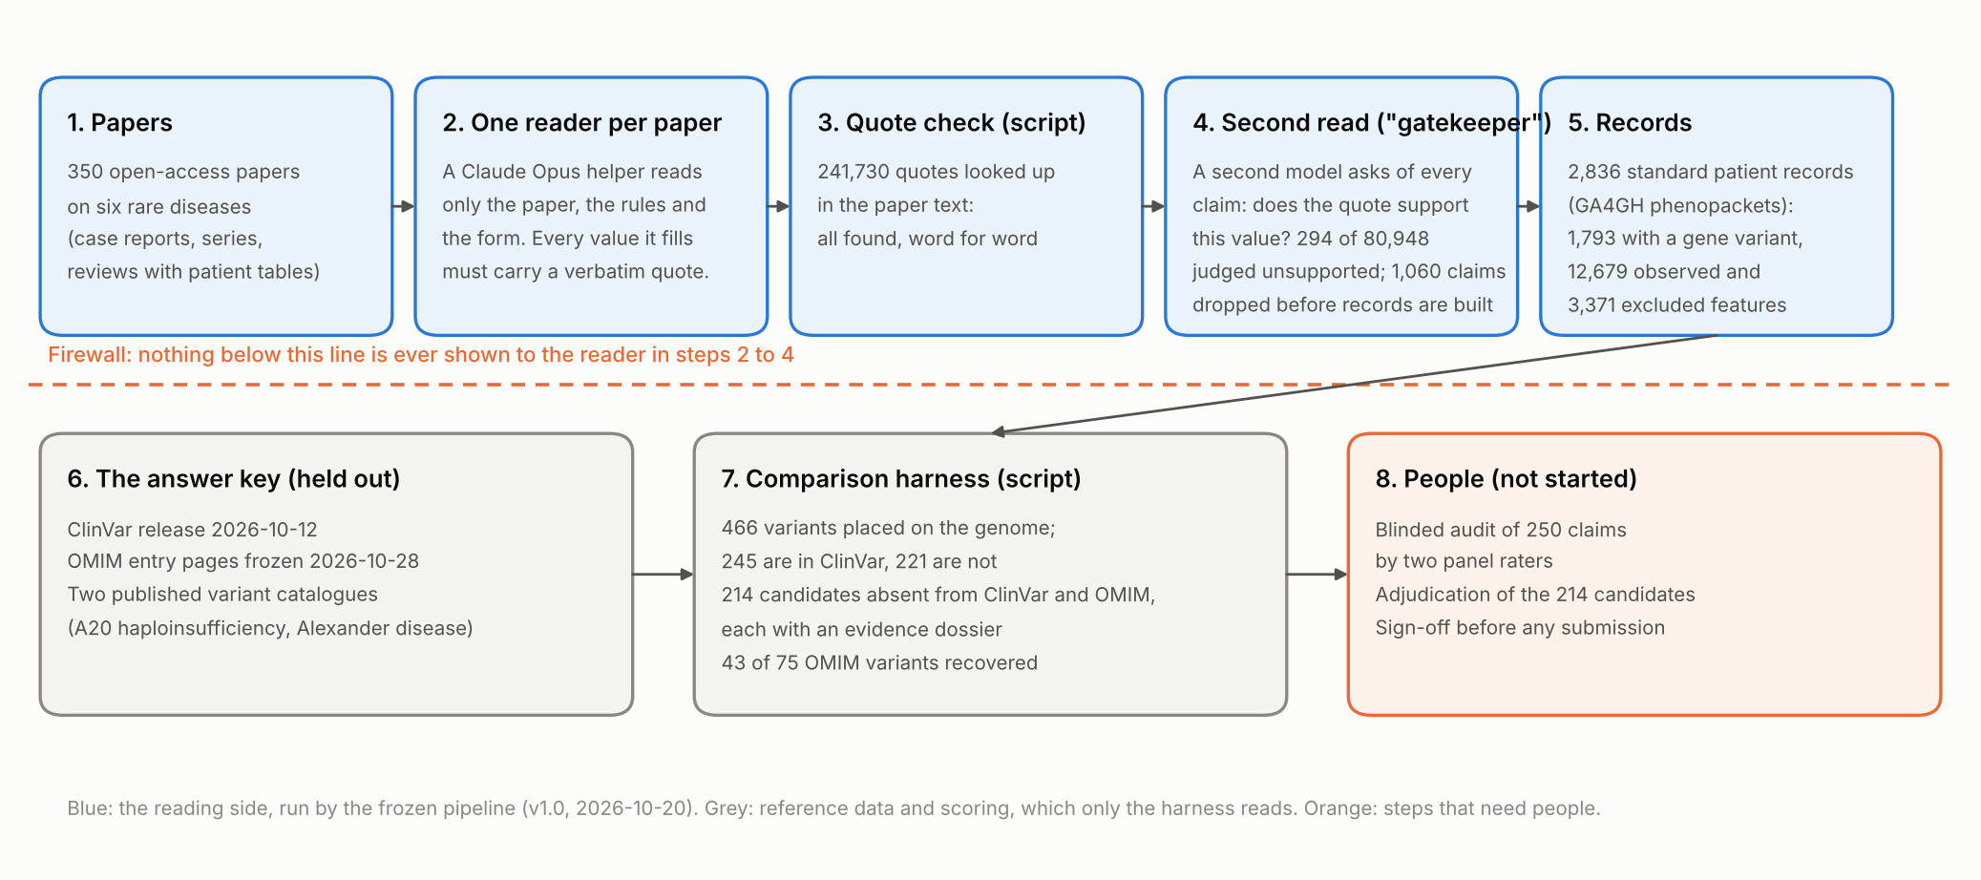
How it works: read, quote, check, compare
Notes:
This is the workflow. One model reader per paper fills a structured form with quotes. A script checks every quote. A second model pass, which we call the gatekeeper, re-reads each value against its quote and drops the ones it cannot support. The result is one standard record per individual, a GA4GH phenopacket. Below the firewall, a separate harness compares the records with ClinVar, OMIM and two published catalogues, and lists the variants the databases are missing. The orange box is what has not happened yet: the human audit and the expert adjudication.

Slide 5
Six diseases, six organ systems
Disease | Gene | Inheritance | Papers read (open share) | Individuals | With a variant | Variants placed | Candidates | OMIM variants recovered
HA20* | TNFAIP3 | AD | 85 (53%) | 769 | 558 | 103 | 64 | 8 of 9
SSADH | ALDH5A1 | AR | 40 (35%) | 363 | 243 | 78 | 10 | 4 of 7
Tangier | ABCA1 | AR | 31 (14%) | 235 | 65 | 16 | 7 | 2 of 19
LAD-I | ITGB2 | AR | 42 (22%) | 508 | 328 | 129 | 82 | 12 of 14
AxD | GFAP | AD / de novo | 69 (23%) | 456 | 318 | 67 | 17 | 9 of 13
Danon | LAMP2 | X-linked dominant | 83 (39%) | 505 | 281 | 73 | 34 | 8 of 13
*A20 haploinsufficiency (HA20) developed the pipeline; the other five are the confirmatory set. Only open-access papers were read. "Placed" = written unambiguously on the GRCh38 genome, which is what makes a variant comparable with ClinVar. "Candidates" = absent from ClinVar and OMIM, awaiting adjudication.
Notes:
We ran six diseases, chosen to span inheritance modes and organ systems. A20 haploinsufficiency was the development disease, so its numbers are flagged and the other five are the confirmatory set. Only open-access papers were read, which matters later: for most of these diseases, only a fifth to a third of the literature is open.

Slide 6
The numbers so far
350
2,836
241,730
open-access papers read, six diseases
individual records (GA4GH phenopackets), every value with a quote
quotes checked against the paper text: all found, word for word
466
214
43 of 75
distinct variants placed on the genome
variants in neither ClinVar nor OMIM, each with an evidence dossier
variants OMIM lists for these diseases recovered (57%)
Notes:
The headline numbers. 350 papers became 2,836 individual records, 1,793 of them carrying a variant in the disease gene. Every one of 241,730 quotes was found verbatim in its paper. 466 distinct variants could be placed on the genome. 214 of them are in neither ClinVar nor OMIM. And we recovered 43 of the 75 variants OMIM lists for these diseases.

Slide 7
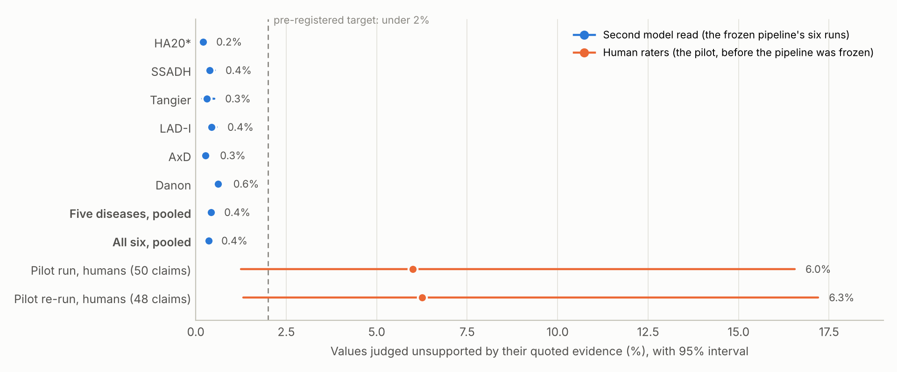
Finding 1: receipts hold, decisive check pending
Second model read: 0.43% of values unsupported on the five confirmatory diseases (0.36% with HA20).
Human raters in the pilot, before the fixes were frozen: 6.0% and 6.3%.
The pre-registered test is a blinded audit of 250 claims by two panel members. It is built; no claim has been rated.
Until then, the machine's rate is a filter's reading, not an accuracy.
Blue: the gatekeeper's verdicts per disease run. Orange: two human audits of the pilot's output. Dashed line: the 2% target.
Notes:
First finding: the receipts hold, but the decisive check has not happened. The gatekeeper judged 0.43 percent of values unsupported across the five confirmatory diseases. That is the blue. The orange is what human raters found in the pilot, before the pipeline was frozen: around six percent. The machine's reading of its own errors is far below the humans'. The pre-registered test is a blinded audit of 250 claims by two panel members. It is built, and nobody has rated a claim yet. Until then, no accuracy claim can be made.

Slide 8
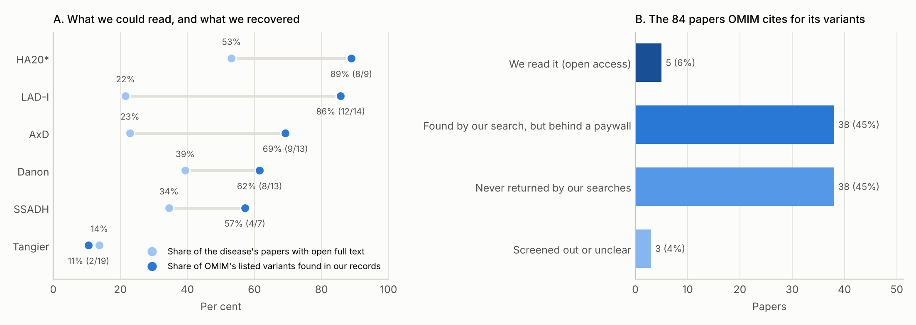
Finding 2: we find what we can read
Left: the share of each disease's papers with open full text (light) beside the share of OMIM's listed variants we recovered (dark). Right: of the 84 papers OMIM cites for those variants, we could read 5; 38 are behind paywalls and 38 were never returned by our searches, mostly pre-1990 papers under earlier names for the disease. Where the source paper was read, the variant was in our records 8 times out of 14.
Notes:
Second finding: we find what we can read. Against OMIM's listed variants we recovered 57 percent overall, from nearly ninety percent for the diseases whose literature is open to eleven percent for Tangier disease, whose variants come from closed papers of the early 2000s. Of the 84 papers OMIM cites as the sources for its variants, we could read 5. Where we had read the source paper, the variant was usually in our records. Access, not reading, sets the ceiling.

Slide 9
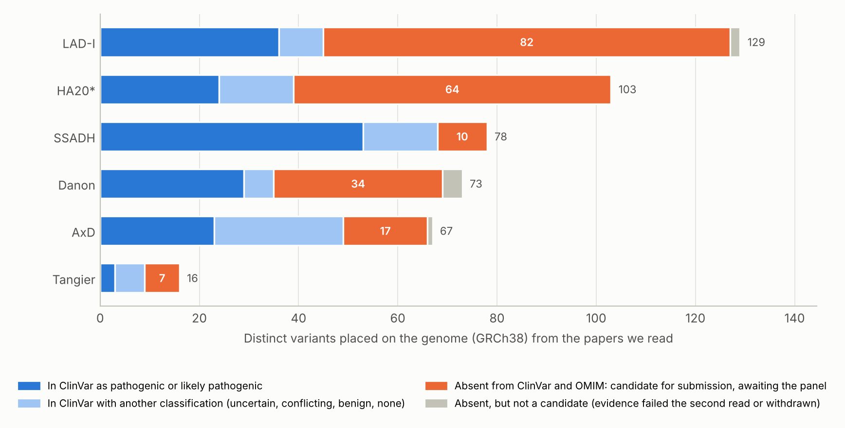
Finding 3: a real gap in the databases
466 variants placed on the genome; 245 are in ClinVar, 168 of them pathogenic or likely pathogenic.
221 are absent from ClinVar. After dropping unsupported ones, checking OMIM and withdrawing one normalization error of our own: 214 candidates.
53 more sit in ClinVar as uncertain or conflicting while papers call them pathogenic; 15 with strong evidence.
Every candidate has a dossier: papers, quotes, individuals, the authors' classification, and flags for the panel. Nothing is submitted without adjudication.
Each bar: one disease's genome-placed variants. Orange: candidates awaiting the panel.
Notes:
Third finding: the database gap is real. Of 466 genome-placed variants, 245 are in ClinVar, and 168 of those are classified pathogenic or likely pathogenic. 221 are absent from ClinVar; after the checks, 214 remain as candidates, each with an evidence dossier listing every paper, every quote and every individual. 53 more sit in ClinVar as uncertain or conflicting while the papers call them pathogenic. Nothing is submitted without expert adjudication.

Slide 10
Finding 4: same variants, lost receipts, lower cost
Same papers, prompts, forms and scoring. The open model found the same variants 89% to 95% of the time (shared over union).
About 1/15 of the cost per paper ($0.07 vs $1.08 median) and 7 times the wall-clock.
3.0% to 3.6% of its values came with no quote at all, which the rules forbid.
The judge is itself Claude, so the comparison is not neutral until the planned blinded human audit of both outputs.
Notes:
Fourth finding: a cheaper open-weight model finds the same variants and loses the receipts. On identical inputs, DeepSeek found the same variants about 89 to 95 percent of the time at roughly one 15th of the cost. But it left 3.0 to 3.6 percent of its values with no quote at all, and the gatekeeper rejected 6.14 to 8.64 percent of its claims, against Claude's 0.20 to 0.38.

Slide 11
Two more checks: repeats and memorization
A
Run-to-run stability
B
Memorization probe
A tenth of the papers (38) were run a second time.
Same checklist answers 97% to 100% of the time.
Same variants 83% to 100% of the time.
Where the runs differed, it was mostly over how many individuals a cohort paper describes.
180 papers were probed, stratified around the model's training cutoff: asked about each paper without its text, and asked to continue a passage.
In the 10 papers published after the cutoff, neither Claude nor the open model produced a specific recall or a correct variant.
The probe is small and will grow, but it gives no sign of memorization.
Notes:
Two more checks. Running a tenth of the papers twice gave the same checklist answers 97 to 100 percent of the time and the same variants 83 to 100 percent of the time. And a memorization probe on 180 papers found no sign that either model recalled the papers from training rather than reading them.

Slide 12
What it means
1
Accuracy
2
Coverage
3
The answer key
Records with complete provenance, stable across repeats, and a second read that removed 1,060 claims before records were built. What is missing is a human-rated error rate for the frozen pipeline. The 250-claim audit provides it and costs no model time.
Reading is not the bottleneck; access is. With 14% to 53% of each corpus open, completeness and the candidate list are lower bounds. A decision on institutional or text-mining access would change these results more than any change to the model.
Databases curated by people deserve the same scrutiny. OMIM lists selected examples, not a catalogue; two of its entries link to ClinVar records that contradict their text. The OMIM check caught one of our own normalization errors, now fixed in the pipeline.
Notes:
What does this mean? On accuracy: the pipeline produces records with complete provenance, but a human-rated error rate is the one number it lacks, and the audit that provides it costs no model time. On coverage: a decision on access to paywalled papers would change these results more than any change to the model. On the answer key: databases curated by people deserve the same scrutiny; OMIM caught one of our normalization errors, and we found two OMIM entries linked to the wrong ClinVar records.

Slide 13
What we need from you
Role | What you would do | Effort | What it unlocks
Audit rater | Rate 250 extracted values against their quoted evidence on a blinded web page; two raters and a tie-breaker | 10 to 15 hours per rater | The primary outcome: the first true accuracy figure
Adjudicator | Review the 214 candidate variants from their dossiers and decide whether the evidence supports a submission | 10 to 15 minutes per candidate | ClinVar literature-only submissions and OMIM candidates
Cohort reader | Fill a comparator sheet of clinical-feature frequencies from a natural-history cohort paper, without looking at our records | 1 to 2 hours per sheet | The ascertainment-bias arm
Methods or domain reviewer | Read the short paper or the full report and tell us what is wrong, missing or unclear, from your field's point of view | 1 to 3 hours | A better study before anything is submitted
Tell us who you are and how you would like to contribute through the form linked on the dashboard. Everything is published literature; there is no patient data.
Notes:
This is where you come in. We need two raters for the 250-claim audit, roughly ten to fifteen hours each, and a tie-breaker. We need experts to adjudicate the 214 candidates from their dossiers. We need people to fill four comparator sheets from natural-history cohorts. And we need reviewers for the methods and the paper. The dashboard has a short form where you can tell us who you are and how you would like to contribute.

Slide 14
Thank you
The dashboard holds the short paper, the full report and supplement, this deck, the overview video, the candidate list and the form.
https://cjimmylin.github.io/gp-rarelink/
Every number in this deck comes from the project repository at commit 8d27d5d, and the report says plainly which questions are still open: the human audit, the access decision, and the adjudication of the candidates.
Notes:
Thank you. Everything in this overview, the papers, the deck, the candidate list and the form, is on the dashboard. The numbers all trace to files in the project repository, and the report says plainly which questions are still open. We look forward to working with you.

