Slide 1
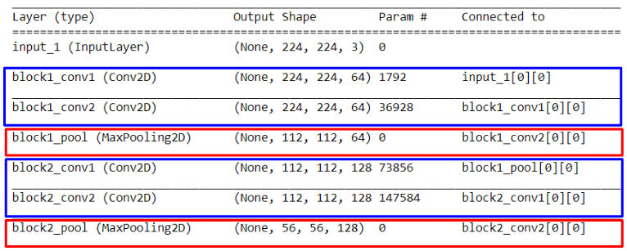
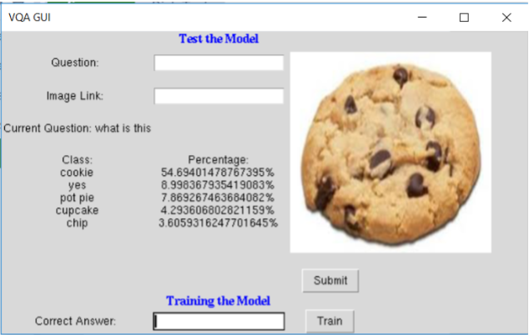
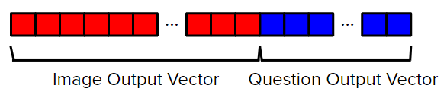
Food-Related Visual Question Answering for the Blind Caroline Jin Computer Systems Lab
Introduction
There are few applications available to help the blind with activities involving sight. Particularly, blind people face situations, in which they do not know whether the food they eat is safe or not. To achieve better human-computer interactions, my research focuses on Visual Question Answering Models, which respond to questions about a food-image. Researchers studying Visual Question Answering face challenges of how to best integrate computer vision with natural language processing. Some researchers propose combining image models with question models while others claim models analyzing the relationship between questions and images. My approach is creating a VQA model composed of a convolutional neural network (CNN) and recurrent neural network (RNN).
Background
There are currently applications that can inform blind people about their food. TapTapSee and CamFind are mobile applications that enable users to take a picture of an object and have it described through a voice over. The next step for these visual applications is to better human-computer interactions, meaning the user can naturally speak to the system to retrieve a more comprehensive response. Visual Question Answering (VQA) enables more information about the image to be gathered by asking specific questions about it.
For the general VQA dataset, researchers have experimented with using simple classifiers such as K-Nearest Neighbors. Researchers also proposed a Multinomial Compact Bilinear pooling model, which projected image and question feature vectors at random and convolved these vectors into a Fourier space. For my project, I created two separate models for extracting image and text features and then inputting these features to a classifier like a neural network. My model followed a similar structure to the Neural-Image-QA models, which used a convolutional neural network (CNN) and a recurrent neural network (RNN) with a long-short term memory layer (LSTM). However, instead of using GoogLeNet for my CNN, I used the VGG16 model.
Methods
Dataset: I used the VizWiz dataset has images taken and questions asked by blind people. I focused on the 7,000 food images in this dataset. The VizWiz dataset had very few examples of each type of food. For instance, there were only two images of apples. I used Microsoft Azure's Bing Web Search API. I used this API to write a Python script that automatically gathered data when I type in command a keyword, such as `cookie.’
Image Feature Extraction: The major component of my model is the convolutional neural network (CNN). Instead of constructing my own CNN, I used a pre-trained CNN, offered by the keras package. The model I used was the VGG16 model. A snippet of the code is shown in Fig. 1.
I composed my GUI of two parts: testing and training. The testing section displayed image of a food item to the right. In this part, the users would type a question about the image into the question-input box and press the `Submit' button. The GUI would output the top five answers the model predicted the answer to be. If the answer was not in the top five choices or the percentage for the answer was too low, users would input the correct answer and press the `Train' button so that the model would learn similar forms of the inputted image-question pairs. Users could also input their own image from online and repeat the process mentioned above (See Fig. 3).
Figure 1. The code snippet shows the first few layers in the VGG16 model. The output shape refers to the magnitude of the vector being outputted.
Question Feature Extraction: My question model contained four layers: an input for the preprocessed questions, an embedding layer, a long-short term memory layer, and a dense layer, which merged the question model to the image model.
Combining the Features and Neural Network: I used elementwise concatenation; this operation pasted the output vector of the image model and the output vector of the question model. The combined output was used as the input for the final classifier, which was a three-layer neural network, consisting of the input, a fully-connected layer, and output.
Figure 3. GUI for users to continuously train the model.
Conclusion and Open Questions
My research focused on three forms of questions: `what is this,' `is this a/an [food],' and `are these [food]s.' Future research can work to expand the question-answering abilities of the vqa model beyond the questions about identification. More specific questions, such as `what brand are these pretzels,' would retrieve more information about the food item. Such expansion can happen with enabling the GUI to take in new questions. Furthermore, these questions would provide an improved conversation between the blind person and computer.
Acknowledgements
I would like to thank the following people for helping me with my research project: Mr. White, my research lab director, for providing guidance over the course of my research, and Dr. Shah for introducing the VQA challenge to me.
Figure 2. This visual shows how the elementwise concatenation works.
Results
Before I trained, I mixed the three forms of questions in a new dataset. I divided my data: 64\% training, 16\% validation, and 20\% evaluation. I trained for a total of around 30 epochs until I reached around 70\% accuracy for training and 60\% accuracy for validation. My final accuracy when evaluating on the testing data was around 60\% on 400 food-question pairs.

