Slide 1

Chapter Five
Large and Fast:
Exploiting Memory Hierarchy

Slide 2
Memories: Review
ROM只读内存（Read-Only Memory）就是一块单独的内部存储器，和随机内存RAM(即平时说的内存)，用来存储和保存永久数据的。ROM数据不能随意更新，但是在任何时候都可以读取。即使是断电，ROM也能够保留数据。
PROM （Programmable Read-Only Memory）－可编程只读存储器，也叫One-Time Programmable (OTP)ROM，是一种可以用程序操作的只读内存。最主要特征是只允许数据写入一次，如果数据烧入错误只能报废。
EROM 可擦除唯读记忆体
RAM（Random Access Memory）的全名为随机存取记忆体，它相当于PC机上的移动存储，用来存储和保存数据的。它在任何时候都可以读写，RAM通常是作为操作系统或其他正在运行程序的临时存储介质（可称作系统内存）

Slide 3
综合性课程设计4
主要内容：
详细分析Cache层次结构的基本概念、映射、查找、替换等算法和策略。介绍主存储器结构及存储器结构与Cache块的关系。
阅读材料：
Computer Organization and Design: The Hardware/Software Interface(Third Edition)，第五章 7.1~7.2，p.473-491， [美] David A.Patterson John L.Hennessy，机械工业出版社，2005。
作业：书后习题 7.5，7.9，7.10，7.11，7.12 ，7.14，7.20, 7.29,7.32，7.33, 7.35

Slide 4
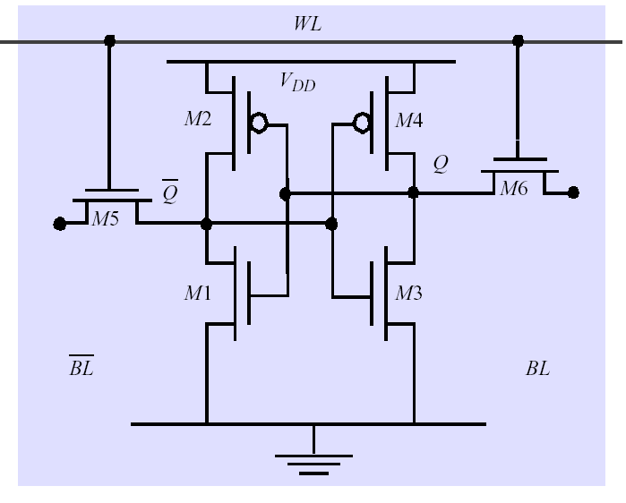
7.1 Introduction
Memories: Review
SRAM:
  value is stored on a pair of inverting gates
  very fast but takes up more space than DRAM
  (4 to 6 transistors)

Slide 5





DRAM logical organization (64 Mbit)
Data in
Column Decoder
D
14
…
Sense
Amps & I/O
Data out
Address buffer
Q
Memory
Array
(16,384×16,384)
A0…A1
3
Row Decoder
Bit Line
…
Storage
Cell
Word Line
Square root of bits per RAS/CAS

Slide 6
Problems in memory designing
In fact
Users want large and fast memories!
Memory technology | Typical access time | Cost per GByte (2004)
SRAM | 0.5-5ns | $4000-$10,000
DRAM | 50-70ns | $100-$200
Magnetic disk | 5,000,000-20,000,000ns

Slide 7
Locality---- two important concepts
1. temporal locality (locality in time):
If an item is referenced, it will tend to be referenced
again soon.
2. spatial locality (locality in space):
If an item is referenced, items whose addresses are
close by will tend to be referenced soon.
As we know, these tow principles actually exists in most programs.
  Why does code have locality?
Our initial focus: two levels (upper, lower)
  block: minimum unit of data (block) for transfers
  hit: data requested is in the upper level
  miss: data requested is not in the upper level

Slide 8
Solutions
Build a memory hierarchy
S
p
e
e
d
C
P
U
S
i
z
e
C
o
s
t
(
$
/
b
i
t
)
processor
upper
F
a
s
t
e
s
t
M
e
m
o
r
y
S
m
a
l
l
e
s
t
H
i
g
h
e
s
t
Data are transferred
M
e
m
o
r
y
S
l
o
w
e
s
t
M
e
m
o
r
y
B
i
g
g
e
s
t
L
o
w
e
s
t

Slide 9
Some important items
hit: The CPU accesses the upper level and succeeds.
Miss: The CPU accesses the upper level and fails.
Hit time:
The time to access the upper level of the memory hierarchy, which includes the time needed to determine whether the access is a hit or a miss.
miss penalty:
The time to replace a block in the upper level with the corresponding block from the lower level, plus the time to deliver this block to the processor.

Slide 10
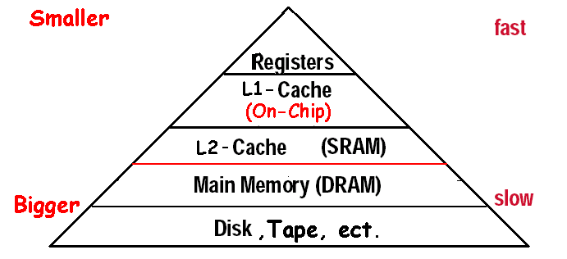
Exploiting Memory Hierarchy
The method
  Hierarchies bases on memories of different speeds and size
  The more closely CPU the level is,the faster the one is.
  The more closely CPU the level is,the smaller the one is.
  The more closely CPU the level is,the more expensive
Levels in the memory hierarchy
Increasing distance form the CPU in access time
Size of the memory at each level

Slide 11
There has been exploited Memory Hierarchy
The basics of Cache: SRAM and DRAM (main memory)
  The solution is in speed
2. Virtual Memory: DRAM and DISK
  The solution is in size

Slide 12
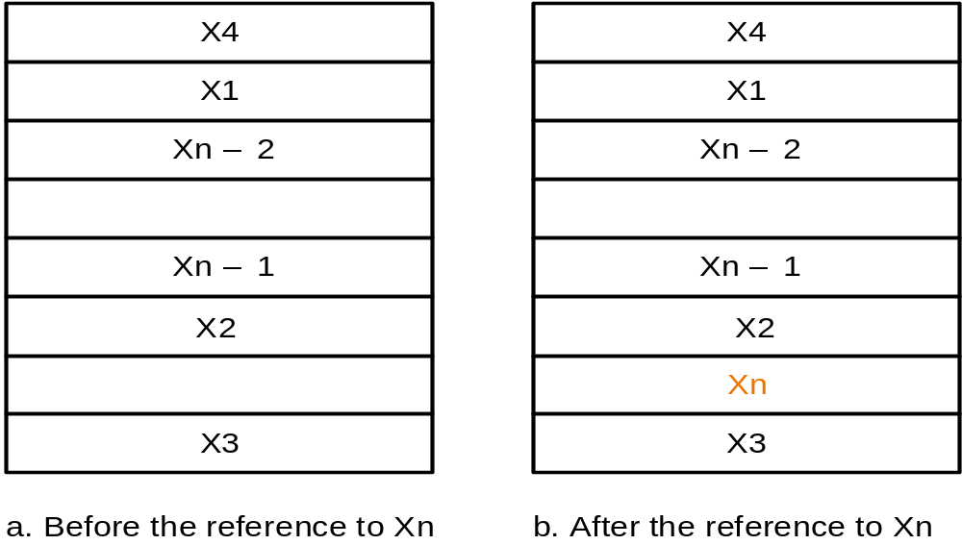
7.2 The basics of Cache
Simple implementations
Two issues:
  How do we know if a data item is in the cache?
  If it is, how do we find it?
Our first example: "direct mapped"
  block size is one word of data
For each item of data at the lower level, there is exactly one location in the cache where it might be.
e.g., lots of items at the lower level share locations in the upper level

Slide 13
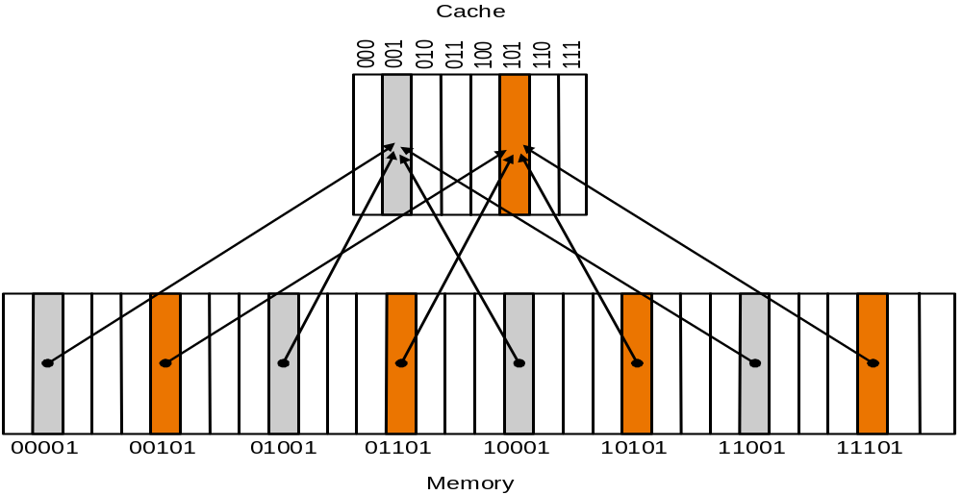
Direct Mapped Cache
Where can a block be placed in the upper level?
index
8 Block
Direct-mapping algorithm.
  memory address is modulo the number of blocks in the cache
Fortunately, while the cache has 2^{n} blocks, the corresponding index is equal to the lowest n bits of memory block address. Here n=3. Let’s check

Slide 14
Accessing a cache---how do we find it?
Memory block address is larger than cache block address
TAG
Index
Byte offset
Block address MOD Numbers of Cache Block
Index | V | Tag | Data
000 | N
001 | N
010 | N
011 | N
100 | N
101 | N
110 | N
111 | N
a. The initial state of the cache after power-on
valid bit

Slide 15
Access sequence
10110,11010,10110,11010,10000,00011,10000,10010
Index | V | Tag | Data
000 | N
001 | N
010 | N
011 | N
100 | N
101 | N
110 | Y | (10)₂ | Memory(10110)
111 | N
b. After handling a miss of address(10110)
Index | V | Tag | Data
000 | N
001 | N
010 | Y | (11)₂ | Memory(11010)
011 | N
100 | N
101 | N
110 | Y | (10)₂ | Memory(10110)
111 | N
c. After handling a miss of address(11010)
Index | V | Tag | Data
000 | N
001 | N
010 | Y | (11)₂ | Memory(11010)
011 | N
100 | N
101 | N
110 | Y | (10)₂ | Memory(10110)
111 | N
d. After handling a hit of address(10110)
Index | V | Tag | Data
000 | N
001 | N
010 | Y | (11)₂ | Memory(11010)
011 | N
100 | N
101 | N
110 | Y | (10)₂ | Memory(10110)
111 | N
e. After handling a hit of address(11010)

Slide 16
Access sequence-2
10110,11010,10110,11010,10000,00011,10000,10010
Index | V | Tag | Data
000 | Y | (10)₂ | Memory(10000)
001 | N
010 | Y | (11)₂ | Memory(11010)
011 | N
100 | N
101 | N
110 | Y | (10)₂ | Memory(10110)
111 | N
f. After handling a miss of address(10000)
Index | V | Tag | Data
000 | Y | (10)₂ | Memory(10000)
001 | N
010 | Y | (11)₂ | Memory(11010)
011 | Y | (00)₂ | Memory(00011)
100 | N
101 | N
110 | Y | (10)₂ | Memory(10110)
111 | N
g. After handling a miss of address(00011)
Index | V | Tag | Data
000 | Y | (10)₂ | Memory(10000)
001 | N
010 | Y | (11)₂ | Memory(11010)
011 | Y | (00)₂ | Memory(00011)
100 | N
101 | N
110 | Y | (10)₂ | Memory(10110)
111 | N
h. After handling a hit of address(10000)
Index | V | Tag | Data
000 | Y | (10)₂ | Memory(10000)
001 | N
010 | Y | (11)→ (10)₂ | Memory(10010)
011 | Y | (00)₂ | Memory(00011)
100 | N
101 | N
110 | Y | (10)₂ | Memory(10110)
111 | N
i. After handling a miss of address(10010)

Slide 17
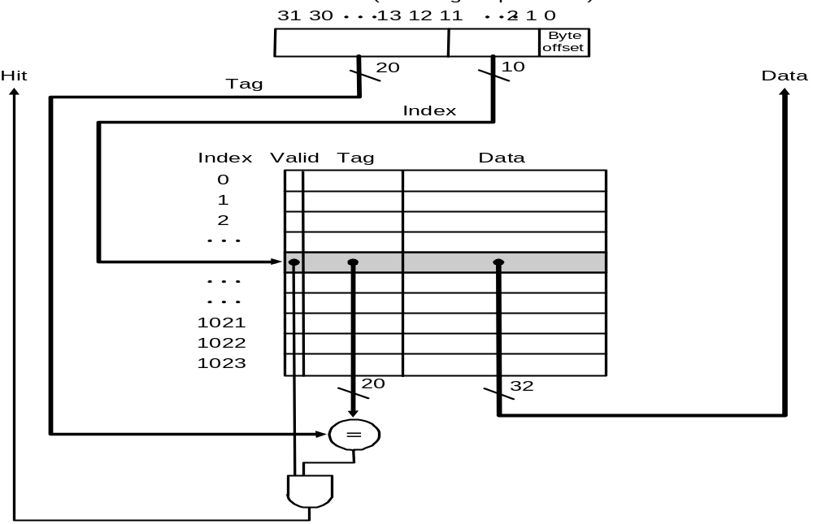
Direct Mapped Cache construction
For MIPS:
What kind of locality are we taking advantage of?
temporal

Slide 18
Bits in Cache
Example
How many total bits are required for a direct-mapped cache 16KB of data and 4-word blocks, assuming a 32-bit address?
Answer
16KB=4KWord=2¹² words
One block=4 words = 2² words
Number of blocks (index bit) = 2¹² ÷ 2² = 2¹⁰ blocks
Data bits of block =4×32=128 bits
Tag bits = address – index-block size =32-10–2-2 =18 bits
Valid bit = 1 bit
Total Cache size = 2¹⁰ × (128+18+1)= 2¹⁰×147= 147 Kbits = 18.4KB
It is about 1.15 times as many as needed just for the data

Slide 19
图例法
How many total bits are required for a direct-mapped cache 16KB of data and 4-word blocks, assuming a 32-bit address?
32－10－4＝18
16KB/2⁴B＝1K
占10位
2⁴B占4位
Block address MOD Numbers of Cache Block
Index | V | Tag | Data
10位长 | N | 18位 | 4word=4*4Bytes
共2¹⁰行 | N
 | N
 | N
 | N
 | N
 | N
 | N
a. The initial state of the cache after power-on
valid bit

Slide 20
Mapping an Address to Multiword Cache Block
Example
Consider a cache with 64 blocks and a block size of 16 bytes.
What block number does byte address 1200 map to?
Answer
(Block address) modulo (Number of cache blocks)
Where the address of the block is
75 modulo 64 =11
Byte address
1200
=
= 75
Bytes per block
16
Notice!!!
Byte address
×Byte per block
Byte address
+( Byte per block-1)
Bytes per block
Bytes per block
×Byte per block
Here:
1200 1215

Slide 21
Handling Cache reads hit and Misses
Read hits
  this is what we want!
Read misses—two kinds of misses
  instruction cache miss
  data cache miss
let’s see main steps taken on an instruction cache miss
  stall the CPU, fetch block from memory, deliver to cache, restart CPU read
1. Send the original PC value (current PC-4) to the memory.
2. Instruct main memory to perform a read and wait for the memory to complete its access.
3. Write the cache entry, putting the data from memory in the data portion of the entry, writing the upper bits of the address (from the ALU) into the tag field,and turning the valid bit on.
4. Restart the instruction execution at the first step, which will refetch the instruction again, this time finding it in the cache.

Slide 22
Handling Cache Writes hit and Misses
Write hits: Difference Strategy
  write-back: Cause Inconsistent
    Wrote the data into only the data cache
    Strategy ---- write back data from the cache to memory later
    Fast
  write-through: Ensuring Consistent
    Write the data into both the memory the cache
    Strategy ---- writes always update both the cache and the memory
    Slower----write buffer
Write misses:
  read the entire block into the cache, then write the word

Slide 23
Deep concept in Cache
Four Questions for Memory Hierarchy Designers
Caching is a general concept used in processors, operating systems, file systems, and applications.
There are Four Questions for Memory Hierarchy Designers
Q1: Where can a block be placed in the upper level?
(Block placement)
  Fully Associative, Set Associative, Direct Mapped
Q2: How is a block found if it is in the upper level?
(Block identification)
  Tag/Block
Q3: Which block should be replaced on a miss?
(Block replacement)
  Random, LRU,FIFO
Q4: What happens on a write?
(Write strategy)
  Write Back or Write Through (with Write Buffer)

Slide 24
Q1: Block Placement
Direct mapped
  Block can only go in one place in the cache
Usually address MOD Number of blocks in cache
Fully associative
Block can go anywhere in cache.
Set associative
  Block can go in one of a set of places in the cache.
  A set is a group of blocks in the cache.
  Block address MOD Number of sets in the cache
  If sets have n blocks, the cache is said to be n-way set associative.
Note that direct mapped is the same as 1-way set associative, and fully associative is m-way set-associative (for a cache with m blocks).

Slide 25
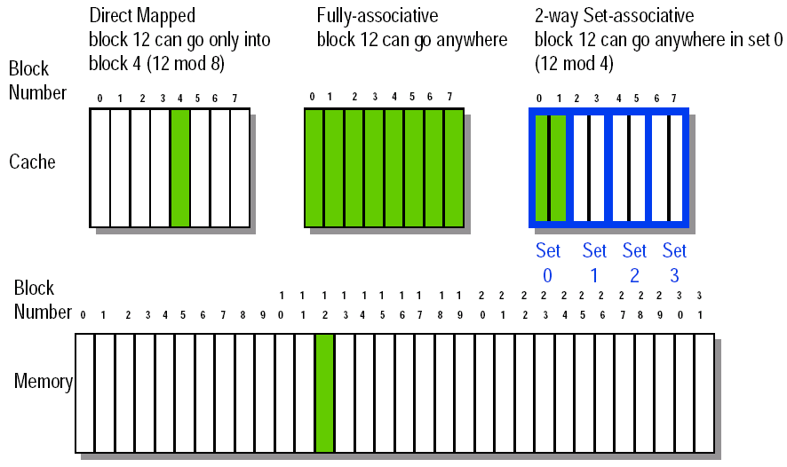
Figure 8-32 Block Placement

Slide 26
Q2: Block Identification
Every block has an address tag that stores the main memory address of the data stored in the block.
When checking the cache, the processor will compare the requested memory address to the cache tag -- if the two are equal, then there is a cache hit and the data is present in the cache
Often, each cache block also has a valid bit that tells if the contents of the cache block are valid

Slide 27
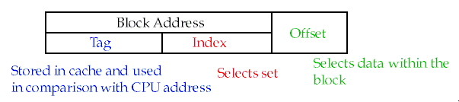
The Format of the Physical Address
The Index field selects
  The set, in case of a set-associative cache
  The block, in case of a direct-mapped cache
  Has as many bits as log2(#sets) for set-associative caches, or log2(#blocks) for direct-mapped caches
The Byte Offset field selects
  The byte within the block
  Has as many bits as log2(size of block)
The Tag is used to find the matching block within a set or in the cache
  Has as many bits as
  Address_size – Index_size – Byte_Offset_Size

Slide 28
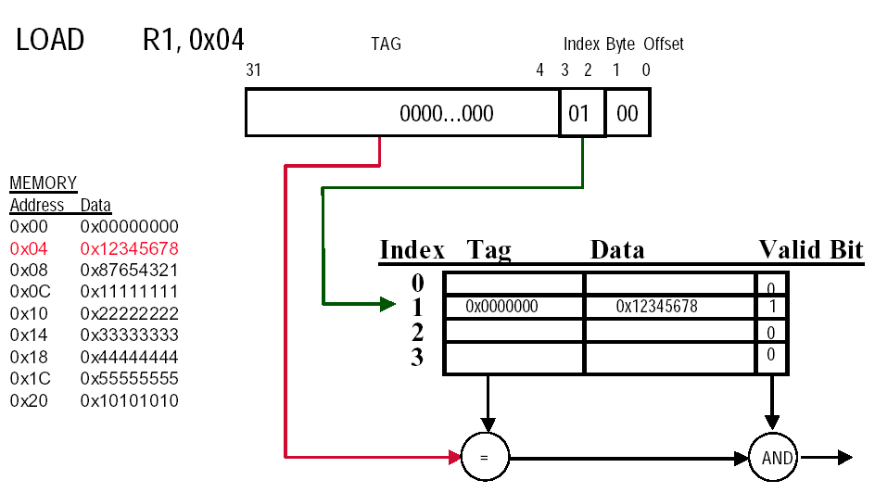
Direct-mapped Cache Example (1-word Blocks)

Slide 29
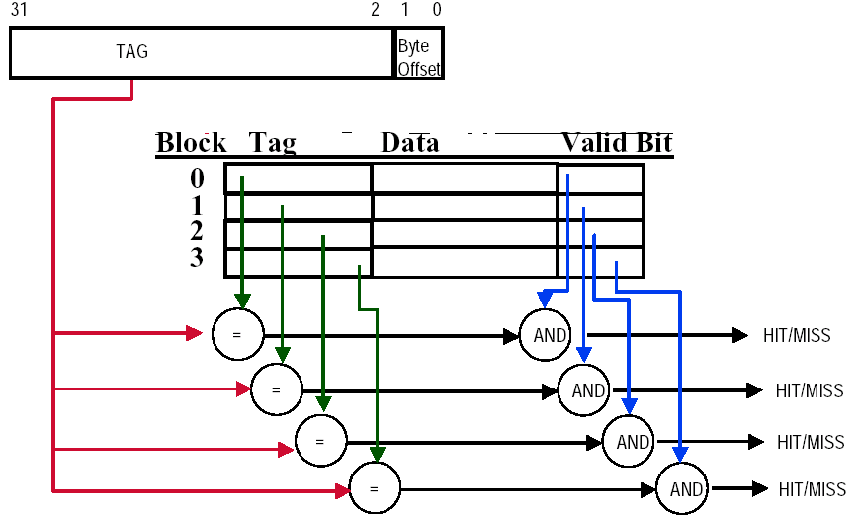
Fully-Associative Cache example (1-word Blocks)
Assume cache has 4 blocks

Slide 30
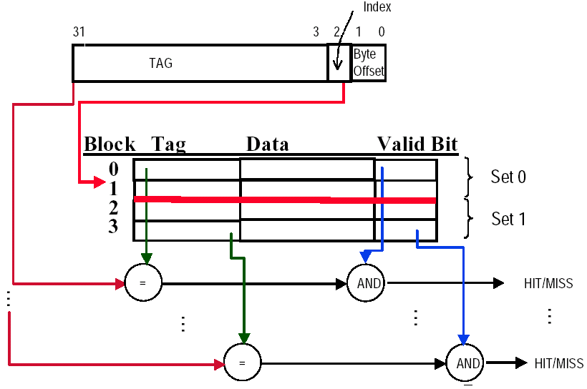
2-Way Set-Associative Cache
Assume cache has 4 blocks and each block is 1 word
2 blocks per set, hence 2 sets per cache

Slide 31
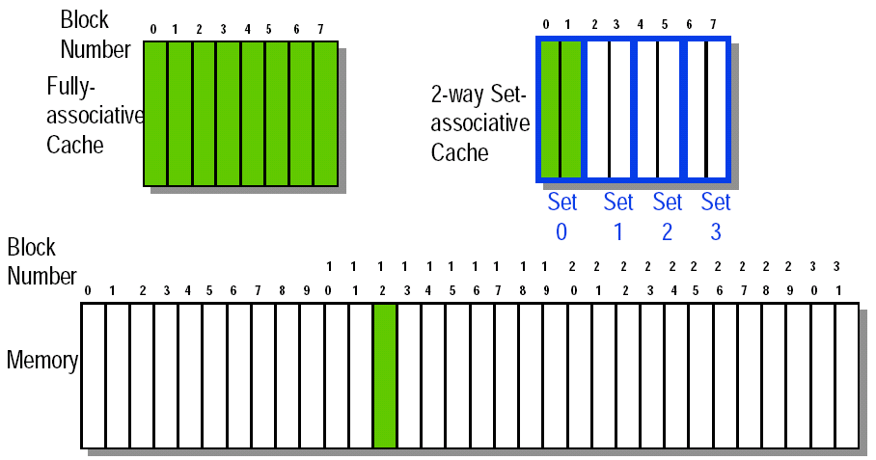
Q3: Block Replacement
In a direct-mapped cache, there is only one block that can be replaced
In set-associative and fully-associative caches, there are N blocks (where N is the degree of associativity

Slide 32
Strategy of block Replacement
Several different replacement policies can be used
  Random replacement - randomly pick any block
    Easy to implement in hardware, just requires a random number generator
    Spreads allocation uniformly across cache
    May evict a block that is about to be accessed
  Least-recently used (LRU) - pick the block in the set which was least recently accessed
    Assumed more recently accessed blocks more likely to be referenced again
    This requires extra bits in the cache to keep track of accesses.
  First in,first out(FIFO)-Choose a block from the set which was first came into the cache

Slide 33
Q4: Write Strategy
When data is written into the cache (on a store), is the data also written to main memory?
  If the data is written to memory, the cache is called a write-through cache
    Can always discard cached data - most up-to-date data is in memory
    Cache control bit: only a valid bit
    memory (or other processors) always have latest data
  If the data is NOT written to memory, the cache is called a write-back cache
    Can’t just discard cached data - may have to write it back to memory
    Cache control bits: both valid and dirty bits
    much lower bandwidth, since data often overwritten multiple times
Write-through adv: Read misses don't result in writes, memory hierarchy is consistent and it is simple to implement.
Write back adv: Writes occur at speed of cache and main memory bandwidth is smaller when multiple writes occur to the same block.

Slide 34
Write stall
Write stall ---When the CPU must wait for writes to complete during write through
Write buffers
  A small cache that can hold a few values waiting to go to main memory.
  To avoid stalling on writes, many CPUs use a write buffer.
  This buffer helps when writes are clustered.
  It does not entirely eliminate stalls since it is possible for the buffer to fill if the burst is larger than the buffer.

Slide 35
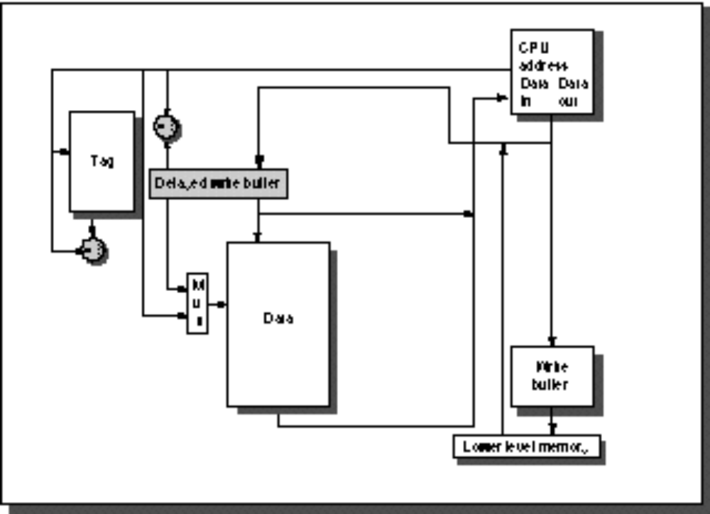
Write buffers
CPU
in out
Write Buffer
write
buffer
DRAM
(or lower mem)

Slide 36
Write misses
Write misses
  If a miss occurs on a write (the block is not present), there are two options.
  Write allocate
    The block is loaded into the cache on a miss before anything else occurs.
  Write around (no write allocate)
    The block is only written to main memory
    It is not stored in the cache.
  In general, write-back caches use write-allocate , and write-through caches use write-around .

Slide 37
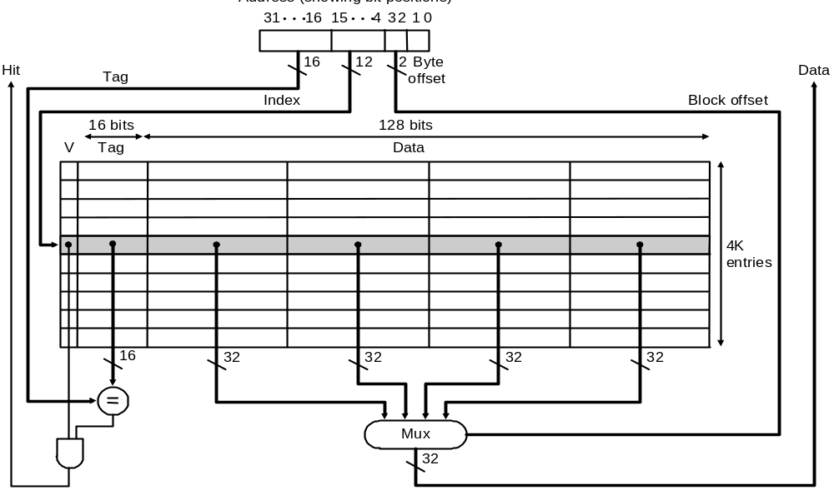
Larger blocks exploit spatial locality
Taking advantage of spatial locality to lower miss rates with many word in the block:

Slide 38
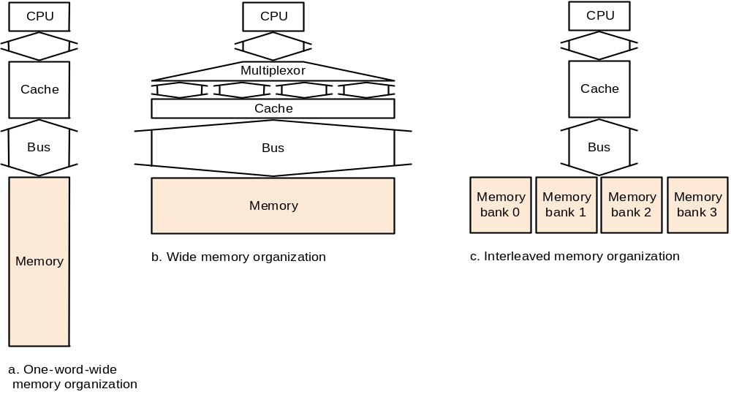
Designing the Memory system to Support Cache
Make reading multiple words easier by using banks of memory
It can get a lot more complicated...

Slide 39

Performance basic memory organization
Assume
1 clock cycles to send the address
15 memory bus clock cycles for each DRAM access initiated
1 bus clock cycles to send a word of data
Block size is 4 words
Every word is 4 bytes
The time to transfer one word is 1+15+1=17
The miss penalty (The time to transfer one block is):
1+4×(1+15)＝65 CLKs
Bandwidth :
Memory
4×4
1
≈
65
4
Only one word is useful,and three other words may be useless. So, for caches using four-word blocks, this memory system is not viable.

Slide 40
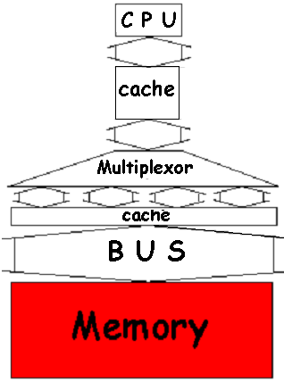
Performance in Wider Main Memory
With a main memory width of 2 words(64bits)
The miss penalty: 4words/Block
1+2×(15+1)＝33 CLKs
Bandwidth :
With a main memory width of 4 words(128bits)
The miss penalty: 4words/Block
1+1×(15+1)＝17 CLKs
Bandwidth :
4×4
16
only two times that needed to transfer one word.
＝
≈0.48
33
33
Equal to time to transfer one word.
4×4
16
＝
≈0.98
17
17

Slide 41
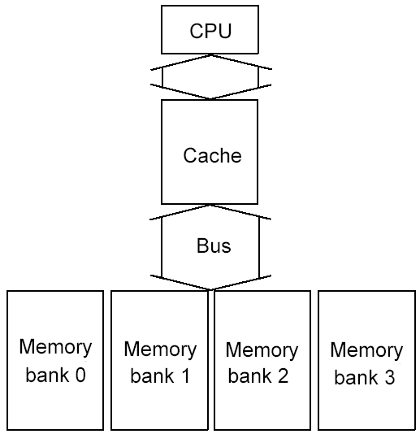
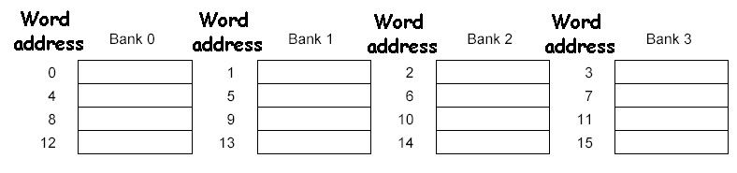
Performance in Four-way interleaved memory
With 4 banks Interleaved Memory
The miss penalty: 4words/Block
1+15 +(4 × 1)＝20
Bandwidth :
Four-way interleaved memory
Almost equal to time to transfer one word.
4×4
＝
0.8
20
Parallel access
Optimizes sequential address access patterns

Slide 42
DRAM developed
Year introduced | Chip size | $ per MB | Total access time to a new row/column | Columm access time to existing row
1980 | 64Kbit | $1500 | 250ns | 150ns
1983 | 128Kbit | $500 | 185ns | 100ns
1985 | 1Mbit | $200 | 135ns | 40ns
1989 | 4Mbit | $50 | 110ns | 40ns
1992 | 16Mbit | $15 | 90ns | 30ns
1996 | 64Mbit | $10 | 60ns | 12ns
1998 | 128Mbit | $4 | 60ns | 10ns
2000 | 256Mbit | $1 | 55ns | 7ns
2002 | 512Mbit | $0.25 | 50ns | 5ns
2004 | 1024Mbit | $0.10 | 45ns | 3ns
DRAM size increased by multiples of four approximately once every three year until 1996,and thereafter doubling approximately every two years.

Slide 43
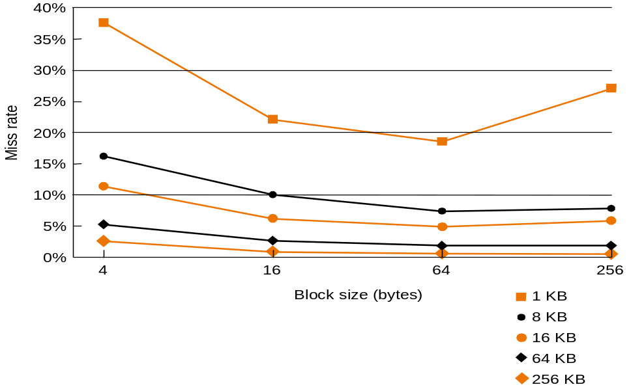
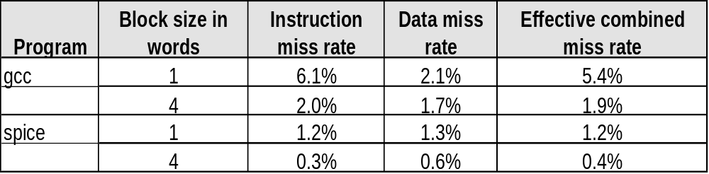
Performance in different block size
Increasing the block size tends to decrease miss rate:
Use split caches because there is more spatial locality in code:

Slide 44
7.3 Measuring and improving cache performance
In this section, we will discuss two questions:
1. How to measure cache performance?
2. How to improve performance?
The main contents are the following:
1. Measuring cache performance
2. Reducing cache misses by more flexible placement of blocks
3. Reducing the miss penalty using multilevel caches
Average Memory Assess time = hit time + miss time
= hit rate × Cache time + miss rate ×memory time
= 99% × 5 + (1-99%) × 45 =5.5ns

Slide 45
Measuring cache performance
We use CPU time to measure cache performance.
CPU time=
(CPU execution clock cycles + Memory-stall clock cycles) ×Clock cycle time
Memory-stall clock cycles = # of instructions × miss ratio × miss penalty
= Read-stall cycles + Write-stall cycles
For Read-stall
Read-stall cycles = ×Read miss rate ×Read miss penalty
For a write-through plus write buffer scheme:
Write-stall cycles= ×Write miss rate ×Write miss penalty
+ Write buffer stalls
If the write buffer stalls are small, we can safely ignore them .
If the cache block size is one word, the write miss penalty is 0.
Read
Program
Write
Program

Slide 46
Combine the reads and writes
In most write-through cache organizations, the read and write miss penalties are the same
  the time to fetch the block from memory.
If we neglect the write buffer stalls, we get the following equation:
Memory-stall clock cycles ＝
× Miss rate × Miss penalty
We can also write this as:
Memory-stall clock cycles ＝
Memory accesses
Program
Instructions
Misses
×
Instructions
×Miss penalty
Program

Slide 47
Calculating cache performance
Assume:
instruction cache miss rate 2%
  data cache miss rate 4%
  CPI without any memory stalls 2
  miss penalty 100 cycles
  The frequency of all loads and stores in gcc is 36%,as we see in Figure 3.26, on page 288.
Question: How faster a processor would run with a perfect cache?
Answer:
Instruction miss cycles = I×2%×100 =2.00I
Data miss cycles = I×36%×4%×100 =1.44I
Total memory-stall cycles= 2.00I+ 1.44I =3.44 I
CPI with stall = CPI with perfect cache + total memory-stalls
= (2 + 3.44 )I = 5.44I

Slide 48
How faster a processor for ideal
CPU time with stalls
I×CPI_{stall}×Clock cycle
=
CPU time with perfect cache
I×CPI_{perfect}×Clock cycle
=
CPI_{stall}
=
5.44
=2.72
CPI_{perfect}
2
What happens if the processor is made faster?
Assume CPI reduces from 2 to 1
CPI with stall = CPI with perfect cache + total memory-stalls
=(1+3.44)I = 4.44I
CPU time with stalls
=
CPI_{stall}
=
4.44
=4.44
CPU time with perfect cache
CPI_{perfect}
1
Ratio time for Memory stalls
from
3.44
3.44
=63% to
=77%
5.44
4.44

Slide 49
Calculating cache performance with Increased Clock Rate
Suppose we increase the performance of the computer in the previous example by doubling its clock rate for same memory system.
Question : How much faster will the computer be with the faster clock to slow clock?
Answer
Total miss cycles per instruction = (2%×200) +36%×(4%×200)=6.88
CPI with cache misses = 2 + 6.88 =8.88
Performance with fast clock
=
Execution time with slow clock
Performance with slow clock
Execution time with fast clock
=
IC×CPI_{slow clock}×Clock cycle
=
5.44
=1.23
IC×CPI_{fast clock}×Clock cycle/2
8.88×1/2
This, the computer with the faster clock is about 1.2 times faster rather than 2 time faster.

Slide 50
Solution 1
Reducing cache misses by more flexible placement of blocks
(1) The disadvantage of a direct-mapped cache
(2) The basics of a set-associative cache
(3) Miss rate versus set-associative
(4) Locating a block in the set-associative cache
(5) Size of tags versus set associative
(6) Choosing which block to replace

Slide 51
The disadvantage of a direct-mapped cache
C
a
c
h
e
0
1
0
1
0
1
0
1
0
0
1
1
0
0
1
1
0
0
0
0
1
1
1
1
0
0
0
0
1
0
0
1
0
1
0
1
0
0
1
0
1
1
0
1
1
0
0
0
1
1
0
1
0
1
1
1
0
0
1
1
1
1
0
1
M
e
m
o
r
y
If the CPU requires the following memory units sequentially: word 0,word 8 and word 0. Word 0 and word 8 both are mapped to cache block 0, so the third access will be a miss.
But obviously, if one memory block can be placed in any cache block , the miss can be avoided. So, there is possibility that the miss rate can be improved.

Slide 52
The basics of a set-associative cache
Decreasing miss ratio with associativity
A set-associative cache is divided into some sets. A set contains several blocks.
A memory block is mapped to a set in the cache through a mapping algorithm.
  The memory block can be placed in any block in the corresponding set.
The mapping algorithm is: (set with direct-mapped)
Set number (Index) =
(Memory block number) modulo (Number of sets in the cache)
If a set has only one block, this set-associative cache is actually a direct-mapped cache.
If a set-associative cache has only one set, this
set-associative cache is called a fully-associative cache.

Slide 53
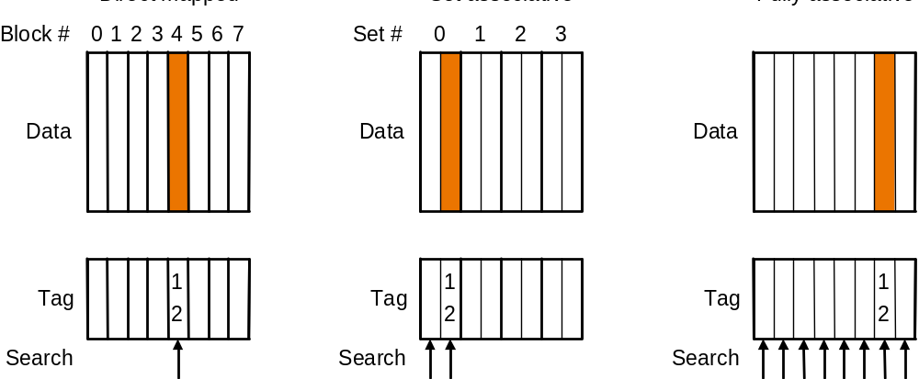
Memory block whose address is 12 in a cache with 8 blocks for different mapped
Direct mapped
Set associative
Fully associative

Slide 54
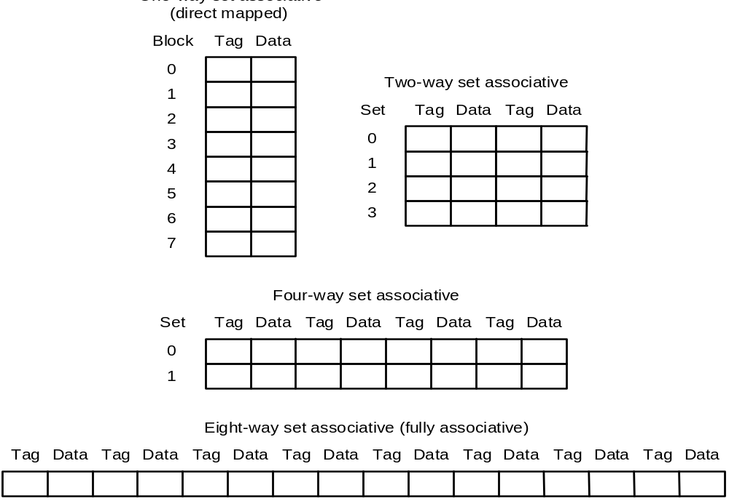
An eight-block cache configured as variety-way

Slide 55
Miss rate versus set-associativity—8Blocks
Assume: there are three small caches, each consisting of four one-word blocks.
One cache is direct-mapped,
the second is two-way set associative
and the third is fully associative.
Question: Given the following sequence of block addresses: 0,8,0,6,8, find the number of misses for each cache organization.
Answer: for direct-mapped 5 misses
Memory block | Hit or miss | Contents after each reference
 |  | Set 0 | Set 1 | Set 2 | Set 3
 |  | Block 0 | Block 1 | Block 2 | Block 3
0 | Miss | M[0]
8 | Miss | M[8]
0 | Miss | M[0]
6 | Miss | M[0] |  | M[6]
8 | Miss | M[8] |  | M[6]

Slide 56
Second, for the two-way set associative cache. 4 misses
Memory block | Hit or miss | Contents after each reference
 |  | Set 0 |  | Set 1
 |  | Block 0 | Block 1 | Block 2 | Block 3
0 | Miss | M[0]
8 | Miss | M[0] | M[8]
0 | Hit | M[0] | M[8]
6 | Miss | M[0] | M[6]
8 | Miss | M[8] | M[6]
Finally, for the fully associative cache. 3 misses
Memory block | Hit or miss | Contents after each reference
 |  | Only one set
 |  | Block 0 | Block 1 | Block 2 | Block 3
0 | Miss | M[0]
8 | Miss | M[0] | M[8]
0 | Hit | M[0] | M[8]
6 | Miss | M[0] | M[8] | M[6]
8 | Hit | M[0] | M[8] | M[6]

Slide 57
How much of a reduction in the miss rate is achieved by associativity?
Associativity | Data miss rate
1 | 10.3%
2 | 8.6%
4 | 8.3%
8 | 8.1%
The data cache miss rates for organization like the Intrinsuty FastMATH processor for SPEC2000 benchmarks with associativity varying form one-way to eight-way .
Data cache organization is 64KB data cache and 16-word block

Slide 58
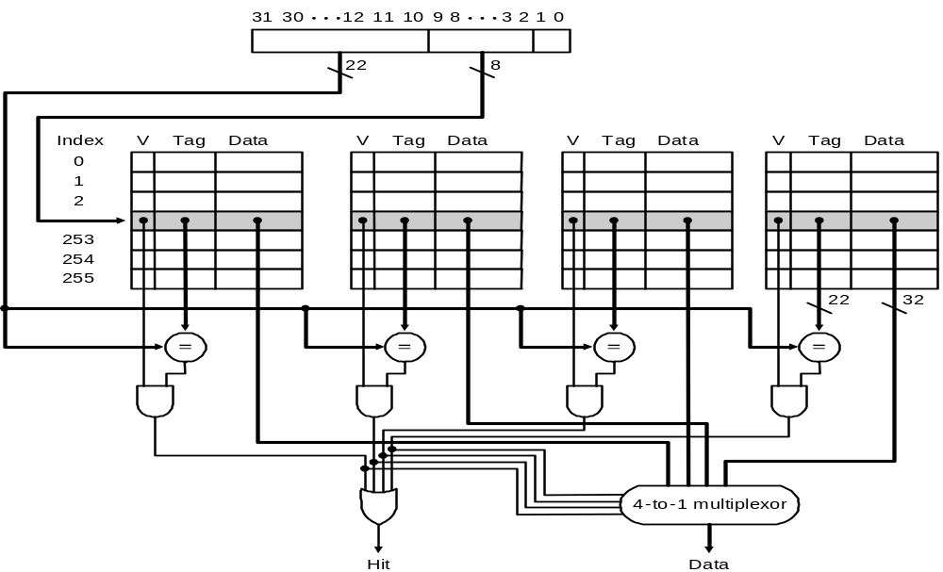
Locating a block in the set-associative cache
The implementation of a four-way set-associative cache requires four comparators and a 4-to-1 multiplexor.

Slide 59
Size of tags versus set associativity
Assume
  Cache size is 4K Block
  Block size is 4 words
  Physical address is 32bits
Question
Find the total number of set and total number of tag bits for variety associativity
Answer
Offset size (Byte) = 16= 2⁴ 4 bits for address
Number of memory block = 2³²÷2⁴=2²⁸ 28 bits for Block address
Number of cache block = 2¹² 12 bits for Block address
For direct-mapped
Bits of index = 12 bits
bits of Tag = (28-12) ×4K=16×4K=64 Kbits

Slide 60
For two-way associative
Number of cache set = 2¹² ÷ 2= 2¹¹
Bits of index = 12-1=11 bits
Bits of Tag = (28-11) ×2×2K=17×2×2K=68 Kbits
For four-way associative
Number of cache set = 2¹² ÷ 4= 2¹⁰
Bits of index = 12-2=10 bits
Bits of Tag = (28-10) ×4×1K=18×4×1K=72 Kbits
For full associative
Number of cache set = 2¹² ÷ 2¹² = 2⁰
Bits of index = 12-12=0 bits
Bits of Tag = (28-0) ×4K×1=112 Kbits
 | Direct | 2-way | 4-way | Fully
Index(bit) | 12 | 11 | 10 | 0
Tag(bit) | 16 | 17 | 18 | 28

Slide 61
Choosing which block to replace
In an associative cache, we must decide which block to replace when a miss happens and the corresponding set is full.
The most commonly used scheme is least recently used (LRU), which we used in the previous example. In an LRU scheme, the block replaced is the one that has been unused for the longest time.
For a two-way set associative cache, the LRU can be implemented easily. We could keep a single bit in each set. We set the bit whenever a specific block in the set is referenced, and reset the bit whenever another block is referenced.
As associativity increases, implementing LRU gets harder.

Slide 62
Decreasing miss penalty with multilevel caches
Add a second level cache:
  often primary cache is on the same chip as the processor
  use SRAMs to add another cache above primary memory (DRAM)
  miss penalty goes down if data is in 2nd level cache
Example:
  CPI of 1.0 on a 5GHz machine with a 2% miss rate, 100ns DRAM access
  Adding 2nd level cache with 5ns access time decreases miss rate to 0.5%
Miss penalty to main memory is
The CPI with one level of caching
Total CPI = 1.0 + Memory-stall cycles per instruction
    = 1.0 + 2% × 500 = 11.0
Miss penalty with levels of cache without access main memory
100ns
= 500 clock cycles
0.2
5ns
= 25 clock cycles
0.2

Slide 63
The CPI with Two level of cache with 0.5% miss rate for main memory
Total CPI = 1.0 + Primary stalls per instruction + Secondary stalls per instruction
= 1 + 2% ×25 + 0.5% × 500
= 1.0 + 0. 5 +2.5 = 4.0
The processor with secondary cache is faster by
Using multilevel caches:
  try and optimize the hit time on the 1st level cache
  try and optimize the miss rate on the 2nd level cache
11.0
=2.8
4.0

Slide 64
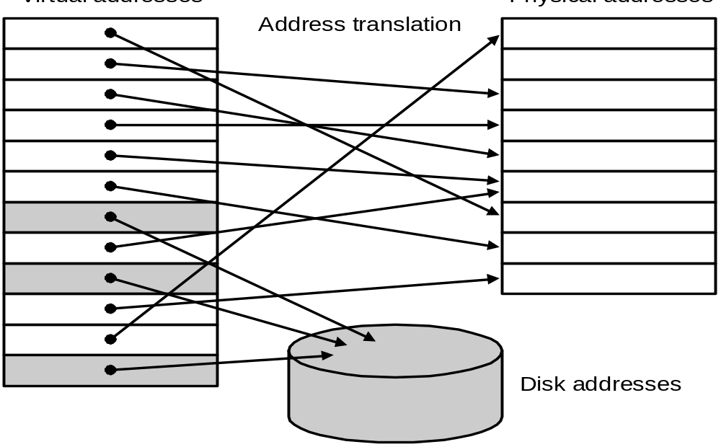
7.4 Virtual Memory
Main memory can act as a cache for the secondary storage (disk)
Advantages:
  illusion of having more physical memory
  program relocation
  protection
Virtual addr.
Physical addr.

Slide 65
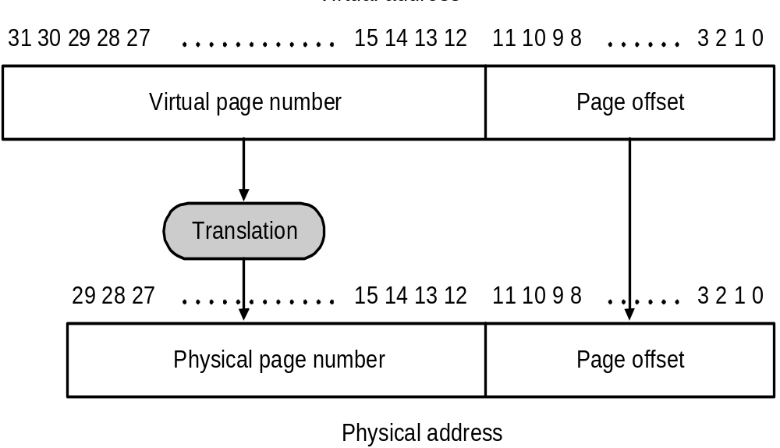
Pages: virtual memory blocks
Page faults: the data is not in memory, retrieve it from disk
  huge miss penalty, thus pages should be fairly large (e.g., 4KB)
  reducing page faults is important (LRU is worth the price)
  can handle the faults in software instead of hardware
  using write-through is too expensive so we use write back

Slide 66
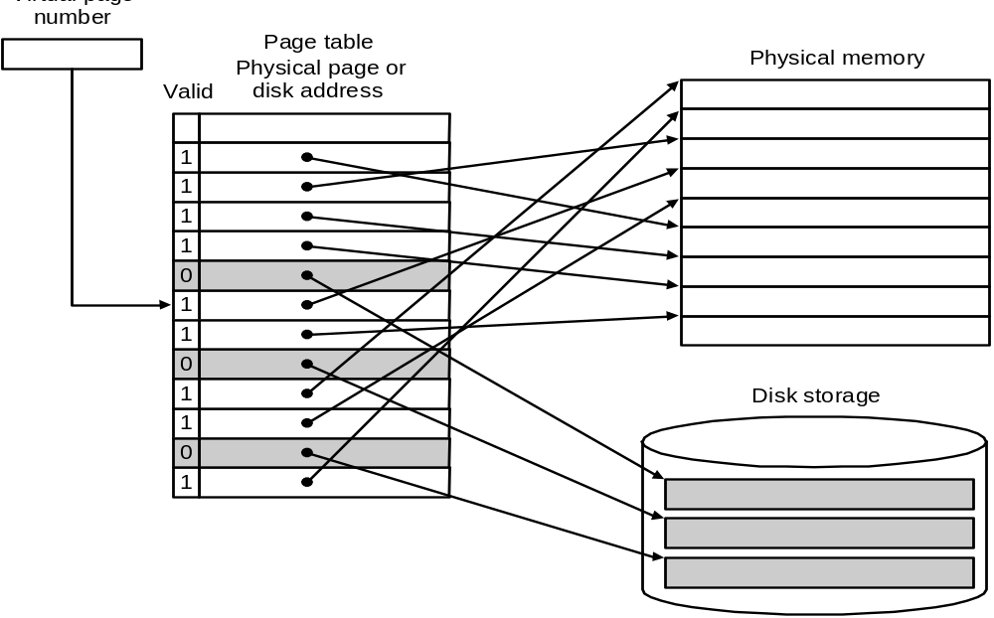
Page Tables
Virtual page

Slide 67
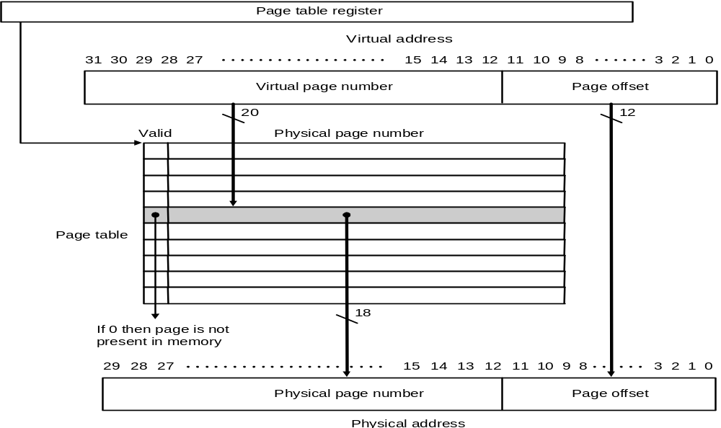
Placing a page and finding it again ----Page Tables
Virtual memory systems use fully associative mapping method

Slide 68
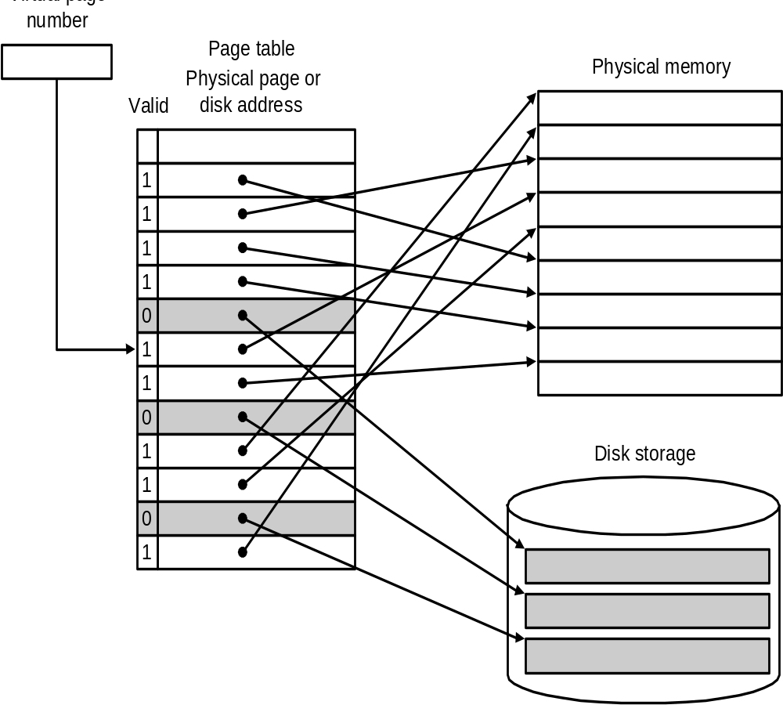
Page faults
When the OS creates a process, it usually creates the space on disk for all the pages of a process.
When a page fault occurs, the OS will be given control through exception mechanism.
The OS will find the page in the disk by the page table.
Next, the OS will bring the requested page into main memory. If all the pages in main memory are in use, the OS will use LRU strategy to choose a page to replace
Virtual page

Slide 69
What about writes?
Because disk accesses are too slow, virtual memory systems can not use write-through strategy.
Instead, they must use write-back strategy. To do so, the machines need add a dirty bit to the entry of page table.
The dirty bit is set when a page is first written. If the dirty bit of a page is set, the page must be written back to disk before being replaced.

Slide 70
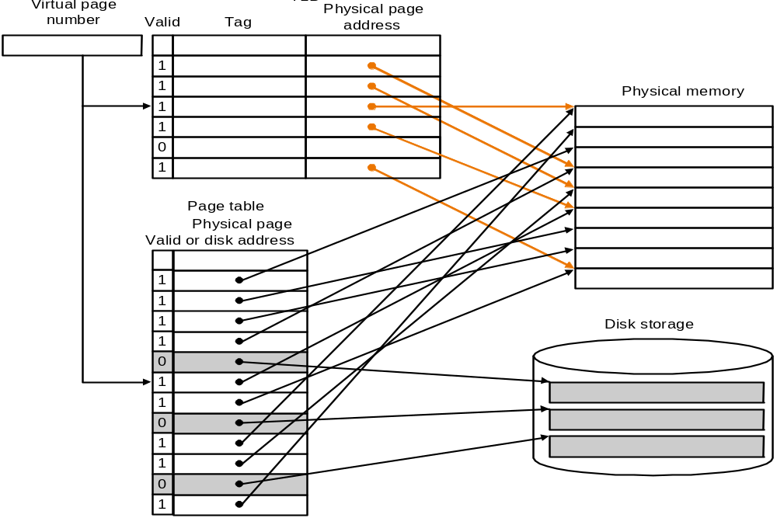
Making Address Translation Fast----TLB
A cache for address translations: translation look aside buffer

Slide 71
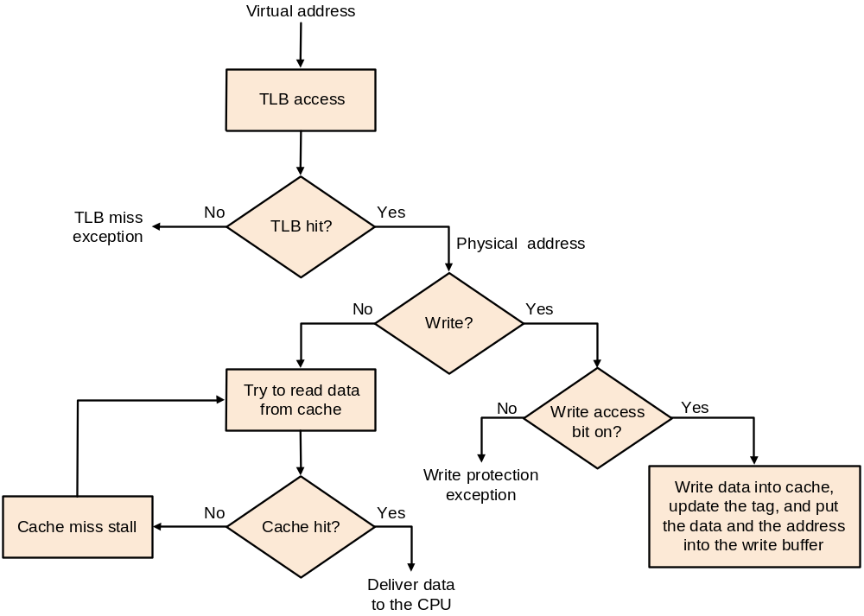
TLBs and caches

Slide 72
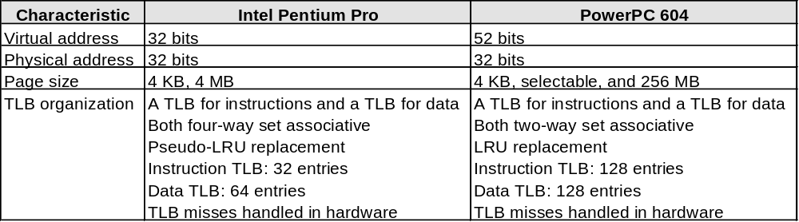
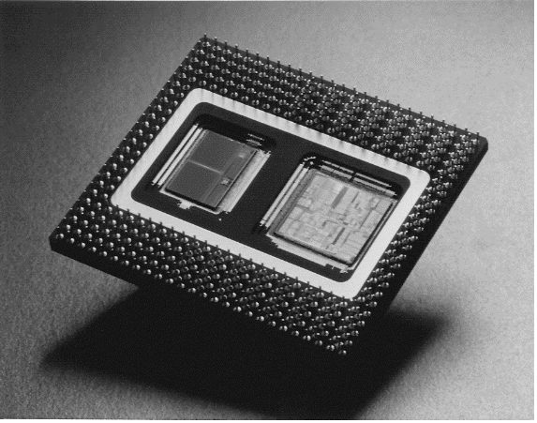
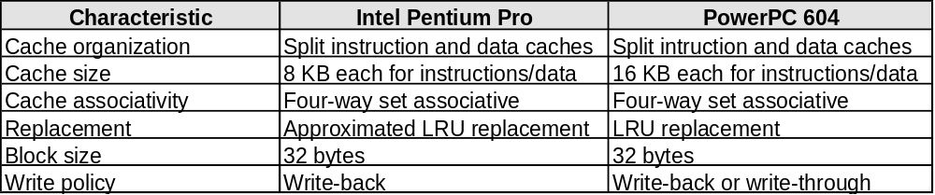
Modern Systems
Very complicated memory systems:

Slide 73
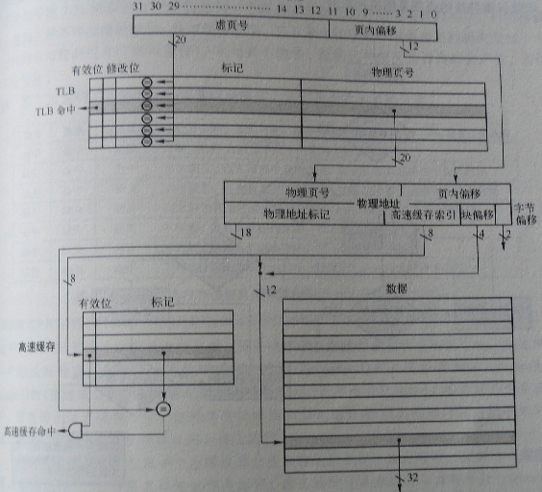
FastMATH Memory Hierarchy

Slide 74
Some Issues
Processor speeds continue to increase very fast
— much faster than either DRAM or disk access times
Design challenge: dealing with this growing disparity
Trends:
  synchronous SDRAMs (provide a burst of data)
  redesign DRAM chips to provide higher bandwidth or processing
  restructure code to increase locality
  use prefetching (make cache visible to ISA)

