Slide 1


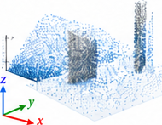
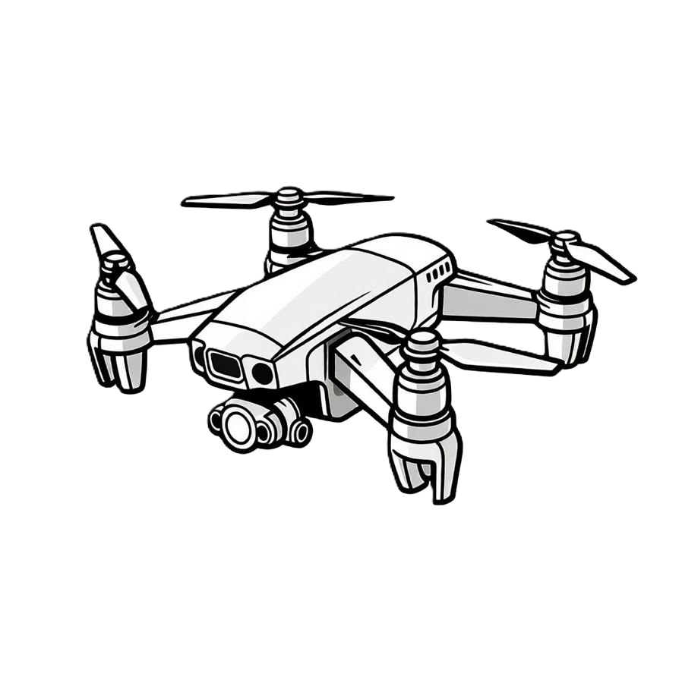
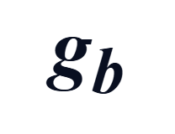
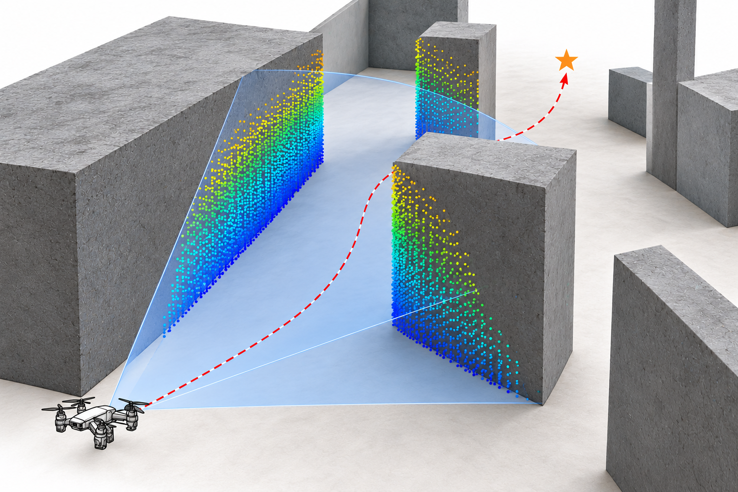



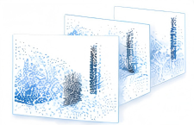





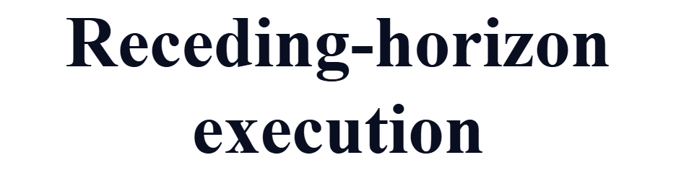
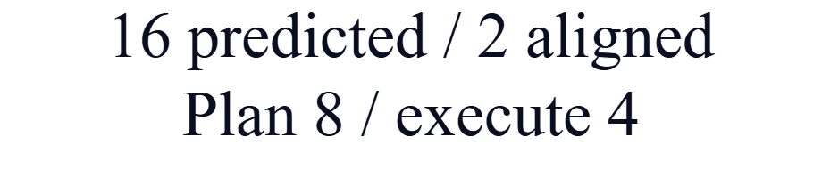
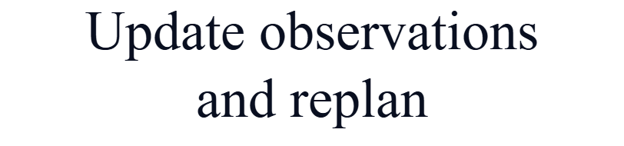












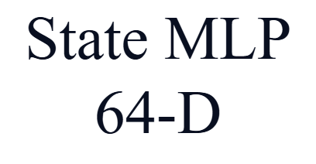
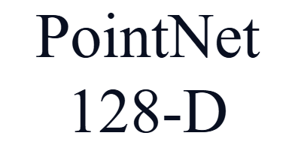
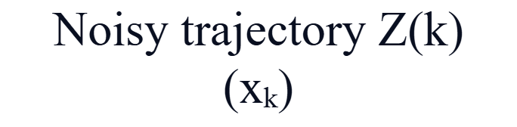










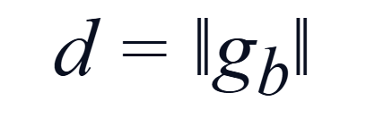
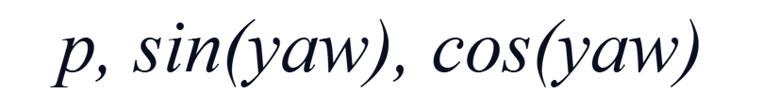

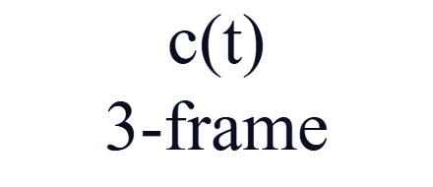
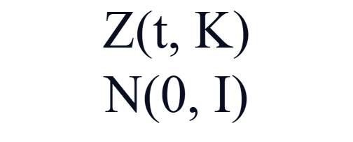



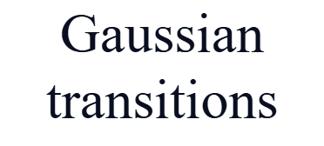
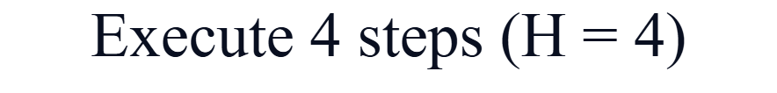
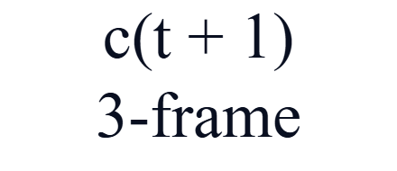
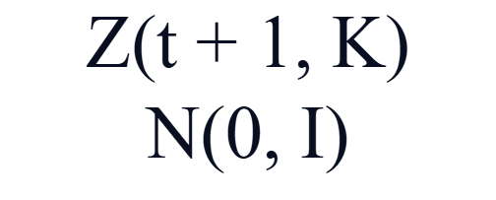

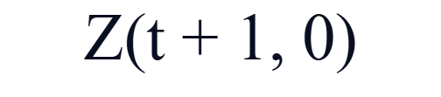

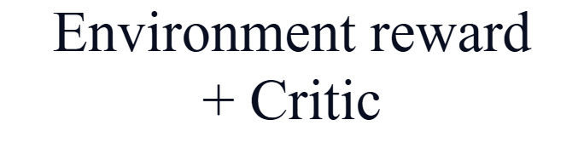
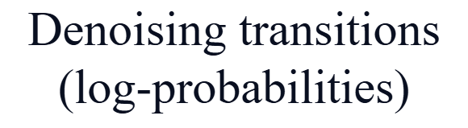


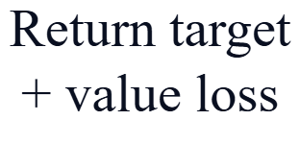


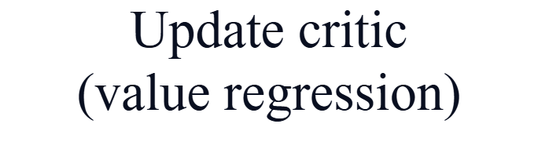
Observation
Local Point Cloud
State history
Noisy trajectory Z_{t}^{K}
Diffusion step k
s_{τ−2}
k
s_{τ−1}
State MLP
s_{τ}
d = ‖g_{b}‖₂
o_{τ}
c_{t}
UAV State
Point-cloud
history
PointNet
FiLM(c_{t}, k)
Frozen backbone
Trainable LoRA
DDIM × 10
p, sin ψ, cos ψ
Trajectory Z_{t}⁰
execute H4, observe, replan
Two-stage training
Stage 1: BC pre-training
Stage 2: DPPO post-training (encoders and BC-pretrained U-Net frozen)
EGO-Planner demos
988 episodes
Closed-loop
rollouts
(H4, reward r_{t})
Critic
V_{φ}(c_{t}, β_{t})
Advantage Â_{t}
(GAE)
Clipped PPO on
denoising steps
Update LoRA
(policy only)
L_{BC} + λ_{geo} L_{geo}
init.
2
4
4
6
next iteration uses the updated LoRA
Aligned
Executed
Update all
parameters
Planned
Unplanned
Log-probabilities of the DDIM steps give the policy gradient; details in Fig. 3 and Algorithm 1.

