Slide 1
An Introduction to AWS Cloud Formation

Slide 2
What this talk is not about
AWS Services
EC2
S3
Security Groups
… countless others
Architecting
CIDR Calculation
Does not cover processes/policies that governs CloudFormation

Slide 3
What this talk is about
CloudFormation Template Creation
Using the available documentation to create the CloudFormation template

Slide 4
What is CloudFormation
Is a declarative way of outlining your AWS infrastructure, for any resources
Within a CloudFormation template, you specify:
I want a VPC
I want three subnets:
DMZ
Application
Database
In each subnet I want to run one EC2 instance

Slide 5



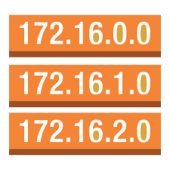


Use Case: A simple web application
10.10.1.0/24
t2.micro 1 vCPU/1GB
20 GB
10.10.2.0/24
t2.micro 1 vCPU/1GB
20 GB
10.10.3.0/24
t2.micro 1 vCPU/1GB
20 GB
Public Route Table
DMZ subnet
APP subnet
DB subnet
Network ACL
Availability Zone
VPC 10.0.0.0/16, 10.10.0.0/16

Slide 6
CloudFormation Building Blocks
Resources – AWS resources that are declared in your template
Parameters – The dynamic inputs to the templates
Mappings – The static variables for your template
Outputs – The references to what has been created
Conditionals – List of conditions to perform resource creation

Slide 7
Deploying CloudFormation Templates
Manual Way
Editing Templates in Designer
Using Console to input parameters
Automated Way
AWS CLI
AWS SDK

Slide 8
CloudFormation Parameters
Parameters are a way to provide inputs to your AWS CloudFormation template
Allows reusability of templates
Inputs cannot be determined ahead of time e.g. instance size, instance names

Slide 9
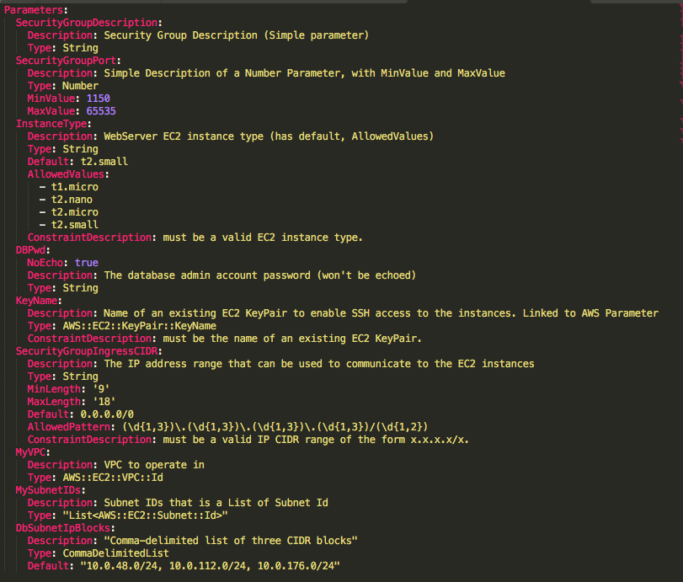
CloudFormation Parameters

Slide 10
AWS Resources
Resources are the core of the CloudFormation template
They represent the different AWS components that will be created and configured
Declared and can reference each other (through the ref function)
Over 200+ of them
Reference:
https://docs.aws.amazon.com/AWSCloudFormation/latest/UserGuide/aws-template-resource-type-ref.html
https://docs.aws.amazon.com/AWSCloudFormation/latest/UserGuide/aws-properties-ec2-instance.html

Slide 11
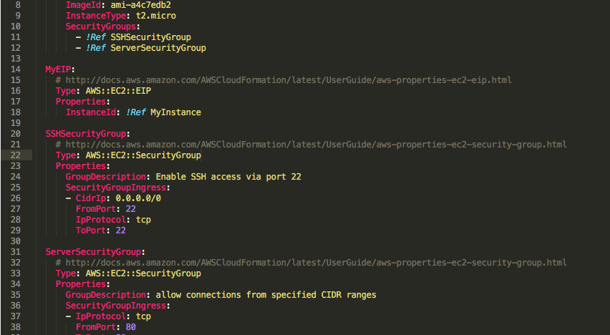
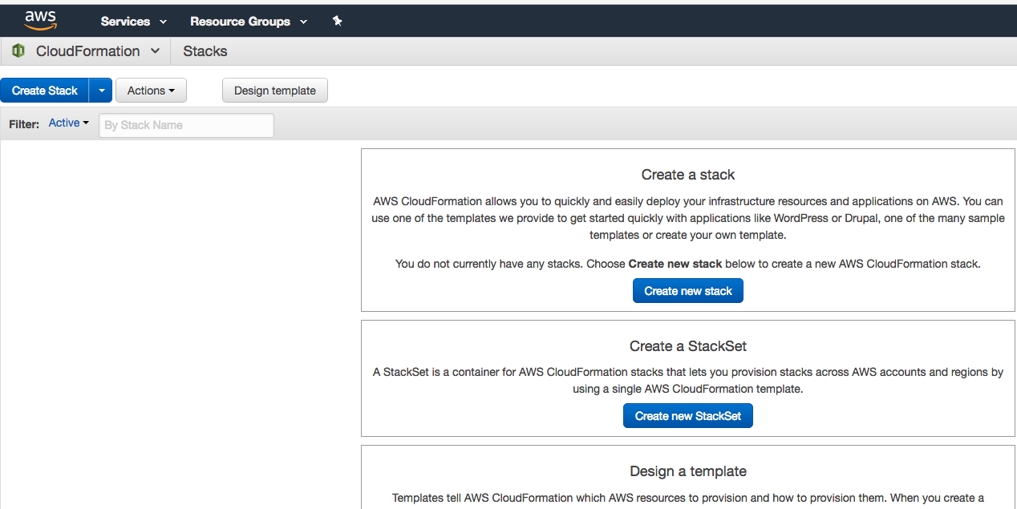
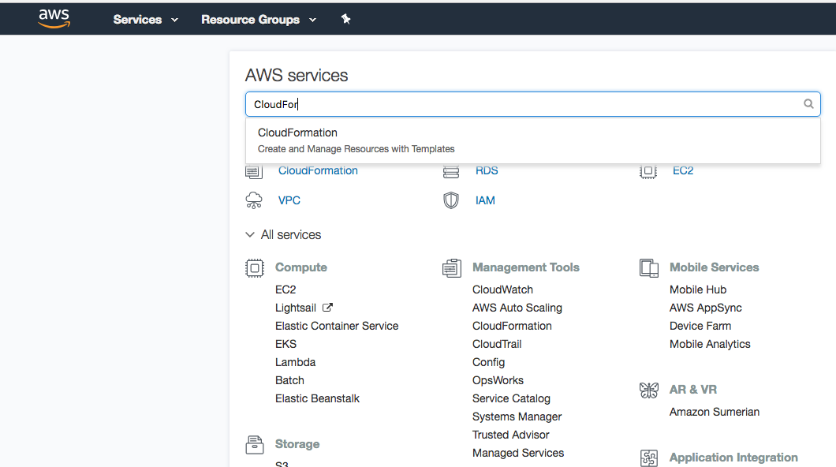
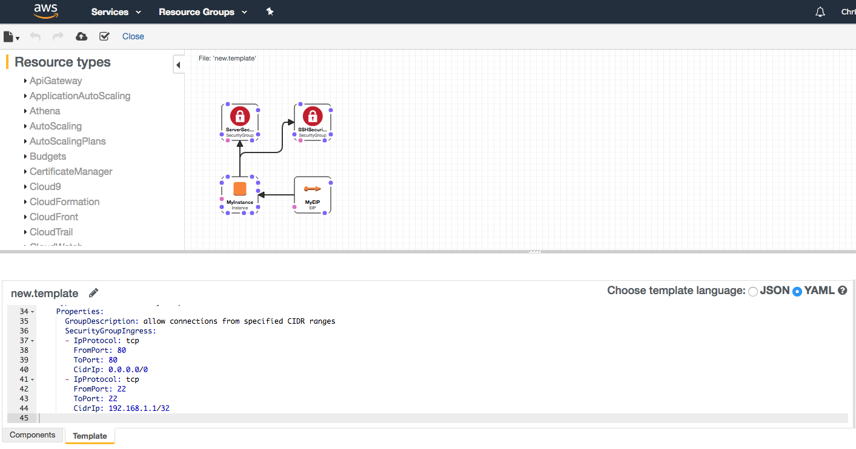

Slide 12
Mappings
Mappings are fixed variables within your CloudFormation Template
All the values are hardcoded within the template
Example:
Mappings:
Mapping01:
Key01:
Name: Value01
Key02:
Name: Value02
Key03:
Name: Value02
RegionMap:
us-east-1:
“32”: “ami-6411e20d”
“64”: “ami-7a11e213”
us-west-1:
“32”: “ami-c9c7978c”
“64”: “ami-cfc7978a”
eu-west-1:
“32”: “ami-37c2f643”
“64”: “ami-31c2f645”

Slide 13
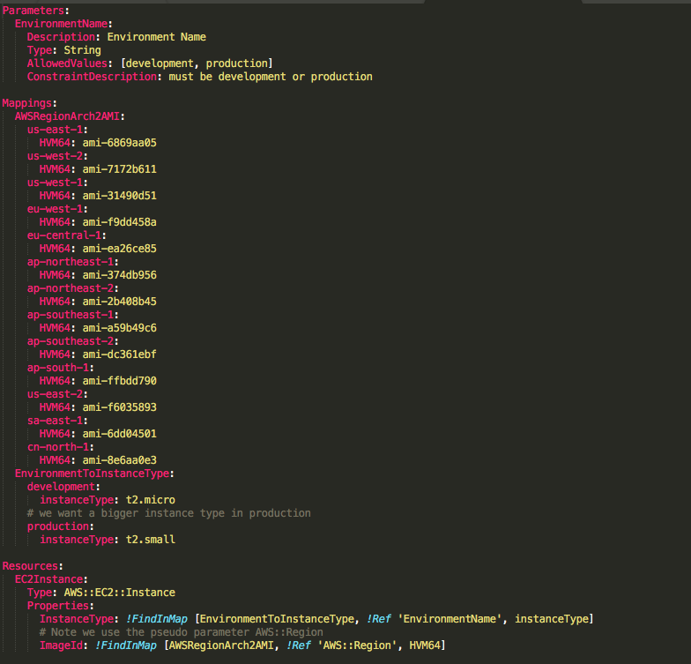
Mappings
Use mappings when you know in advance all the values that can be taken. E.g. Region, AZ, Environment
Use parameters when values are user specific

Slide 14
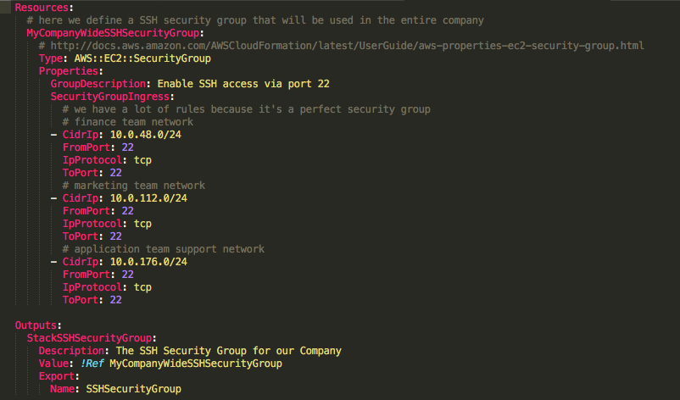
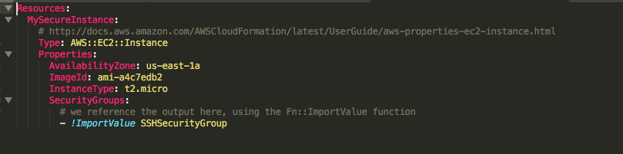
Outputs
Output section declares optional outputs values that can be imported into other stacks
Useful when defining a network CloudFormation, and output the variables such as VPC Id and Subnet Ids
Best way in to collaborate with AWS SMEs. e.g. Network Team, Compute Team, BigData Team, etc

Slide 15
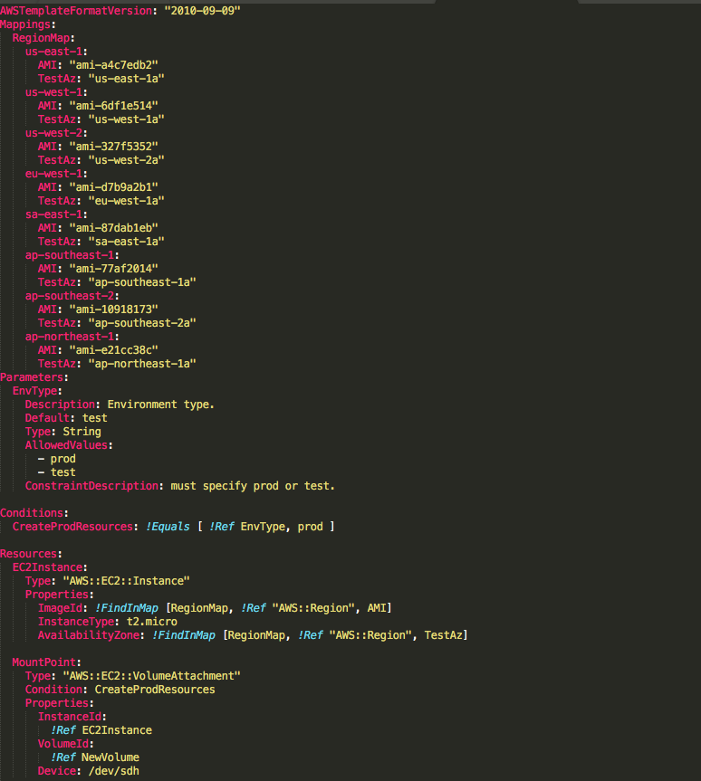
Conditionals
Conditionals are used to control the creation of resources or outputs based on a condition .e.g Environment, Region, Parameter Value

Slide 16
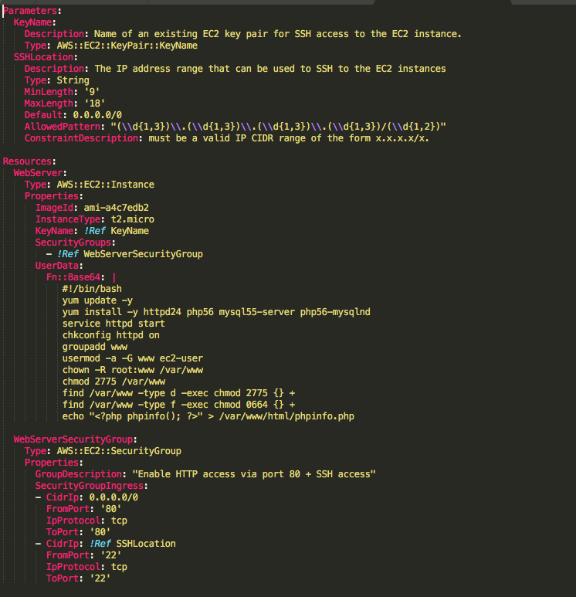
CFN Init & EC2 User Data
Setup & Configuration of EC2 Fleet for them to be able to do perform the business needs

Slide 17
But wait, there’s more!
Enter CloudFormation Helper Scripts
There are 4 python scripts that comes pre-installed on Amazon Linux AMI or use yum on non-Amazon Linux
cfn-init: Used to retrieve and interpret the resource metadata, installing packages, creating files & starting services
cfn-signal: Used to signal an AWS CloudFormation CreationPolicy or WaitCondition, enabling you to synchronize other resources in the stack with the application being ready
cfn-get-metadata: Script to retrieve all metadata defined for a resource or path to a specific key or subtree of the resource metadata
cfn-hup: Daemon to check for updates to metadata & execute custom hooks when changes are detected

Slide 18
CFN Init & EC2 User Data
Resources:
MyInstance:
Type: “AWS::EC2::Instance”
Metadata:
AWS::CloudFormation::Init:
config:
packages:
:
groups:
:
users:
:
sources:
:
files:
:
commands:
:
services:
:
Properties:
:
A config contains the following and is executed in that order:
Packages: install a list of packages on the Linux OS
Groups: Define user groups
Users: Define users and which group they belong to
Sources: Download an archive file & place it on ec2 instance
Files: Create files
Commands: Run a series of commands
Services: Launch a list of sysvinit services

Slide 19
Where do we go from here?
It is important to be able to do things manually before moving to CloudFormation
Get familiar with the docs
Practice, practice, practice ☺

