Slide 1

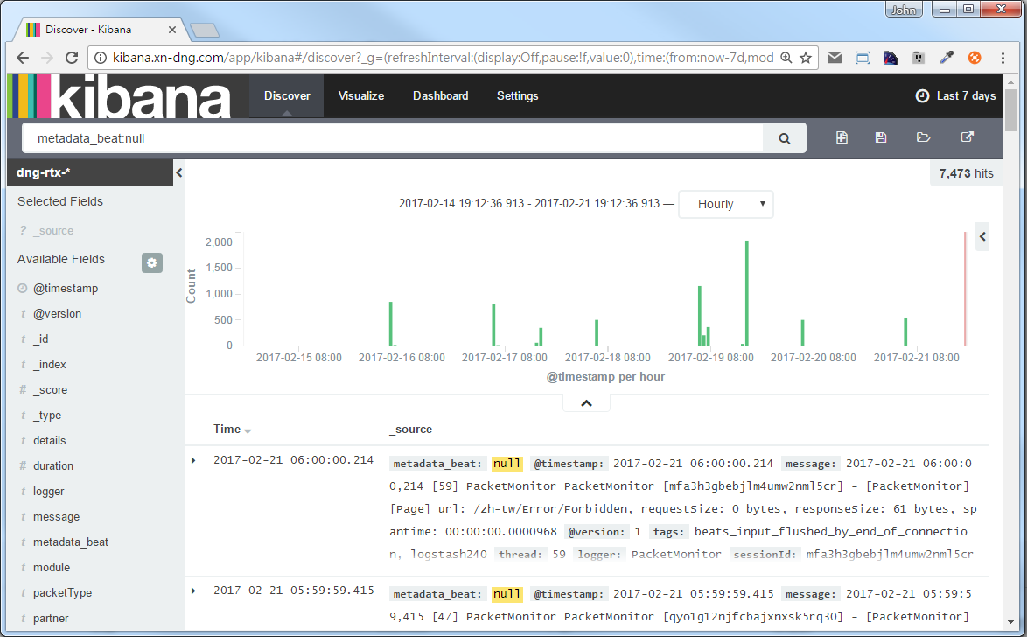
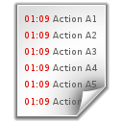


blog.johnwu.cc
Parsing log
Time: 2017-02-21 18:38:37.893
Type: Info
Message: XXXXXXXXX
Host: 10.0.0.1
…
Query
Send custom fields
Data
Logstash
Elasticsearch
Kibana
Data
Query
Send log
Filebeat
Server

Slide 2





blog.johnwu.cc
Session: 1 exists
Session: 1
Request - 2
Request - 1
Response
Clone
Website A
Session: 1
Session: 1
Session: 1 Not exists
Request Session
Session: 1
User
Response
Redis
Request - 3
Get Session
Website B

Slide 3
blog.johnwu.cc
Session: 1
Request Session
Request - 2
Request - 1
Response
Get Session
Save Session
Website A
Session: 1
Session: 1
Session: 1
Request Session
Session: 1
User
Response
Redis
Request - 3
Get Session
Website B

Slide 4
blog.johnwu.cc
First
Middleware
Second
Middleware
Third
Middleware
Action
Request
{
// Logic
next();
// Logic
}
{
// Logic
next();
// Logic
}
{
// Logic
next();
// Logic
}
{
// Logic
}
Response

Slide 5
blog.johnwu.cc
Routing
Action
Routing Attribute
Request
Request
Router Middleware

Slide 6


XXXXXXXXXXXXXXX
XXXXXXXXXXXXXXX
XXXXXXXXXXXXXXX
XXXXXXXXXXXXXXX
XXXXXXXXXXXXXXX
XXXXXXXXXXXXXXX
XXXXXXXXXXXXXXX
XXXXXXXXXXXXXXX

Slide 7

Start
Keep
More of
Stop
Less of

Slide 8
Concern
Influence
Control

Slide 9
Liked
Learned
Lacked
Longed For

Slide 10
TypeScript
(Component)
Interpolation
HTML
(Template)
Property Binding
Event Binding
Two-way Data Binding

Slide 11
blog.johnwu.cc
Action
Request
Model Binding
Authorization Filters
Middleware
Resource Filters
Action Filters
Response
Result Filters
Response
Exception Filters
Throw
Exception

