Slide 1
RUGE
Open Source framework for random testing
Brendan McCarthy
DevClear
Oct 1, 2013

Slide 2
What is RUGE
New OSS framework
Generates and runs integration/system tests
When manually-crafted testing hits the wall
Diminishing returns
The more tests, the more costly are changes
Random test generation guided by rules
Guide random tests toward useful cases
Functional testing + load testing
Generate lots of realistic (non-skewed) test events
Reads and writes (side-effect producing)
Common in financial systems: large streams of events from large numbers of actors over time

Slide 3
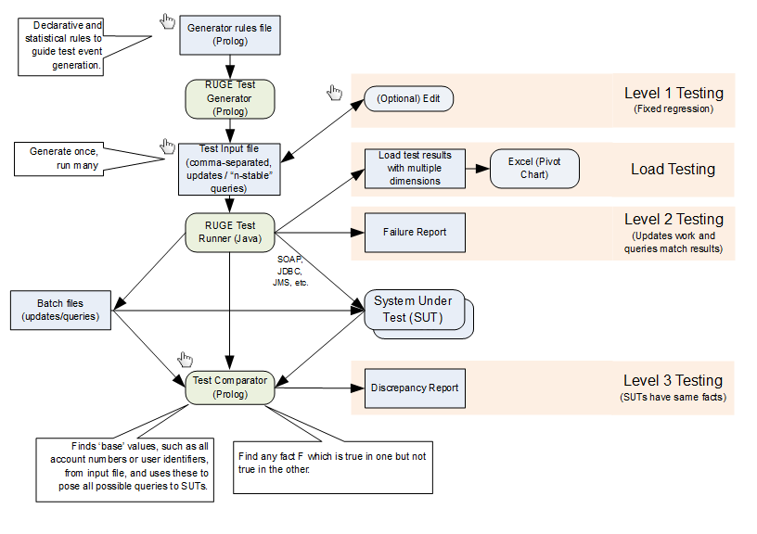
RUGE Components

Slide 4
Motivations
Why not other libraries?
Generation separated from execution
Not Prolog (or Prolog-like)
Why Prolog?
Excels at exploring search spaces
Straightforward syntax, declarative semantics
Structures are freely defined without type definitions
Strong embedded DSL features
Add operators
Prolog interpreter in Prolog in 12 or 13 lines of code
Data is code, code is data
Why Ruge on top of Prolog?
Prolog alone is depth-first deterministic

Slide 5
Simple Prolog Program
item(rivets).
item(caps).
item(hammers).
item(mallets).
gen :-
item(X),
write(X),
nl,
fail.
gen.
| ?- gen.
rivets
caps
hammers
mallets
| ?-

Slide 6
RUGE Gen Loop
user:file_search_path(ruge,'$RUGE_HOME').
:- include(ruge(common)).
item(rivets).
item(caps).
item(hammers).
item(mallets).
| ?- gen(item).
item(rivets).
item(caps).
item(hammers).
item(mallets).
| ?-
Beyond gen example:
store(file(markets,csv),
filter(after,ffn,10,
csort(1,gen(action(1m))))).

Slide 7
Clause Randomization
25 pct item(rivets).
25 pct item(caps).
25 pct item(hammers).
25 pct item(mallets).
| ?- item(X).
X = caps
| ?- gen(item).
item(hammers).
| ?- gen(item).
item(rivets).
| ?-

Slide 8
GOAL Randomization
event(Item,Amount) :-
item(Item),
percent(Amount,
1..avg(10)..99).
25 pct item(rivets).
25 pct item(caps).
25 pct item(hammers).
25 pct item(mallets).
| ?- event(X,Y).
X = hammers,
Y = 15 ?
| ?- gen(event).
event(caps,9).
| ?-

Slide 9
Randomized Cross Product
event(Action,Item,Amount) :-
action(Action),
item(Item),
percent(Amount,
1..avg(50)..99).
40 pct action(buy).
40 pct action(sell).
20 pct action(trade(For)) :- item(For).
25 pct item(rivets).
25 pct item(caps).
25 pct item(hammers).
25 pct item(mallets).
| ?- gen(event, 5).
event(buy,hammers,11).
event(sell,caps,45).
event(buy,rivets,39).
event(trade(mallets),hammers,45).
event(buy,rivets,68).
| ?-

Slide 10
Add Patterns
90 pct event(Action,Item,Amount) :-
action(Action),
item(Item),
percent(Amount,
1..avg(50)..99).
10 pct event(sell,Item,Amount) :-
item(Item),
percent(Amounts,
bag(3..5,15..20)),
member(Amount,Amounts).
40 pct action(buy).
40 pct action(sell).
20 pct action(trade(For)) :- item(For).
25 pct item(rivets).
25 pct item(caps).
25 pct item(hammers).
25 pct item(mallets).
| ?- gen(event, 10).
event(buy,rivets,39).
event(sell,mallets,17).
event(sell,mallets,20).
event(sell,mallets,15).
event(sell,mallets,15).
event(buy,rivets,55).
event(trade(rivets),hammers,28).
event(buy,rivets,25).
event(trade(rivets),caps,76).
event(sell,rivets,93).
| ?-

Slide 11
Summary
Rule-guided random test generation
Test execution
Functional
Load/stress
Legacy comparison
Find more
https://bitbucket.org/bmccarthy/ruge
brendan.mccarthy@devclear.com

