Slide 1
ShopLens
Language adaptation for
multimodal recommendation
Qwen3-Embedding-0.6B with LoRA
EE6405 Natural Language Processing
Notes:
ShopLens combines a controlled recommendation study with an interactive shopping interface. We compare frozen Qwen with semantic alignment and user preference LoRA. I will show the actual offline results, then a complete local workflow from a written request to a saved decision.
Sources
Source path convention: Resolve src/..., reports/..., results/..., data/..., and artifacts/... from the repository root. Resolve assets/... relative to reports/. Runtime data and artifacts require a separate runtime asset installation.
https://huggingface.co/Qwen/Qwen3-Embedding-0.6B/tree/97b0c614be4d77ee51c0cef4e5f07c00f9eb65b3
https://arxiv.org/abs/2106.09685
https://proceedings.mlr.press/v139/radford21a.html

Slide 2
Semantic alignment and user preference
Does learning what a review describes improve what a user receives next?
Arm | Recommendation head | Qwen update
Frozen | BPR ranking loss | Encoder stays fixed
Semantic alignment | BPR on detached text | Review–description InfoNCE
User preference | BPR ranking loss | Same BPR gradient
Frozen still trains a recommendation head.
Same Qwen family and frozen CLIP image features across all arms.
02
Notes:
The central question separates semantic matching from preference learning. Semantic LoRA matches training reviews with product descriptions. Preference LoRA learns directly from ranking loss. Every arm trains its recommendation head, including Frozen. The image encoder stays fixed, so the controlled comparison concerns the language objective.
Discussion notes
Semantic InfoNCE uses frozen base-Qwen training-review anchors and live candidate descriptions, with multiple positives for the same item. Its BPR text input is detached. Preference training never uses the target review as its recommendation query.
Sources
src/shoplens/qwen_pipeline.py
src/shoplens/qwen_models.py
https://arxiv.org/abs/1205.2618

Slide 3
Three Amazon domains and one ranking protocol
Domain | Products | Users | Interactions
Baby | 7,037 | 18,479 | 155,180
Sports | 18,273 | 34,555 | 289,579
Clothing | 22,491 | 36,437 | 255,681
47,801 catalogued products. Top 3 and Top 12 are display subsets.
Chronological 80% / 10% / 10% split
Strictly earlier positives. Latest 20 distinct products.
Full catalogue ranking, excluding previous positives. User-macro metrics.
Three domains from one Amazon source limit evidence about cross-source generalization.
03
Notes:
The data contains real product text, reviews and photographs across Baby, Sports and Clothing. We split chronologically and use only strictly earlier positive history. Ranking covers the full prepared catalogue, excluding previous positives. Metrics first average targets within users. These are three domains from one Amazon source, which limits evidence about cross-source generalization.
Discussion notes
Global timestamp quantiles retain ties in the earlier split. Evaluation is prequential: earlier held-out observations may enter later histories while weights remain fixed. Repeated targets already in history do not enter evaluation. A stable item-ID rule breaks score ties. Positive interactions have ratings of four or five stars.
Sources
https://mcauleylab.ucsd.edu/public_datasets/data/amazon/datasets.html
src/shoplens/qwen_evaluate.py
data/processed/baby/audit.json
data/processed/sports/audit.json
data/processed/clothing/audit.json

Slide 4
History and candidate representations
Path | Text input | Image input
Liked-product history | Frozen base Qwen, 1024d | Frozen CLIP, 512d
Candidate products | Base or selected LoRA, 1024d | Same CLIP, 512d
Separate history and candidate towers produce 128d vectors.
User vector = normalize(MLP(mean(history vectors)))
Score = user vector · candidate vector
04
Notes:
The formal model uses an asymmetric architecture. Histories always enter through frozen base text and fixed images. Candidate text changes across objectives. Separate towers produce compact vectors. A user network pools history and scores candidates by a dot product. Adapted candidate vectors must never replace the frozen history inputs.
Sources
src/shoplens/qwen_models.py
src/shoplens/qwen_inference.py

Slide 5
Shared initialization and adaptation budget
Common warmup
All eligible training cases. Validation selects one shared head
for each domain and seed.
Controlled adaptation
30,000 matched cases per domain and seed, over two epochs.
Identical case order and sampled negatives across the arms.
Validation selects epoch 1 or 2. Seeds 42, 43 and 44 repeat the full pipeline.
05
Notes:
Each domain and seed first selects a common warmup head. The three arms then share thirty thousand matched training cases, their order and sampled negatives for two adaptation epochs. Validation selects epoch one or two. Three complete pipeline seeds give twenty-seven formal test records. Test scores never choose the checkpoint.
Discussion notes
Warmup uses all eligible cases, at most 20 epochs and validation early stopping. Adaptation batch size is 32. Head learning rate is 1e-4 and LoRA learning rate is 2e-5. LoRA rank 8, alpha 16, dropout 0.05, q_proj/v_proj. Epoch 0 cannot replace a poor adaptation checkpoint.
Sources
src/shoplens/qwen_data.py
src/shoplens/qwen_pipeline.py
results/qwen/results_qwen_summary.json

Slide 6
Formal test results
User-macro NDCG@10. Mean across three complete pipeline seeds.
Frozen has the highest observed mean in all three domains.
06
Notes:
These bars come from all twenty-seven audited test records after validation-only selection. Frozen has the highest observed mean in each domain. Semantic alignment loses to Frozen in seven of nine matched comparisons. Preference LoRA loses in six of nine. The experiment does not support a general improvement from adaptation under this budget.
Discussion notes
Means and sample standard deviations appear in Appendix 1. A matched win is a positive difference for the same domain and seed. These measurements describe the declared offline protocol, not purchasing conversion.
Sources
results/qwen/results_qwen_summary.json
artifacts/qwen/baby/results.json
artifacts/qwen/sports/results.json
artifacts/qwen/clothing/results.json

Slide 7
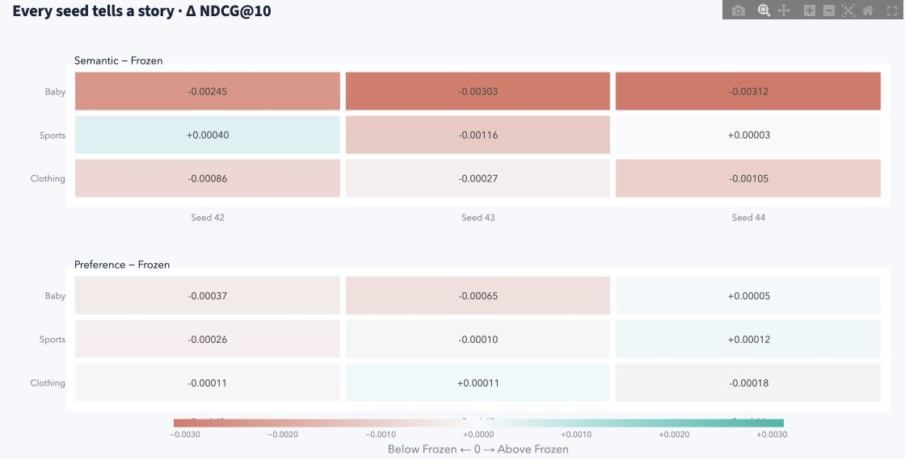
Experiment gallery: every recorded seed
18 matched comparisons against Frozen, from the original 27 formal test records
Columns: seeds 42, 43 and 44. Cells: actual Δ NDCG@10.
Coral falls below Frozen. Teal exceeds Frozen. Three seeds do not establish significance.
07
Notes:
Experiment gallery exposes the original twenty-seven evaluations through metric, paired-seed and training views. This matrix contains eighteen same-seed differences against Frozen, including losses. The three columns show all recorded seeds. The gallery adds inspection and export, while the evidence remains the same controlled study.
Discussion notes
Each cell subtracts the Frozen test NDCG@10 for the same domain and seed. Semantic alignment wins 2 of 9 pairs and user preference wins 3 of 9. Three seeds, sample standard deviation and observed signs do not establish statistical significance. This feature displays existing runs and does not add a new experiment.
Sources
assets/experiment_paired_matrix.png
src/shoplens/experiment_ui.py
src/shoplens/experiment_data.py
src/shoplens/experiment_charts.py
results/qwen/results_qwen_summary.json

Slide 8
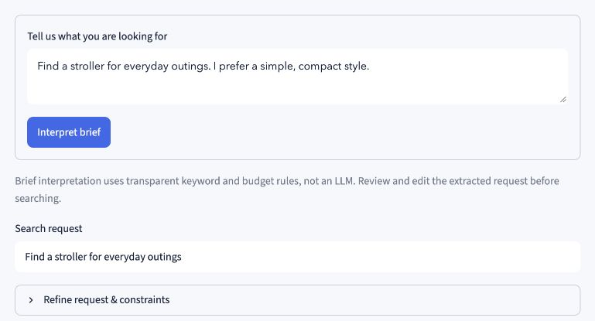
A shopping request without a liked-product history
Interpretation uses transparent keyword rules. Qwen supplies the retrieval embeddings.
08
Notes:
Studio starts with a written request, here a compact stroller for everyday outings. Interpretation uses transparent rules and leaves editable fields. The user reviews omitted nuance before searching. Qwen retrieves products after Find products. Positive feedback is optional.
Sources
assets/studio_brief.png
src/shoplens/studio_ui.py
src/shoplens/studio.py

Slide 9
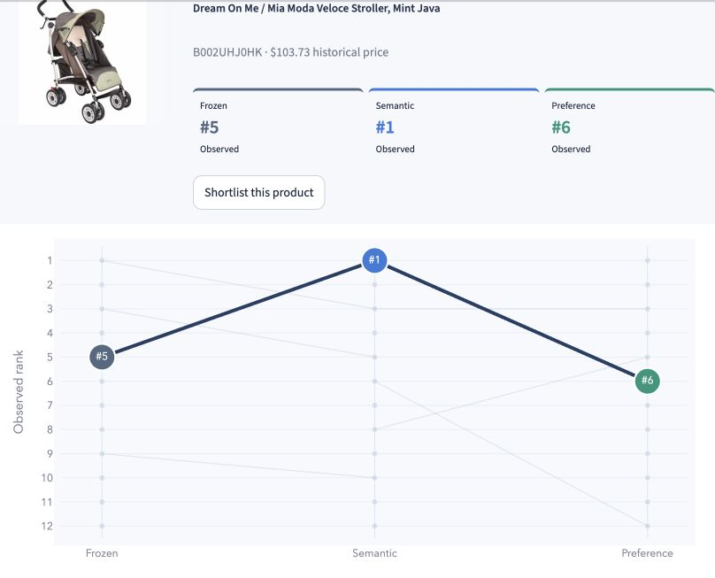
Model arena: one product across three models
“Find a stroller for everyday outings” in Baby, with no positive feedback
Dream On Me / Mia Moda Veloce
ASIN B002UHJ0HK
Frozen #5
Semantic #1
Preference #6
Observed Top 12 per model
24 unique products
2 in all three lists
14 in exactly one list
Each query matches its model’s candidate space. Missing Top-K positions stay unknown.
These observed rank differences describe disagreement, without relevance labels.
09
Notes:
Model arena follows one actual stroller across the three request lists. Frozen places it fifth, Semantic first and Preference sixth. Each query matches its candidate space, without positive feedback. The three Top-twelve lists contain twenty-four unique products. These differences reveal disagreement, with no relevance labels to establish which model is better.
Discussion notes
The actual query is Find a stroller for everyday outings. Dream On Me / Mia Moda Veloce Stroller, Mint Java is ASIN B002UHJ0HK. The observed union contains 24 unique items, with 2 in all three lists, 8 in exactly two and 14 in exactly one. Each model retrieves its own top 200 text-similar candidates, including boundary ties. This application example is exploratory request retrieval, separate from the formal history-to-item test. A missing Top-K position remains unknown. Raw scores are not compared across models.
Sources
assets/studio_model_arena.png
src/shoplens/studio_encoders.py
src/shoplens/studio_models.py
src/shoplens/studio_ui.py
src/shoplens/studio_charts.py

Slide 10
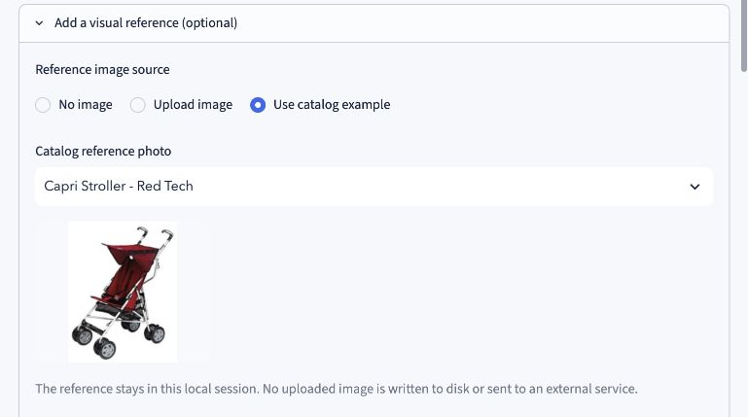
Visual reference and explicit constraints
Historical price ceiling
$150
Soft avoid: bulky
Text weight: 0.65
Local catalog reference
Reference: Capri Stroller - Red Tech. Metadata prices are historical, not live offers.
10
Notes:
This later state adds a catalogue photo, soft avoidance of bulky products and a historical price ceiling of one hundred and fifty dollars. Frozen CLIP supplies the image signal. Uploads stay in local memory. Filters can leave fewer results without expanding the retrieved pool.
Discussion notes
This screenshot shows a separate, later refined Baby state from the Model arena capture. Actual selected reference is Capri Stroller - Red Tech and text weight is 0.65. The image source is Use catalog example, not an uploaded file. Current UI limits uploads to single JPG/PNG/WebP, 8 MB and 16 megapixels. Budget filtering excludes unknown prices. Source metadata categories are not verified product types. An avoid penalty does not guarantee perfect semantic exclusion.
Sources
assets/studio_visual_filters.png
src/shoplens/studio_encoders.py
src/shoplens/studio.py

Slide 11
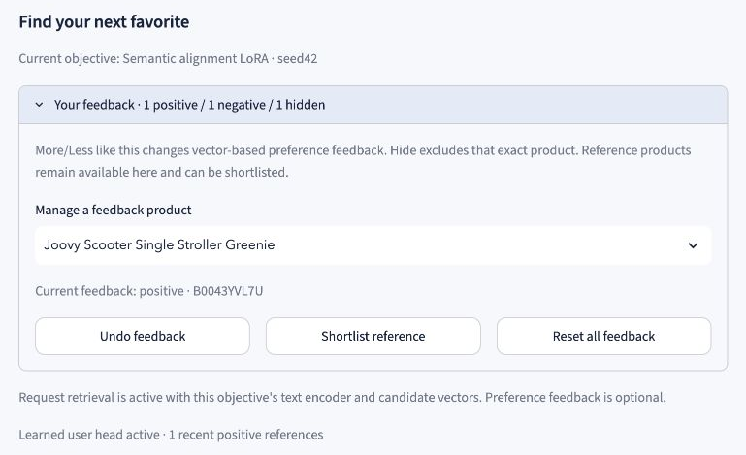
Feedback, exact hiding and undo
Feedback reranks products using cached query vectors. Positive examples activate the selected trained recommender.
11
Notes:
More like this adds positive evidence and activates the selected model’s trained history recommender. Less like this penalizes similar products. Hide removes an exact product. All reference products leave subsequent suggestions. The feedback manager exposes the current state and Undo. These actions rerank products using cached request vectors rather than retraining a model.
Discussion notes
At most the latest 20 distinct positive products enter the history network. Shortlisting alone gives no training feedback. Feedback and query percentiles follow a disclosed application policy rather than the formal evaluation score.
Sources
assets/studio_feedback.png
src/shoplens/studio_ui.py
src/shoplens/studio.py
src/shoplens/studio_models.py

Slide 12
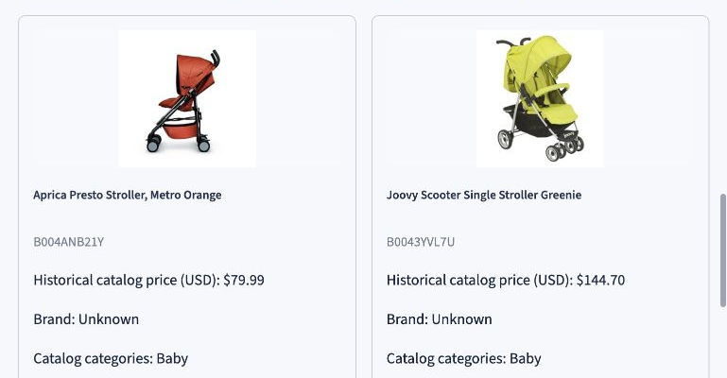
A shortlist with original product evidence
Adding a product to the shortlist does not activate preference feedback.
12
Notes:
The shortlist compares a few real candidates through photographs, historical prices, categories and original descriptions. Source details can reveal information that embeddings miss. The user makes the final choice. Saving a shortlist item supplies no preference feedback.
Sources
assets/studio_shortlist.png
src/shoplens/studio_ui.py

Slide 13
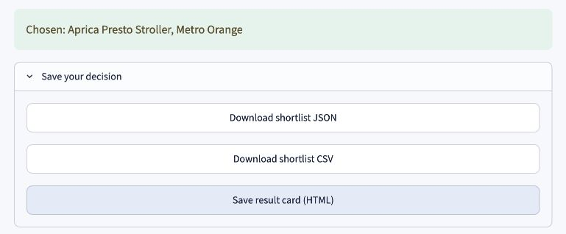
A final choice with portable exports
Exports retain the chosen product, request, feedback and model provenance.
13
Notes:
After confirming a final choice, the user downloads the decision. JSON retains context and model provenance. CSV provides a simple shortlist. HTML includes catalogue photos in a standalone card. Exporting preserves the record after the session ends. The app places no order.
Sources
assets/studio_export.png
src/shoplens/studio.py
src/shoplens/studio_ui.py

Slide 14
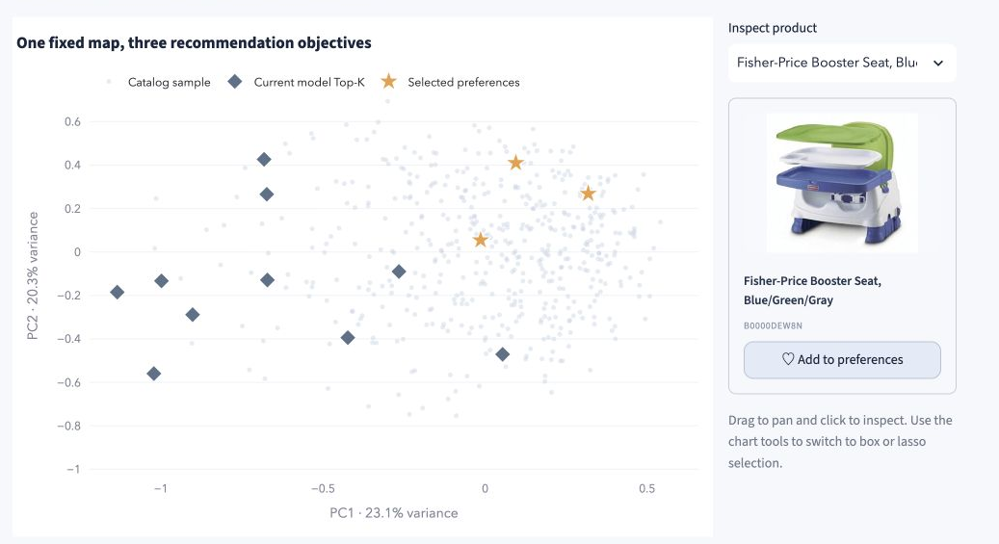
Product atlas with a real product inspector
One fixed PCA map preserves coordinates across models. Projection distance can hide information.
14
Notes:
Product atlas places catalogue products, selected preferences and recommendations on one fixed PCA map. Clicking a point opens its photo, title and product ID and can add a preference. Switching models changes highlights while keeping coordinates fixed. The two-dimensional view loses information.
Discussion notes
This earlier actual Baby capture shows the complete map and inspector together. The displayed capture does not identify all history items, so it is not treated as the same session as the fresh Research figures. The fixed PCA uses the Frozen candidate tower. The plotted sample is not the ranking candidate set. Ranking still uses the full eligible catalogue. The 2D variance fraction is shown, and proximity is a lossy projection rather than a causal explanation.
Sources
assets/research_atlas_complete.jpg
src/shoplens/visual_data.py
src/shoplens/visual_ui.py

Slide 15
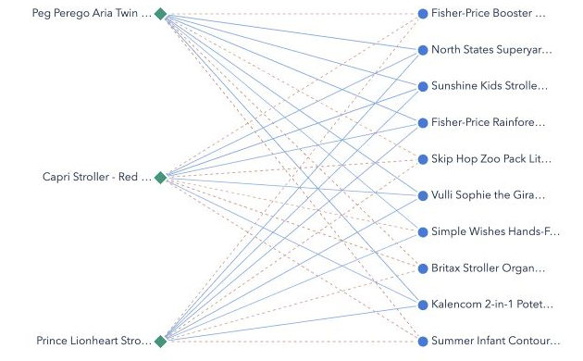
Preference relationships in the actual tower
Green: history. Blue: candidates. Solid/dashed links: positive/negative cosine.
These diagnostics do not decompose the final user-network score.
15
Notes:
Preference lab shows how selected history products relate to recommended candidates in the actual one-hundred-and-twenty-eight-dimensional towers. The network retains positive and negative cosine links. A heatmap provides the same numerical relationship in a different form. These links are neither attention weights nor causal contributions to the final ranking.
Sources
assets/research_network.png
src/shoplens/visual_ui.py
src/shoplens/visual_charts.py

Slide 16
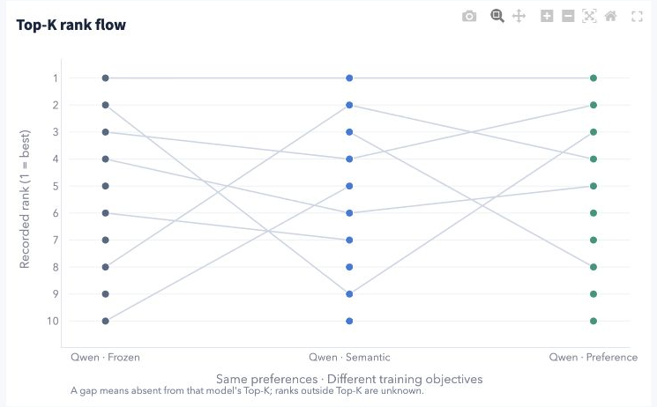
Observed rank flow across objectives
A broken line means absence from the observed Top-K. The missing full rank remains unknown.
16
Notes:
Rank flow follows products across the three model lists for a fixed history. The adjacent view reports Top-K Jaccard overlap. Lines break when products leave the displayed list. We never invent their missing ranks. These views describe disagreement, rather than which list is correct.
Sources
assets/research_rankflow.png
src/shoplens/visual_charts.py
src/shoplens/ui.py

Slide 17
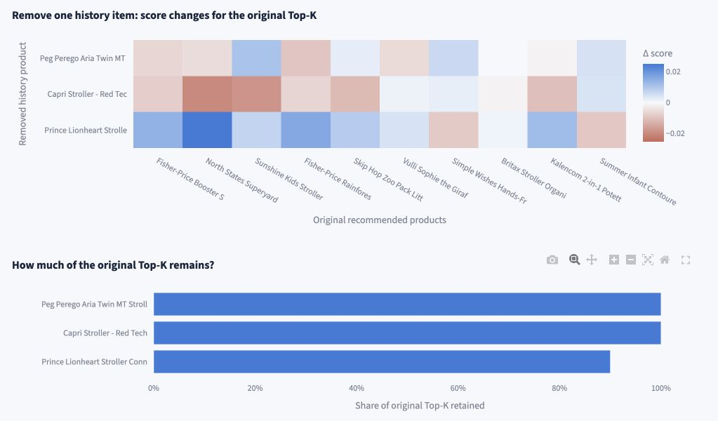
Removal sensitivity for the current history
Each removal reruns the selected seed42 recommender. This is a session sensitivity check.
17
Notes:
The removal experiment drops one active history item at a time and reruns the recommender. It measures score changes and retention of the original Top-K. It never backfills older history. Original selected products stay excluded. This is session sensitivity, rather than causal attribution.
Discussion notes
This earlier actual Baby capture names Peg Perego Aria Twin, Capri Stroller Red Tech and Prince Lionheart Stroller Connectors. The model selector lies outside the capture. No numeric comparison with another capture or model is inferred. The result is conditional on its current history and selected seed42 model. It is neither a formal held-out metric nor a causal attribution. Empty and single-item histories do not invent a removal experiment.
Sources
assets/research_removal_complete.jpg
src/shoplens/visual_data.py
src/shoplens/visual_ui.py

Slide 18
Findings and limits
Adaptation did not improve the mean NDCG@10
in any of the three domains under this budget.
Semantic alignment: 2 of 9 matched wins
User preference: 3 of 9 matched wins
The interface makes the trained models inspectable and usable.
Examples from text requests remain exploratory, with no relevance labels.
One Amazon source. Static metadata. Three seeds.
No online conversion, causal explanation or broad cold-start claim.
18
Notes:
Our main finding is negative: neither adaptation objective improves average NDCG at ten in any domain under this budget. The interface makes the trained models inspectable and supports a complete decision workflow, but attractive examples cannot replace relevance evaluation. Three seeds, one Amazon source and static metadata limit the evidence. The references are the original Amazon archive, official Qwen documentation, LoRA, CLIP and BPR.
Discussion notes
Earlier MiniLM baselines remain separate because their architecture and training budget differ. Clothing live CUDA LoRA training used MATH SDPA after a reproduced gradient failure, while earlier completed runs retained automatic dispatch. No specific fused-kernel cause or bitwise trajectory identity is established.
Sources
results/qwen/results_qwen_summary.json
https://mcauleylab.ucsd.edu/public_datasets/data/amazon/datasets.html
https://huggingface.co/Qwen/Qwen3-Embedding-0.6B/tree/97b0c614be4d77ee51c0cef4e5f07c00f9eb65b3
https://arxiv.org/abs/2106.09685
https://proceedings.mlr.press/v139/radford21a.html
https://arxiv.org/abs/1205.2618

Slide 19
Appendix 1. Formal NDCG@10 detail
Mean ± sample standard deviation. Three complete pipeline seeds per cell.
Domain | Frozen | Semantic | Preference
Baby | 0.012796 ± 0.000959 | 0.009930 ± 0.000728 | 0.012475 ± 0.000849
Sports | 0.007116 ± 0.000684 | 0.006872 ± 0.000613 | 0.007039 ± 0.000584
Clothing | 0.005186 ± 0.000562 | 0.004460 ± 0.000384 | 0.005124 ± 0.000463
Matched wins versus Frozen
Baby: semantic 0/3, preference 1/3
Sports: semantic 2/3, preference 1/3
Clothing: semantic 0/3, preference 1/3
19
Notes:
Optional discussion: every cell uses the three actual complete pipeline seeds. Variation is a sample standard deviation, not a population confidence interval. Matched win counts pair the same domain and seed.
Discussion notes
All 27 raw records passed the declared artifact and protocol audit. No diagnostic or synthetic run supplies these values.
Sources
results/qwen/results_qwen_summary.json

Slide 20
Appendix 2. Sparse items and numerical scope
Mean user-macro NDCG@10 across three seeds.
Targets with at most five distinct training-positive users, including zero.
All Baby scores are zero. This cohort does not isolate strict cold start.
Clothing LoRA training used MATH SDPA after a reproduced gradient failure.
Earlier completed runs kept automatic dispatch. Trajectories may differ.
20
Notes:
Optional discussion: sparse-item results remain close to zero, including zero in Baby. The cohort combines unseen items with low-interaction items, so it does not establish strict cold start. Clothing LoRA training used the MATH attention backend after same-state nonfinite-gradient diagnostics. That recovery does not identify a particular fused-kernel cause or establish bitwise-equivalent training.
Discussion notes
Candidate cache numerical checks cover only the first min(4,N) live-Qwen candidates and one validation history. CPU serving replay checks a different layer of correctness.
Sources
results/qwen/results_qwen_summary.json

Slide 21
Appendix 3. Request retrieval and history evaluation
 | Formal history evaluation | Shopping Studio
Input | Earlier positive products | Text request, optional image
Candidate set | Full eligible catalogue | Text: Top 200 per model Image only: shared CLIP pool
Model selection | Validation, seeds 42/43/44 | Selected seed42 exports
Meaning | Held-out user-macro metrics | Exploratory session ranking
Queries use the matching base or LoRA encoder. Images share fixed CLIP.
Positive feedback uses each model’s exported history tower and trained user head.
21
Notes:
Optional discussion: the application and the formal experiment answer different questions. Studio uses a matching query encoder for each candidate space and retrieves a model-specific pool before applying constraints and feedback. The formal test instead begins with actual earlier history and ranks the complete eligible catalogue. Studio scores and examples cannot be substituted for those metrics.
Discussion notes
All query arms share the shopping instruction, left padding, last-valid-token pooling, maximum 256 tokens and L2 normalization. Image-only requests can produce identical base retrieval lists. The trained head activates with positive history, which always uses frozen base history inputs.
Sources
src/shoplens/studio_encoders.py
src/shoplens/studio_models.py
src/shoplens/studio.py
src/shoplens/qwen_evaluate.py

Slide 22
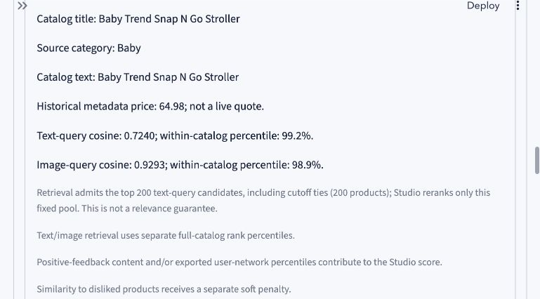
Appendix 4. Studio source evidence
Original catalogue fields and computed retrieval signals
Cosines and within-catalogue percentiles are diagnostic signals, not probabilities or causal explanations.
22
Notes:
Optional discussion: a result card exposes its original title, source category, historical price and computed text and image signals. The disclosed retrieval pool and penalty policy help the user inspect the current result. These signals do not establish suitability or explain the score causally.
Discussion notes
This is the later Baby state with a reference photo, a 150 USD historical budget, soft avoid bulky and optional positive/negative/hidden feedback. The screenshot concerns Baby Trend Snap N Go Stroller, not the final chosen Aprica. Its observed text-query cosine is 0.7240 and image-query cosine is 0.9293 in this state.
Sources
assets/studio_evidence.png
src/shoplens/studio_ui.py
src/shoplens/studio.py

Slide 23
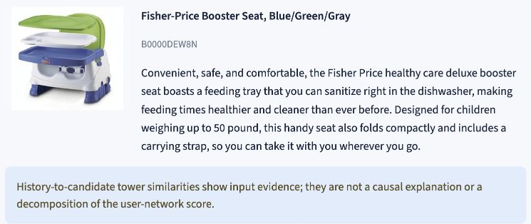
Appendix 5. Research recommendation evidence
Original records support inspection. Similarity diagnostics do not explain the score causally.
23
Notes:
Optional discussion: Research recommendation evidence combines the product record with the selected history and model. It exposes cross-tower similarities and structured inference evidence. This page supports inspection of an individual recommendation, while the experiment dashboard provides the held-out quality measurements.
Discussion notes
The actual Baby example selects Frozen and Fisher-Price Booster Seat, Blue/Green/Gray (B0000DEW8N), with the three displayed preset history items. This slide retains the original candidate description. The full inference evidence view exposes the actual scoring and provenance fields. Similarities remain diagnostics rather than causal score contributions.
Sources
assets/research_evidence_product.png
src/shoplens/ui.py

Slide 24
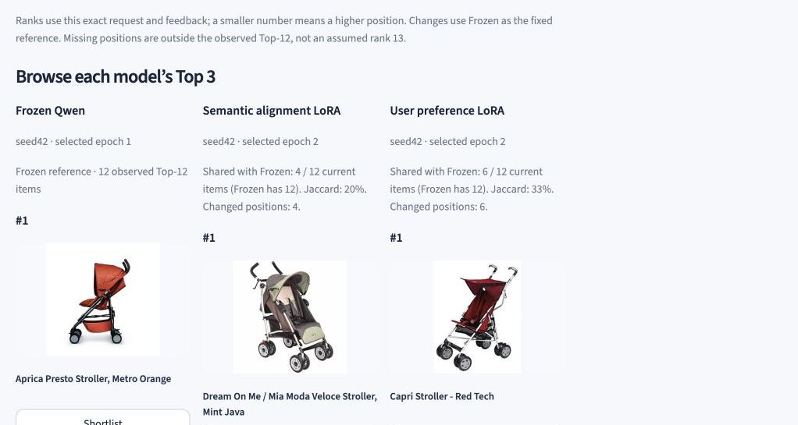
Appendix 6. Product lists from three models
An earlier actual Baby request, with no positive feedback
Baby has 7,037 products. Shown: each model’s first recommendation.
Top 12 is a display subset. Three models do not mean three catalogue products.
24
Notes:
Optional discussion: the original three-column product view gives photographic evidence for each model’s first visible recommendation. The catalogue contains 7,037 Baby products. Top-twelve and Top-three views show subsets of results. Three refers to the model alternatives rather than the catalogue size.
Discussion notes
This earlier actual Baby request screenshot is independent of the Model arena capture. It shows the first visible recommendation in each column, not every row of the Top 3. Each request uses the matching query and candidate encoder. The respective retrieved pools can differ. Product examples do not replace held-out relevance evaluation.
Sources
assets/studio_models.jpg
src/shoplens/studio_ui.py
src/shoplens/studio_encoders.py
src/shoplens/studio_models.py

Slide 25
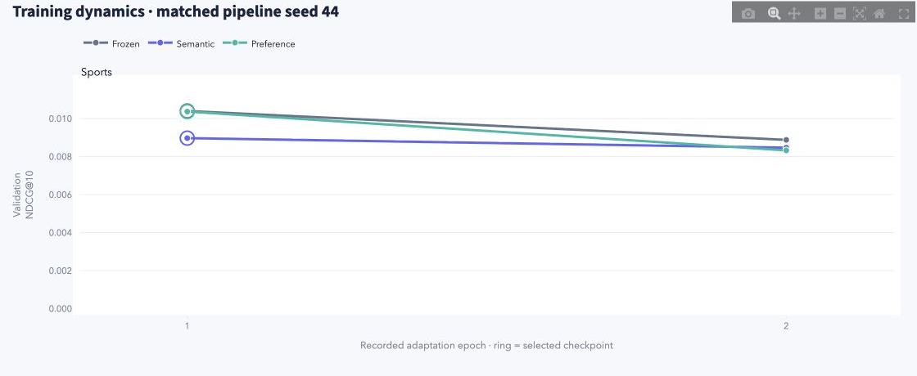
Appendix 7. Training dynamics
Sports, matched pipeline seed 44. Actual validation NDCG@10.
All three Sports seed44 models select epoch 1. Rings mark the selected checkpoints.
Only two recorded validation epochs. Test metrics never select the checkpoint.
25
Notes:
Optional discussion: Experiment gallery displays the two recorded adaptation-epoch validation results for each arm. In Sports seed forty-four, all three models select epoch one. The rings mark those choices. Lines connect actual saved observations and do not show unrecorded optimization steps. Test results never choose the epoch.
Discussion notes
Actual validation NDCG@10: Frozen epoch1 0.01039775584130691, epoch2 0.00887591995099229. Semantic epoch1 0.008968238048314637, epoch2 0.008466524502734576. Preference epoch1 0.010366837105701692, epoch2 0.008324549533718625. All select epoch1. Across the formal study, full-catalogue validation selects epoch1 or2. Frozen keeps its text encoder fixed while its recommendation head still trains. This Sports seed44 example differs from Studio’s selected seed42 serving models. dist/experiment-gallery is an optional separately generated or downloaded offline export folder, not a claim that generated files belong to the Git source tree.
Sources
assets/experiment_training_sports_seed44.png
src/shoplens/experiment_charts.py
results/qwen/results_qwen_summary.json
scripts/export_experiment_gallery.py
dist/experiment-gallery/training_curves.csv

Slide 26
Appendix 8. Sources and reproducibility
Data and methods
Amazon Reviews 2014, McAuley Lab
Qwen3-Embedding official model card and training documentation
LoRA, Hu et al. CLIP, Radford et al. BPR, Rendle et al.
Report, code and offline evidence
English experiment report and audited 27-record summary
Selected model exports, hashes and recorded validation results
Experiment gallery: seven interactive figures plus CSV / JSON
The export script creates the optional offline gallery. Runtime assets install separately.
26
Notes:
Optional discussion: primary sources establish the data and model methods. The English experiment report and audited summary describe the formal study. Source code exposes the application and gallery calculations. The export script produces a standalone offline gallery with seven interactive figures, the plotted CSV values and structured evidence JSON.
Discussion notes
Resolve src/..., scripts/..., reports/..., results/..., data/..., artifacts/... and dist/... from the repository root. Resolve assets/... relative to reports/. Runtime data and model artifacts require a separate runtime installation. The optional dist/experiment-gallery folder is generated by the export script or supplied as a separate offline export package. Its seven figures are four performance metrics, the paired seed matrix, paired effect summary and validation dynamics. The HTML embeds Plotly locally. This is presentation and export of the existing 27 evaluations, without retraining or new relevance measurements.
Sources
https://mcauleylab.ucsd.edu/public_datasets/data/amazon/datasets.html
https://huggingface.co/Qwen/Qwen3-Embedding-0.6B/tree/97b0c614be4d77ee51c0cef4e5f07c00f9eb65b3
https://arxiv.org/abs/2106.09685
https://proceedings.mlr.press/v139/radford21a.html
https://arxiv.org/abs/1205.2618
reports/ShopLens_Qwen_report_en.md
results/qwen/results_qwen_summary.json
src/shoplens/experiment_data.py
src/shoplens/experiment_charts.py
scripts/export_experiment_gallery.py
dist/experiment-gallery/index.html

Slide 27
Additional benchmarks for four questions
Existing dataset labels support the new measurements. No new manual annotation.
Question | Evidence source | Measured scope
Search relevance | Amazon ESCI Official query-product labels | 500 test queries Complete lists of 2–40 products
Image + language | FashionIQ Image, relative edit, target | 287 validation queries Selected category image galleries
History and exposure | Amazon Reviews 2014 Fixed seed42 checkpoints | 1,000 selected test users per domain History caps and exposure
Local inference cost | Prepared local models CPU execution | Cold, new input and exact repeat Paired ranking-stage comparison
The original 27 training evaluations remain unchanged. Each added task keeps its own metrics.
27
Notes:
These additional experiments answer distinct questions. ESCI measures title-only relevance in an official judged candidate list. FashionIQ measures retrieval from a reference photograph and relative language. Recommendation diagnostics reuse fixed historical checkpoints. Local profiling measures engine execution. Their numerical scores are not averaged across tasks. The original 27-run recommendation study stays intact.
Sources
results/esci/summary.json
results/fashion/summary.json
results/diagnostics/recommendation_diagnostics.json
results/performance/studio.json
https://github.com/amazon-science/esci-data/tree/7916cdf6ab75a462e77f20ab40428a10923998d5
https://github.com/XiaoxiaoGuo/fashion-iq/tree/f71b16c3b09ef03b02c0fed160fa072fb3b8aa16

Slide 28
ESCI query-to-product relevance
500 official English test queries, 9,766 judged candidates. Title-only transfer.
The Clothing adapters transfer from historical recommendation training without ESCI fine-tuning.
All models rerank the same complete per-query list. These scores do not measure whole-catalogue search.
28
Notes:
The declared hash-based procedure selects 500 queries from eligible official US Task1 test queries using IDs and candidate counts, before reading relevance labels. Every model ranks the same complete list. Dense scoring uses matching Frozen or Clothing seed42 LoRA encoders for the query and title. TF-IDF fits only selected official training titles. Primary NDCG uses linear E=1, S=0.1, C=0.01, I=0 gains. The official qrel script reverses S/C, which the result JSON reports separately as a sensitivity. No model selection uses these test outcomes.
Exact measured primary means
[{"model":"tfidf","ndcg10":0.6915837904181256,"ndcg_all":0.8215935010640373},{"model":"qwen_frozen","ndcg10":0.7244598968871097,"ndcg_all":0.840688004205202},{"model":"qwen_semantic","ndcg10":0.7241732679546133,"ndcg_all":0.8390807582484276},{"model":"qwen_preference","ndcg10":0.7304411548007471,"ndcg_all":0.8419096138927247}]
Sources
results/esci/summary.json
results/esci/protocol.json
results/esci/queries.jsonl
scripts/run_esci_benchmark.py
src/shoplens/search_benchmark.py
https://github.com/amazon-science/esci-data/blob/7916cdf6ab75a462e77f20ab40428a10923998d5/ranking/train.py#L45-L50

Slide 29
One official request across four ranking methods
“I would want a light weight protable laptop with a graphics card and alot of memory”
Model | Rank 1 | Rank 2 | Rank 3
TF-IDF | E 2021 HP Stream 14" HD Laptop Light-Weight, Intel… | C Sapphire Technology Nitro+ AMD Radeon RX 6700 XT… | C Sapphire Technology Pulse AMD Radeon RX 6700 XT …
Frozen | E Windows 10 Laptop 13.3" Full HD 1920 x 1080, Lig… | E Lenovo Chromebook Flex 5 13" Laptop, FHD (1920 x… | E 2021 Lenovo Ideapad 3 15.6" Touchscreen Laptop C…
Semantic | S Acer Aspire 5 Slim Laptop, 15.6 inches Full HD I… | E 2021 HP Stream 14" HD Laptop Light-Weight, Intel… | E 2021 Lenovo Ideapad 3 15.6" Touchscreen Laptop C…
Preference | E Windows 10 Laptop 13.3" Full HD 1920 x 1080, Lig… | E Lenovo Chromebook Flex 5 13" Laptop, FHD (1920 x… | E 2021 Lenovo Ideapad 3 15.6" Touchscreen Laptop C…
Query 5722 has 39 official candidates. E exact, S substitute, C complement, I irrelevant.
This query is first in the fixed hash sample. The example does not select an apparent model win.
29
Notes:
The example uses query5722, first in the predeclared deterministic hash sample. It does not choose a query based on model success. The four rows display actual top-three candidates and official labels. Display titles shorten with an ellipsis where needed. The source JSON retains every complete title, score, rank and label. All39 candidates remain in the evaluation. Original query spelling is retained.
Complete example
{"query_id":"5722","query":"I would want a light weight protable laptop with a graphics card and alot of memory","locale":"us","candidates":[{"product_id":"B00014FGTK","product_title":"Hyland's Nerve Tonic Stress Relief Tablets, Natural Relief of Restlessness, Nervousness and Irritability Symptoms, Non-Habit Forming, 500 Count","esci_label":"I","gain":0,"scores":{"tfidf":0.02678055279948125,"qwen_frozen":0.21921178698539734,"qwen_semantic":0.15597638487815857,"qwen_preference":0.19960369169712067},"ranks":{"tfidf":30,"qwen_frozen":35,"qwen_semantic":35,"qwen_preference":36}},{"product_id":"B00V5HLMJA","product_title":"HP 8GB (1 x 8GB) PC3L-12800 DDR3L-1600 SODIMM for notebook [PN: 693374-001 / 693374-005]","esci_label":"C","gain":0.01,"scores":{"tfidf":0,"qwen_frozen":0.49500295519828796,"qwen_semantic":0.5640051364898682,"qwen_preference":0.4626540541648865},"ranks":{"tfidf":33,"qwen_frozen":15,"qwen_semantic":20,"qwen_preference":14}},{"product_id":"B00XD023L8","product_title":"I Don't Like Morning People Graphic Novelty Sarcastic Funny T Shirt L Black","esci_label":"I","gain":0,"scores":{"tfidf":0,"qwen_frozen":0.20868155360221863,"qwen_semantic":0.09004858136177063,"qwen_preference":0.19175377488136292},"ranks":{"tfidf":34,"qwen_frozen":36,"qwen_semantic":37,"qwen_preference":37}},{"product_id":"B0145V6NKU","product_title":"Timetec 8GB KIT(2x4GB) DDR3L / DDR3 1600MHz PC3L-12800 / PC3-12800 Non-ECC Unbuffered 1.35V / 1.5V CL11 2Rx8 Dual Rank 204 Pin SODIMM Laptop Notebook PC Computer Memory RAM Module Upgrade","esci_label":"C","gain":0.01,"scores":{"tfidf":0.09301981666547098,"qwen_frozen":0.4565044045448303,"qwen_semantic":0.48889225721359253,"qwen_preference":0.420512855052948},"ranks":{"tfidf":9,"qwen_frozen":22,"qwen_semantic":26,"qwen_preference":22}},{"product_id":"B01G0BYATO","product_title":"Cushy Form Bolster Pillow for Lumbar and Leg Support - 20.5 x 8 x 4.5 Inches Half Moon Memory Foam Cushion for Stomach, Back & Side Sleepers - Roll Pillows for Back and Neck w/ Washable Cover","esci_label":"I","gain":0,"scores":{"tfidf":0.046271617342553015,"qwen_frozen":0.33212459087371826,"qwen_semantic":0.22113734483718872,"qwen_preference":0.3031119108200073},"ranks":{"tfidf":22,"qwen_frozen":32,"qwen_semantic":33,"qwen_preference":32}},{"product_id":"B074RNRM2B","product_title":"SanDisk 400GB Ultra microSDXC UHS-I Memory Card with Adapter - 100MB/s, C10, U1, Full HD, A1, Micro SD Card - SDSQUAR-400G-GN6MA","esci_label":"I","gain":0,"scores":{"tfidf":0.09013631030398163,"qwen_frozen":0.3798115849494934,"qwen_semantic":0.3460956811904907,"qwen_preference":0.35565000772476196},"ranks":{"tfidf":11,"qwen_frozen":31,"qwen_semantic":29,"qwen_preference":31}},{"product_id":"B07932SPXV","product_title":"Amplim 32GB Micro SD Card, 2 Pack MicroSD Memory Plus Adapter, MicroSDHC Class 10 UHS-I U1 V10 TF Extreme High Speed Nintendo-Switch, GoPro Hero, Raspberry Pi, Phone Galaxy, Camera Cam, Tablet, PC","esci_label":"C","gain":0.01,"scores":{"tfidf":0.054238143730797043,"qwen_frozen":0.39868032932281494,"qwen_semantic":0.3018004298210144,"qwen_preference":0.3729461133480072},"ranks":{"tfidf":21,"qwen_frozen":29,"qwen_semantic":31,"qwen_preference":28}},{"product_id":"B07GLV1VC7","product_title":"Lenovo Chromebook S330 Laptop, 14-Inch FHD (1920 x 1080) Display, MediaTek MT8173C Processor, 4GB LPDDR3, 64GB eMMC, Chrome OS, 81JW0000US, Business Black","esci_label":"E","gain":1,"scores":{"tfidf":0.03907489211990967,"qwen_frozen":0.4895872473716736,"qwen_semantic":0.7156237363815308,"qwen_preference":0.450412392616272},"ranks":{"tfidf":25,"qwen_frozen":17,"qwen_semantic":13,"qwen_preference":17}},{"product_id":"B07GM2J11Q","product_title":"Lenovo Chromebook C330 2-in-1 Convertible Laptop, 11.6-Inch HD (1366 x 768) IPS Display, MediaTek MT8173C Processor, 4GB LPDDR3, 64 GB eMMC, Chrome OS, 81HY0000US, Blizzard White","esci_label":"S","gain":0.1,"scores":{"tfidf":0.03878395064862853,"qwen_frozen":0.48011600971221924,"qwen_semantic":0.7132580280303955,"qwen_preference":0.43642550706863403},"ranks":{"tfidf":26,"qwen_frozen":18,"qwen_semantic":14,"qwen_preference":21}},{"product_id":"B07HRZM2V4","product_title":"ASUS Chromebook C423 14.0\" 180 Degree HD NanoEdge Display, Intel Dual Core Celeron Processor, 4GB LPDDR4 RAM, 32GB Storage, Silver Color, C423NA-DH02","esci_label":"E","gain":1,"scores":{"tfidf":0,"qwen_frozen":0.5159722566604614,"qwen_semantic":0.6891939640045166,"qwen_preference":0.4748796224594116},"ranks":{"tfidf":35,"qwen_frozen":10,"qwen_semantic":15,"qwen_preference":11}},{"product_id":"B07P6NRTNW","product_title":"Windows 10 Laptop 13.3\" Full HD 1920 x 1080, Light Laptop Computer 4GB RAM, Dual Band 5GHz WiFi (2X WiFi Speeds), Intel Celeron Processor, USB 3.0, Bluetooth, Laptop (64GB,Free Office 1 Year)","esci_label":"E","gain":1,"scores":{"tfidf":0.08440624843022289,"qwen_frozen":0.5780681371688843,"qwen_semantic":0.718634843826294,"qwen_preference":0.5489944815635681},"ranks":{"tfidf":14,"qwen_frozen":1,"qwen_semantic":11,"qwen_preference":1}},{"product_id":"B07PZF5C2J","product_title":"New Phone, Who Dis? - The 100% Offline Text Messaging Party Game - by What Do You Meme?","esci_label":"I","gain":0,"scores":{"tfidf":0,"qwen_frozen":0.2612046003341675,"qwen_semantic":0.2279626727104187,"qwen_preference":0.24320559203624725},"ranks":{"tfidf":36,"qwen_frozen":33,"qwen_semantic":32,"qwen_preference":33}},{"product_id":"B07Q8YBYZP","product_title":"I'm Sorry I Hurt your Feelings When I Called You Stupid T-Shirt","esci_label":"I","gain":0,"scores":{"tfidf":0,"qwen_frozen":0.12739329040050507,"qwen_semantic":0.06628315150737762,"qwen_preference":0.11359299719333649},"ranks":{"tfidf":37,"qwen_frozen":39,"qwen_semantic":39,"qwen_preference":39}},{"product_id":"B07RF1XD36","product_title":"Acer Aspire 5 Slim Laptop, 15.6 inches Full HD IPS Display, AMD Ryzen 3 3200U, Vega 3 Graphics, 4GB DDR4, 128GB SSD, Backlit Keyboard, Windows 10 in S Mode, A515-43-R19L, Silver","esci_label":"S","gain":0.1,"scores":{"tfidf":0.08641721377050954,"qwen_frozen":0.5323029160499573,"qwen_semantic":0.7643455266952515,"qwen_preference":0.49188950657844543},"ranks":{"tfidf":13,"qwen_frozen":7,"qwen_semantic":1,"qwen_preference":7}},{"product_id":"B07RJZMC49","product_title":"Lenovo 11.6\" 300e Chromebook Touchscreen LCD 2 in 1 Chromebook - MediaTek M8173C Quad-core 2.1GHz 4GB LPDDR3 32GB Flash Memory Chrome OS Model 81H00000US (Renewed)","esci_label":"S","gain":0.1,"scores":{"tfidf":0.044631886752219484,"qwen_frozen":0.4759824275970459,"qwen_semantic":0.658586859703064,"qwen_preference":0.4370397925376892},"ranks":{"tfidf":23,"qwen_frozen":20,"qwen_semantic":16,"qwen_preference":20}},{"product_id":"B07SXMZLPK","product_title":"AMD Ryzen 7 3700X 8-Core, 16-Thread Unlocked Desktop Processor with Wraith Prism LED Cooler","esci_label":"I","gain":0,"scores":{"tfidf":0.00871027831843621,"qwen_frozen":0.4761200547218323,"qwen_semantic":0.5114675760269165,"qwen_preference":0.4387146234512329},"ranks":{"tfidf":32,"qwen_frozen":19,"qwen_semantic":22,"qwen_preference":19}},{"product_id":"B07TWHYTSQ","product_title":"Lenovo Flex 14 2-in-1 Convertible Laptop, 14 Inch FHD Touchscreen Display, AMD Ryzen 5 3500U Processor, 12GB DDR4 RAM, 256GB NVMe SSD, Windows 10, 81SS000DUS, Black, Pen Included","esci_label":"E","gain":1,"scores":{"tfidf":0.03113240290382686,"qwen_frozen":0.5150547027587891,"qwen_semantic":0.7462353706359863,"qwen_preference":0.4749408960342407},"ranks":{"tfidf":29,"qwen_frozen":11,"qwen_semantic":4,"qwen_preference":10}},{"product_id":"B07W5L1T9S","product_title":"Antiquity Quest | A Look | A Set Collection Game from The Creators of Cover Your Assets & Skull King, Grandpa Beck's Games | 2-8 Players 10+","esci_label":"I","gain":0,"scores":{"tfidf":0.012412356716444809,"qwen_frozen":0.2065417766571045,"qwen_semantic":0.1103554368019104,"qwen_preference":0.17934691905975342},"ranks":{"tfidf":31,"qwen_frozen":37,"qwen_semantic":36,"qwen_preference":38}},{"product_id":"B07XW266D9","product_title":"SAMSUNG XE350XBA-K01US Chromebook 4 + Chrome OS 15.6\" Full HD Intel Celeron Processor N4000 4GB RAM 32Gb Emmc Gigabit Wi-Fi, Silver","esci_label":"E","gain":1,"scores":{"tfidf":0,"qwen_frozen":0.4915120601654053,"qwen_semantic":0.6424169540405273,"qwen_preference":0.4528116285800934},"ranks":{"tfidf":38,"qwen_frozen":16,"qwen_semantic":17,"qwen_preference":16}},{"product_id":"B07ZV7937T","product_title":"I Went Outside Once, The Graphics Weren't That Great Funny T-Shirt","esci_label":"I","gain":0,"scores":{"tfidf":0.11717954595110697,"qwen_frozen":0.20634524524211884,"qwen_semantic":0.08568193018436432,"qwen_preference":0.20091602206230164},"ranks":{"tfidf":4,"qwen_frozen":38,"qwen_semantic":38,"qwen_preference":35}},{"product_id":"B07ZWDTMKC","product_title":"HP 15-dy1751ms Intel i5-1035G1 8GB DDR4 Memory 512GB SSD 15.6 Touch Screen","esci_label":"E","gain":1,"scores":{"tfidf":0.05688565588772284,"qwen_frozen":0.4537894129753113,"qwen_semantic":0.5780513286590576,"qwen_preference":0.4122944176197052},"ranks":{"tfidf":19,"qwen_frozen":23,"qwen_semantic":19,"qwen_preference":23}},{"product_id":"B081D9HJ4P","product_title":"HP 14\" Touchscreen Home and Business Laptop Ryzen 3-3200U, 8GB RAM, 128GB M.2 SSD, Dual-Core up to 3.50 GHz, Vega 3 Graphics, RJ-45, USB-C, 4K Output HDMI, Bluetooth, Webcam, 1366x768, Win 10","esci_label":"E","gain":1,"scores":{"tfidf":0.10137131060605073,"qwen_frozen":0.5262613296508789,"qwen_semantic":0.7362712621688843,"qwen_preference":0.4875645041465759},"ranks":{"tfidf":6,"qwen_frozen":9,"qwen_semantic":9,"qwen_preference":9}},{"product_id":"B081FZV45H","product_title":"2019 Apple MacBook Pro (16-inch, 16GB RAM, 512GB Storage, 2.6GHz Intel Core i7) - Space Gray","esci_label":"E","gain":1,"scores":{"tfidf":0,"qwen_frozen":0.5007044672966003,"qwen_semantic":0.6260837912559509,"qwen_preference":0.46765944361686707},"ranks":{"tfidf":39,"qwen_frozen":14,"qwen_semantic":18,"qwen_preference":12}},{"product_id":"B082358X13","product_title":"New HP 15.6\" HD Touchscreen Laptop Intel Core i3-1005G1 8GB DDR4 RAM 128GB SSD HDMI Bluetooth 802.11/b/g/n/ac Windows 10 15-dy1731ms Silver","esci_label":"E","gain":1,"scores":{"tfidf":0.03730220301485526,"qwen_frozen":0.5053638815879822,"qwen_semantic":0.7371221780776978,"qwen_preference":0.46689900755882263},"ranks":{"tfidf":27,"qwen_frozen":13,"qwen_semantic":7,"qwen_preference":13}},{"product_id":"B084QDTJVJ","product_title":"Qwixx Card Game - A Fast Family Card Game","esci_label":"I","gain":0,"scores":{"tfidf":0.07575495353166999,"qwen_frozen":0.2552863359451294,"qwen_semantic":0.15994305908679962,"qwen_preference":0.2366057187318802},"ranks":{"tfidf":15,"qwen_frozen":34,"qwen_semantic":34,"qwen_preference":34}},{"product_id":"B086383HC7","product_title":"Lenovo Chromebook Flex 5 13\" Laptop, FHD (1920 x 1080) Touch Display, Intel Core i3-10110U Processor, 4GB DDR4 Onboard RAM, 64GB eMMC, Intel Integrated Graphics, Chrome OS, 82B80006UX, Graphite Grey","esci_label":"E","gain":1,"scores":{"tfidf":0.08744852155685742,"qwen_frozen":0.5662075281143188,"qwen_semantic":0.7428934574127197,"qwen_preference":0.5316685438156128},"ranks":{"tfidf":12,"qwen_frozen":2,"qwen_semantic":6,"qwen_preference":2}},{"product_id":"B08B3X4L95","product_title":"2020 HP Pavilion x360 14\" FHD WLED Touchscreen 2-in-1 Convertible Laptop, Intel Core i5-1035G1 up to 3.6GHz, 8GB DDR4, 256GB SSD, 802.11ac, Bluetooth, Webcam, HDMI, Fingerprint Reader, Windows 10","esci_label":"E","gain":1,"scores":{"tfidf":0.03300597471063695,"qwen_frozen":0.5055114030838013,"qwen_semantic":0.7268966436386108,"qwen_preference":0.4544459879398346},"ranks":{"tfidf":28,"qwen_frozen":12,"qwen_semantic":10,"qwen_preference":15}},{"product_id":"B08C2G1J9M","product_title":"Micro Center 32GB Class 10 Micro SDHC Flash Memory Card with Adapter for Mobile Device Storage Phone, Tablet, Drone & Full HD Video Recording - 80MB/s UHS-I, C10, U1 (5 Pack)","esci_label":"C","gain":0.01,"scores":{"tfidf":0.061442774815512385,"qwen_frozen":0.4087170660495758,"qwen_semantic":0.39733433723449707,"qwen_preference":0.380153089761734},"ranks":{"tfidf":17,"qwen_frozen":26,"qwen_semantic":28,"qwen_preference":26}},{"product_id":"B08C7FBYCC","product_title":"2021 Flagship Lenovo IdeaPad 3 Laptop 15.6\" HD Touchscreen 10th Gen Intel Core i3-10110U (Beats i5-8200Y) 12GB RAM 512GB SSD Webcam, HDMI, Win 10, Blue with 32GB E.S USB Card","esci_label":"E","gain":1,"scores":{"tfidf":0.0697500482032873,"qwen_frozen":0.5418035387992859,"qwen_semantic":0.7453022003173828,"qwen_preference":0.5006104111671448},"ranks":{"tfidf":16,"qwen_frozen":5,"qwen_semantic":5,"qwen_preference":5}},{"product_id":"B08C818XGW","product_title":"HP Stream Laptop PC 11.6\" Intel N4000 Quad Core 4GB DDR4 SDRAM 32GB eMMC Includes Office 365 Personal for One Year","esci_label":"E","gain":1,"scores":{"tfidf":0.042268253704273846,"qwen_frozen":0.53022301197052,"qwen_semantic":0.7161848545074463,"qwen_preference":0.49056750535964966},"ranks":{"tfidf":24,"qwen_frozen":8,"qwen_semantic":12,"qwen_preference":8}},{"product_id":"B08HCPTMJG","product_title":"SanDisk 1TB Ultra MicroSDXC UHS-I Memory Card with Adapter - 120MB/s, C10, U1, Full HD, A1, Micro SD Card - SDSQUA4-1T00-GN6MA","esci_label":"C","gain":0.01,"scores":{"tfidf":0.09030279564742373,"qwen_frozen":0.38136690855026245,"qwen_semantic":0.34528589248657227,"qwen_preference":0.35638147592544556},"ranks":{"tfidf":10,"qwen_frozen":30,"qwen_semantic":30,"qwen_preference":30}},{"product_id":"B08KSV5KBM","product_title":"Patriot LX Series Micro SD Flash Memory Card 32GB - 5 Pack","esci_label":"I","gain":0,"scores":{"tfidf":0.09513850409438689,"qwen_frozen":0.39936167001724243,"qwen_semantic":0.3984692096710205,"qwen_preference":0.3727000951766968},"ranks":{"tfidf":8,"qwen_frozen":28,"qwen_semantic":27,"qwen_preference":29}},{"product_id":"B08LVJJ8LL","product_title":"2021 HP Stream 14\" HD Laptop Light-Weight, Intel N4020 (Up tp 2.8GHz), 4GB RAM, 64GB eMMC, Webcam, HDMI, WiFi, 1 Year Office 365, Google Classroom or Zoom Compatible, w/Ghost Manta 128GB SD Card","esci_label":"E","gain":1,"scores":{"tfidf":0.20199934582997364,"qwen_frozen":0.5438319444656372,"qwen_semantic":0.7553839087486267,"qwen_preference":0.5085145235061646},"ranks":{"tfidf":1,"qwen_frozen":4,"qwen_semantic":2,"qwen_preference":4}},{"product_id":"B08Q7YS4FN","product_title":"2021 Newest Lenovo IdeaPad 3 15.6\" HD Touch Screen Laptop, Intel Quad-Core i5-1035G1 Up to 3.6GHz (Beats i7-8550U), 12GB DDR4 RAM, 256GB PCIe SSD, Webcam, WiFi 5, HDMI, Windows 10 S + TiTac Card","esci_label":"E","gain":1,"scores":{"tfidf":0.05821869242889165,"qwen_frozen":0.5383970141410828,"qwen_semantic":0.7370926141738892,"qwen_preference":0.4931934177875519},"ranks":{"tfidf":18,"qwen_frozen":6,"qwen_semantic":8,"qwen_preference":6}},{"product_id":"B08YN79ZW2","product_title":"Sapphire Technology Nitro+ AMD Radeon RX 6700 XT Gaming Graphics Card with 12GB GDDR6, AMD RDNA 2 (11306-01-20G)","esci_label":"C","gain":0.01,"scores":{"tfidf":0.1690991896494949,"qwen_frozen":0.4060481786727905,"qwen_semantic":0.5008367300033569,"qwen_preference":0.3744790852069855},"ranks":{"tfidf":2,"qwen_frozen":27,"qwen_semantic":24,"qwen_preference":27}},{"product_id":"B08YNQ4ZM1","product_title":"Sapphire Technology Pulse AMD Radeon RX 6700 XT Gaming Graphics Card with 12GB GDDR6, AMD RDNA 2 (11306-02-20G)","esci_label":"C","gain":0.01,"scores":{"tfidf":0.16183554723917304,"qwen_frozen":0.41455987095832825,"qwen_semantic":0.4917290210723877,"qwen_preference":0.3812839388847351},"ranks":{"tfidf":3,"qwen_frozen":25,"qwen_semantic":25,"qwen_preference":25}},{"product_id":"B091PKXT6Z","product_title":"2021 Lenovo Ideapad 3 15.6\" Touchscreen Laptop Computer Intel Quad-Core i5-10210U (Beats i7-8665U), 12GB DDR4 RAM, 1TB HDD, WiFi , Bluetooth, Webcam, Almond, Windows 10 Home, GOLDOXIS 32GB SD Card","esci_label":"E","gain":1,"scores":{"tfidf":0.054705260026514324,"qwen_frozen":0.5489039421081543,"qwen_semantic":0.7499745488166809,"qwen_preference":0.508720874786377},"ranks":{"tfidf":20,"qwen_frozen":3,"qwen_semantic":3,"qwen_preference":3}},{"product_id":"B092L9GF5N","product_title":"AMD Ryzen 5 5600G 6-Core 12-Thread Desktop Processor with Radeon Graphics","esci_label":"I","gain":0,"scores":{"tfidf":0.09816389797988367,"qwen_frozen":0.47400322556495667,"qwen_semantic":0.516968309879303,"qwen_preference":0.44318488240242004},"ranks":{"tfidf":7,"qwen_frozen":21,"qwen_semantic":21,"qwen_preference":18}},{"product_id":"B096HQC9Y5","product_title":"MSI Gaming GeForce RTX 3070 Ti 8GB GDRR6X 256-Bit HDMI/DP Nvlink Tri-Frozr 2 Ampere Architecture OC Graphics Card (RTX 3070 Ti Ventus 3X 8G OC)","esci_label":"I","gain":0,"scores":{"tfidf":0.10966068186321438,"qwen_frozen":0.4367237985134125,"qwen_semantic":0.5027077794075012,"qwen_preference":0.40154778957366943},"ranks":{"tfidf":5,"qwen_frozen":24,"qwen_semantic":23,"qwen_preference":24}}],"official_candidate_count":39,"split":"test","metrics":{"tfidf":{"ndcg@10":0.30227786866351486,"ndcg@all":0.7317082802704848,"mrr_exact@10":1,"recall_exact@10":0.125,"ndcg@10_qrels_script_variant":0.33636836914434903,"ndcg@all_qrels_script_variant":0.7466108125066789},"qwen_frozen":{"ndcg@10":0.9339724701105758,"ndcg@all":0.9811606679614249,"mrr_exact@10":1,"recall_exact@10":0.5625,"ndcg@10_qrels_script_variant":0.9273697171216335,"ndcg@all_qrels_script_variant":0.9788227797578992},"qwen_semantic":{"ndcg@10":0.8019174103317278,"ndcg@all":0.884500865203945,"mrr_exact@10":0.5,"recall_exact@10":0.5625,"ndcg@10_qrels_script_variant":0.7821091513649006,"ndcg@all_qrels_script_variant":0.8728061411120422},"qwen_preference":{"ndcg@10":0.9339724701105758,"ndcg@all":0.9800310671206776,"mrr_exact@10":1,"recall_exact@10":0.5625,"ndcg@10_qrels_script_variant":0.9273697171216335,"ndcg@all_qrels_script_variant":0.9779827657193062}}}
Sources
results/esci/queries.jsonl
results/esci/selected_query_ids.json
results/esci/summary.json

Slide 30
FashionIQ composed image retrieval
850 train, 82 internal development, 287 official validation queries. Frozen CLIP.
Learned fusion improves fixed fusion by 12.17 percentage points at Recall@10.
Text alone reaches 56.05% at Recall@10. Learned fusion reaches 52.27%.
Selected image pools, one known target per query, seed42. These are subset results.
30
Notes:
FashionIQ provides existing reference-image, relative-caption and target triples. The protocol selects 300 train, 30 development and 100 validation pairs per category before downloads. Unavailable images cause omissions without replacement. Actual counts appear on the slide. The final training, development and evaluation candidate pools have neither shared image IDs nor shared image SHA256s. An outcome-independent integrity repair after preliminary result inspection removed three training image IDs and their three pairs, and one development distractor. It protected every preselected validation query and the entire evaluation gallery. The final run keeps the original seed, hyperparameters, methods and internal-development checkpoint rule. Preliminary results remain private for audit. A 262,784-parameter residual projection trains over frozen 512-dimensional CLIP image and text features for 40 epochs. Internal development macro Recall@10 chooses epoch 12. Official validation never selects a checkpoint. Candidate pools contain 281 dress, 292 shirt and 293 toptee images before excluding each reference. Macro metrics average categories. Text-only outperforms learned fusion at Recall@10. Learned fusion outperforms text-only at Recall@50. One seed and the reduced galleries limit generalization.
Exact measured metrics
[{"method":"image_only","queries":287,"recall@1":0.07299739830859593,"recall@5":0.1706720223733275,"recall@10":0.21252909385586508,"recall@50":0.4178966817771929,"mrr":0.12588106601590407},{"method":"text_only","queries":287,"recall@1":0.2160058857936682,"recall@5":0.4250315310375082,"recall@10":0.5605449233506373,"recall@50":0.7800900538617143,"mrr":0.3161962395920573},{"method":"fixed_fusion","queries":287,"recall@1":0.15291029952962396,"recall@5":0.3102082876361775,"recall@10":0.4010123443250226,"recall@50":0.641290274426653,"mrr":0.2399637558859554},{"method":"trained_fusion","queries":287,"recall@1":0.20902336038604954,"recall@5":0.41482964100314396,"recall@10":0.5227061551022397,"recall@50":0.8013308535010114,"mrr":0.31089428670041325}]
Sources
results/fashion/summary.json
results/fashion/queries.json
assets/benchmarks/fashion/manifest.json
models/fashion/fusion.pt
scripts/run_fashion_experiment.py
https://github.com/XiaoxiaoGuo/fashion-iq/tree/f71b16c3b09ef03b02c0fed160fa072fb3b8aa16

Slide 31
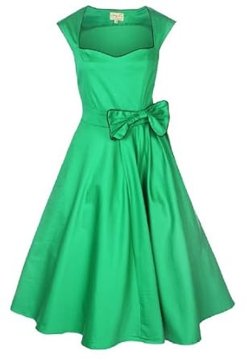
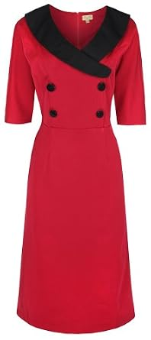
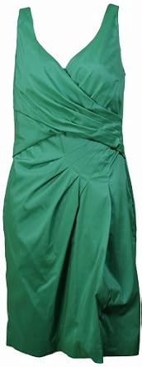
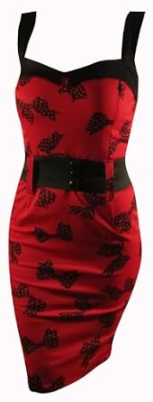
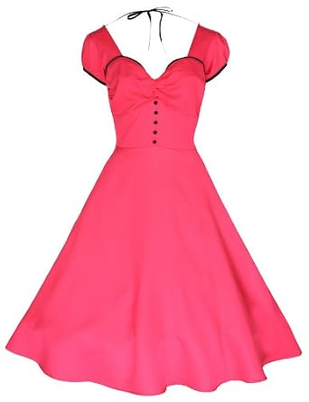
Reference, modification and retrieved garments
Actual FashionIQ photographs and recorded ranks from the held-out subset
Reference
Paired target
Relative modification
“is red with black buttons and has longer sleeves”
dress category. Reference excluded from every candidate ranking.
Image only
Text only
Fixed fusion
Learned fusion
Target rank 177
Target rank 2
Target rank 24
Target rank 1
Top 1 B00BLNL7G6
Top 1 B006X6XGT2
Top 1 B00ATPE8CW
Top 1 B00CFL3FDQ
31
Notes:
This is a layout of actual FashionIQ photographs and measured retrieval outputs, not a fabricated interface screenshot. The illustration chooses the query with the greatest disagreement among the four top-one IDs, breaking ties by query ID. This selection illustrates disagreement and does not change the benchmark. Each shown target rank comes from the fixed held-out evaluation. Repeated image content is intentional when two methods retrieve the same garment or retrieve the known target. The application also supports a custom text edit through actual local CLIP inference. A custom edit has no new relevance label, so that route hides paired-target ranks and accuracy.
Measured example
{"category":"dress","reference":"B00801W1H6","target":"B00CFL3FDQ","captions":["is red with black buttons","has longer sleeves"],"text":"is red with black buttons and has longer sleeves","query_id":"evaluation-dress-0000","methods":{"image_only":{"target_rank":177,"top_ids":["B00BLNL7G6","B00H2FUGOQ","B0091SFTVC","B00BVGHQKO","B0032FOQUU","B00ATPE8CW","B009FX8ODI","B008UC9MGS","B00B29NXUC","B00DZ02CJY","B00AE4C2LC","B0097J0RVC"]},"text_only":{"target_rank":2,"top_ids":["B006X6XGT2","B00CFL3FDQ","B00A8VHMRK","B00ANSYKPA","B00B903O7G","B00BGIFKM8","B009NW4TW6","B0016CHUWW","B00ATPE8CW","B004XJI4I4","B008X711D2","B005278U3U"]},"fixed_fusion":{"target_rank":24,"top_ids":["B00ATPE8CW","B0091SFTVC","B00B29NXUC","B00BLNL7G6","B00H2FUGOQ","B00BVGHQKO","B008VIXCL2","B002G5GHCM","B00B903O7G","B009NW4TW6","B007TWJCBA","B007P048TC"]},"trained_fusion":{"target_rank":1,"top_ids":["B00CFL3FDQ","B00ATPE8CW","B009NW4TW6","B007FG0Y8U","B00997L4QE","B00H2FUGOQ","B00ANSYKPA","B005KMQQFQ","B00BLNL7G6","B00BVGHQKO","B007EGKM5G","B00139HWLC"]}}}
Sources
results/fashion/queries.json
assets/benchmarks/fashion/manifest.json
assets/benchmarks/fashion/images/B00801W1H6.jpg
assets/benchmarks/fashion/images/B00CFL3FDQ.jpg
assets/benchmarks/fashion/images/B00BLNL7G6.jpg
assets/benchmarks/fashion/images/B006X6XGT2.jpg
assets/benchmarks/fashion/images/B00ATPE8CW.jpg
assets/benchmarks/fashion/images/B00CFL3FDQ.jpg
src/shoplens/fashion_retrieval.py
src/shoplens/benchmark_ui.py

Slide 32
History length and recommendation exposure
Clothing, fixed seed42 checkpoints. 1,000 users and 1,865 test targets.
History truncation changes model input. Every earlier positive remains excluded from candidates.
Coverage measures exposure across this cohort. It does not measure satisfaction or a training-seed effect.
32
Notes:
This diagnostic uses the same selected 1,000 Clothing users and all 1,865 eligible targets across caps 1, 3, 5, 10 and 20. Only the visible model history changes. Complete earlier positives remain excluded from candidates. Fixed seed42 checkpoints are reused without retraining. Left: actual user-macro NDCG@10. Right: distinct products occupying any Top 10 recommendation slot divided by the full 22,491-item Clothing catalogue, measured at cap 20. The full evidence includes all three domains, popularity cohorts, exposure concentration and paired user-bootstrap differences conditional on the selected checkpoint/cohort. Neither chart estimates uncertainty over training seeds.
Exposure records
[{"domain":"clothing","model":"qwen_frozen","seed":42,"recommendation_slots":18650,"covered_items":502,"catalog_items":22491,"coverage@10":0.022320039126761816,"gini":0.9945563211879926,"hhi":0.010419757203746164,"mean_training_positive_users":69.11597855227882,"top_1pct_exposure_share":0.9461662198391421,"popularity_exposure":[{"bucket":"0","catalog_items":480,"catalog_share":0.021341870081365878,"recommendation_slots":198,"exposure_share":0.010616621983914208},{"bucket":"1-5","catalog_items":11850,"catalog_share":0.5268774176337202,"recommendation_slots":1027,"exposure_share":0.055067024128686325},{"bucket":"6-20","catalog_items":8948,"catalog_share":0.3978480281001289,"recommendation_slots":3392,"exposure_share":0.18187667560321716},{"bucket":"21+","catalog_items":1213,"catalog_share":0.05393268418478502,"recommendation_slots":14033,"exposure_share":0.7524396782841823}],"most_exposed_products":[{"item_id":"B003DNR4XC","title":"BEARPAW Women's Emma Tall 612-W Boot","recommendation_slots":562,"training_positive_users":79},{"item_id":"B005LERHD8","title":"Vintage, Retro Colorful Crystal Owl Pendant and Long Chain Necklace with Antiqued Bronze/Brass Finish","recommendation_slots":513,"training_positive_users":308},{"item_id":"B0013KDS96","title":"eBags Packing Cubes - 3pc Set","recommendation_slots":455,"training_positive_users":99},{"item_id":"B0007YR8WW","title":"Playtex Women's 18-Hour Original Comfort-Strap Bra #4693","recommendation_slots":417,"training_positive_users":110},{"item_id":"B003DNR2HK","title":"BEARPAW Women's Emma Short Boot","recommendation_slots":410,"training_positive_users":113}]},{"domain":"clothing","model":"qwen_semantic","seed":42,"recommendation_slots":18650,"covered_items":598,"catalog_items":22491,"coverage@10":0.026588413143034992,"gini":0.9935622506375206,"hhi":0.01043547786586549,"mean_training_positive_users":52.057211796246655,"top_1pct_exposure_share":0.9203217158176945,"popularity_exposure":[{"bucket":"0","catalog_items":480,"catalog_share":0.021341870081365878,"recommendation_slots":65,"exposure_share":0.003485254691689008},{"bucket":"1-5","catalog_items":11850,"catalog_share":0.5268774176337202,"recommendation_slots":2997,"exposure_share":0.1606970509383378},{"bucket":"6-20","catalog_items":8948,"catalog_share":0.3978480281001289,"recommendation_slots":5175,"exposure_share":0.2774798927613941},{"bucket":"21+","catalog_items":1213,"catalog_share":0.05393268418478502,"recommendation_slots":10413,"exposure_share":0.558337801608579}],"most_exposed_products":[{"item_id":"B007OUFMAW","title":"Lee Women's Classic Fit Straight Leg Jackie O Pant","recommendation_slots":749,"training_positive_users":14},{"item_id":"B003DNR4XC","title":"BEARPAW Women's Emma Tall 612-W Boot","recommendation_slots":576,"training_positive_users":79},{"item_id":"B005GYGD7O","title":"Spalding Women's Capri Legging","recommendation_slots":471,"training_positive_users":151},{"item_id":"B007WNWEFC","title":"Vintage Steampunk Nautical Style Antiqued Bronze Octopus Necklace 28 inch Long Chain","recommendation_slots":434,"training_positive_users":140},{"item_id":"B0013KDS96","title":"eBags Packing Cubes - 3pc Set","recommendation_slots":415,"training_positive_users":99}]},{"domain":"clothing","model":"qwen_preference","seed":42,"recommendation_slots":18650,"covered_items":495,"catalog_items":22491,"coverage@10":0.022008803521408563,"gini":0.9945579900116139,"hhi":0.010536218904757456,"mean_training_positive_users":71.07528150134047,"top_1pct_exposure_share":0.9468096514745308,"popularity_exposure":[{"bucket":"0","catalog_items":480,"catalog_share":0.021341870081365878,"recommendation_slots":220,"exposure_share":0.011796246648793566},{"bucket":"1-5","catalog_items":11850,"catalog_share":0.5268774176337202,"recommendation_slots":979,"exposure_share":0.052493297587131366},{"bucket":"6-20","catalog_items":8948,"catalog_share":0.3978480281001289,"recommendation_slots":2899,"exposure_share":0.15544235924932975},{"bucket":"21+","catalog_items":1213,"catalog_share":0.05393268418478502,"recommendation_slots":14552,"exposure_share":0.7802680965147453}],"most_exposed_products":[{"item_id":"B003DNR4XC","title":"BEARPAW Women's Emma Tall 612-W Boot","recommendation_slots":588,"training_positive_users":79},{"item_id":"B005LERHD8","title":"Vintage, Retro Colorful Crystal Owl Pendant and Long Chain Necklace with Antiqued Bronze/Brass Finish","recommendation_slots":515,"training_positive_users":308},{"item_id":"B0013KDS96","title":"eBags Packing Cubes - 3pc Set","recommendation_slots":455,"training_positive_users":99},{"item_id":"B007WA3K4Y","title":"Allegra K Women's Self Tie Knot Stand Collar Striped Autumn Shirt","recommendation_slots":409,"training_positive_users":113},{"item_id":"B0007YR8WW","title":"Playtex Women's 18-Hour Original Comfort-Strap Bra #4693","recommendation_slots":396,"training_positive_users":110}]}]
Sources
results/diagnostics/recommendation_diagnostics.json
src/shoplens/recommendation_diagnostics.py
scripts/run_recommendation_diagnostics.py

Slide 33
Local M4 CPU inference and ranking cost
22,491 Clothing products, 12 paired repeats, 4 Torch threads
First three text encoders
6.82 s
One cold observation
New text, three encoders
231.185 ms
Median of distinct requests
Exact text embedding cache
1.799 ms
Median of exact repeats
Full engine: new-request median 367.4 ms. Exact-repeat median 137.054 ms.
Before/after compares the CPU ranking stage only. All complete returned rows match the baseline.
33
Notes:
The before/after chart compares only the pure three-model ranking stage, alternating execution order on identical prepared inputs. It does not claim an end-to-end baseline speedup. The baseline source reference and hashes, all samples and complete-row parity live in the JSON. Cold encoder timings are single observations. New-text timings execute three actual encoders. Exact-repeat timing exercises a cache and does not represent a new request. End-to-end engine timings exclude browser/Streamlit rendering, network and downloads. Results are descriptive on the measured local CPU with a small repeat count.
Measured environment
{"platform":"macOS-27.0.1-arm64-arm-64bit","machine":"arm64","processor":"arm","logical_cpus":10,"hardware":{},"torch":"2.14.1","numpy":"2.5.4","torch_threads":4,"thread_environment":{"OMP_NUM_THREADS":"4","OPENBLAS_NUM_THREADS":"4","MKL_NUM_THREADS":"4","VECLIB_MAXIMUM_THREADS":"4","NUMEXPR_NUM_THREADS":"4"},"device":"cpu","mps_available":false,"process_peak_rss_mib":3232.4375,"host_hardware_verified_separately":{"cpu":"Apple M4","memory_bytes":17179869184,"verification":"Read-only host sysctl outside the measured process; measured timings and process observations unchanged."}}
Measured chart samples
[{"stage":"three_rankers_text_before","n":12,"p50_ms":393.40497949160635,"p95_ms":472.0919395564124,"samples_ms":[472.08970808424056,317.42649991065264,472.0946669112891,321.45120901986957,467.2551671974361,317.1544591896236,467.48783299699426,313.31983394920826,465.42862500064075,316.9929999858141,465.35874996334314,316.0869169514626]},{"stage":"three_rankers_text_after","n":12,"p50_ms":103.61739608924836,"p95_ms":104.66685430146754,"samples_ms":[103.68166700936854,104.53095799311996,104.74774986505508,104.60066702216864,103.55312516912818,103.13416598364711,103.54645806364715,102.90175001136959,104.03158399276435,102.76008304208517,103.88137493282557,102.72837500087917]},{"stage":"three_rankers_multimodal_feedback_before","n":12,"p50_ms":418.25783310923725,"p95_ms":492.98373992787674,"samples_ms":[346.8897910788655,492.8780838381499,342.85929217003286,491.46129097789526,340.2614579536021,492.8190840873867,340.9061669372022,489.625875139609,341.156667098403,491.7901670560241,340.7734588254243,493.112875148654]},{"stage":"three_rankers_multimodal_feedback_after","n":12,"p50_ms":127.77345802169293,"p95_ms":130.52390234079212,"samples_ms":[132.7692079357803,128.6868341267109,127.94112507253885,128.00466688349843,127.30612512677908,126.95854203775525,128.10304202139378,127.60579097084701,127.33812490478158,126.46925006993115,126.92124978639185,128.33400000818074]},{"stage":"three_rankers_avoid_budget_before","n":12,"p50_ms":864.7267705528066,"p95_ms":939.7900538169779,"samples_ms":[938.0874170456082,792.3940001055598,939.9086248595268,793.5425830073655,939.198249951005,788.068792084232,935.9109580982476,788.0594169255346,939.0605830121785,789.5238341297954,939.6930411458015,789.7193341050297]},{"stage":"three_rankers_avoid_budget_after","n":12,"p50_ms":109.40710408613086,"p95_ms":109.95875383960083,"samples_ms":[109.85116614028811,109.225207939744,109.76033308543265,109.5090419985354,109.30516617372632,108.8138751219958,109.2799580655992,109.66308391653001,110.0902499165386,108.98070805706084,109.51941693201661,108.68329205550253]}]
Sources
results/performance/studio.json
scripts/benchmark_studio.py
src/shoplens/studio.py
https://github.com/cjk041212/ShopLens/blob/eb53149346207b2500d8e160682e3894fb30125d/src/shoplens/studio.py

Slide 34
Benchmark lab and reproducibility
Measured evidence, actual local interaction and reproducible experiment entry points
Benchmark lab view | What the interface exposes | Reproduction script
Search relevance | Official queries, graded labels, four rankings | scripts/run_esci_benchmark.py
Image + language | Recorded targets and a real local custom text edit | scripts/run_fashion_experiment.py
Recommendation diagnostics | History caps, popularity cohorts, exposure | scripts/ run_recommendation_diagnostics.py
Local performance | Measured cold/new/repeat cost, parity and samples | scripts/benchmark_studio.py
Runtime assets and trained heads are versioned in Git. Local preparation reconstructs the selected data.
Official Qwen and CLIP base models require local preparation. Existing recorded views need no retraining.
34
Notes:
Benchmark lab adds four application routes beside the existing Shopping Studio, Research lab and Experiment gallery. Search relevance inspects official judged candidate lists. Image+language offers both recorded labeled examples and real local CLIP text modifications. Custom requests have no ground-truth metrics. Diagnostics expose fixed-cohort recommendation measurements. Performance distinguishes genuine new input from exact-repeat caching. Each result file records its protocol and limitations. The repository versions the selected runtime payload and trained recommendation/fusion heads. The installation helper reconstructs the runtime locally without a Release package. Foundation Qwen/CLIP models remain separate official local preparations. These additions do not alter the original 27-run study.
Repository commands and full model/data terms are in the root README and ATTRIBUTION.
Sources
src/shoplens/benchmark_ui.py
README.md
ATTRIBUTION.md
scripts/install_assets.py
scripts/prepare_studio_models.py
scripts/run_esci_benchmark.py
scripts/run_fashion_experiment.py
scripts/run_recommendation_diagnostics.py
scripts/benchmark_studio.py
reports/ShopLens_Qwen_report_en.md

