Slide 1
ShopLens
Language adaptation for
multimodal recommendation
Qwen3-Embedding-0.6B with LoRA
EE6405 Natural Language Processing
Notes:
ShopLens combines a controlled recommendation study with an interactive shopping interface. We compare frozen Qwen with semantic alignment and user preference LoRA. I will show the actual offline results, then a complete local workflow from a written request to a saved decision.
Sources
Source path convention: Resolve src/..., submission/..., data/..., and artifacts/... from the repository root. Resolve assets/... relative to submission/. Runtime data and artifacts require a separate runtime asset installation.
https://huggingface.co/Qwen/Qwen3-Embedding-0.6B/tree/97b0c614be4d77ee51c0cef4e5f07c00f9eb65b3
https://arxiv.org/abs/2106.09685
https://proceedings.mlr.press/v139/radford21a.html

Slide 2
Semantic alignment and user preference
Does learning what a review describes improve what a user receives next?
Arm | Recommendation head | Qwen update
Frozen | BPR ranking loss | Encoder stays fixed
Semantic alignment | BPR on detached text | Review–description InfoNCE
User preference | BPR ranking loss | Same BPR gradient
Frozen still trains a recommendation head.
Same Qwen family and frozen CLIP image features across all arms.
02
Notes:
The central question separates semantic matching from preference learning. Semantic LoRA matches training reviews with product descriptions. Preference LoRA learns directly from ranking loss. Every arm trains its recommendation head, including Frozen. The image encoder stays fixed, so the controlled comparison concerns the language objective.
Discussion notes
Semantic InfoNCE uses frozen base-Qwen training-review anchors and live candidate descriptions, with multiple positives for the same item. Its BPR text input is detached. Preference training never uses the target review as its recommendation query.
Sources
src/shoplens/qwen_pipeline.py
src/shoplens/qwen_models.py
https://arxiv.org/abs/1205.2618

Slide 3
Three Amazon domains and one ranking protocol
Domain | Products | Users | Interactions
Baby | 7,037 | 18,479 | 155,180
Sports | 18,273 | 34,555 | 289,579
Clothing | 22,491 | 36,437 | 255,681
47,801 catalogued products. Top 3 and Top 12 are display subsets.
Chronological 80% / 10% / 10% split
Strictly earlier positives. Latest 20 distinct products.
Full catalogue ranking, excluding previous positives. User-macro metrics.
Three domains from one Amazon source limit evidence about cross-source generalization.
03
Notes:
The data contains real product text, reviews and photographs across Baby, Sports and Clothing. We split chronologically and use only strictly earlier positive history. Ranking covers the full prepared catalogue, excluding previous positives. Metrics first average targets within users. These are three domains from one Amazon source, which limits evidence about cross-source generalization.
Discussion notes
Global timestamp quantiles retain ties in the earlier split. Evaluation is prequential: earlier held-out observations may enter later histories while weights remain fixed. Repeated targets already in history do not enter evaluation. A stable item-ID rule breaks score ties. Positive interactions have ratings of four or five stars.
Sources
https://mcauleylab.ucsd.edu/public_datasets/data/amazon/datasets.html
src/shoplens/qwen_evaluate.py
data/processed/baby/audit.json
data/processed/sports/audit.json
data/processed/clothing/audit.json

Slide 4
History and candidate representations
Path | Text input | Image input
Liked-product history | Frozen base Qwen, 1024d | Frozen CLIP, 512d
Candidate products | Base or selected LoRA, 1024d | Same CLIP, 512d
Separate history and candidate towers produce 128d vectors.
User vector = normalize(MLP(mean(history vectors)))
Score = user vector · candidate vector
04
Notes:
The formal model uses an asymmetric architecture. Histories always enter through frozen base text and fixed images. Candidate text changes across objectives. Separate towers produce compact vectors. A user network pools history and scores candidates by a dot product. Adapted candidate vectors must never replace the frozen history inputs.
Sources
src/shoplens/qwen_models.py
src/shoplens/qwen_inference.py

Slide 5
Shared initialization and adaptation budget
Common warmup
All eligible training cases. Validation selects one shared head
for each domain and seed.
Controlled adaptation
30,000 matched cases per domain and seed, over two epochs.
Identical case order and sampled negatives across the arms.
Validation selects epoch 1 or 2. Seeds 42, 43 and 44 repeat the full pipeline.
05
Notes:
Each domain and seed first selects a common warmup head. The three arms then share thirty thousand matched training cases, their order and sampled negatives for two adaptation epochs. Validation selects epoch one or two. Three complete pipeline seeds give twenty-seven formal test records. Test scores never choose the checkpoint.
Discussion notes
Warmup uses all eligible cases, at most 20 epochs and validation early stopping. Adaptation batch size is 32. Head learning rate is 1e-4 and LoRA learning rate is 2e-5. LoRA rank 8, alpha 16, dropout 0.05, q_proj/v_proj. Epoch 0 cannot replace a poor adaptation checkpoint.
Sources
src/shoplens/qwen_data.py
src/shoplens/qwen_pipeline.py
submission/results_qwen_summary.json

Slide 6
Formal test results
User-macro NDCG@10. Mean across three complete pipeline seeds.
Frozen has the highest observed mean in all three domains.
06
Notes:
These bars come from all twenty-seven audited test records after validation-only selection. Frozen has the highest observed mean in each domain. Semantic alignment loses to Frozen in seven of nine matched comparisons. Preference LoRA loses in six of nine. The experiment does not support a general improvement from adaptation under this budget.
Discussion notes
Means and sample standard deviations appear in Appendix 1. A matched win is a positive difference for the same domain and seed. These measurements describe the declared offline protocol, not purchasing conversion.
Sources
submission/results_qwen_summary.json
artifacts/qwen/baby/results.json
artifacts/qwen/sports/results.json
artifacts/qwen/clothing/results.json

Slide 7
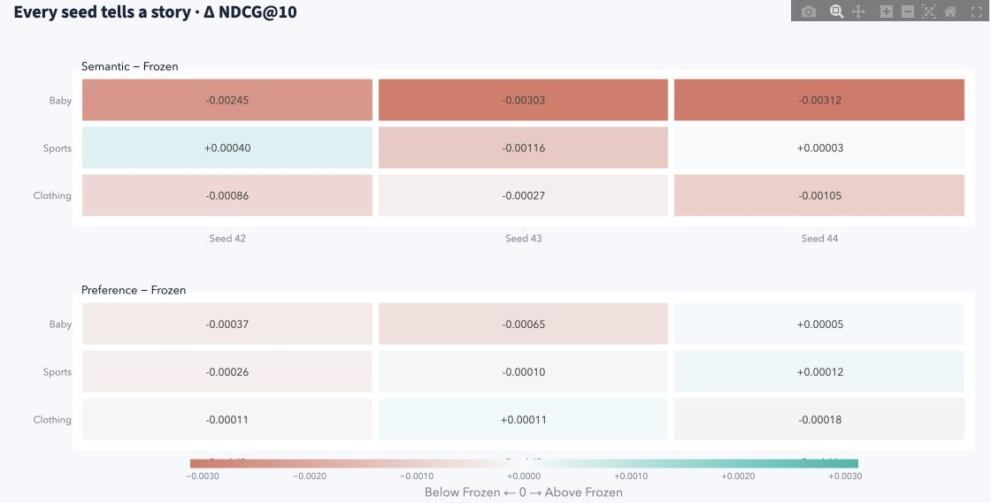
Experiment gallery: every recorded seed
18 matched comparisons against Frozen, from the original 27 formal test records
Columns: seeds 42, 43 and 44. Cells: actual Δ NDCG@10.
Coral falls below Frozen. Teal exceeds Frozen. Three seeds do not establish significance.
07
Notes:
Experiment gallery exposes the original twenty-seven evaluations through metric, paired-seed and training views. This matrix contains eighteen same-seed differences against Frozen, including losses. The three columns show all recorded seeds. The gallery adds inspection and export, while the evidence remains the same controlled study.
Discussion notes
Each cell subtracts the Frozen test NDCG@10 for the same domain and seed. Semantic alignment wins 2 of 9 pairs and user preference wins 3 of 9. Three seeds, sample standard deviation and observed signs do not establish statistical significance. This feature displays existing runs and does not add a new experiment.
Sources
assets/experiment_paired_matrix.png
src/shoplens/experiment_ui.py
src/shoplens/experiment_data.py
src/shoplens/experiment_charts.py
submission/results_qwen_summary.json

Slide 8
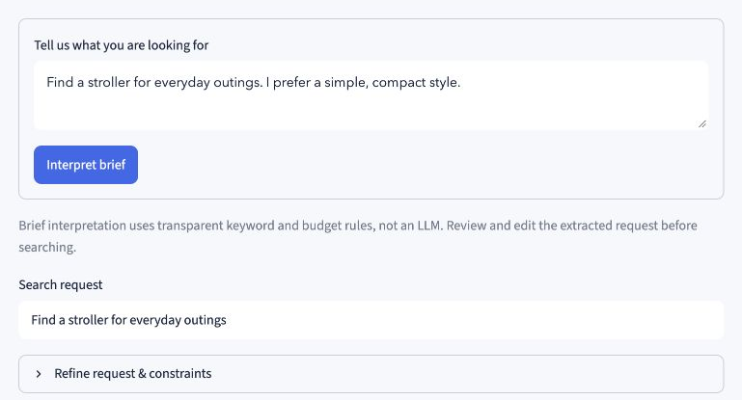
A shopping request without a liked-product history
Interpretation uses transparent keyword rules. Qwen supplies the retrieval embeddings.
08
Notes:
Studio starts with a written request, here a compact stroller for everyday outings. Interpretation uses transparent rules and leaves editable fields. The user reviews omitted nuance before searching. Qwen retrieves products after Find products. Positive feedback is optional.
Sources
assets/studio_brief.png
src/shoplens/studio_ui.py
src/shoplens/studio.py

Slide 9
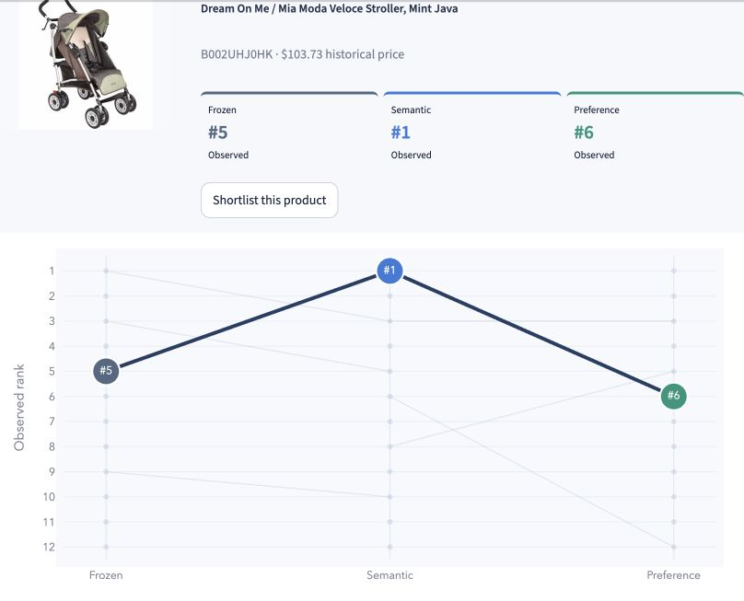
Model arena: one product across three models
“Find a stroller for everyday outings” in Baby, with no positive feedback
Dream On Me / Mia Moda Veloce
ASIN B002UHJ0HK
Frozen #5
Semantic #1
Preference #6
Observed Top 12 per model
24 unique products
2 in all three lists
14 in exactly one list
Each query matches its model’s candidate space. Missing Top-K positions stay unknown.
These observed rank differences describe disagreement, without relevance labels.
09
Notes:
Model arena follows one actual stroller across the three request lists. Frozen places it fifth, Semantic first and Preference sixth. Each query matches its candidate space, without positive feedback. The three Top-twelve lists contain twenty-four unique products. These differences reveal disagreement, with no relevance labels to establish which model is better.
Discussion notes
The actual query is Find a stroller for everyday outings. Dream On Me / Mia Moda Veloce Stroller, Mint Java is ASIN B002UHJ0HK. The observed union contains 24 unique items, with 2 in all three lists, 8 in exactly two and 14 in exactly one. Each model retrieves its own top 200 text-similar candidates, including boundary ties. This application example is exploratory request retrieval, separate from the formal history-to-item test. A missing Top-K position remains unknown. Raw scores are not compared across models.
Sources
assets/studio_model_arena.png
src/shoplens/studio_encoders.py
src/shoplens/studio_models.py
src/shoplens/studio_ui.py
src/shoplens/studio_charts.py

Slide 10
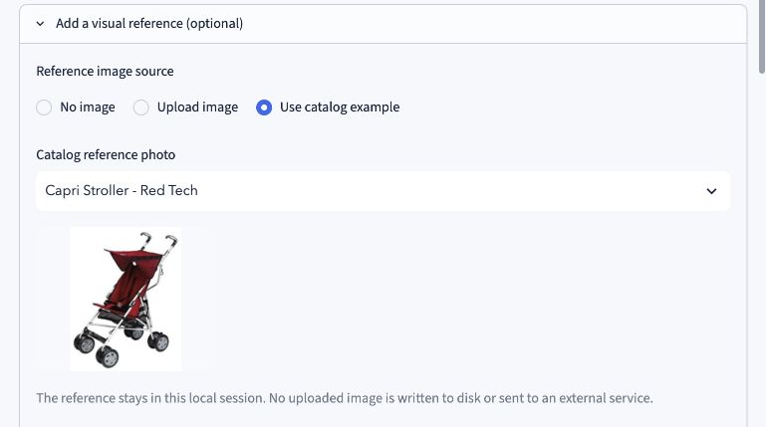
Visual reference and explicit constraints
Historical price ceiling
$150
Soft avoid: bulky
Text weight: 0.65
Local catalog reference
Reference: Capri Stroller - Red Tech. Metadata prices are historical, not live offers.
10
Notes:
This later state adds a catalogue photo, soft avoidance of bulky products and a historical price ceiling of one hundred and fifty dollars. Frozen CLIP supplies the image signal. Uploads stay in local memory. Filters can leave fewer results without expanding the retrieved pool.
Discussion notes
This screenshot shows a separate, later refined Baby state from the Model arena capture. Actual selected reference is Capri Stroller - Red Tech and text weight is 0.65. The image source is Use catalog example, not an uploaded file. Current UI limits uploads to single JPG/PNG/WebP, 8 MB and 16 megapixels. Budget filtering excludes unknown prices. Source metadata categories are not verified product types. An avoid penalty does not guarantee perfect semantic exclusion.
Sources
assets/studio_visual_filters.png
src/shoplens/studio_encoders.py
src/shoplens/studio.py

Slide 11
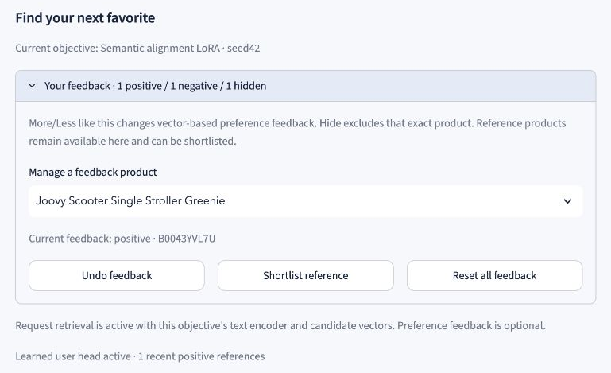
Feedback, exact hiding and undo
Feedback reranks products using cached query vectors. Positive examples activate the selected trained recommender.
11
Notes:
More like this adds positive evidence and activates the selected model’s trained history recommender. Less like this penalizes similar products. Hide removes an exact product. All reference products leave subsequent suggestions. The feedback manager exposes the current state and Undo. These actions rerank products using cached request vectors rather than retraining a model.
Discussion notes
At most the latest 20 distinct positive products enter the history network. Shortlisting alone gives no training feedback. Feedback and query percentiles follow a disclosed application policy rather than the formal evaluation score.
Sources
assets/studio_feedback.png
src/shoplens/studio_ui.py
src/shoplens/studio.py
src/shoplens/studio_models.py

Slide 12
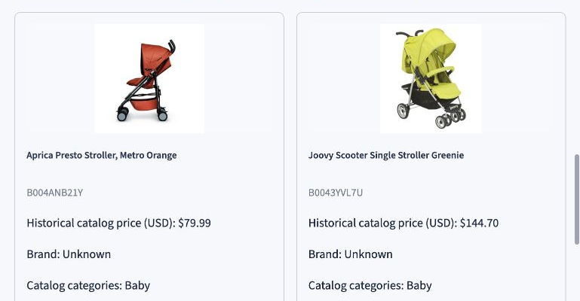
A shortlist with original product evidence
Adding a product to the shortlist does not activate preference feedback.
12
Notes:
The shortlist compares a few real candidates through photographs, historical prices, categories and original descriptions. Source details can reveal information that embeddings miss. The user makes the final choice. Saving a shortlist item supplies no preference feedback.
Sources
assets/studio_shortlist.png
src/shoplens/studio_ui.py

Slide 13
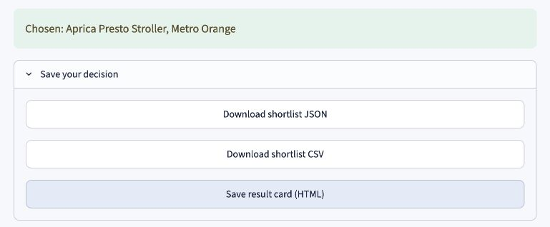
A final choice with portable exports
Exports retain the chosen product, request, feedback and model provenance.
13
Notes:
After confirming a final choice, the user downloads the decision. JSON retains context and model provenance. CSV provides a simple shortlist. HTML includes catalogue photos in a standalone card. Exporting preserves the record after the session ends. The app places no order.
Sources
assets/studio_export.png
src/shoplens/studio.py
src/shoplens/studio_ui.py

Slide 14
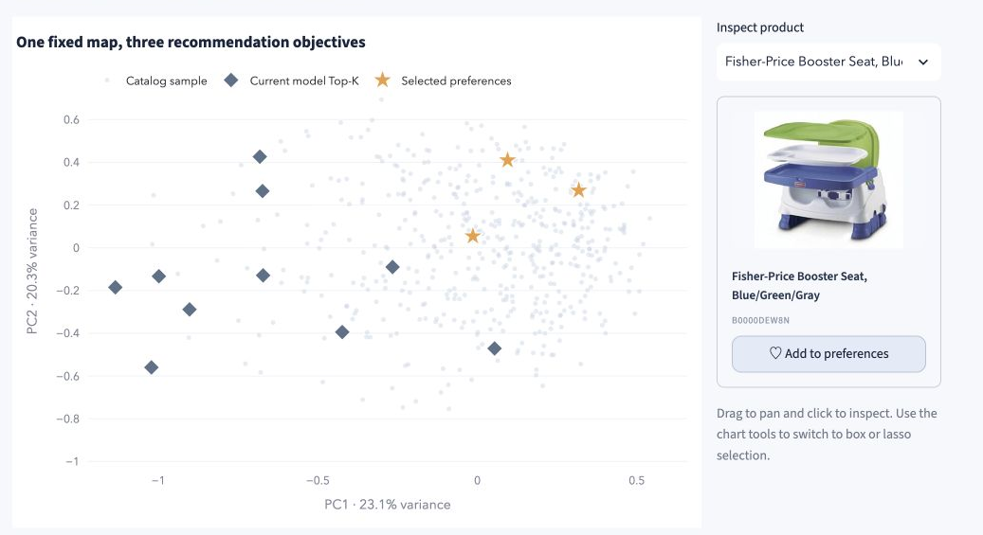
Product atlas with a real product inspector
One fixed PCA map preserves coordinates across models. Projection distance can hide information.
14
Notes:
Product atlas places catalogue products, selected preferences and recommendations on one fixed PCA map. Clicking a point opens its photo, title and product ID and can add a preference. Switching models changes highlights while keeping coordinates fixed. The two-dimensional view loses information.
Discussion notes
This earlier actual Baby capture shows the complete map and inspector together. The displayed capture does not identify all history items, so it is not treated as the same session as the fresh Research figures. The fixed PCA uses the Frozen candidate tower. The plotted sample is not the ranking candidate set. Ranking still uses the full eligible catalogue. The 2D variance fraction is shown, and proximity is a lossy projection rather than a causal explanation.
Sources
assets/research_atlas_complete.jpg
src/shoplens/visual_data.py
src/shoplens/visual_ui.py

Slide 15
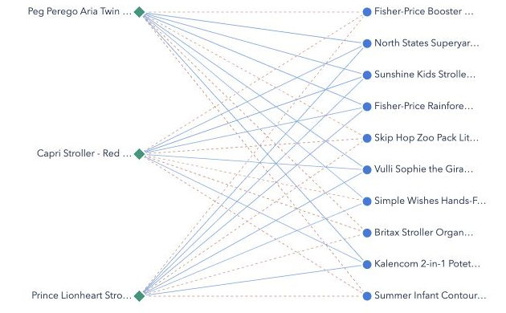
Preference relationships in the actual tower
Green: history. Blue: candidates. Solid/dashed links: positive/negative cosine.
These diagnostics do not decompose the final user-network score.
15
Notes:
Preference lab shows how selected history products relate to recommended candidates in the actual one-hundred-and-twenty-eight-dimensional towers. The network retains positive and negative cosine links. A heatmap provides the same numerical relationship in a different form. These links are neither attention weights nor causal contributions to the final ranking.
Sources
assets/research_network.png
src/shoplens/visual_ui.py
src/shoplens/visual_charts.py

Slide 16
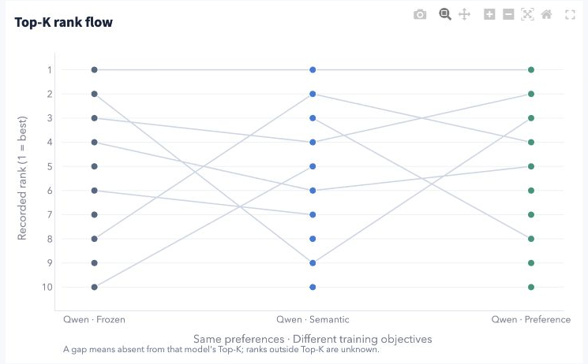
Observed rank flow across objectives
A broken line means absence from the observed Top-K. The missing full rank remains unknown.
16
Notes:
Rank flow follows products across the three model lists for a fixed history. The adjacent view reports Top-K Jaccard overlap. Lines break when products leave the displayed list. We never invent their missing ranks. These views describe disagreement, rather than which list is correct.
Sources
assets/research_rankflow.png
src/shoplens/visual_charts.py
src/shoplens/ui.py

Slide 17
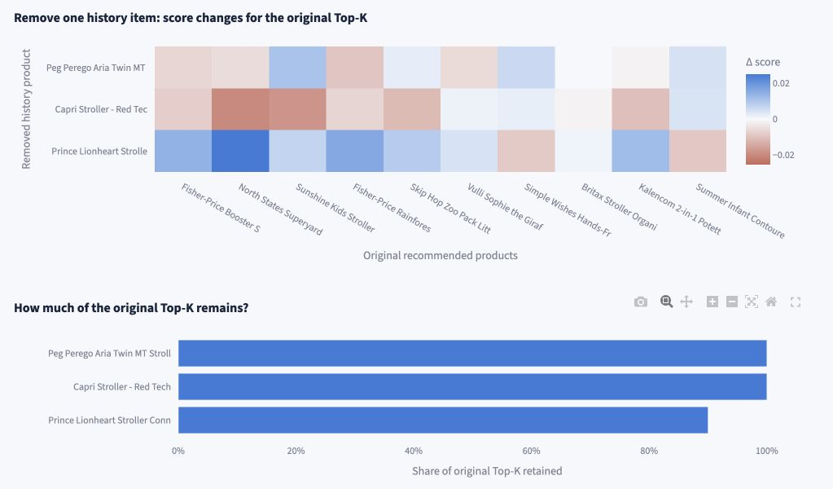
Removal sensitivity for the current history
Each removal reruns the selected seed42 recommender. This is a session sensitivity check.
17
Notes:
The removal experiment drops one active history item at a time and reruns the recommender. It measures score changes and retention of the original Top-K. It never backfills older history. Original selected products stay excluded. This is session sensitivity, rather than causal attribution.
Discussion notes
This earlier actual Baby capture names Peg Perego Aria Twin, Capri Stroller Red Tech and Prince Lionheart Stroller Connectors. The model selector lies outside the capture. No numeric comparison with another capture or model is inferred. The result is conditional on its current history and selected seed42 model. It is neither a formal held-out metric nor a causal attribution. Empty and single-item histories do not invent a removal experiment.
Sources
assets/research_removal_complete.jpg
src/shoplens/visual_data.py
src/shoplens/visual_ui.py

Slide 18
Findings and limits
Adaptation did not improve the mean NDCG@10
in any of the three domains under this budget.
Semantic alignment: 2 of 9 matched wins
User preference: 3 of 9 matched wins
The interface makes the trained models inspectable and usable.
Examples from text requests remain exploratory, with no relevance labels.
One Amazon source. Static metadata. Three seeds.
No online conversion, causal explanation or broad cold-start claim.
18
Notes:
Our main finding is negative: neither adaptation objective improves average NDCG at ten in any domain under this budget. The interface makes the trained models inspectable and supports a complete decision workflow, but attractive examples cannot replace relevance evaluation. Three seeds, one Amazon source and static metadata limit the evidence. The references are the original Amazon archive, official Qwen documentation, LoRA, CLIP and BPR.
Discussion notes
Earlier MiniLM baselines remain separate because their architecture and training budget differ. Clothing live CUDA LoRA training used MATH SDPA after a reproduced gradient failure, while earlier completed runs retained automatic dispatch. No specific fused-kernel cause or bitwise trajectory identity is established.
Sources
submission/results_qwen_summary.json
https://mcauleylab.ucsd.edu/public_datasets/data/amazon/datasets.html
https://huggingface.co/Qwen/Qwen3-Embedding-0.6B/tree/97b0c614be4d77ee51c0cef4e5f07c00f9eb65b3
https://arxiv.org/abs/2106.09685
https://proceedings.mlr.press/v139/radford21a.html
https://arxiv.org/abs/1205.2618

Slide 19
Appendix 1. Formal NDCG@10 detail
Mean ± sample standard deviation. Three complete pipeline seeds per cell.
Domain | Frozen | Semantic | Preference
Baby | 0.012796 ± 0.000959 | 0.009930 ± 0.000728 | 0.012475 ± 0.000849
Sports | 0.007116 ± 0.000684 | 0.006872 ± 0.000613 | 0.007039 ± 0.000584
Clothing | 0.005186 ± 0.000562 | 0.004460 ± 0.000384 | 0.005124 ± 0.000463
Matched wins versus Frozen
Baby: semantic 0/3, preference 1/3
Sports: semantic 2/3, preference 1/3
Clothing: semantic 0/3, preference 1/3
19
Notes:
Optional discussion: every cell uses the three actual complete pipeline seeds. Variation is a sample standard deviation, not a population confidence interval. Matched win counts pair the same domain and seed.
Discussion notes
All 27 raw records passed the declared artifact and protocol audit. No diagnostic or synthetic run supplies these values.
Sources
submission/results_qwen_summary.json

Slide 20
Appendix 2. Sparse items and numerical scope
Mean user-macro NDCG@10 across three seeds.
Targets with at most five distinct training-positive users, including zero.
All Baby scores are zero. This cohort does not isolate strict cold start.
Clothing LoRA training used MATH SDPA after a reproduced gradient failure.
Earlier completed runs kept automatic dispatch. Trajectories may differ.
20
Notes:
Optional discussion: sparse-item results remain close to zero, including zero in Baby. The cohort combines unseen items with low-interaction items, so it does not establish strict cold start. Clothing LoRA training used the MATH attention backend after same-state nonfinite-gradient diagnostics. That recovery does not identify a particular fused-kernel cause or establish bitwise-equivalent training.
Discussion notes
Candidate cache numerical checks cover only the first min(4,N) live-Qwen candidates and one validation history. CPU serving replay checks a different layer of correctness.
Sources
submission/results_qwen_summary.json

Slide 21
Appendix 3. Request retrieval and history evaluation
 | Formal history evaluation | Shopping Studio
Input | Earlier positive products | Text request, optional image
Candidate set | Full eligible catalogue | Text: Top 200 per model Image only: shared CLIP pool
Model selection | Validation, seeds 42/43/44 | Selected seed42 exports
Meaning | Held-out user-macro metrics | Exploratory session ranking
Queries use the matching base or LoRA encoder. Images share fixed CLIP.
Positive feedback uses each model’s exported history tower and trained user head.
21
Notes:
Optional discussion: the application and the formal experiment answer different questions. Studio uses a matching query encoder for each candidate space and retrieves a model-specific pool before applying constraints and feedback. The formal test instead begins with actual earlier history and ranks the complete eligible catalogue. Studio scores and examples cannot be substituted for those metrics.
Discussion notes
All query arms share the shopping instruction, left padding, last-valid-token pooling, maximum 256 tokens and L2 normalization. Image-only requests can produce identical base retrieval lists. The trained head activates with positive history, which always uses frozen base history inputs.
Sources
src/shoplens/studio_encoders.py
src/shoplens/studio_models.py
src/shoplens/studio.py
src/shoplens/qwen_evaluate.py

Slide 22
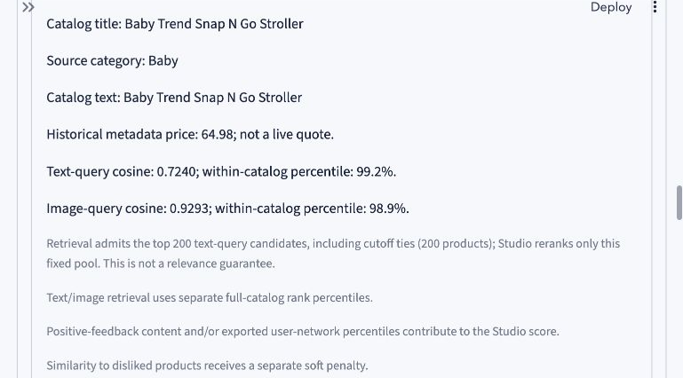
Appendix 4. Studio source evidence
Original catalogue fields and computed retrieval signals
Cosines and within-catalogue percentiles are diagnostic signals, not probabilities or causal explanations.
22
Notes:
Optional discussion: a result card exposes its original title, source category, historical price and computed text and image signals. The disclosed retrieval pool and penalty policy help the user inspect the current result. These signals do not establish suitability or explain the score causally.
Discussion notes
This is the later Baby state with a reference photo, a 150 USD historical budget, soft avoid bulky and optional positive/negative/hidden feedback. The screenshot concerns Baby Trend Snap N Go Stroller, not the final chosen Aprica. Its observed text-query cosine is 0.7240 and image-query cosine is 0.9293 in this state.
Sources
assets/studio_evidence.png
src/shoplens/studio_ui.py
src/shoplens/studio.py

Slide 23
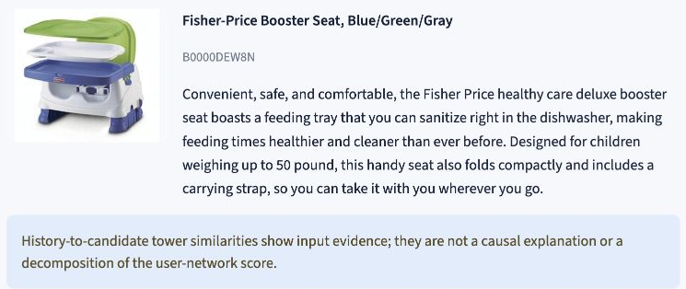
Appendix 5. Research recommendation evidence
Original records support inspection. Similarity diagnostics do not explain the score causally.
23
Notes:
Optional discussion: Research recommendation evidence combines the product record with the selected history and model. It exposes cross-tower similarities and structured inference evidence. This page supports inspection of an individual recommendation, while the experiment dashboard provides the held-out quality measurements.
Discussion notes
The actual Baby example selects Frozen and Fisher-Price Booster Seat, Blue/Green/Gray (B0000DEW8N), with the three displayed preset history items. This slide retains the original candidate description. The full inference evidence view exposes the actual scoring and provenance fields. Similarities remain diagnostics rather than causal score contributions.
Sources
assets/research_evidence_product.png
src/shoplens/ui.py

Slide 24
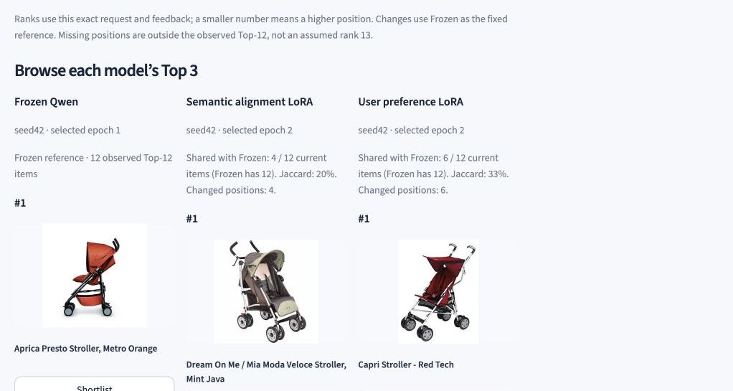
Appendix 6. Product lists from three models
An earlier actual Baby request, with no positive feedback
Baby has 7,037 products. Shown: each model’s first recommendation.
Top 12 is a display subset. Three models do not mean three catalogue products.
24
Notes:
Optional discussion: the original three-column product view gives photographic evidence for each model’s first visible recommendation. The catalogue contains 7,037 Baby products. Top-twelve and Top-three views show subsets of results. Three refers to the model alternatives rather than the catalogue size.
Discussion notes
This earlier actual Baby request screenshot is independent of the Model arena capture. It shows the first visible recommendation in each column, not every row of the Top 3. Each request uses the matching query and candidate encoder. The respective retrieved pools can differ. Product examples do not replace held-out relevance evaluation.
Sources
assets/studio_models.jpg
src/shoplens/studio_ui.py
src/shoplens/studio_encoders.py
src/shoplens/studio_models.py

Slide 25
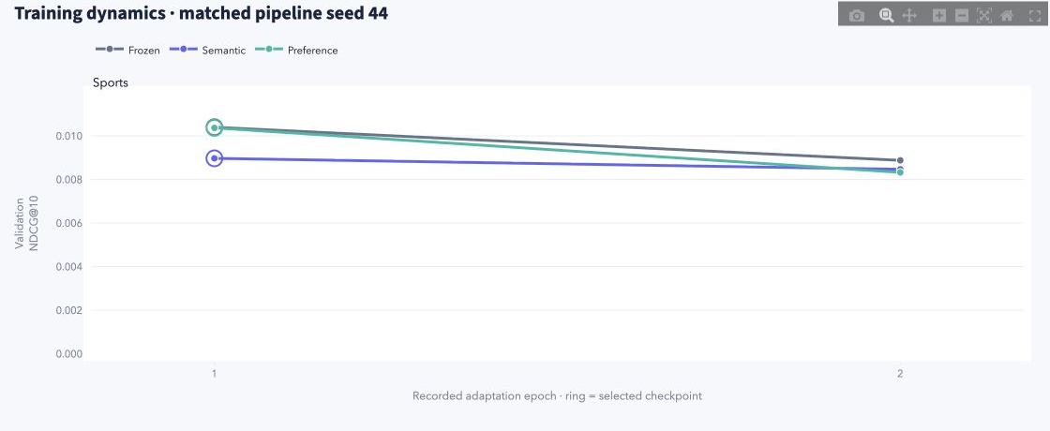
Appendix 7. Training dynamics
Sports, matched pipeline seed 44. Actual validation NDCG@10.
All three Sports seed44 models select epoch 1. Rings mark the selected checkpoints.
Only two recorded validation epochs. Test metrics never select the checkpoint.
25
Notes:
Optional discussion: Experiment gallery displays the two recorded adaptation-epoch validation results for each arm. In Sports seed forty-four, all three models select epoch one. The rings mark those choices. Lines connect actual saved observations and do not show unrecorded optimization steps. Test results never choose the epoch.
Discussion notes
Actual validation NDCG@10: Frozen epoch1 0.01039775584130691, epoch2 0.00887591995099229. Semantic epoch1 0.008968238048314637, epoch2 0.008466524502734576. Preference epoch1 0.010366837105701692, epoch2 0.008324549533718625. All select epoch1. Across the formal study, full-catalogue validation selects epoch1 or2. Frozen keeps its text encoder fixed while its recommendation head still trains. This Sports seed44 example differs from Studio’s selected seed42 serving models. dist/experiment-gallery is an optional separately generated or downloaded offline export folder, not a claim that generated files belong to the Git source tree.
Sources
assets/experiment_training_sports_seed44.png
src/shoplens/experiment_charts.py
submission/results_qwen_summary.json
scripts/export_experiment_gallery.py
dist/experiment-gallery/training_curves.csv

Slide 26
Appendix 8. Sources and reproducibility
Data and methods
Amazon Reviews 2014, McAuley Lab
Qwen3-Embedding official model card and training documentation
LoRA, Hu et al. CLIP, Radford et al. BPR, Rendle et al.
Report, code and offline evidence
English experiment report and audited 27-record summary
Selected model exports, hashes and recorded validation results
Experiment gallery: seven interactive figures plus CSV / JSON
The export script creates the optional offline gallery. Runtime assets install separately.
26
Notes:
Optional discussion: primary sources establish the data and model methods. The English experiment report and audited summary describe the formal study. Source code exposes the application and gallery calculations. The export script produces a standalone offline gallery with seven interactive figures, the plotted CSV values and structured evidence JSON.
Discussion notes
Resolve src/..., scripts/..., submission/..., data/..., artifacts/... and dist/... from the repository root. Resolve assets/... relative to submission/. Runtime data and model artifacts require a separate runtime installation. The optional dist/experiment-gallery folder is generated by the export script or supplied as a separate offline export package. Its seven figures are four performance metrics, the paired seed matrix, paired effect summary and validation dynamics. The HTML embeds Plotly locally. This is presentation and export of the existing 27 evaluations, without retraining or new relevance measurements.
Sources
https://mcauleylab.ucsd.edu/public_datasets/data/amazon/datasets.html
https://huggingface.co/Qwen/Qwen3-Embedding-0.6B/tree/97b0c614be4d77ee51c0cef4e5f07c00f9eb65b3
https://arxiv.org/abs/2106.09685
https://proceedings.mlr.press/v139/radford21a.html
https://arxiv.org/abs/1205.2618
submission/ShopLens_Qwen_report_en.md
submission/results_qwen_summary.json
src/shoplens/experiment_data.py
src/shoplens/experiment_charts.py
scripts/export_experiment_gallery.py
dist/experiment-gallery/index.html

