Slide 1
HTML Standard Tag

Slide 2
Deprecated Tags
Tags (Elements) | Description
<acronym> | Defines an acronym
<applet> | Defines an applet
<basefont> | Defines an base font for the page.
<big> | Defines big text
<center> | Defines centered text
<dir> | Defines a directory list
<font> | Defines text font, size, and color
<frame> | Defines a frame
<frameset> | Defines a set of frames
<isindex> | Defines a single-line input field
<noframes> | Defines a noframe section
<s> | Defines strikethrough text
<strike> | Defines strikethrough text
<tt> | Defines teletype text
<u> | Defines underlined text

Slide 3
Depreciated Attributes
From the Elements | Removed Attributes
a | shape,coords
area | nohref
body | alink,link,vlink,text,background
br | clear
caption, iframe, img, input, object, legend, table, hr, div, h1, h2, h3, h4, h5, h6, p, col, colgroup, tbody, td, tfoot, th, thead and tr. | align
col, colgroup, tbody, td, tfoot, th, thead and tr | valign,char,charoff
dl, menu, ol and ul. | compact
head | profile
hr | noshade,size
hr, table, td, th, col, colgroup and pre. | width
html | version
iframe | frameborder,scrolling,marginheight,marginwidth
img | name
img and iframe. | longdesc
img and object. | hspace,vspace
li, ol and ul. | type
link | target
link, a | rev,charset
meta | scheme
object | archive, classid codebase codetype declare standby
param | valuetype,type
table | cellpadding,cellspacing,frame,rules
table and object. | border
table, tr, td, th and body. | bgcolor
td | scope
td and t | axis,abbr
td and th | nowrap

Slide 4
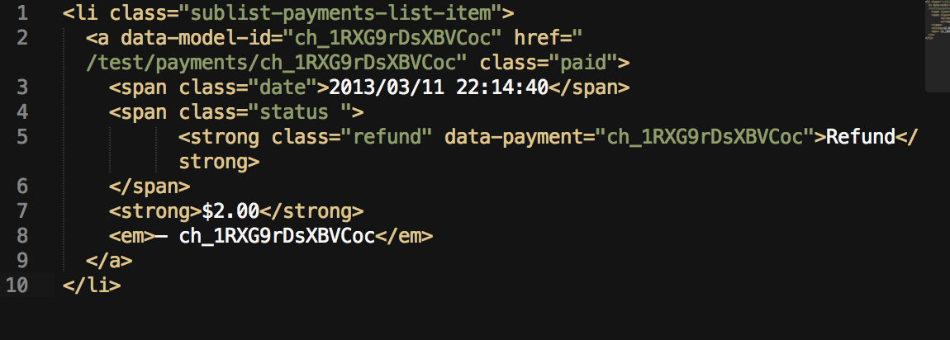
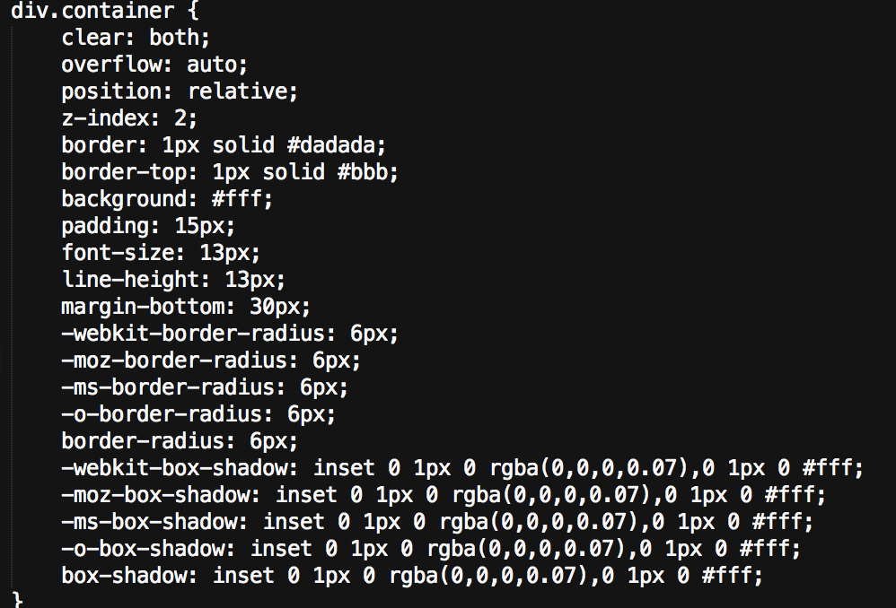

Slide 5
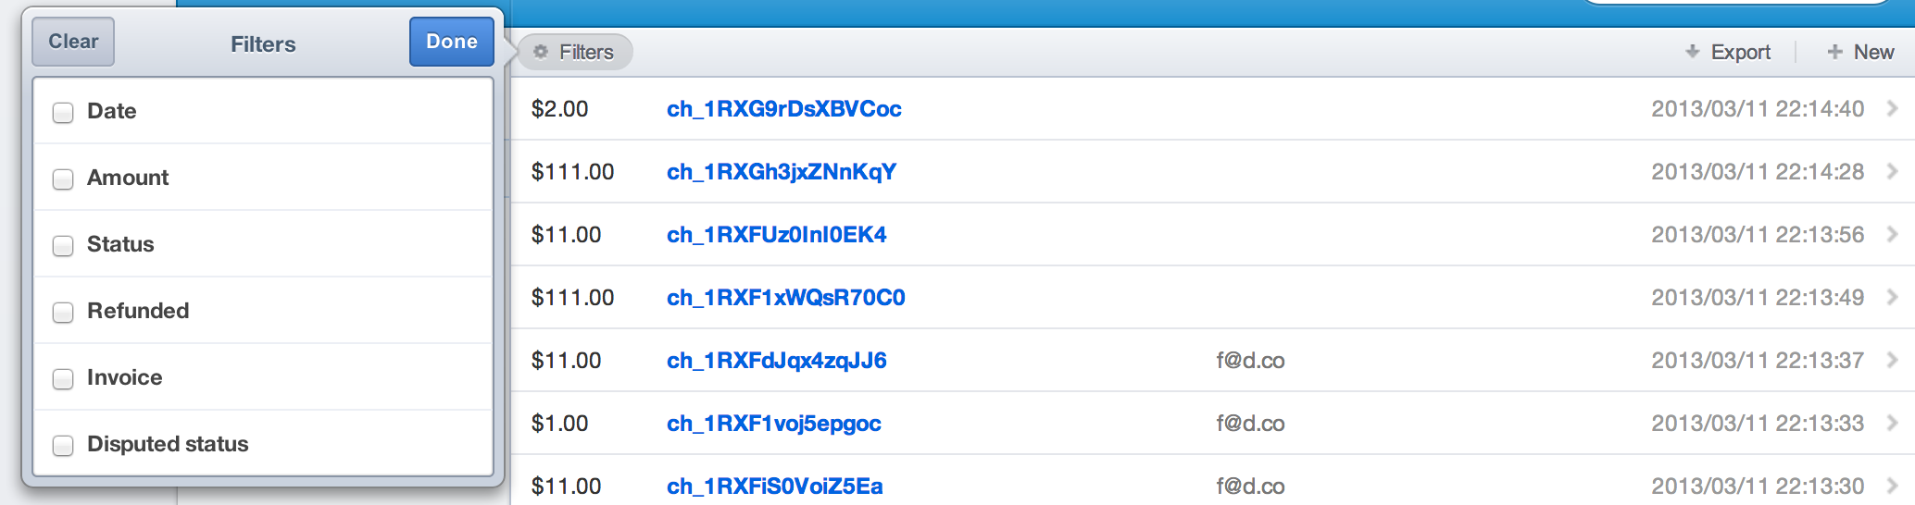
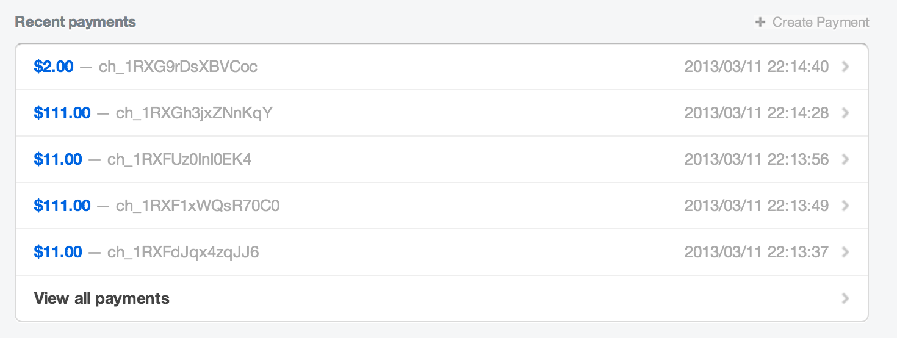

Slide 6
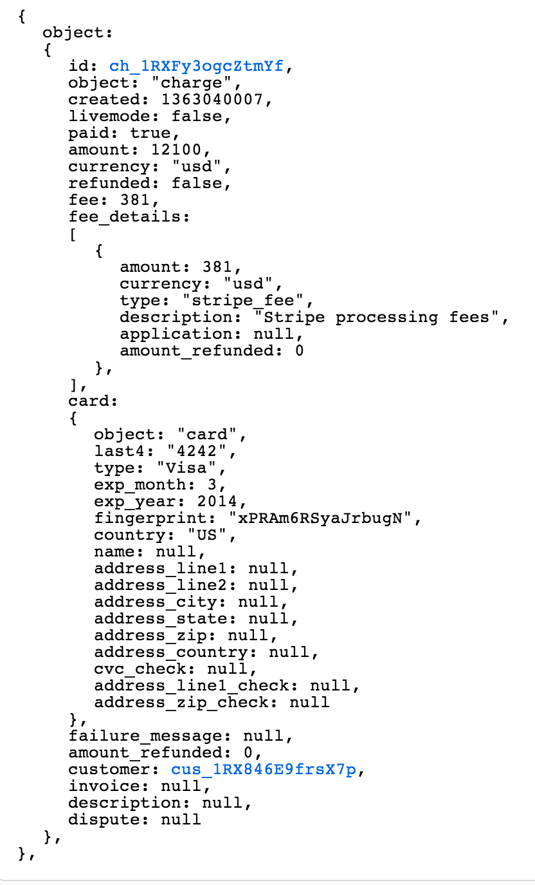
Notes:
https://manage.stripe.com/test/events/evt_1RXFZ0KAA15Gds

Slide 7
1234556790-=`~`]\[][‘\’’’\\\;/`.12!@#$%$#@&^*()_z+`]p[]’\/.,.kmnzxcv高
‘’’’;;””:`````~~`~+:;’ “```~+=~```~[[

