Slide 1
Reinforcement Learning for 3 vs. 2 Keepaway
P. Stone, R. S. Sutton, and S. Singh
Presented by Brian Light

Slide 2
Robotic Soccer
Sequential decision problem
Distributed multi-agent domain
Real-time
Partially observable
Noise
Large state space
Notes:
SQP – agents attempt to achieve a goal by executing a sequence of actions over time; each action chosen from many possible actions.
Distributed – both teammates and adversaries; communication opportunities are limited
Real-Time – episodic; perception and action cycles are asynchronous
Partially Observable – hidden states
Noise – do not perceive world exactly as it appears; do not affect world exactly as intended
State Space – many states exist that will never be encountered

Slide 3
Reinforcement Learning
Map situations to actions
Individual agents learn from direct interaction with environment
Can work with an incomplete model
Unsupervised

Slide 4
Distinguishing Features
Trial and error search
Delayed reward
Not defined by characterizing a particular learning algorithm…

Slide 5
Aspects of a Learning Problem
Sensation
Action
Goal

Slide 6
Elements of RL
Policy defines the learning agent's way of behaving at a given time
Reward function defines the goal in a reinforcement learning problem
Value of a state is the total amount of reward an agent can expect to accumulate in the future starting from that state
Notes:
A policy is a mapping from perceived states of the environment to actions to be taken when in those states. Whereas a reward function indicates what is good in an immediate sense, a value function specifies what is good in the long run.

Slide 7
Example: Tic-Tac-Toe
Non-RL Approach
  Search space of possible policies for one with high probability of winning
  Policy – Rule that tells what move to make for every state of the game
  Evaluate a policy by playing many games with it to determine its win probability

Slide 8
RL Approach to Tic-Tac-Toe
Table of numbers
  One entry for each possible state
  Estimates probability of winning from that state
  Learned value function

Slide 9
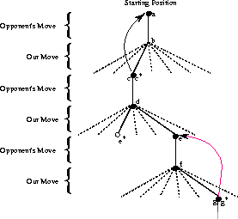
Tic-Tac-Toe Decisions
Examine possible next states to pick move
  Greedy
  Exploratory
After looking at next move
  Back up
  Adjust value of state

Slide 10
Tic-Tac-Toe Learning
s – state before the greedy move
s’ – state after the move
V(s) – estimated value of s
α – step-size parameter
Update V(s) :
V(s) ← V(s) + α[V(s’) – V(s)]

Slide 11
Tic-Tac-Toe Results
Over time, methods converges for a fixed opponent
Moves (unless exploratory) are optimal
If α is not reduced to zero, plays well against opponents who change strategy slowly

Slide 12
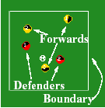
3 Vs. 2 Keepaway
3 Forwards try to maintain possession within a region
2 Defenders try to gain possession
Episode ends when defenders gain possession or ball leaves region

Slide 13
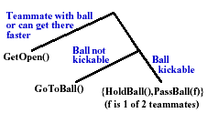
Agent Skills
HoldBall()
PassBall(f)
GoToBall()
GetOpen()

Slide 14
Mapping Keepaway onto RL
Forwards Learn
Series of Episodes
  States
  Actions
  Rewards – all 0 except last reward → -1
Temporal Discounting
  Postpone final reward as long as possible

Slide 15
Benchmark Policies
Random
  Hold or pass randomly
Hold
  Always hold
Hand-coded
  Human intelligence?

Slide 16
Learning
Function Approximation
Policy Evaluation
Policy Learning

Slide 17
Function Approximation
Tile coding
Avoids “Curse of Dimensionality”
  Hyperplanar slices
    Ignores some dimensions in some tilings
  Hashing
    High resolution needed in only a fraction of the state space

Slide 18

Policy Evaluation
Fixed, pre-determined policy
Omniscient property
13 state variables
Supervised learning used to arrive at an initial approximation for V(s)

Slide 19
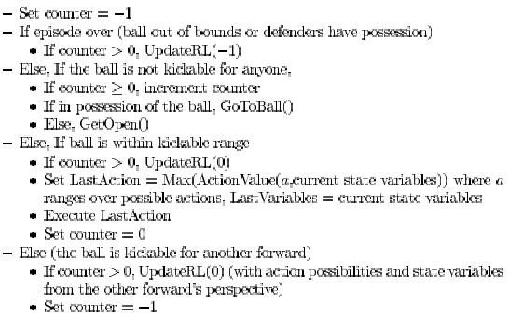
Policy Learning

Slide 20
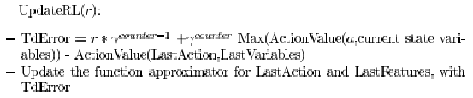
Policy Learning (cont’d)
Update the function approximator:
V(s_{t}) ← V(s_{t}) + α[TdError]
This method is known as Q-learning

Slide 21
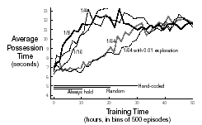
Results

Slide 22
Future Research
Eliminate omniscience
Include more players
Continue play after a turnover

Slide 23
Questions?

