Slide 1

Municipality Income & Expenditure
TAWANDA CHIFAMBA
CLIFFORD XABA
MAIDI KHARONGA
XOLA NTLANGULA
Notes:
To use this title animation slide with a new image simply 1) move the top semi-transparent shape to the side, 2) delete placeholder image, 3) click on the picture icon to add a new picture, 4) Move semi-transparent shape back to original position, 5) Update text on slide.

Slide 2
Contents
Team Structure
Processes
Requirements
Design
Visualization
Demo
References.
Q&A.
Background.

Slide 3
Background
Municipalities in South Africa
Local, Districts and Metros
Income and Expenditure
Revenue spend and revenue income

Slide 4

Team Structure
Trusted source vs. untrusted Process (Xola)
Requirements (Maidi)
Design (Clifford)
Visualization (Tawanda)

Slide 5

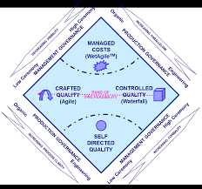



Process
Methodology
CASM
Technologies
Trello
Zoom
Drop box
Github
Resource Allocation

Slide 6
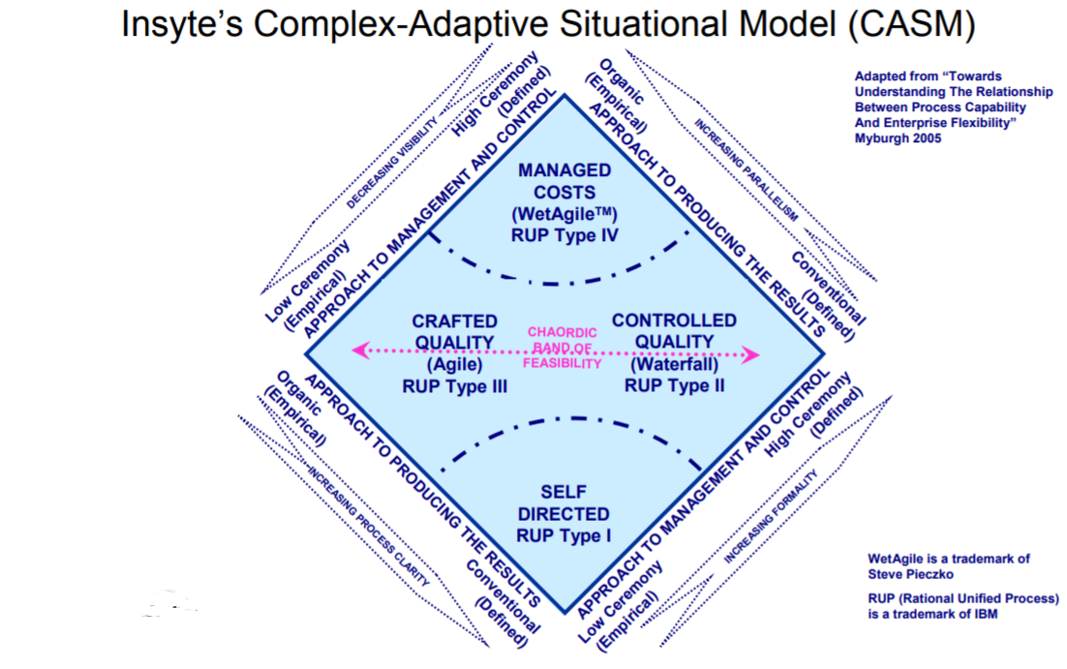
CASM
Complex Adaptive Situational Model
Agile : Continuous integration
Waterfall : following a process
Self directed quality
Wet Agile

Slide 7
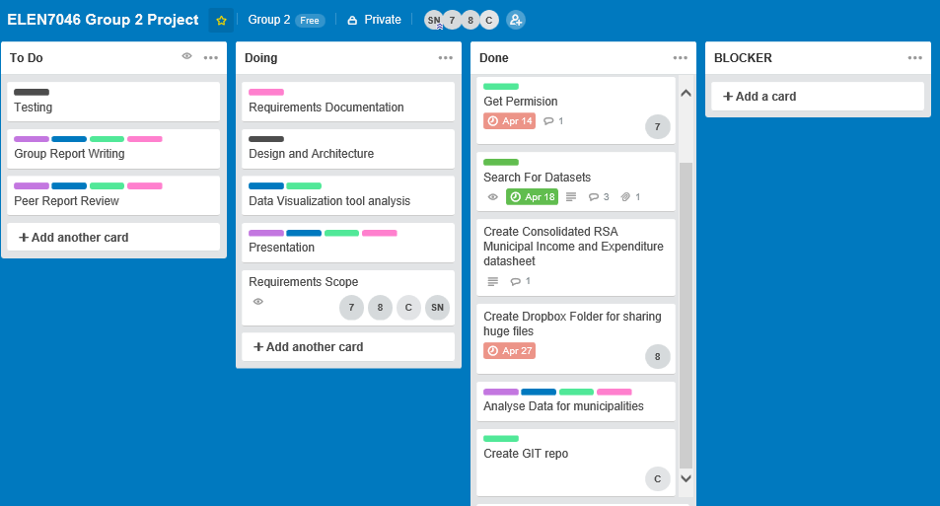
Trello

Slide 8

Requirements
Brainstorming Technique used to gather requirements
JAD session
Scope
Visio for UML diagram

Slide 9
Scope

Slide 10
Design
High-level design
DB design
Technologies
Azure SQL Database
MS SQL server

Slide 11
High-Level Design
Picture to be added here

Slide 12
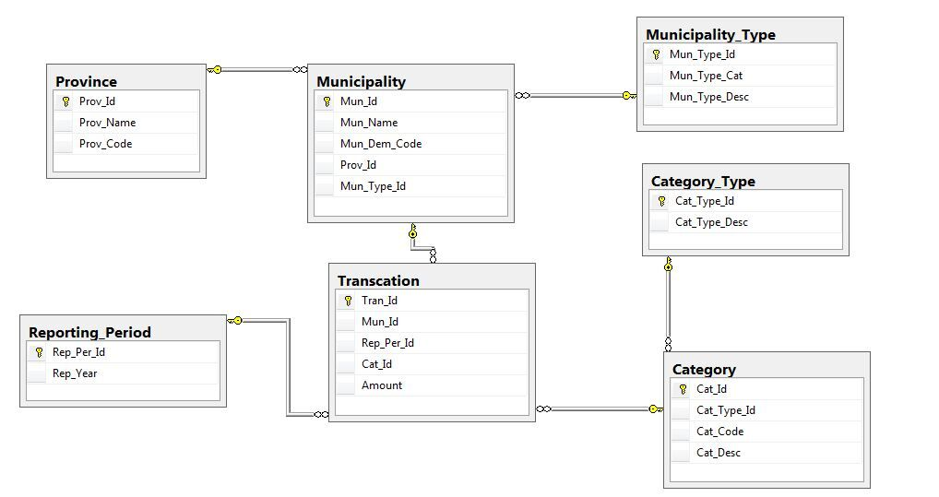
ERD

Slide 13
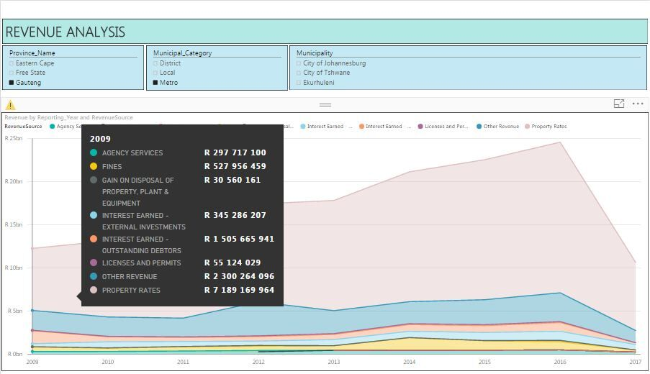
Visualisation
Technologies : Power BI
Language : R
Demo

Slide 14


Slide 15
Challenges
Data import
Deciding on scope
Choosing technologies
Time management ( Schedule, procrastination)
Keeping the Trello board up to date
Unavailability of group members

Slide 16
Lessons Learnt
Pair programming helps
Reliance in one Technology (PowerBI)
Being Agile not easy with a group of 4
We used SQL server and realized it was not practical and planning to move it to the cloud

Slide 17
References

Slide 18


